Slide 1
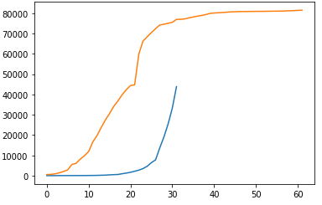
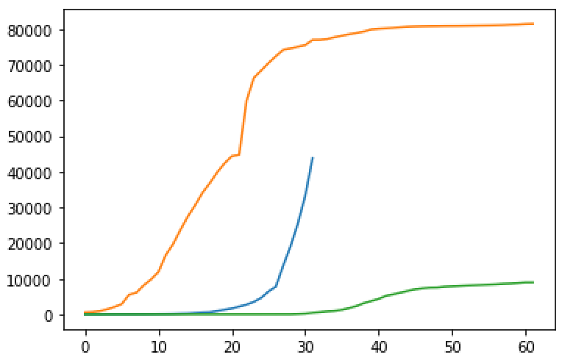
US vs China
US, China, SK
Abs. # of cases
Days Since Onset

Slide 2
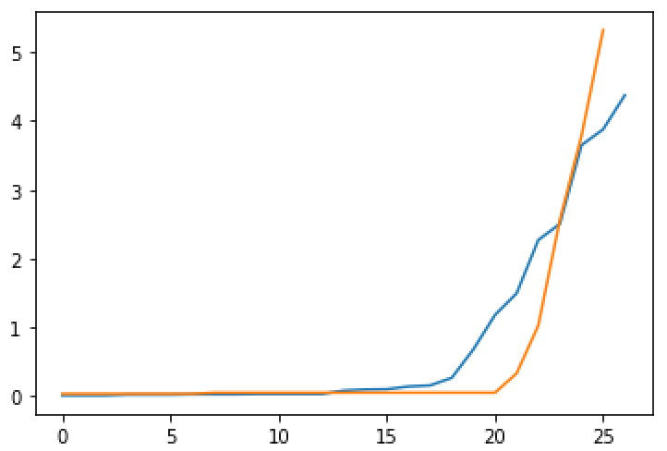
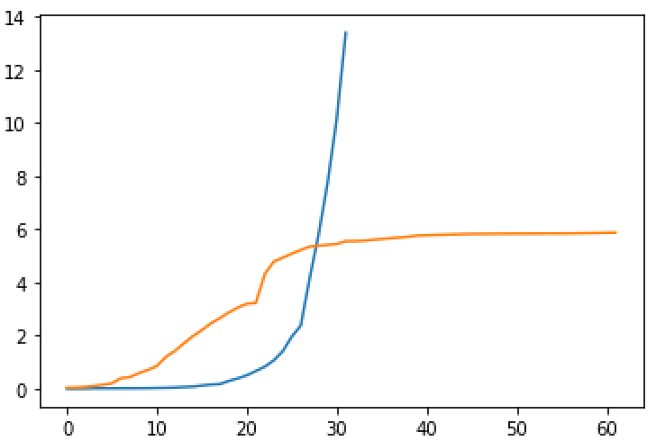
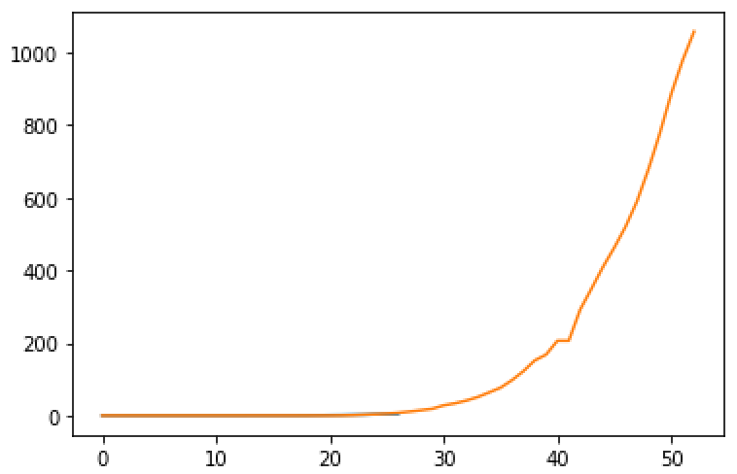
Normalize Cases To Populations
Pakistan, and Italy (first 25 days). Blue is pk
Y = cases per million of population
Cases/pop *10^5
What happens when we don’t truncate:
BLUE is US!

Slide 3
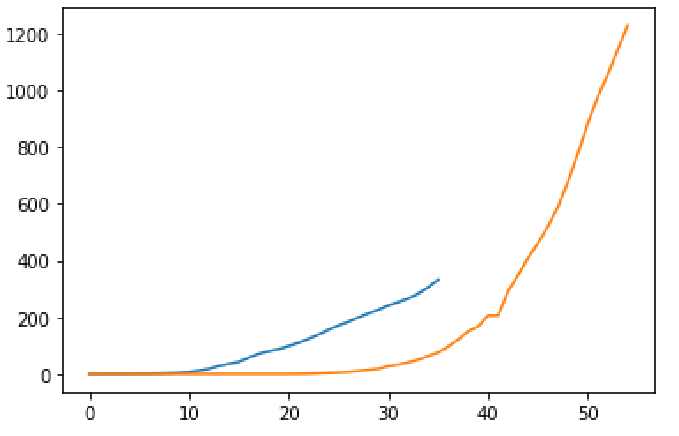
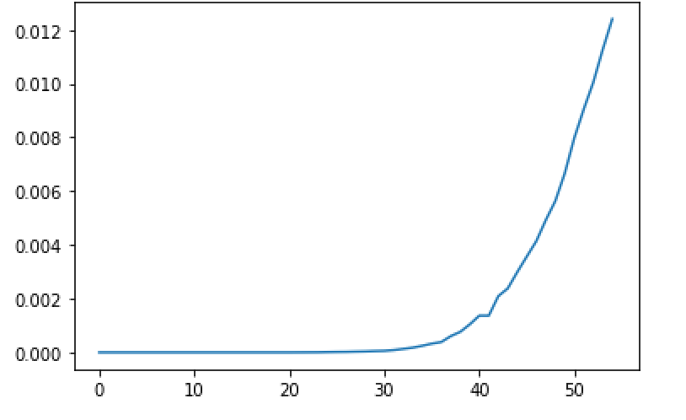
Iran ke chudday…..
Cases per million of pop
Days since outbreak
Blue – iran
Orange - italy

Slide 4
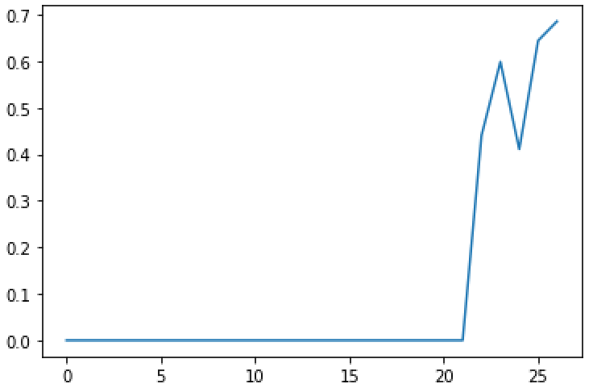
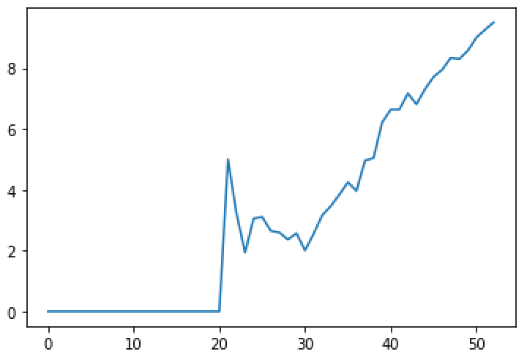
Death Rates….
Pakistan
Italy
Note: always spike at ~20day mark!
Notes:
Intuitively: death rate vs. time should likely be decreasing since # of cases is growing more rapidly than deaths….. Increasing death rate is really alarming……..

Slide 5
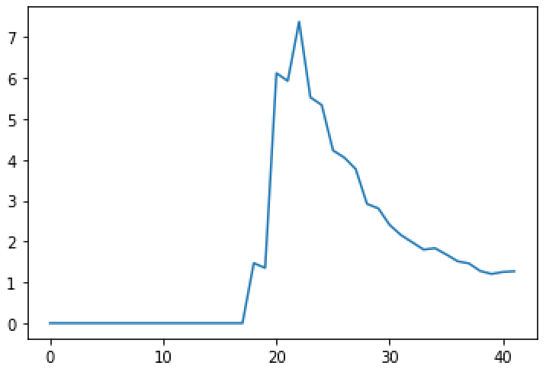
US: after first 11 cases (cruise ships..)
Would make more sense to do a running avg….

