Slide 1

Case Study 2
arsAlan Chandwani

Slide 2
The Goal
Find leading contributors to attrition within the organization.
Predict whether an employee is likely to leave or not.
Predict salaries of employees with an RMSE < $6,000

Slide 3
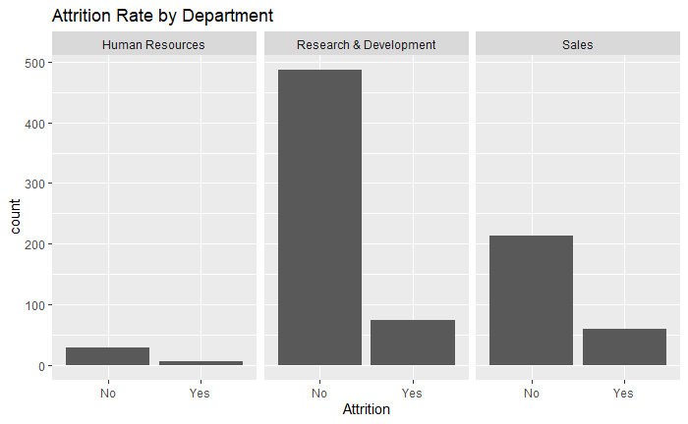
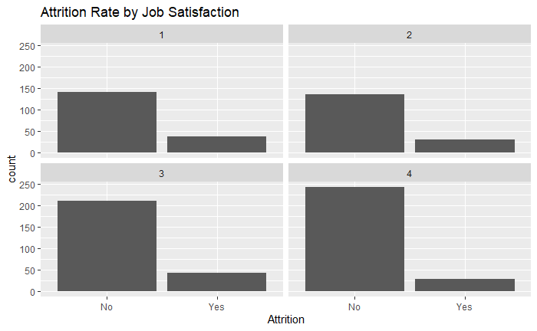
Initial Analysis
Wanted to find trends with attrition
Noted that we would want to use discreet variables in our data model
Noted imbalanced data between attrition and non attrition

Slide 4
Models Used
Naïve Bayes for predicting attrition levels.
Linear Regression for salary prediction.

Slide 5
Naïve Bayes for attrition levels Attempt 1:
First looked at our model using just a few columns (Environment Satisfaction, Hourly Rate, Job Level and Job Role)
70/30 split for training and testing sets
Very low specificity, needed to adjust model
Estimated Value | True Value
 | No | Yes
No | 208 | 31
Yes | 9 | 13
Accuracy: 84.67%
Sensitivity: 95.85%
Specificity: 29.55%

Slide 6
Naïve Bayes for attrition levels Attempt 2:
Added all columns and removed unrelated columns (ex. Employee number)
Total of 29 columns used in our 2nd model.
70/30 split for training and testing sets
Specificity was still too low (Below 60% threshold)
Estimated Value | True Value
 | No | Yes
No | 187 | 19
Yes | 29 | 26
Accuracy: 81.09%
Sensitivity: 85.65%
Specificity: 57.46%

Slide 7
Naïve Bayes for attrition levels Attempt 3: Under sampling
Same columns as our last model
Got rid of 30% of “No” values in our training set.
Lower accuracy and sensitivity but higher specificity.
More balanced model.
Estimated Value | True Value
 | No | Yes
No | 163 | 12
Yes | 53 | 33
Accuracy: 75.10%
Sensitivity: 75.46%
Specificity: 73.33%

Slide 8
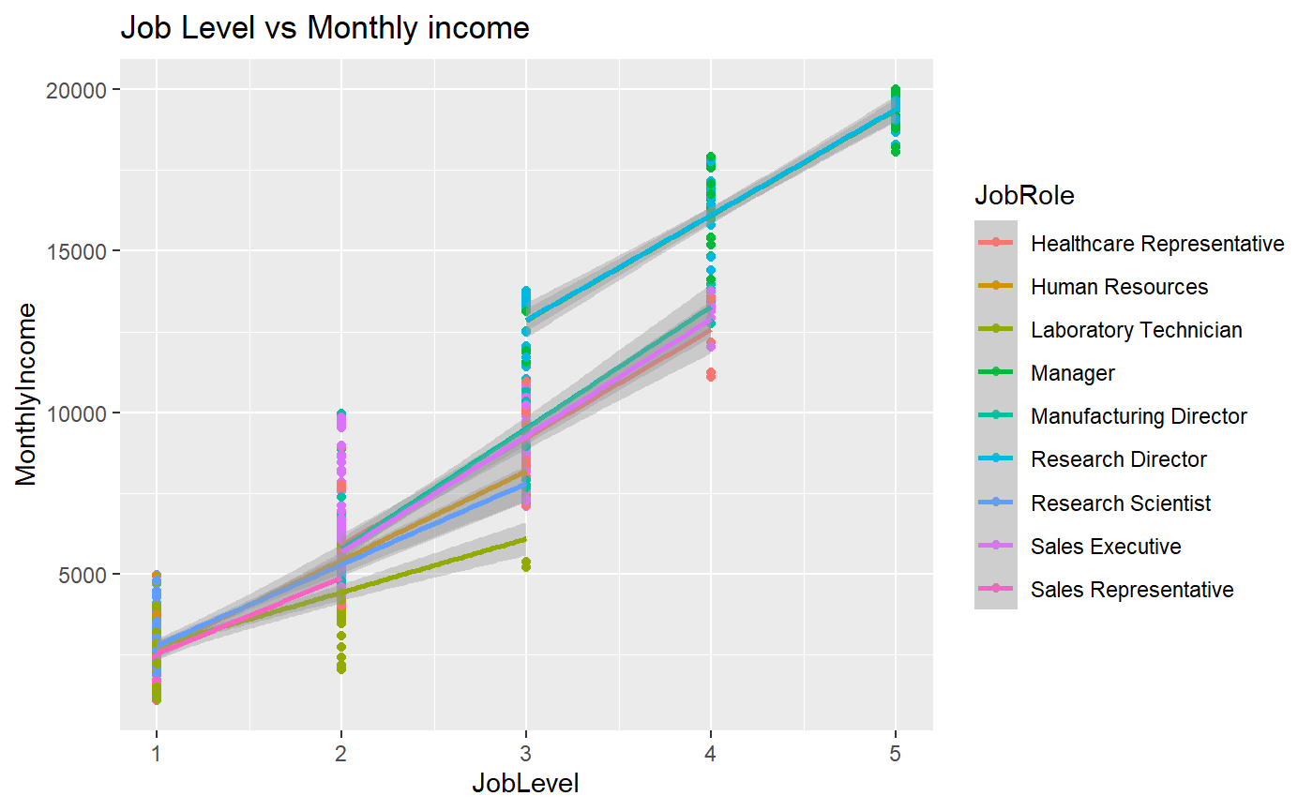
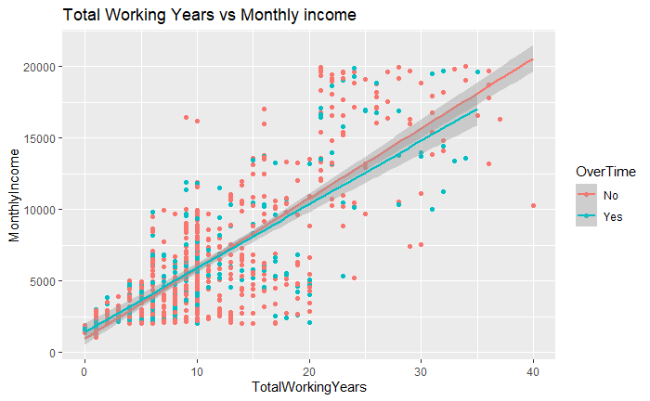
Data Exploration for Salary Prediction
Clear linear trends with certain columns
Variables used: JobLevel, TotalWorkingYears, YearsAtCompany, JobRole, YearsInCurrentRole, YearsSinceLastPromotion
Variables Dismissed: DailyRate, Education, DistanceFromHome, EducationField, Department, JobSatisfaction

Slide 9
Salary Prediction
Create different linear model depending on job role
70/30 split for training and testing sets
Role | RMSE
Healthcare Representative | 5139.56
Human Resources | 3931.94
Laboratory Technician | 2597.70
Manager | 4008.82
Manufacturing Director | 4353.57
Research Director | 3813.78
Research Scientist | 2793.07
Sales Executive | 4778.08
Sales Representative | 4778.08

