Slide 1
Project 1: EDA

Slide 2
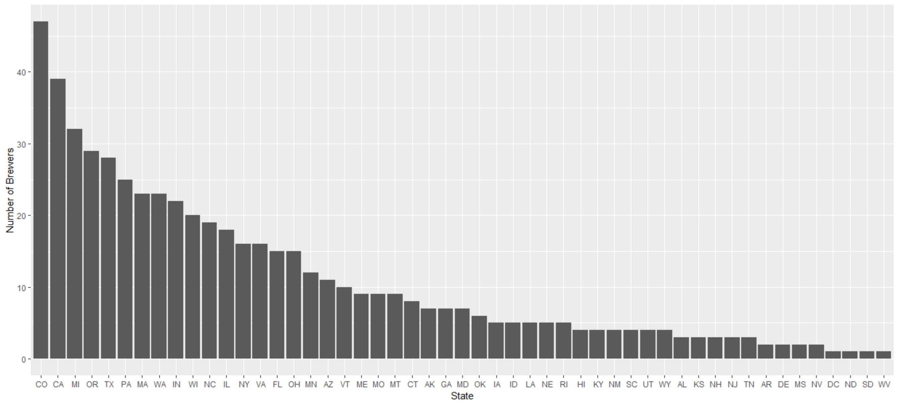
How many Breweries in each State?

Slide 3
Missing Values

Slide 4
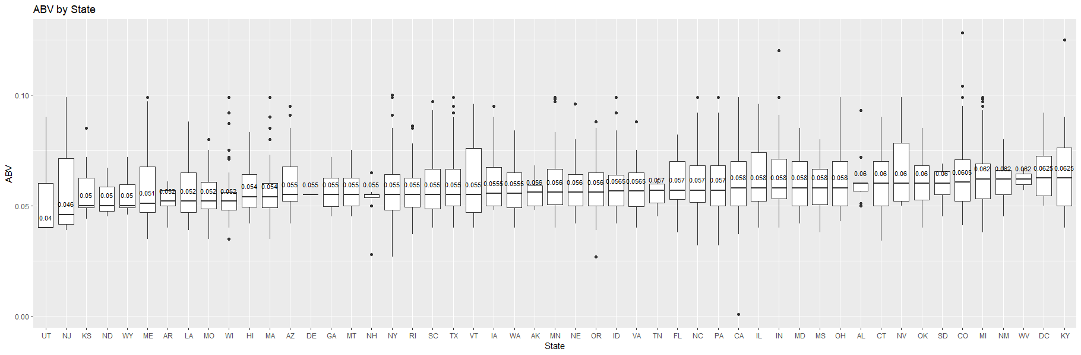
ABV by State

Slide 5
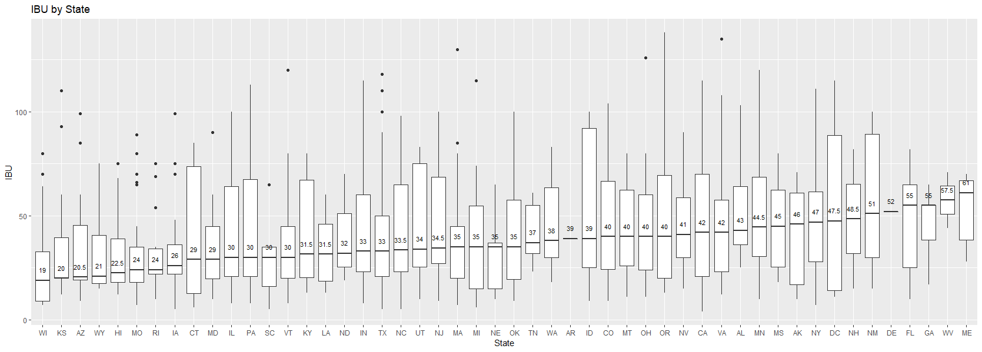
IBU by State

Slide 6
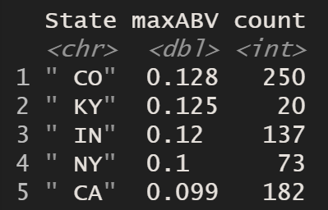
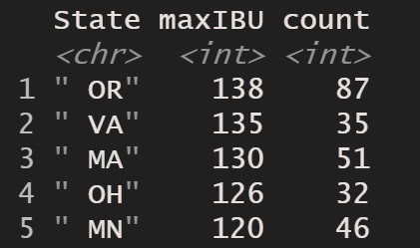
Max ABV and IBU

Slide 7
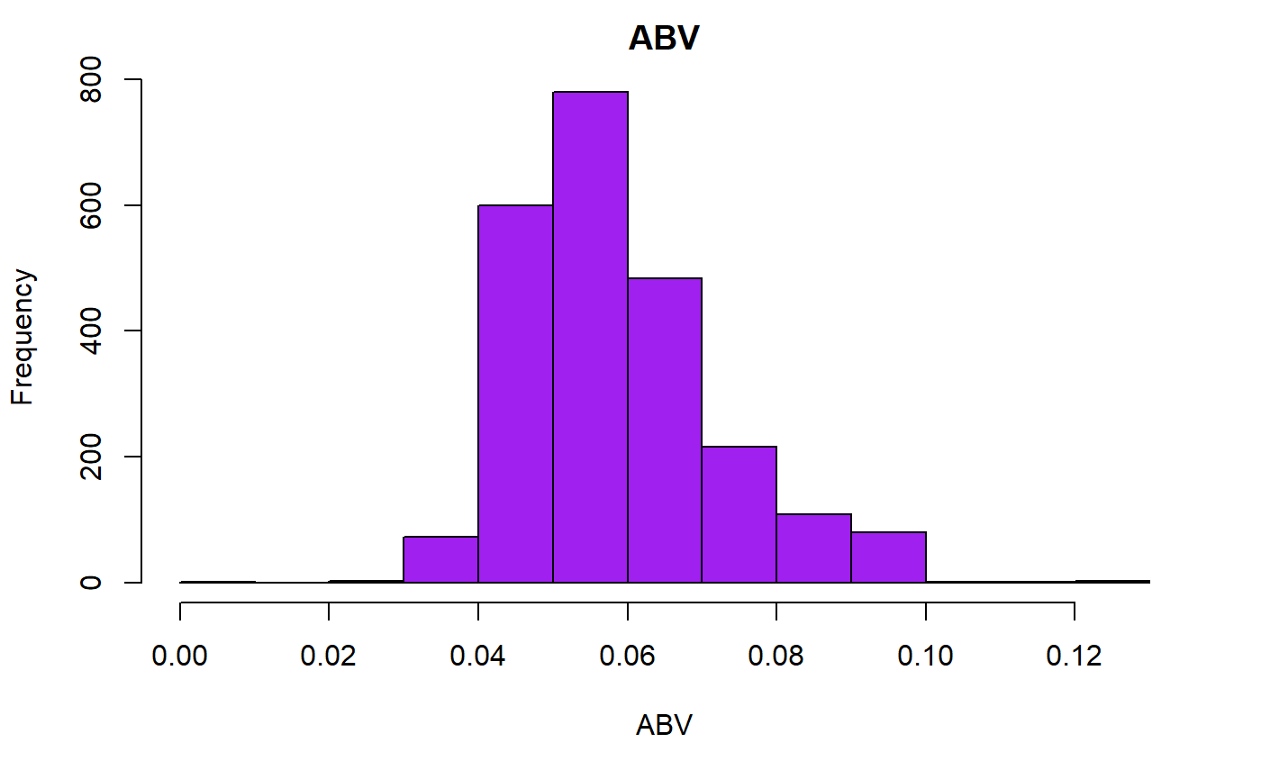
Total ABV statistics

Slide 8
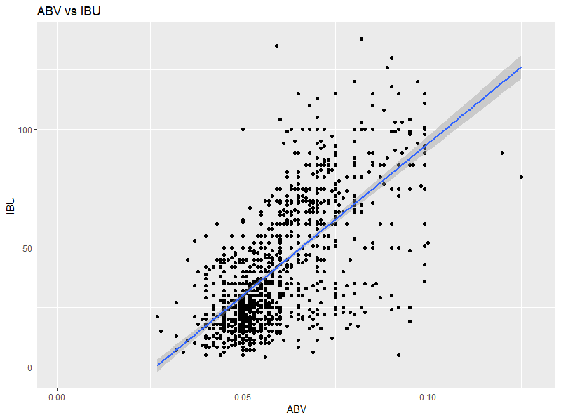
ABV and IBU correlation

Slide 9
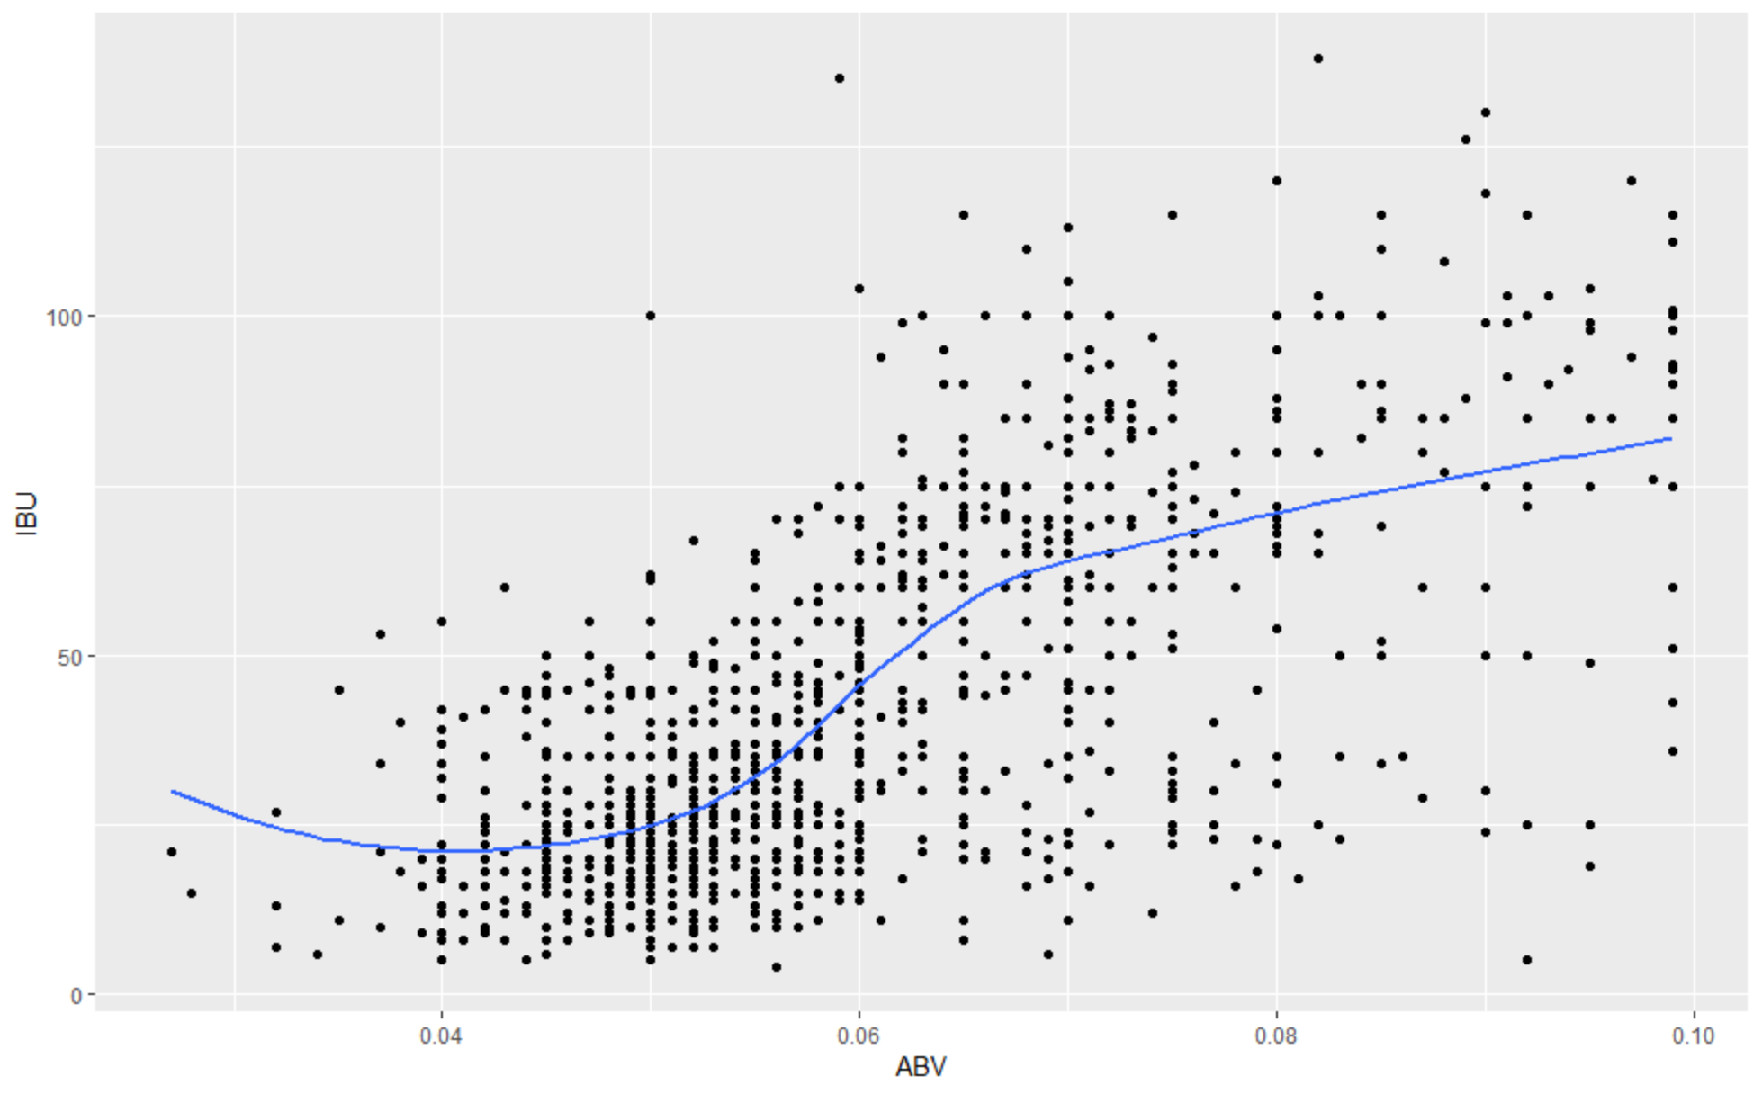
ABV and IBU correlation

Slide 10
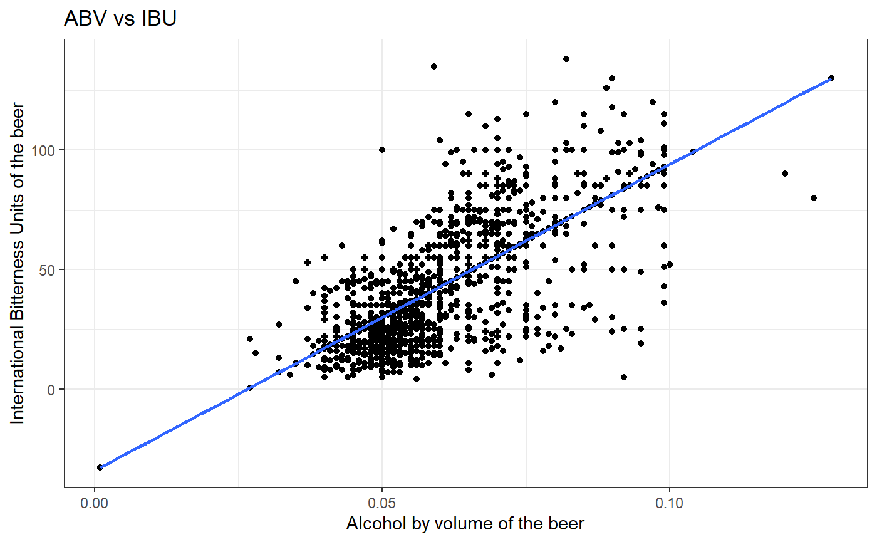
ABV and IBU correlation

