Slide 1




SYED ARSALAN KHAN PIAIC 121133

Slide 2
Metaverse
“A massively scaled and interoperable network of real-time rendered 3D virtual worlds that can be experienced synchronously and persistently by an effectively unlimited number of users with an individual sense of presence, and with continuity of data, such as identity, history, entitlements, objects, communications, and payments.”

Slide 3
History of Metaverse
On the 6th of August 1991, Tim Berners-Lee posted the very first public invitation for collaboration on the World Wide Web. This is the date the Internet was born.
The term metaverse was coined in Neal Stephenson&amp;apos;s 1992 science fiction novel Snow Crash, where humans, as programmable avatars, interact with each other and software agents, in a three-dimensional virtual space that uses the metaphor of the real world.

Slide 4
Time line of Metaverse
Bitcoin
Ethereum
Blockchain
Decentraland
NFTs
Pokémon GO
1
4
2009
2015
2
5
2009
2015
3
6
2012
2016

Slide 5
Time line of Metaverse
DAO
Decentralized Apps
Dai Stablecoin
Solana
(DEX)
First Concert in the Metaverse
7
10
Decentralized Autonomous Organizations
2016
2020
8
11
2018
2020
9
12
Decentralized Exchanges
2018
2020

Slide 6
Types of Metaverse
Blockchain based
Social world
One of them deals with building a Blockchain-based metaverse, using NFTs and Cryptocurrencies. Some of the examples are decentraland and the sandbox.
While the other one is a simple, Virtual world where people can meet and greet each other. Facebook is working towards creating this version of metaverse.

Slide 7
What can we do in Metaverse
Make a virtual property
Earn money by investing in nfts, playing games that earn you money, etc.
Advertise anything
Create an environment customized to yourself
Buy and sell unique assets
Own digital properties

Slide 8
Elements in Metaverse
01.
02.
03.
Digital Currency
NFTs
Digital Comeerece
04.
05.
06.
Gaming
Device independence
Infrastructure
07.
08.
09.
Digital Assets
Online Shopping
Digital Humans

Slide 9
Metaverse work’s based on
Blockchain
VR / AR
Web 3.0
A blockchain is a digitally distributed, decentralized, public ledger that exists across a network.
Augmented reality (AR) and Virtual Reality (VR) bridge the digital and physical worlds. They allow you to take in information and content visually, in the same way you take in the world
The upcoming third generation of the internet where websites and apps will be able to process information in a smart human-like way through technologies

Slide 10
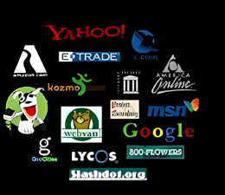
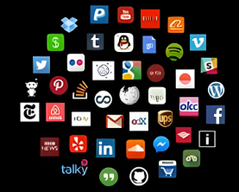
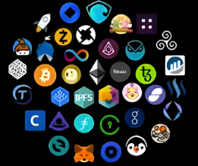
What are we working on?
Web 1.0
Web 2.0
Web 3.0

Slide 11
Pros of Metaverse
Cons of Metaverse
Traveling the world without moving
Increasing technological literacy and skills
Connecting with new people without feeling awkward
Creating completely new job opportunities
Required of Advanced Digital Technologies
Privacy and Security Implications
Reducing the Difference between Real and Virtual

Slide 12
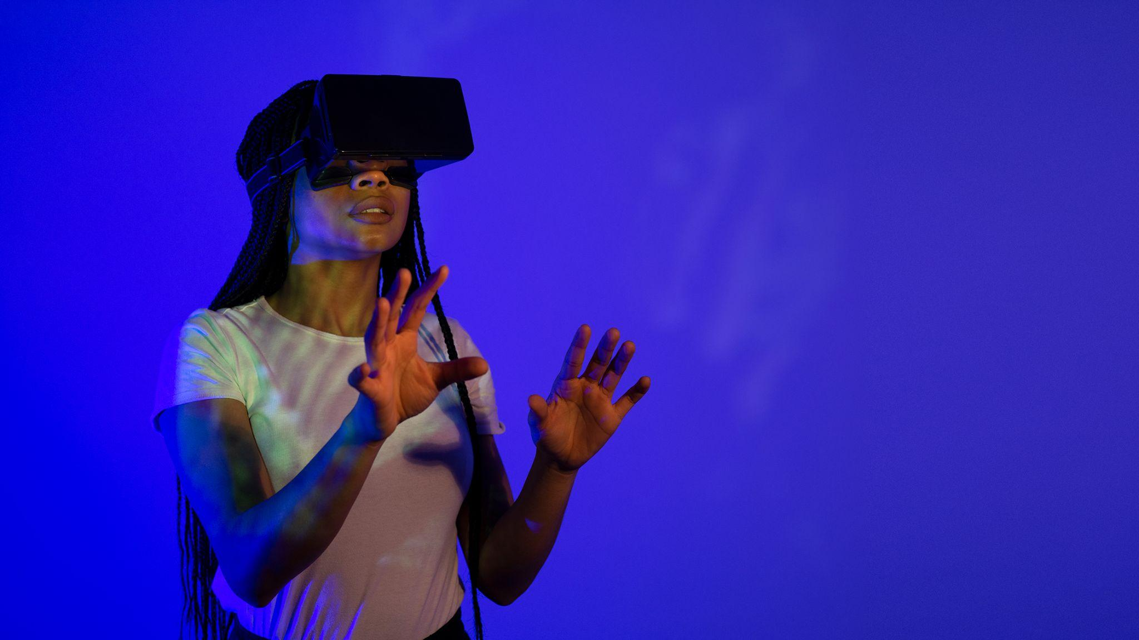
Can we have meaningful life in Metaverse ?
What makes your life meaningful? And are there any ways in which a virtual existence would get in the way of those things? There's a lot of factors in a meaningful life.
There's having significant goals and reaching them.
There's having positive relationships with other people.
There's having positive subjective experiences.
There's coming to understand things. But most of these basic kinds of things that matter, you ought to be able to get in a virtual world.
A virtual world won't give you that. I don't want to say there's no loss in moving to a virtual world.

Slide 13

Companes work on Metaverse
Meta:
Meta is the main company developing Metaverse for users and players to be in the vast network of real-time 3D virtual worlds while maintaining identity and payment history.
NVIDIA.
Epic Games.
Microsoft.
Apple.
Decentraland.
Roblox Corporation.
Unity Software.

Slide 14
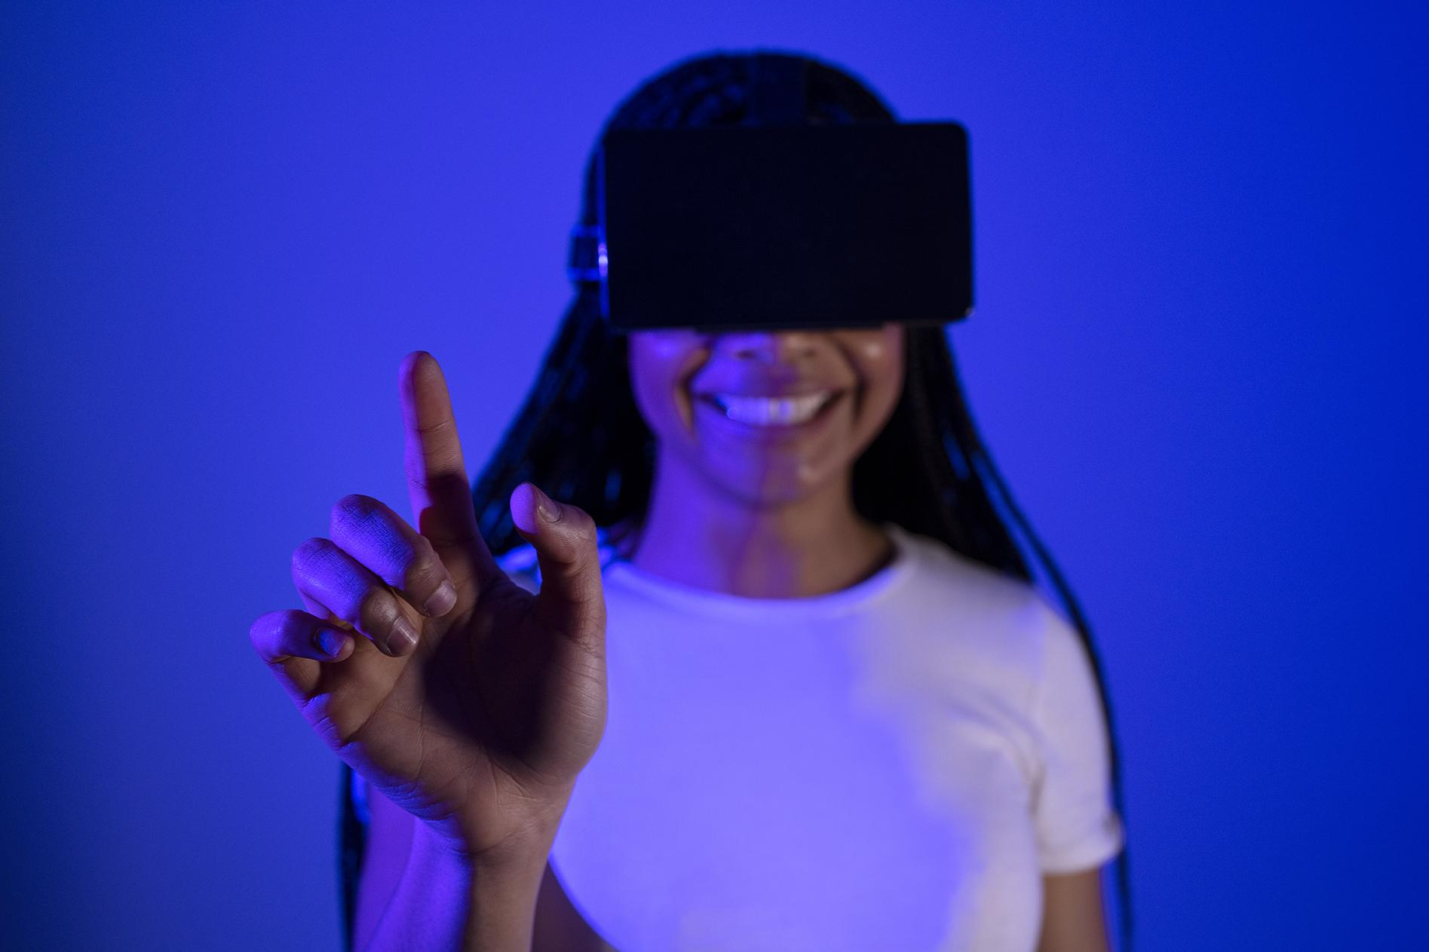
Future of Metaverse
Today's metaverse: virtual reality as the "digital escape". Over the next few years the future metaverse would be something very similar to our real world in many aspects and even replace some real-world activities (like working or hanging out).
"A lot of people think that virtual reality is an illusion, that it's not real. But I say that it has causal power, it exists outside of our mind, and is not an illusion."

Slide 15
Conclusion
Metaverse is the future of internet.
Large companies taking a
step forward it.
It has its own advantages
and disadvantages.
Two realities will exist.

