Slide 1

PackGuard
AI-Assisted Multi-Layer Software Supply-Chain Defense Platform
Final Year Project Proposal — FAST National University of Computer and Emerging Sciences, Karachi Campus
Arslan Asad (23I-2505) · Ammar Hussain (23K-0520) · M Asad Ur Rehman Bin Usman (23K-0902)

Slide 2


The Problem: AI Package Hallucination
What Is Slopsquatting?
Real Incidents & Tool Gaps
AI coding assistants hallucinate package names that don't exist. Attackers register those exact names on npm or PyPI and embed malware — an attack called slopsquatting.
huggingface-cli — thousands of downloads in 48 hrs after a researcher registered a hallucinated name
react-codeshift — baked into 47 published AI agent instructions (January 2026)
USENIX Security 2025: hallucination rates of 5.2%–21.7% across 16 LLMs — 205,474 unique hallucinated package names identified.
Existing Tools Fall Short
Socket.dev & Phylum: general supply-chain risk, not hallucination-specific
OSV-Scanner: only catches already-reported packages
slopcheck: closest, but no calibrated score, no metadata analysis, no cross-model signal

Slide 3





Our Idea: PackGuard
A five-layer defense platform purpose-built around the AI-hallucination attack path — combining pre-install verification, calibrated risk scoring, sandboxed behavior testing, and a full audit trail.
Intercept
Score
Catch install requests before they execute
Bayesian + ML risk assessment
Sandbox
Decide
Behavioral testing in isolation
Allow, Warn, Quarantine, or Block
Goal: catch fake or malicious packages before they are ever trusted into a real project — not after.

Slide 4
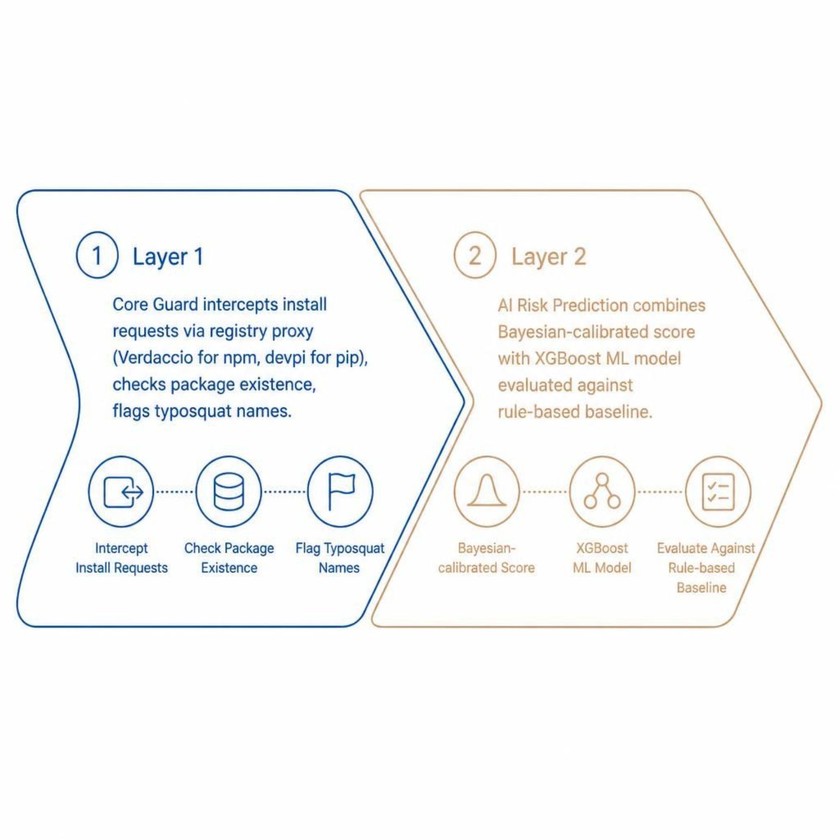

Layer 1 & 2 — Core Guard and AI Risk Prediction
Core Guard — Layer 1
Intercepts install requests via a registry proxy (Verdaccio for npm, devpi for pip). Checks package existence and flags typosquat-style names before installation proceeds.
AI Risk Prediction — Layer 2
Combines a Bayesian-calibrated score (registry + metadata evidence) with a trained XGBoost model, evaluated against a rule-based baseline.
Cross-model consensus check — flags any package name that multiple independent AI models hallucinate identically. PackGuard's most distinctive feature with no equivalent in any existing tool.

Slide 5
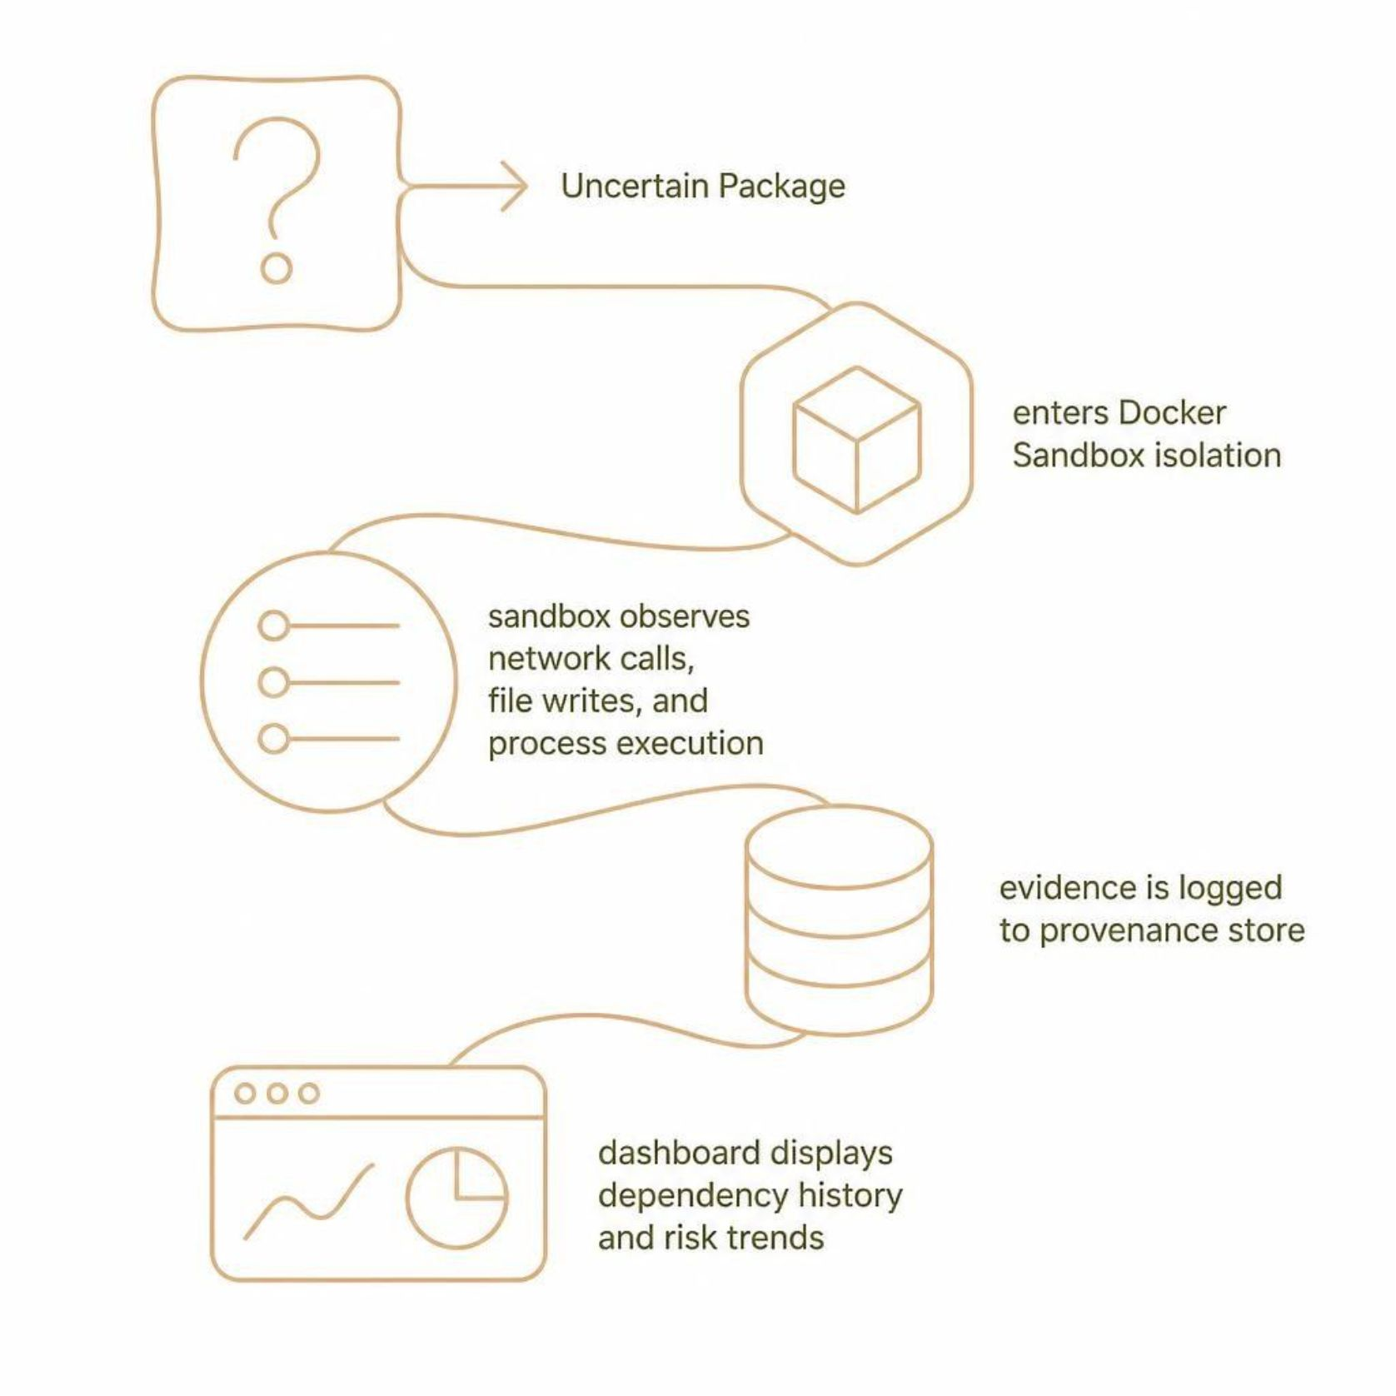
Layer 3 & 4 — Runtime Behavior Guard and Provenance Visibility
Runtime Behavior Guard — Layer 3
Executes uncertain packages inside an isolated, disposable Docker sandbox, observing real behavior — network calls, file writes, process execution — before any code touches the real project.
Dependency & Provenance Visibility — Layer 4
Logs every package checked and every decision made. A dashboard surfaces dependency history, risk trends, and the full evidence trail behind each verdict.

Slide 6
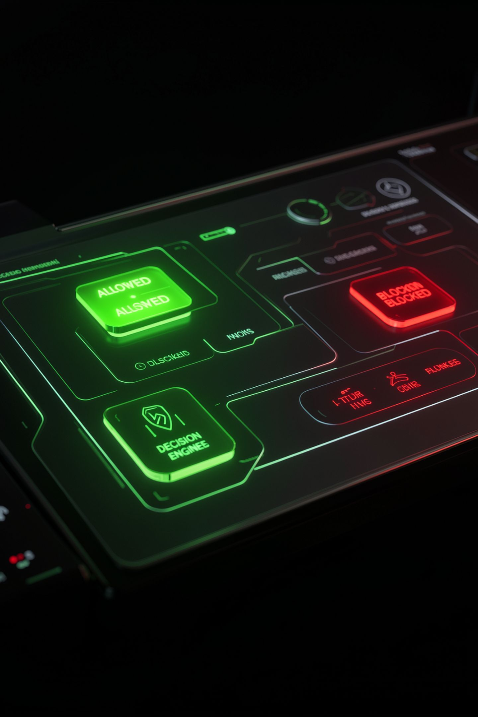


Layer 5 — Unified Decision Engine & What Makes PackGuard Unique
The Decision Engine
PackGuard's Uniqueness
Combines evidence from every layer into one final, explainable action:
Cross-Model Consensus
No equivalent in any existing supply-chain tool
✅ Allow
⚠️ Warn
Hallucination-Specific
🔒 Quarantine
Purpose-built around the AI-hallucination attack path
🚫 Block
Empirical Multi-Layer Evaluation
Tests whether combining layers improves detection over any single layer

Slide 7


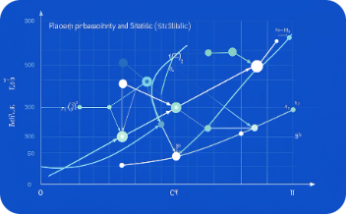
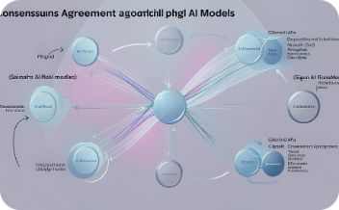
Research Foundation
Spracklen et al., USENIX Security 2025
Krishna et al., ICML 2024
Hillah et al., 2026
Churilov, 2026
Bayesian two-channel detection architecture — the direct blueprint for PackGuard's risk scoring engine.
Found 127 names hallucinated identically across 5 frontier models — motivating the cross-model consensus layer.
Foundational hallucination study. MIT-licensed dataset of 205,474 hallucinated package names used directly in PackGuard.
Importing Phantoms — independent confirmation of hallucination across 11 additional LLMs.

Slide 8
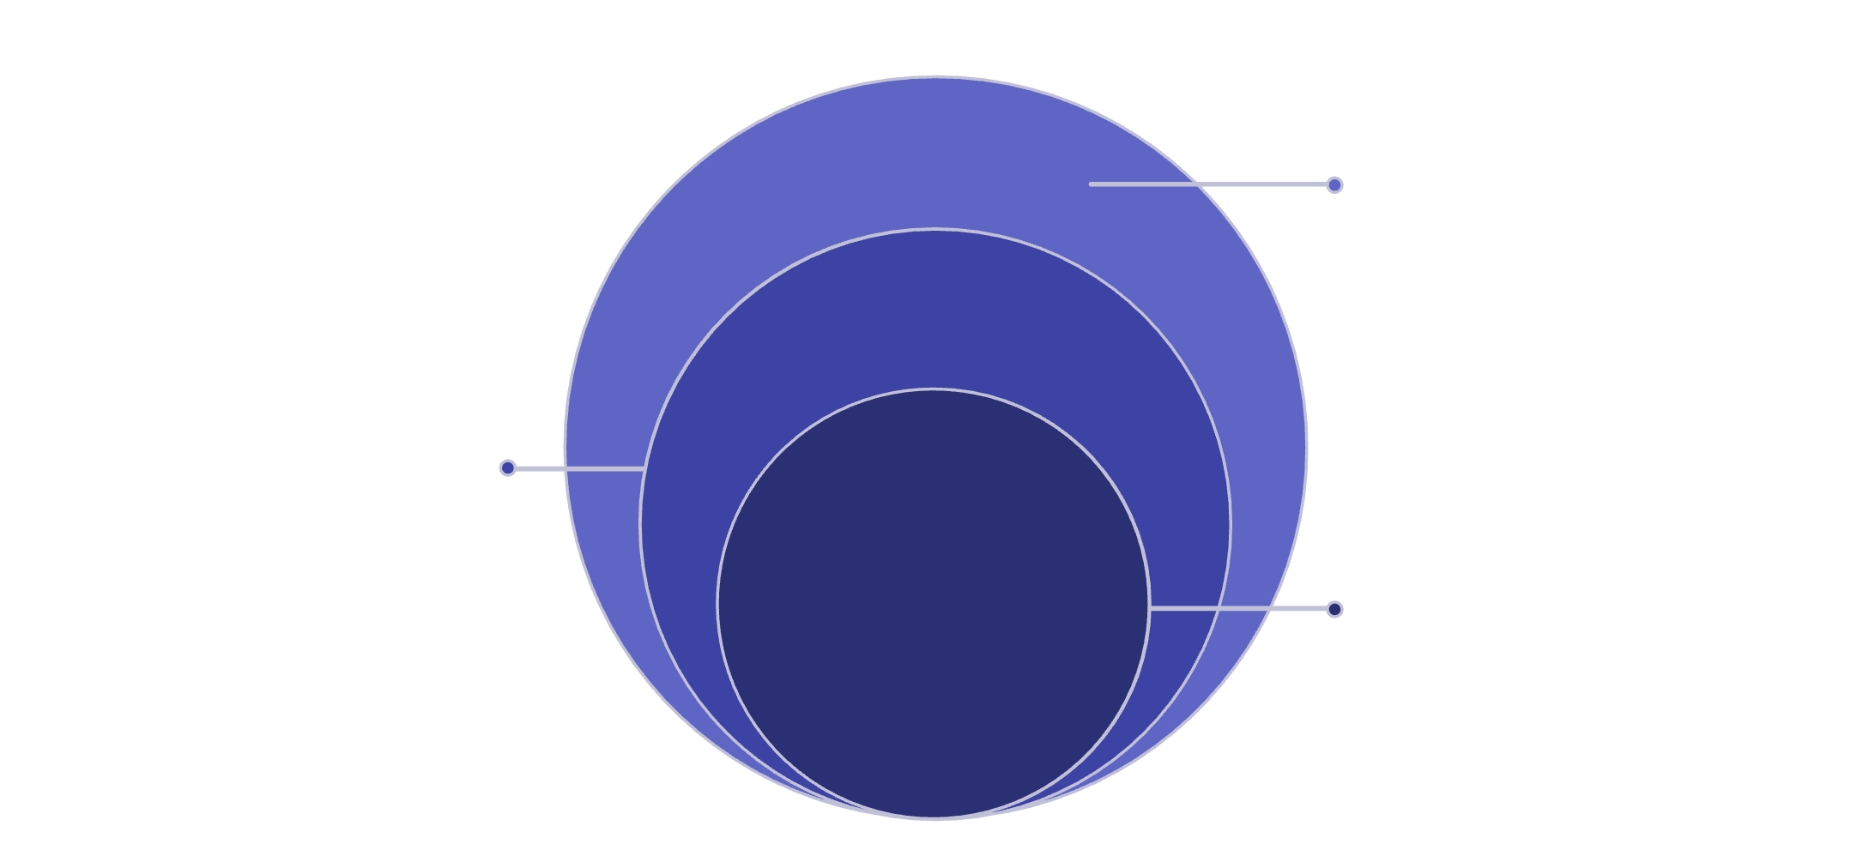
System Architecture & Technology Stack
Data
PostgreSQL stores evidence, scores, and audit logs
Request Flow
A package request flows through interception → scoring → decision, with evidence accumulating at each layer before a final explainable verdict is issued.
Application
Core Guard, Risk & Decision Engines as FastAPI services
Presentation
Next.js dashboard for request visualization
Technology Stack
Backend
ML
Infra
Frontend
Python · FastAPI · Verdaccio · devpi
scikit-learn · XGBoost
Docker · GitHub Actions · Terraform · PostgreSQL
Next.js · Tailwind CSS

Slide 9


Project Timeline & Expected Deliverables
FYP-I — Fall 2026 (Confirmed)
1
Deliverables
Five-layer working prototype for npm & PyPI
Trained ML model evaluated vs. rule-based baseline
Threat modeling · Core Guard · Bayesian risk scoring · Cross-model consensus checker · ML risk model · Working prototype by evaluation milestones
2
FYP-II — (Tentative)
Runtime Behavior Guard · Dependency & Provenance store · Decision Engine integration · Full evaluation · Final defense
Cross-model hallucination lookup table
Measured precision, recall & false-positive rate across controlled test scenarios

Slide 10

Thank You
PackGuard — catching AI-hallucinated and malicious packages before they ever reach a real project.
Arslan Asad · Ammar Hussain · M Asad Ur Rehman Bin Usman
FAST-NUCES Karachi · Final Year Project 2025–26
Questions and discussion welcome.

