Slide 1
My Journey
Arsam Fayyaz
(Front-end web Developer)

Slide 2
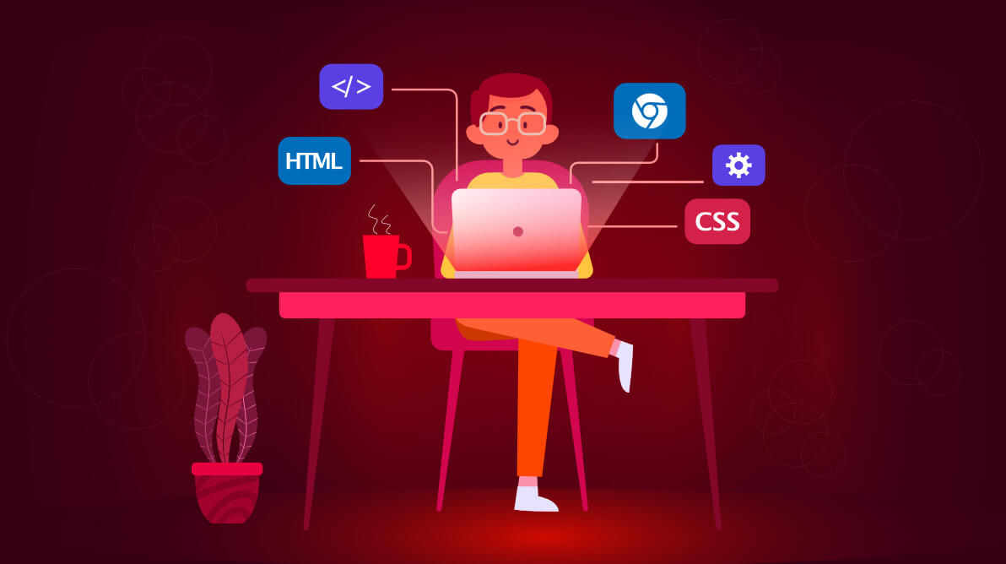
Contents of this template
About me
How you get there?
Why you have chosen this field
Your achievements
Pros and cons of this field
Future trends
Pathways to pursue this field
Do’s and don’ts
Opportunities
Challenges
Resources
Conclusion

Slide 3
About me
A passionate and enthusiast front-end web developer having experience on some real time projects currently pursuing software engineering at MUET, Jamhsoro.
Apart from web, in recent times I have started learning flutter which is a hybrid mobile application development framework from Google. Thing that fascinates me to switch from web to flutter is its cross platform development nature which is platform independent. In addition, it incorporates aesthetic and easy to build designs using google material design library.
The most cumbersome thing that web development requires is to build everything from scratch and its diverse tools and libraries which keeps updating from time to time. You never know when your current framework will get obsolete and again you have to switch to the new one. Whereas flutter is platform supported by Google and uses built-in, customizable widgets to develop modern layouts efficiently without writing much code. Well predicting trends in today’s developing IT industry is still difficult but you should keep exploring.

Slide 4
About me
DevOps is a latest and modern technology that boosts the organization’s ability to deliver applications/ product at high velocity. Understanding the traditional product lifecycle in a typical software house helps me aware of the importance of DevOps. Considering this, it also fascinated me and I started learning DevOps tools and its working on my own. Being a software engineer, you should keep exploring diverse fields and increase your skillsets.
Entrepreneurship culture is progressing so rapidly in Pakistan. Considering this, Govt of Pakistan had started its initiative to incubate startups under a project named NEP NIC. So following this, me and my teammates had pitched a startup named RentPayy at NIC Jamshoro and won office space for its 3rd cohort, this is where my entrepreneurship journey had started. Throughout this journey, I have learned a lo and understand the dynamics of business and how SAAS startups can progress in Pakistan.

Slide 5
How you Get There?
After completing my matriculation, I pursued CIT course at Aptech Hyderabad where I get to know regarding web development and how it works. Later in my second semester of software engineering, I got registered in NAVTAAC CIT programme at MUET Jamshoro. From there I have pursued Fornt-end web development as my career path. Initially it took me some time to grasp basic concepts but by the time I started working professionally on real time projects, I learned a lot.
At start I sticked to improve my website designing skills which requires intermediate and advance knowledge of html, css and javascript. I have also explored multiple libraries and framework including bootstrap and tailwindcss.
Later I started working on ReactJs which is a javascript library for developing efficient user interfaces. It took a lot of efforts to learn ReactJs as it variety of complex features. For this, I took Udemy certification and upgraded my skillset as a front-end developer.

Slide 6
Why you have chosen this field
Front-end web development seems fascinating to me by the I started learning C++, java and other traditional languages which requires a lot of logic and multiple lines of code to do even a small thing. Web development is result oriented where you write and got instant results. This was the major reason I chosen web development over old school languages.
Also, my creative mind and good design skills lets me create aesthetic and modern layouts. This was another major reason to keep pursuing this field. Considering its trends, fornt-end web developers were always in demand and also awarded with handsome salary packages in IT world.

Slide 7
Your achievements
Pursuing web development for more than a year or two professionally, I worked on multiple projects and freelance projects which helps me earn little bit of amount to afford my side expenses. In my startup, apart for being CEO I have also developed its website on my own from scratch

Slide 8

Pros and cons of this field
PROS
Creative: Front-end web development allows for a lot of creativity in designing the user interface and user experience. You can experiment with different layouts, colors, fonts, and animations to make your website or application stand out.
In-demand: Front-end web development skills are highly in-demand in the tech industry. Many companies are looking for developers who can build engaging and responsive user interfaces.
Immediate feedback: Front-end development allows you to see immediate results of your work. You can see the changes you make in real-time, which can be very satisfying.
Flexibility: Front-end developers have a lot of flexibility in terms of the tools and technologies they use. There are many different front-end frameworks and libraries available to choose from.

Slide 9
Pros and cons of this field
CONS
Constantly changing: The front-end web development landscape is constantly changing, with new frameworks and tools being introduced all the time. It can be difficult to keep up with all the latest trends and technologies.
Limited control: Front-end developers have limited control over the back-end of a website or application. This can be frustrating if you want to make changes that require access to the back-end.

Slide 10

Future trends
Front-end web development is constantly evolving, and it's important to stay up-to-date with the latest trends to remain competitive. Here are some of the future trends for front-end web development:
Artificial Intelligence (AI) and Machine Learning (ML): AI and ML are becoming more integrated into front-end web development. They can be used to create personalized user experiences, automate tasks, and enhance user interfaces.
Virtual Reality (VR) and Augmented Reality (AR): VR and AR are changing the way users interact with websites and applications. Front-end developers will need to learn how to create immersive experiences that take advantage of these technologies.

Slide 11
Future trends
Responsive design: Responsive design has been around for a while, but it will continue to be an important trend in front-end web development. With more people accessing the internet on mobile devices, it's essential to create websites and applications that work well on smaller screens.
Overall, the future of front-end web development is exciting and full
opportunities. Developers who stay up-to-date with the latest trends and
technologies will be well-positioned to succeed in this rapidly evolving field.

Slide 12
Pathways to pursue this field
If you're interested in pursuing a career in front-end web development, here are
some pathways you can follow:
Internships: Many companies offer internships to students or recent graduates. These internships provide valuable experience and can lead to full-time job offers.
Freelancing: If you have the necessary skills, you can work as a freelance front-end developer. This will give you the opportunity to work on a variety of projects and gain experience working with different clients.
Open-source projects: Contributing to open-source projects is a great way to gain experience and build a portfolio. It also allows you to work with other developers and learn from their expertise.

Slide 13
Pathways to pursue this field
Networking: Attend meetups, conferences, and other events to network with other developers and learn about the latest trends in front-end web development. You can also join online communities and participate in forums and discussions.
Building your own projects: Build your own projects to showcase your skills and creativity. This will help you stand out to potential employers and clients.
Regardless of which pathway you choose, it's important to stay up-to
date with the latest technologies and trends in front-end web
development. This will ensure that you remain competitive and have the
necessary skills to succeed in this field.

Slide 14
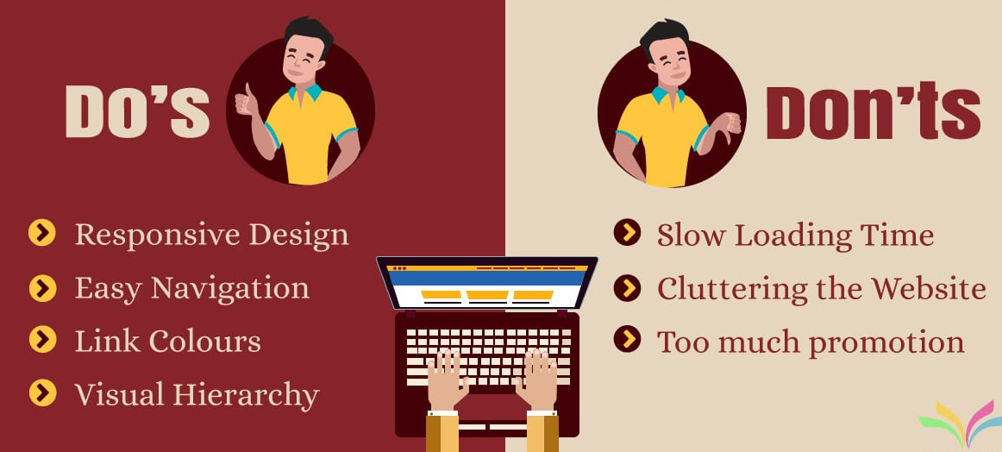
Do’s and Don’t

Slide 15
Do’s and Don’t
Do's:
Stay up-to-date with the latest technologies and trends.
Practice good design principles, such as using a grid system, typography, and color theory.
Optimize for performance, including page load times and mobile responsiveness.
Write clean, maintainable code and use version control systems like Git.
Test your code across different browsers and devices.
Collaborate effectively with other developers, designers, and stakeholders.
Don't:
Rely too heavily on frameworks and libraries without understanding the underlying code.
Sacrifice user experience for design trends or flashy animations.
Use too many plugins or third-party scripts that can slow down the website or affect security.
Ignore accessibility guidelines and principles.
Neglect SEO best practices, such as using semantic HTML and meta tags.

Slide 16
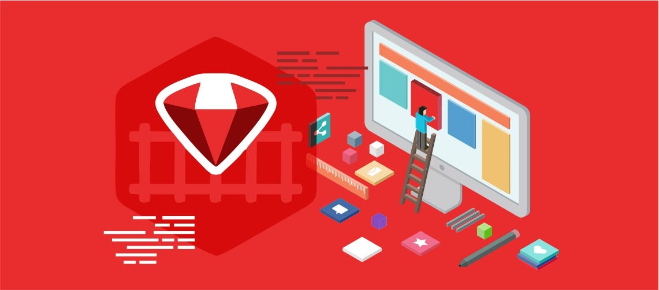
Opportunities and Challenges

Slide 17
Opportunities and Challenges
Opportunities:
Growing demand for front-end developers in a variety of industries.
The ability to work on exciting and innovative projects using cutting-edge technologies.
Opportunities to work remotely or as a freelancer.
Potential for high salaries and career growth.
Challenges:
The need to constantly adapt to new technologies and trends.
The pressure to create engaging and responsive user interfaces that work across
different devices and browsers.
The challenge of collaborating with other developers and stakeholders effectively.
The need to balance design aesthetics with usability and accessibility.
The potential for burnout due to long hours or tight deadlines.

Slide 18

Resources
Here are some resources for front-end web development:
Online courses and tutorials:
Codecademy
Udemy
Coursera
FreeCodeCamp
W3Schools
Community forums and Q&A sites:
Stack Overflow
Reddit Webdev
CSS Tricks
Sitepoint

Slide 19
Resources
News and trends websites:
Smashing Magazine
A List Apart
CSS-Tricks
CSS Weekly
JavaScript Weekly
Frameworks and libraries:
React
Angular
Vue.js
Bootstrap
Foundation
These are just a few of the many resources available for front-end web development. It's
important to find the ones that work best for your learning style and goals.

Slide 20
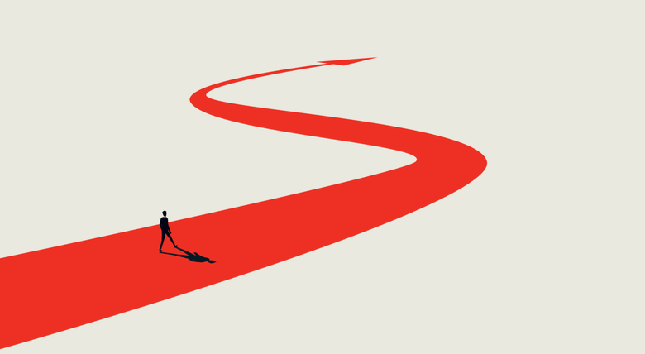
Conclusion
Hope this would be a short guide for the one who wants to pursue front-end web development in future and could benefit from the information and experience I have shared.

