Slide 1




Project Goals
Recommendation Generator with Graphical output
Project Overview
Algorithms
Output
The main idea of the project is to be able to create recommendations in real time according to the users preferences
Dijkstras Algorithim
Our output is interms of a graph with the nodes’ color genre dependent.
The datasets we use have information about movies/games/songs of multiple genres with ratings for each entry.
BFS Traversal.
Another output is the recommendation generator which outputs movies according to users preferences
We organize data into vertices and connect them with edges based on their genre and hence be grouped according to genre.
Notes:
Interviewer: Umair
Notetakers: Shivani

Slide 2







Development Log
Week 1
Week 2 + 3
We developed an idea to have a graph with different movies as nodes with edges connecting movies sharing the same genre in a pattern. However we decided to discard priority queue implementation as rating would only be partially ordered. Then we decided to make a base graph class and add two derived graph classes with different movies as nodes. Recommendations in our model could also be generated based on search history and our overall graphic output was decided to be done using a force directed graph drawing algorithim.
We wrote the header files for our program
Made a timeline for our project deliverables
Week 4
Divided the work up according to each others strengths
Week 4 is where we completed the bulk of our code for dijkstras algorithim, force directed graph drawing, search engine functions, constructors and main functions.
We also added tests to our project which would test every function individually and finished our make file.
Our make file has 2 executables: test which contains all our tests which are run together and project which is our entire program with the user interface.
Started writing code for the functions

Slide 3
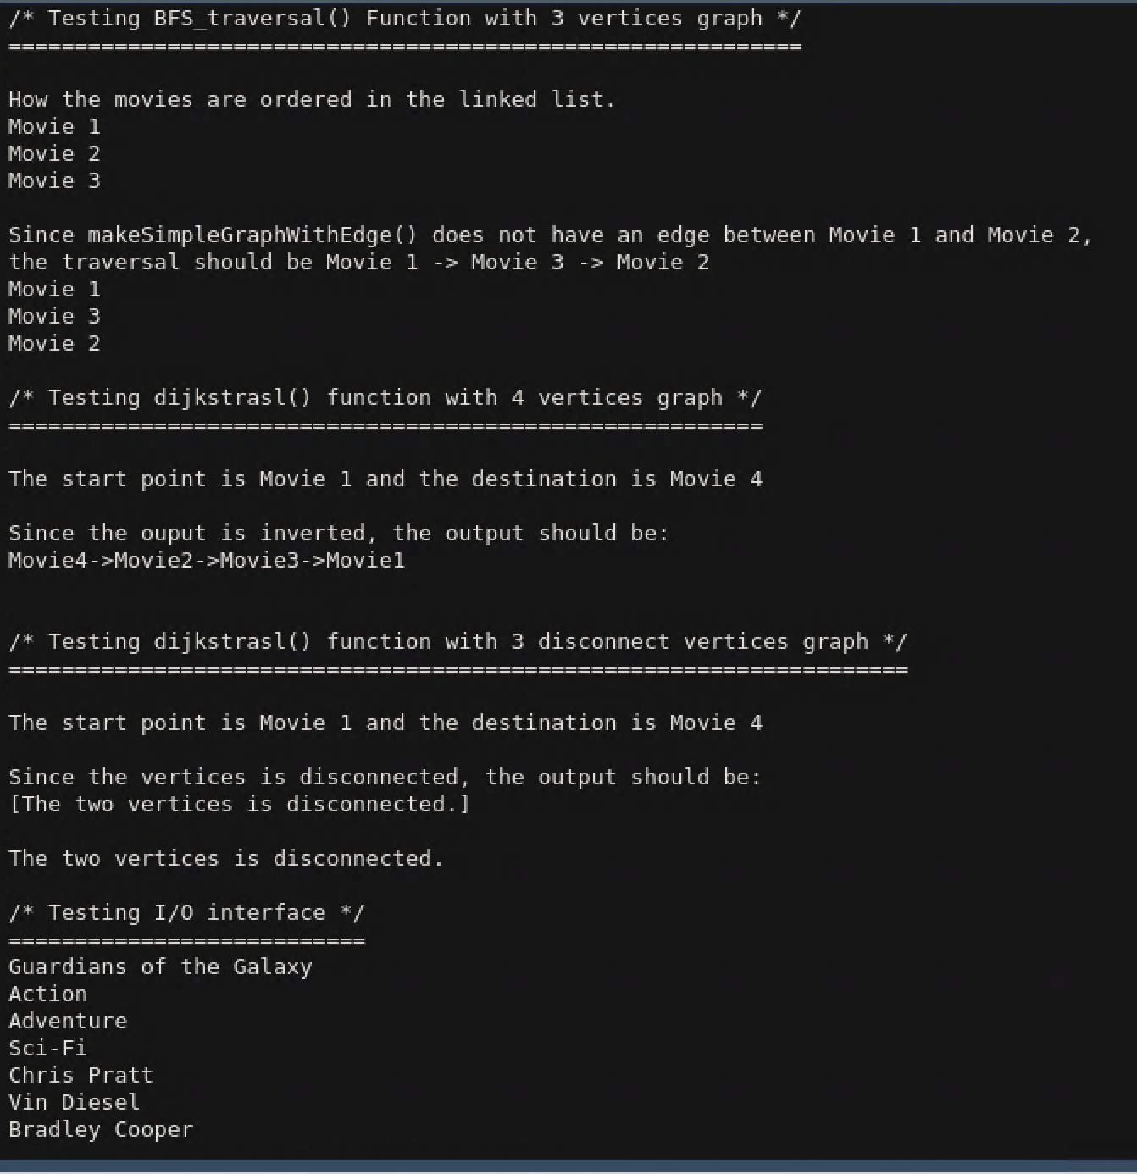
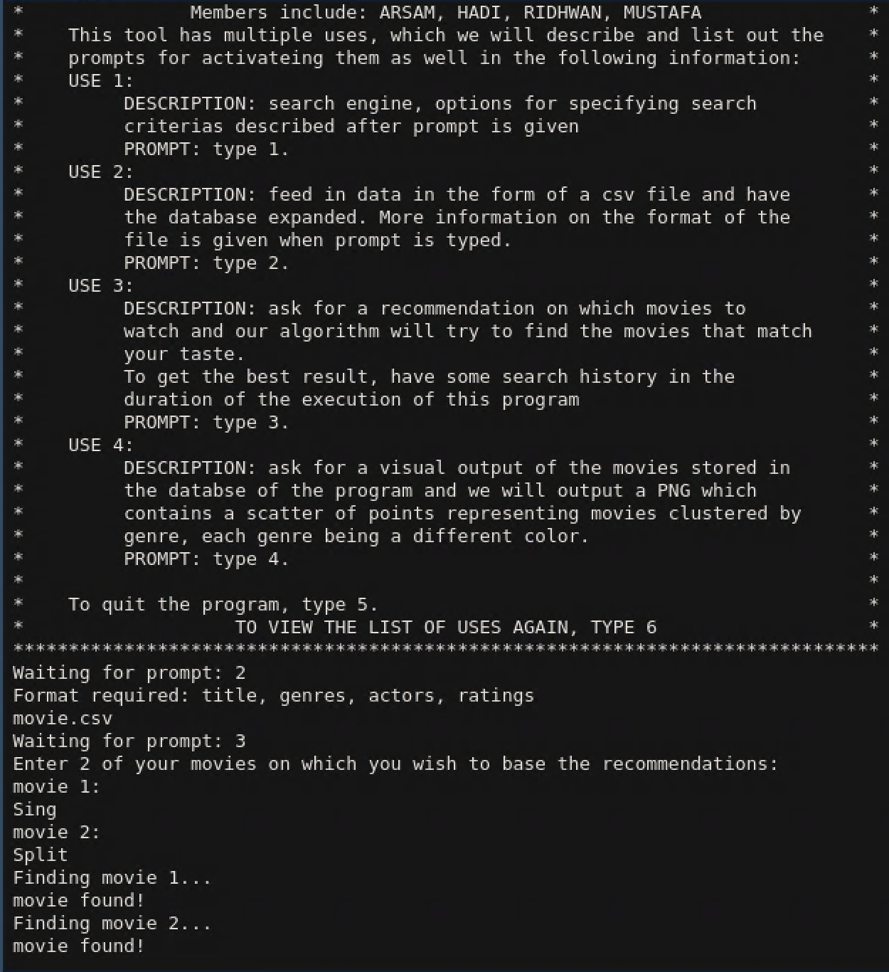
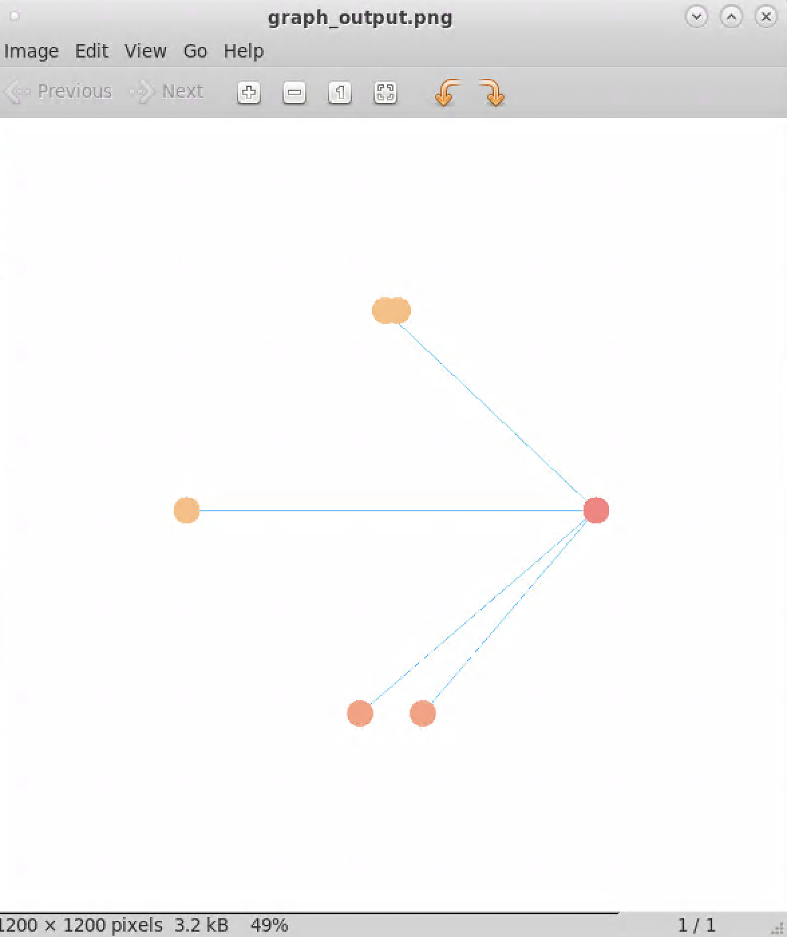
Our Outputs in terms of Images

