Slide 1


MESSIER 12 GLOBULAR CLUSTER ANALYSIS
Presented by
Sanjeev Kumawat
Department of Physics
Indian Institute of Technology Hyderabad
Date: May 19, 2026

Slide 2
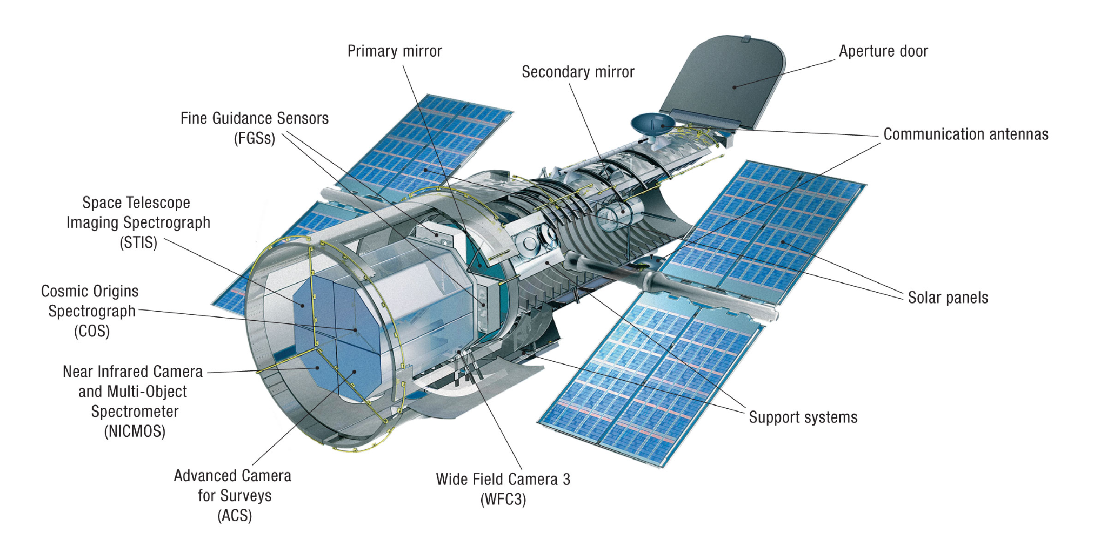
Introduction to Hubble
The Hubble Space Telescope (HST) is a space-based observatory launched by NASA in 1990 into low Earth orbit.
Operates above the Earth's atmosphere to capture high-resolution imagery in ultraviolet, visible, and near-infrared wavelengths without atmospheric distortion.
Over three decades of service, HST has fundamentally advanced the study of galaxies, nebulae, black holes, exoplanets, and globular clusters.
It provides unprecedented clarity in deep-space observations, serving as a primary source for high-fidelity astronomical data.

Slide 3
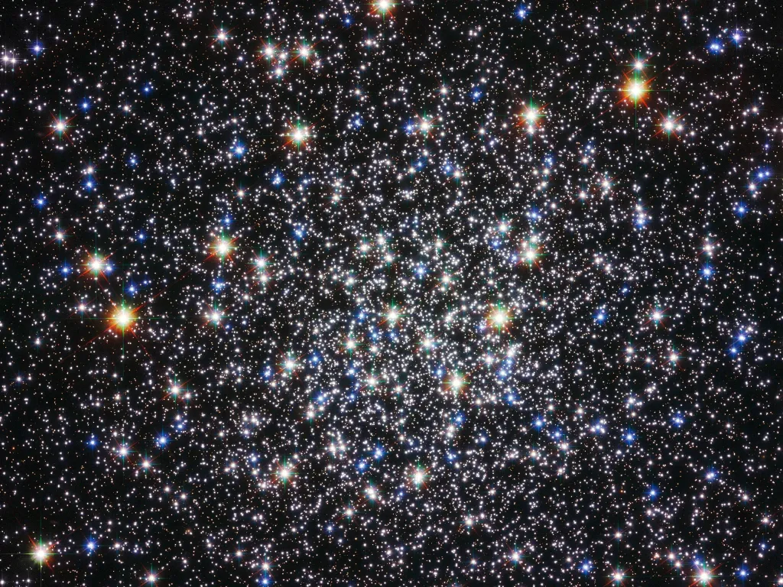
Messier 12 Globular Cluster
Messier 12 (M12) is a globular cluster located in the constellation Ophiuchus.
M12 contains a dense population of old stars and is important for studying stellar evolution and galactic dynamics.
A dense globular cluster located approximately 23,000 light-years from Earth in the constellation Ophiuchus.
First discovered by Charles Messier in 1764, the system consists of old stars gravitationally bound in a nearly spherical geometry.
Research suggests M12 lacks a significant population of low-mass stars, likely due to gravitational stripping caused by interactions with the Milky Way’s dense regions.
It functions as an astrophysical laboratory for studying stellar dynamics, binary systems, and the broader structure of our galaxy.

Slide 4

Objectives
Workflow
Load and analyze astronomical FITS image data.
Estimate background statistics using Sigma Clipping.
Detect stellar sources using DAOStarFinder.
Mark detected stars using circular apertures.
Analyze stellar brightness distribution using flux histograms.
4
2
DAOStarFinder
6
1
3
Visualize image
5
Flux Histogram
Loads FITS data
Sigma Clipping
Mark Detected Stars

Slide 5
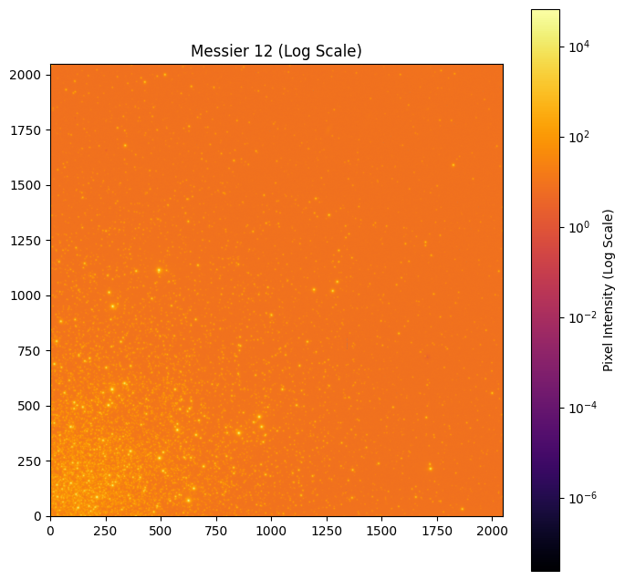
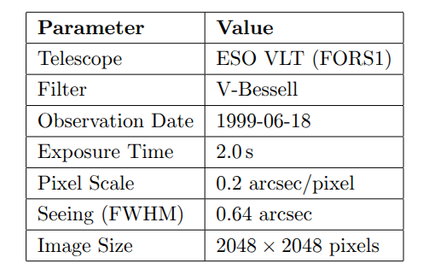
FITS Metadata
Image Visualization
FITS image visualized using logarithmic normalization.
LogNorm() improved visibility of faint stellar structures.
Inferno colormap enhanced contrast across the cluster field.

Slide 6
Background Estimation (Sigma Clipping)
Raw images contain detector noise, sky glow, and cosmic rays. So, before detecting stars, we must define what "empty space" looks like. The Concept: μ±nσ
Sigma Clipping is an iterative process that calculates the mean (μ) and standard deviation (σ) of the image, then throws away pixels that are too far from the average (outliers).
sigma_clipped_stats() function from the Astropy library is used for background estimation and clipping threshold of σ = 3.0 is considered for the calculation.
Calculated Values:
Mean: 9.28 ADU.
Median: 9.00 ADU.
Standard Deviation: 2.26 ADU.
Importance: Provides a stable baseline for defining a reliable detection threshold.

Slide 7
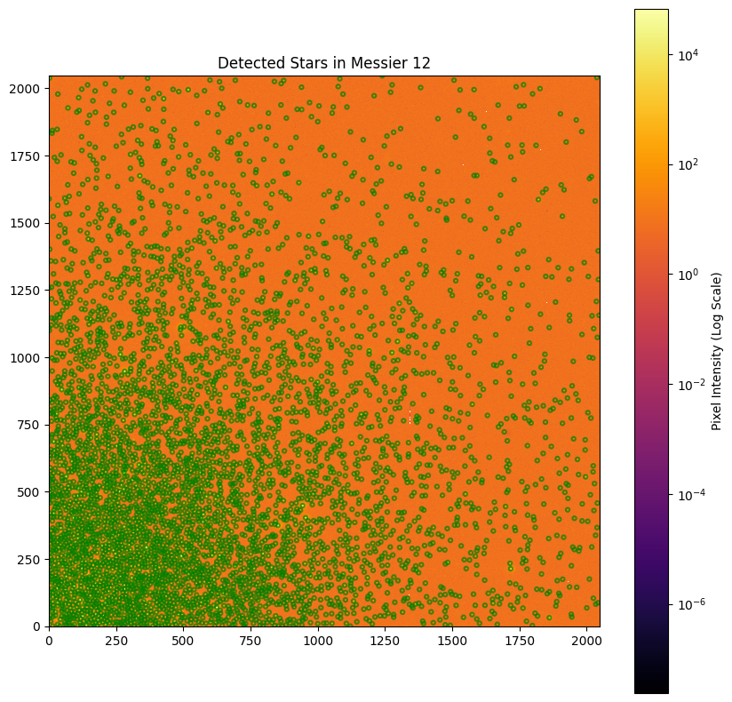
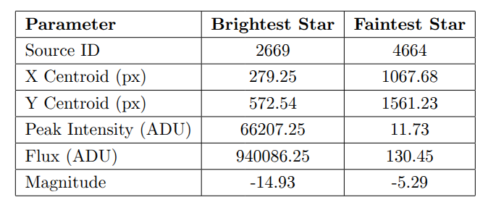
Star Detection using DAOStarFinder
DAOStarFinder used for stellar source extraction.
Detection threshold = 5 × σ
FWHM = 3.0 pixels
Total detected stars = 4950
Brightest and Faintest Detected Stars
The detected stellar population spans a very large brightness range. Most stars are faint, while only a few exhibit extremely high flux values.

Slide 8
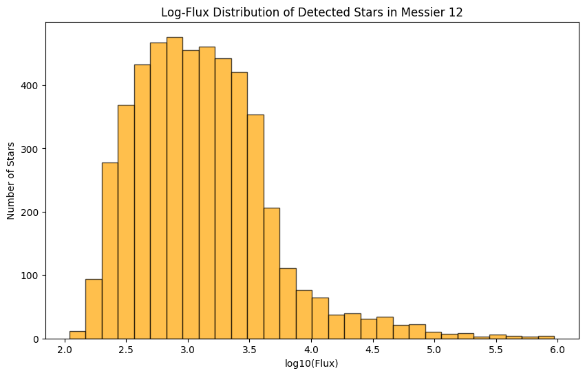
Flux Distribution Analysis
Stellar brightness distribution analyzed using a logarithmic flux histogram.
Most detected stars are concentrated in the low-flux region, indicating a dominant population of faint stars.
A small fraction of stars exhibit extremely high flux values, corresponding to bright stellar sources within the cluster.
The wide dynamic range of stellar brightness is characteristic of dense globular cluster systems.
Logarithmic scaling improves visualization of both faint and bright stellar populations simultaneously.

Slide 9
Conclusion
References
Successfully analyzed the Messier 12 FITS image using Python.
Estimated background statistics using Sigma Clipping.
Detected and visualized stellar sources using DAOStarFinder.
Performed photometric flux analysis of detected stars.
Demonstrated a complete astronomical image-analysis workflow.
NASA Science Mission Directorate — Messier 12
Astropy Documentation
Photutils Documentation
Hubble Space Telescope Archive

Slide 10
“
Thank You

