Slide 1



Demographic Questionnaire
Demographic Questionnaire
First name:
Last name:
Gender:
Female
Male
Age:
Yes
No
Do you wear glasses or contact lenses
Height:
Handedness:
Left
Right
Profession / Occupation:
Do you have prior experience with a haptic device?
Yes
No
If yes, in which context did you use the haptic device?
Do you have prior experience with Virtual Reality or Virtual environment?
Yes
No
1(very less)
2
3
4
5 (Very good)
If yes, how much experience do you have?
Next

Slide 2
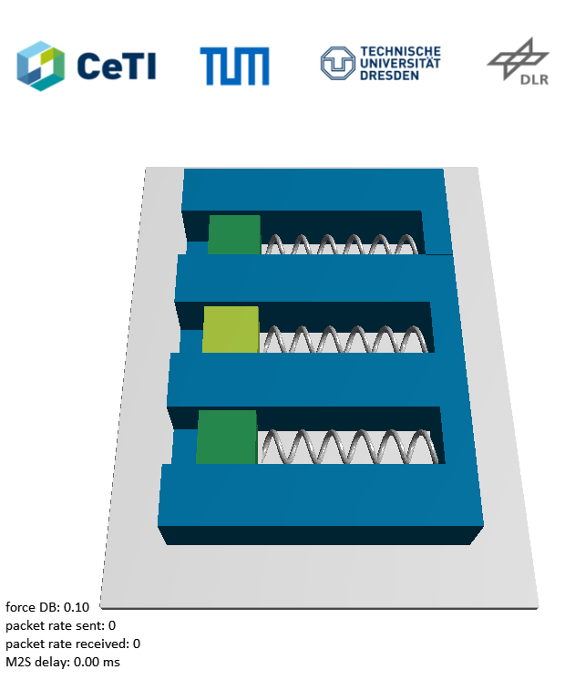

Task Selection
Select the task to start the test
Stiffness Discrimination
Letter Writing
Trial
Trial
Start Test
Start Test

Slide 3
Stiffness Discrimination: during test questions
Stiffness Discrimination
Order the stiffness of the springs:
Highest: → Here there should be options for yellow, green, blue
Middle:
Lowest:
Give a scale between 1 and 9 to the stiffness of the springs if the spring with green block has stiffness of 5
Yellow → Here there should be options from 1 to 9 to select
Red
Rate your experience: → Here there should be options from 1 to 10 to select
(1: very bad. 10: very good)
Once clicked next, the code should wait a while to restart the test with new parameters
Next

Slide 4
Stiffness Discrimination: finished
Stiffness Discrimination
You have finished the stiffness discrimination task!
Main menu
Usability Questionnaire

Slide 5
Letter Writing: during test questions
Letter Writing
Rate your experience: → Here there should be options from 1 to 10 to select
(1: very bad. 10: very good)
How accurate do you think
you performed the task? → Here there should be options from 1 to 10 to select
(1: very bad. 10: very good)
How difficult was the task ? → Here there should be options from 1 to 10 to select
(1: very easy. 10: very difficult)
Once clicked next, the code should wait a while to restart the test with new parameters
Next

Slide 6
Paint: finished
Paint task
You have finished the paint task!
Main menu
Usability Questionnaire

Slide 7
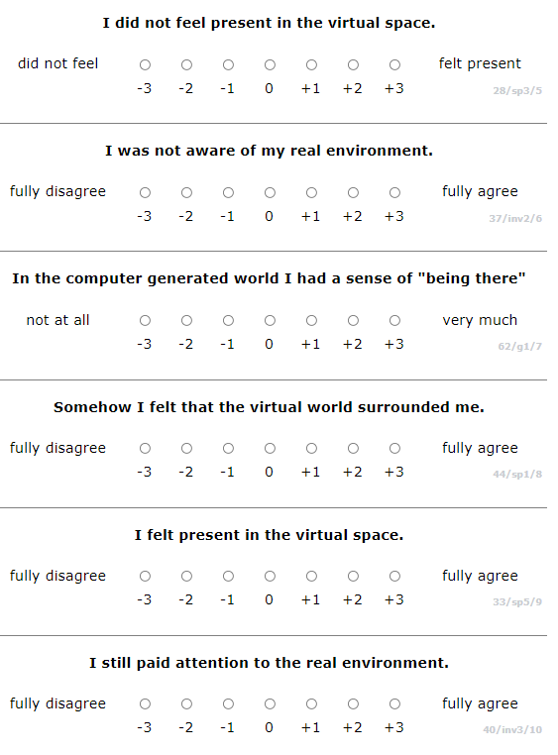
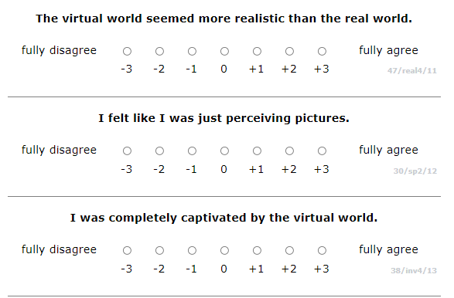
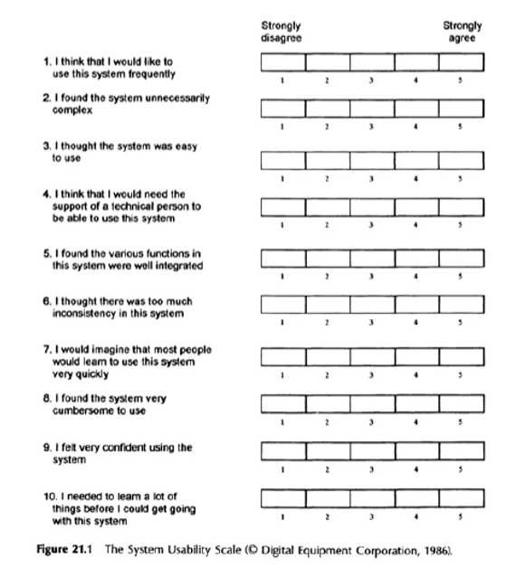
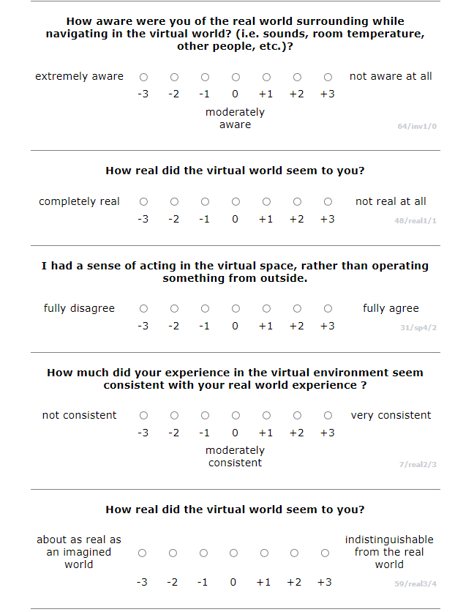
Usability Questionnaire
http://www.igroup.org/pq/ipq/ipq_english.htm

