Slide 1



ANALYSIS OF INDIA ELECTION DATASET
Project Guide
DR. C. S. KANIMOZHI SELVI
Head of the Department
Department Of AI
PROJECT MEMBER
MOHAMED ARSATH H H(22ADR064)
MOHAMMED SAMEER B(22ADR066)
PALANIMURUGAN V(22ADR075)

Slide 2
OBJECTIVE
To Help political parties and candidates understand voting patterns and performance using data, so they can plan better for future elections.
Give voters easy access to election results, allowing them to see how the parties and candidates they voted for performed.
Identify key factors like regional strengths, community influence, and voting trends to improve campaign strategies.

Slide 3
DATASET
https://www.kaggle.com/datasets/awadhi123/indian-election-dataset
This database contains detailed candidate‐level data for elections to the lower houses of India’s national legislatures, i.e., the Lok Sabha
The Dataset consists of 73,082 rows and 11 columns.

Slide 4
DATASET PREPROCESSING
Imported the dataset into Power BI Desktop and checked for any errors or missing values.
Renamed some column names and values for improved clarity and understanding.
Applied necessary data transformations to ensure consistency and accuracy for analysis.

Slide 5
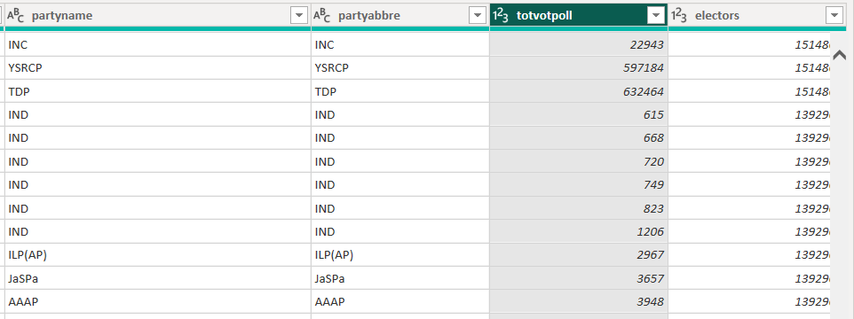
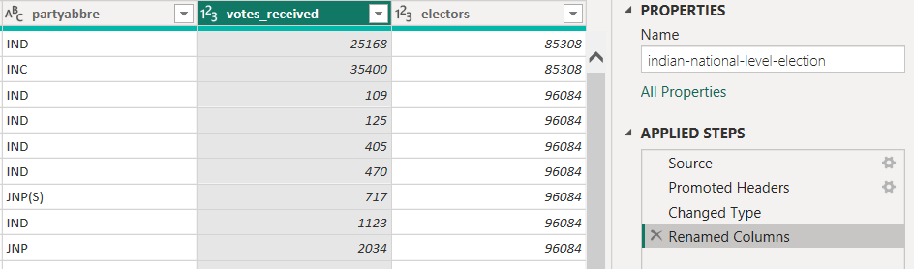
ANALYSIS ON DATASET
Name the column totvotpoll to Votes_received. What are the total votes received by each political party for every election year?
Inference: The column totvotpoll was renamed to votes_received, making it easier to understand and use for analyisis.

Slide 6
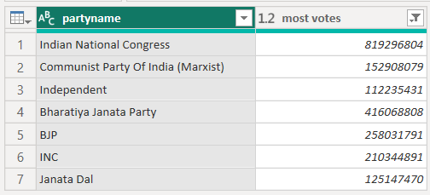
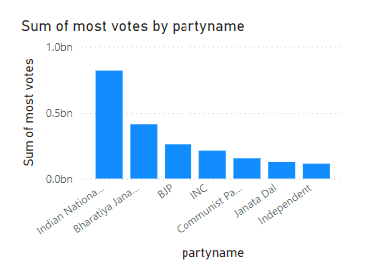
ANALYSIS ON DATASET
Which political party received the most votes in each year, and how did their performance change over the years?
Inference: A groupby partyname was done, and the total votes received for each party was calculated .Indian National Congress has received the most votes.

Slide 7
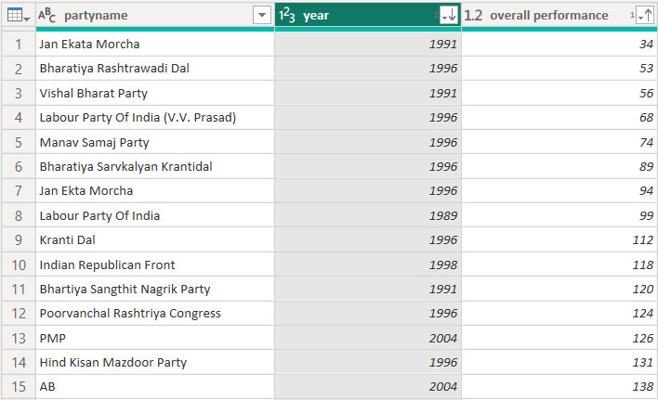
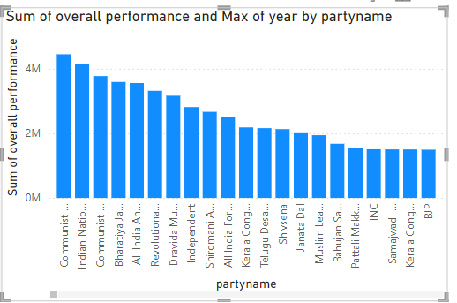
ANALYSIS ON DATASET
How has the overall performance of the top 8 political parties evolved over time in terms of total votes received?
Inference:
The data was grouped by partyname and year, and the total votes_received were shown. Thus the over all performance of the political parties has been shown.

Slide 8
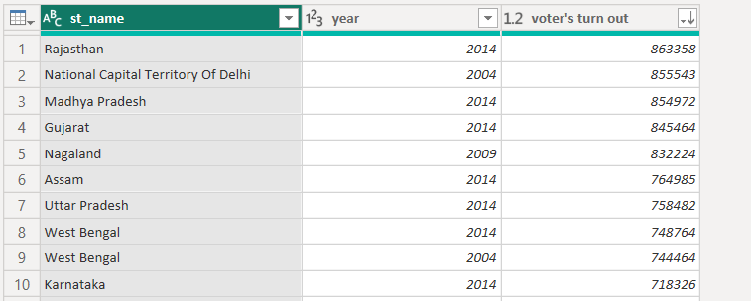
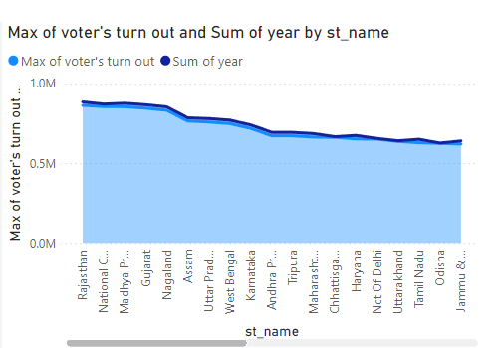
ANALYSIS ON DATASET
Which state had the highest voter turnout in each election year, and how does voter turnout vary across different states?
Inference:
The data was also grouped by st_name and year, focusing on the highest votes_received. Thus Rajasthan has the highest voter turnout in each election year.

Slide 9
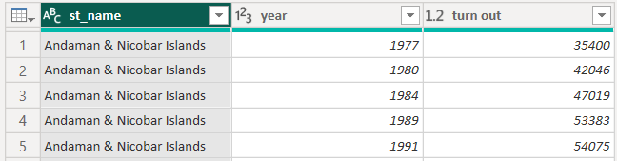
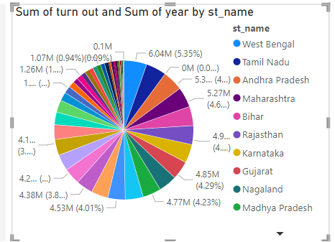
ANALYSIS ON DATASET
Which state had the highest number of candidates contesting in a particular year, and how did it affect voter turnout and election results?
Inference:
Andaman and Nicobar Islands have the highest number of candidates contesting in each election year.

Slide 10
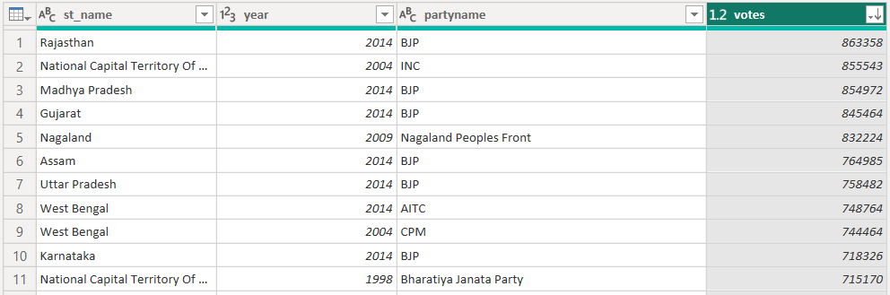
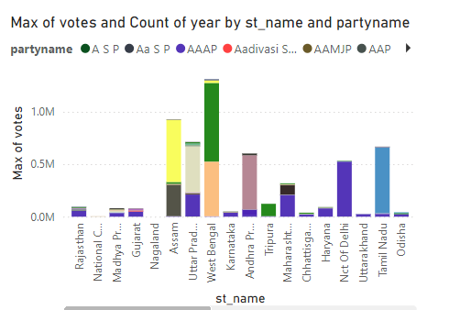
ANALYSIS ON DATASET
Which state had the highest and lowest votes received by a party in a given year? What does this reveal about state-level party dominance?
Highest:

Slide 11
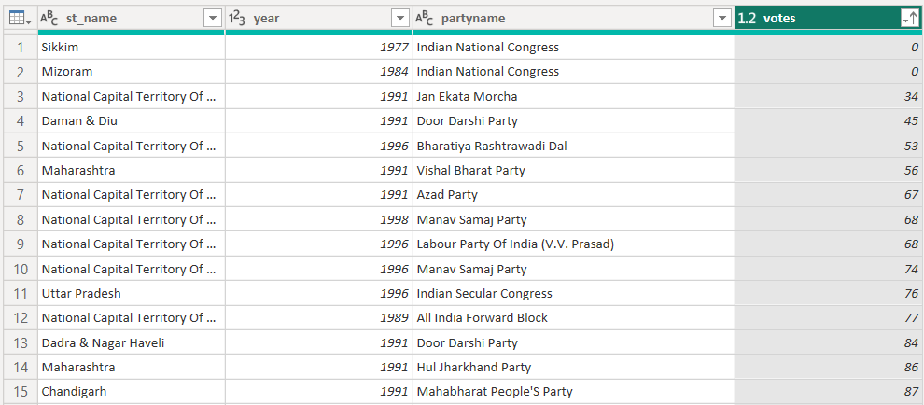
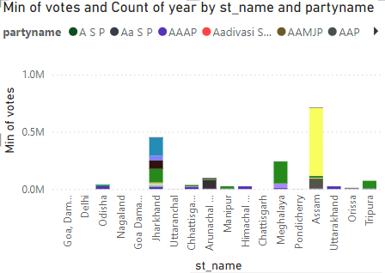
ANALYSIS ON DATASET
Lowest:
Inference:
Rajasthan has the highest number of votes received in the year 2014 and Sikkim has the lowest votes received in the year 1997.

Slide 12
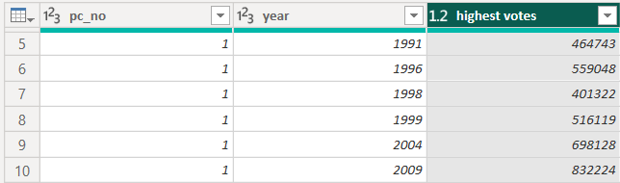
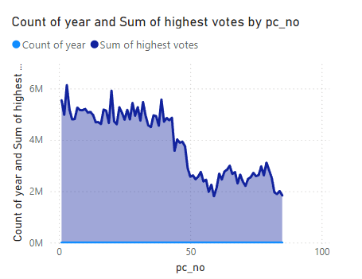
ANALYSIS ON DATASET
Which parliamentary constituency had the highest voter turnout in a specific year, and what factors contributed to this high turnout?
Inference:
Parliament constituency No:1 has the highest votes received in a specific year.

Slide 13
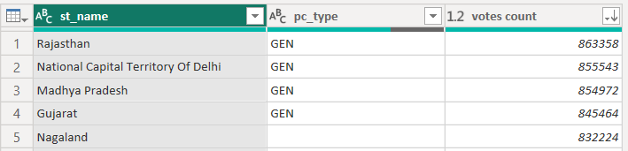
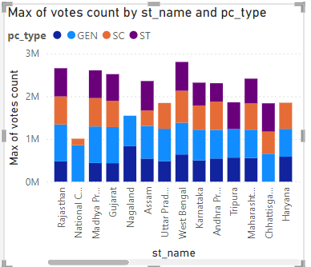
ANALYSIS ON DATASET
How do reserved constituencies compare to unreserved constituencies in terms of votes received by candidates and voter turnout?
Inference:
St_name and pc_type have been grouped to find how many votes were received by candidates and voter turnout. The visual is displayed to understand the difference based on pc_type (sc/st/general).

Slide 14
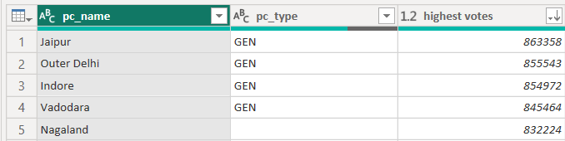
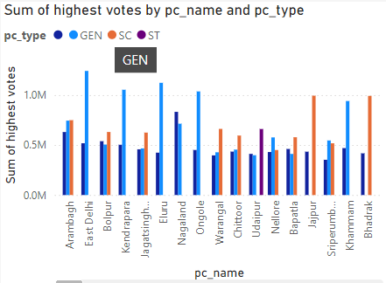
ANALYSIS ON DATASET
Did the reservation status of a constituency (SC/ST/General) affect the election results and voter turnout?
Inference:
The general and SC categories are high in some states hence this affects the election result and voter turnout.

Slide 15
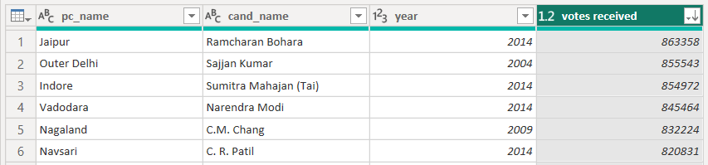
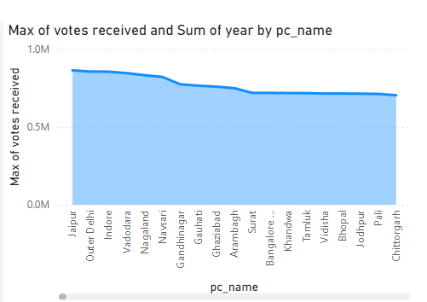
ANALYSIS ON DATASET
Who were the winning candidates in each constituency for each election year, and how many votes did they receive?
Inference:
The winners of each state with the number of votes received have been displayed as a bar chart using group by function.

Slide 16
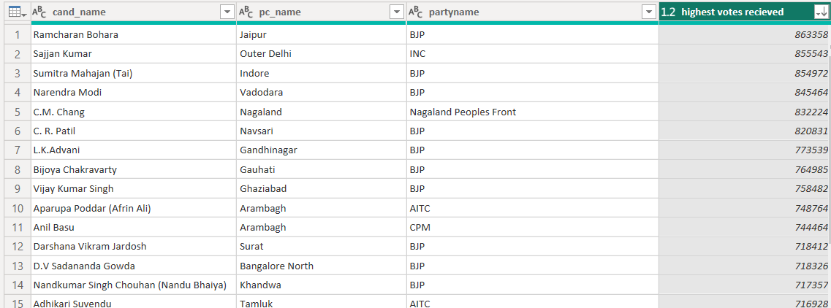
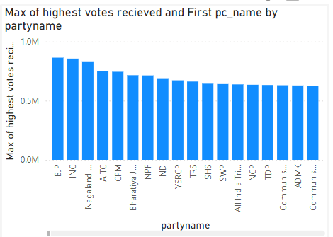
ANALYSIS ON DATASET
Who are the top-performing candidates in terms of total votes received, and which parties do they represent?
Inference:
Ramcharan Bohara is the highest votes received candidate from Jaipur representing the party BJP with a vote count of 863358.

Slide 17
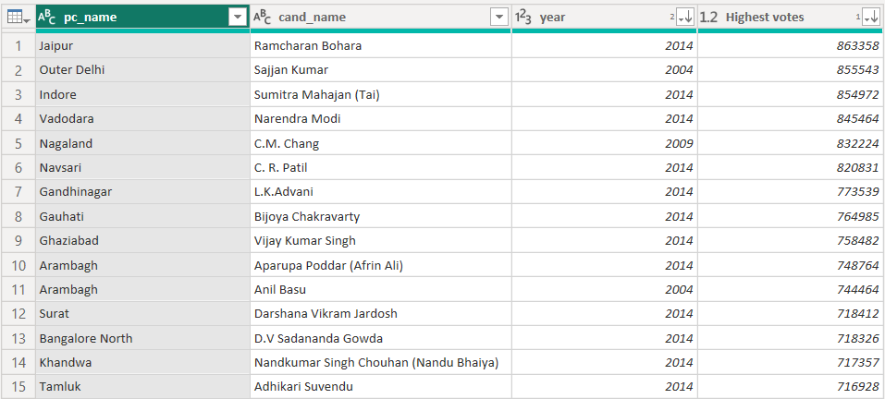
ANALYSIS ON DATASET
How has the performance of winning candidates evolved in constituencies over multiple elections?
Inference:
Jaipur has the performance of winning candidates evolved in constituencies over multiple elections.

Slide 18
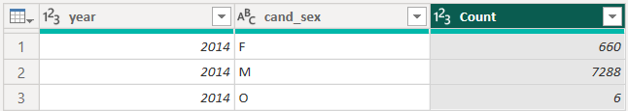
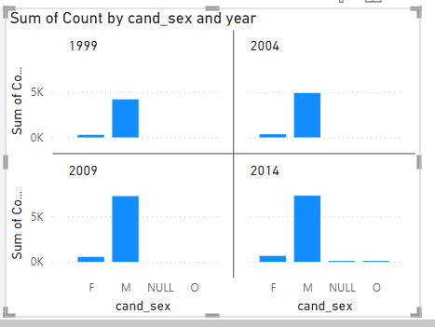
ANALYSIS ON DATASET
What is the gender distribution of candidates over the years, and how has this changed in recent elections?
Inference:
During each election year the number of male voters increased gradually when compared to the female voters.

Slide 19
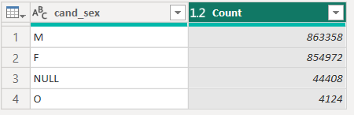
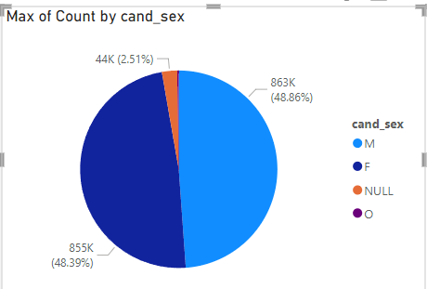
ANALYSIS ON DATASET
How do male and female candidates compare in terms of votes received and winning margins?
Inference:
Male candidates of 863358 and female candidates of 854972 have been voted in the election.

Slide 20
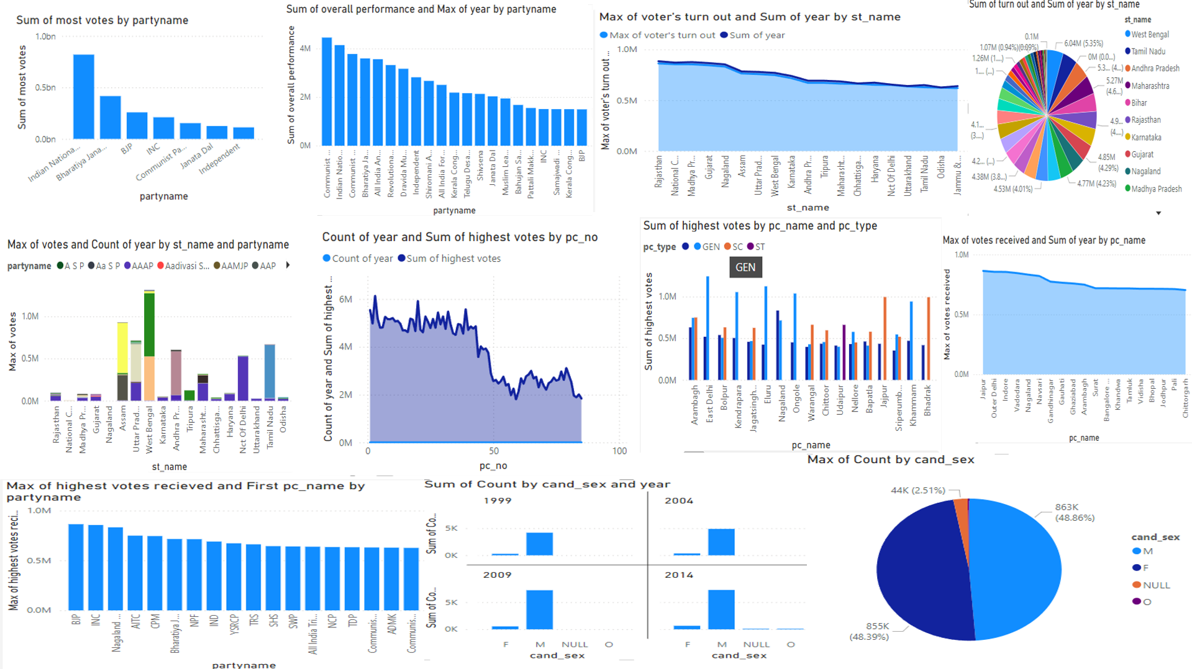
DASHBOARD

Slide 21
GITHUB LINK
Github: github.com/arsath-02/Indian-election-analysis

Slide 22
REFERENCE
Sharma, P., &Moh, T. S. (2016, December). Prediction of Indian election using sentiment analysis on Hindi Twitter. In 2016 IEEE international conference on big data (big data) (pp. 1966-1971). IEEE.
Brass, P. R. (1978). Indian election studies. South Asia: Journal of South Asian Studies, 1(2), 91-108.
Neyazi, T. A., & Schroeder, R. (2021). Were the 2019 Indian Election won by Digital media? The Communication Review, 24(2), 87-106.
Singh, H., & Shukla, A. K. (2021, December). An Analysis of Indian Election Outcomes using Machine Learning. In 2021 10th International Conference on System Modeling & Advancement in Research Trends (SMART) (pp. 297-306). IEEE.
Khan, A., Zhang, H., Boutella, N., Ahmad, A., Shang, J., Dai, L., & Hayat, B. (2021). Election Prediction on Twitter: A Systematic Mapping Study. Complexity, 2021.

Slide 23
THANK YOU

