Slide 1



Amazon Stock Price Prediction
MOHAMED ARSATH H
(22ADR064)

Slide 2
INTRODUCTION
Predicting Amazon's stock price involves analyzing technical indicators, financial health, and expert opinions.
Factors like market trends, economic conditions, and company performance play crucial roles in determining its future stock price.

Slide 3
OBJECTIVE
To develop a predictive model for Amazon's stock price using Long Short-Term Memory (LSTM) networks, with an emphasis on hyperparameter tuning and pipelining to enhance the model's accuracy and efficiency.

Slide 4
DATASET
LINK: https://www.kaggle.com/datasets/kaushiksuresh147/faang-fbamazonapplenetflixgoogle-stocks
There are 7 Attribute in the dataset
There are 80000 rows in the dataset

Slide 5
DATASET
Column | Description
Date | The date of the stock price data
Open | The opening price of the stock for the day
High | The highest price of the stock for the day
Low | The lowest price of the stock for the day
Close | The closing price of the stock for the day
Vol. | The trading volume for the day
Change % | The percentage change in the stock price from the previous day

Slide 6
ALGORITHMS USED
Frontend:
React + Tailwind css
Backend:
Flask
LSTM for training the dataset(LSTM is used for time series data)
Hosted:
Frontend – Netlify
Backend – render
6-Jun-24

Slide 7
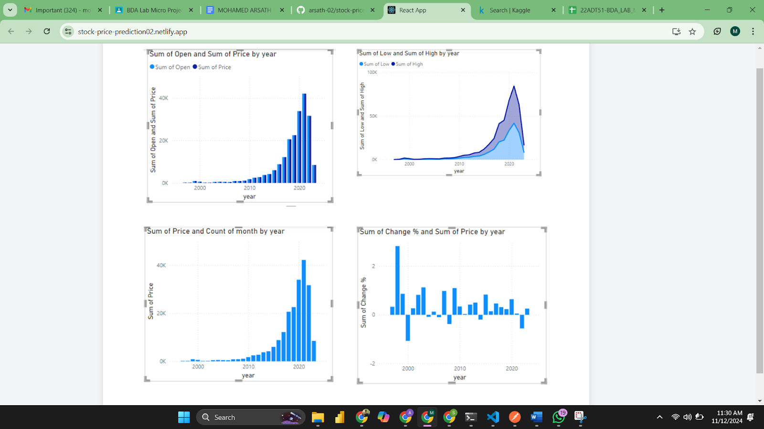
Analysis

Slide 8
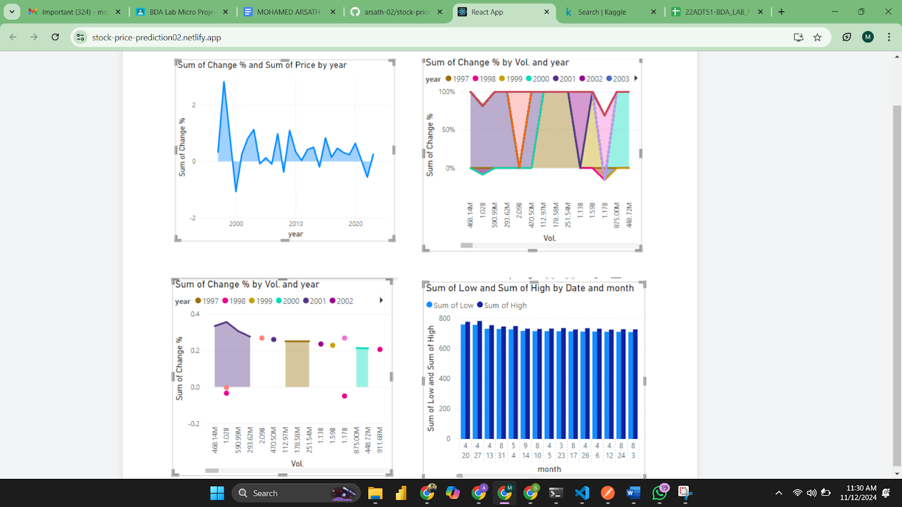

Slide 9
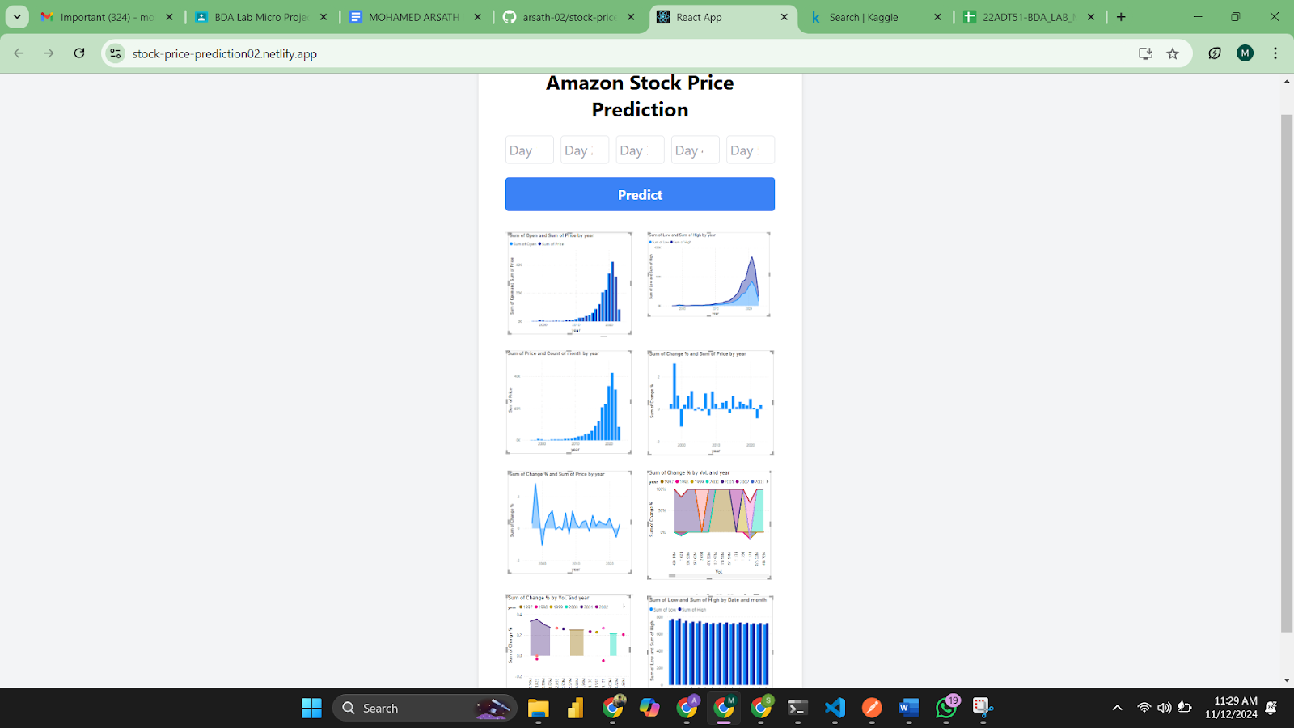

Slide 10
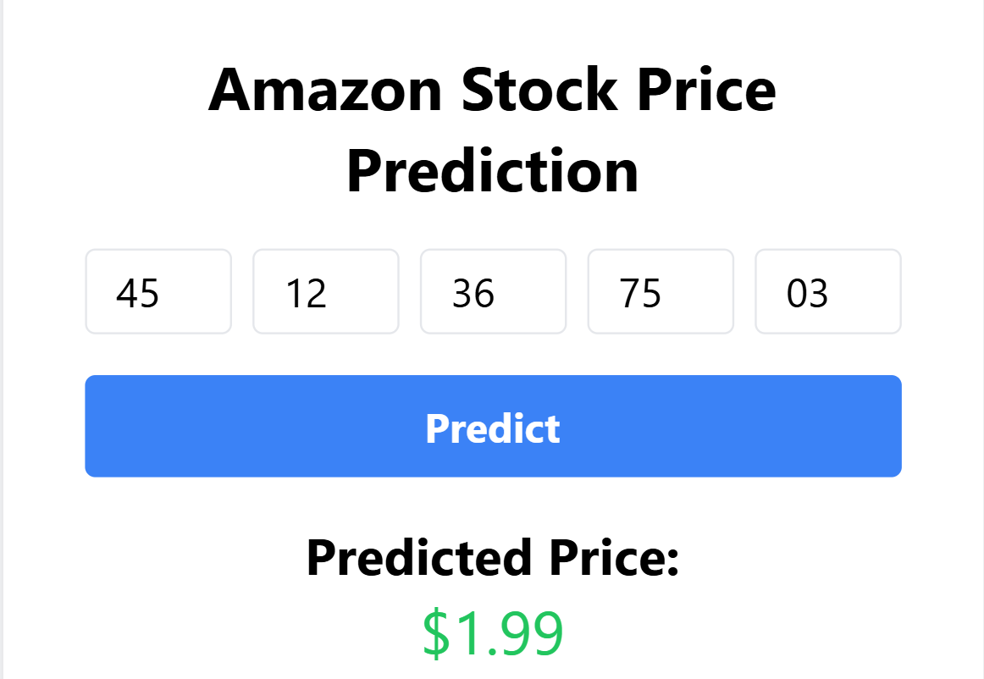

Slide 11
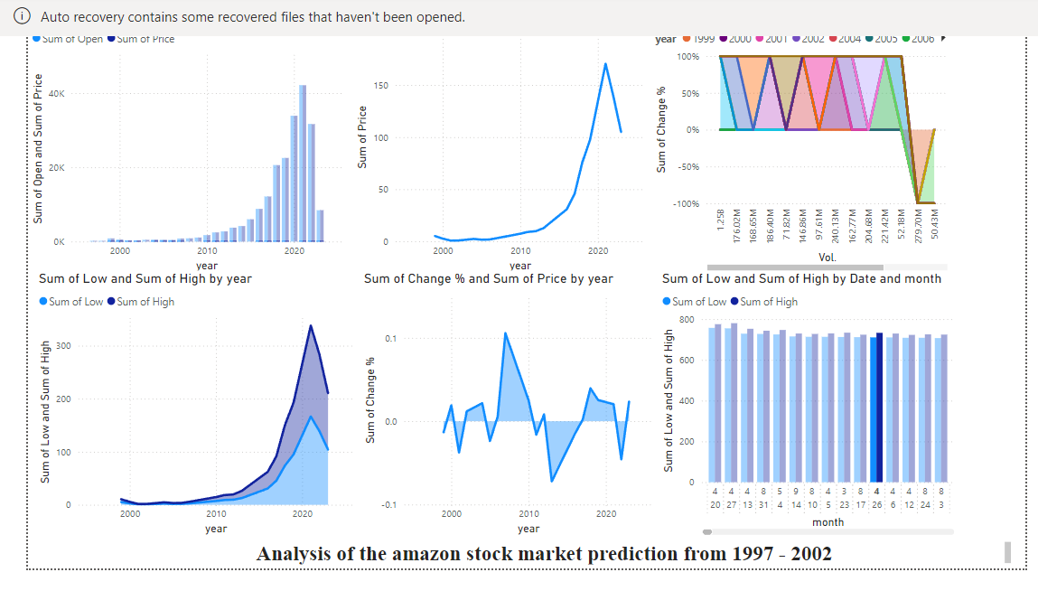
DashBoard:

Slide 12
Links
Github: https://github.com/arsath-02/stock-price-prediction
Host: https://stock-price-prediction02.netlify.app/

Slide 13
THANK YOU

