Slide 1



Text To Image Generator
MOHAMED ARSATH H(22ADR064)

Slide 2
INTRODUCTION
The project utilizes for generating images from text prompts and gives image description.
Combines state-of-the-art diffusion models and natural language generation to create images based on user input.

Slide 3
OBJECTIVE
To generate an Image by using user’s prompt.
And Generates the description of the image generated.
To Build a user-friendly API that converts text prompts into images.
To Generate relevant descriptions for the generated images.

Slide 4
LITERATURE SURVEY
MobileDiffusion: Rapid Text-to-Image Generation on Mobile Devices (2023)
Controllable Generation with Text-to-Image Diffusion Models: A Survey (2023)
Latent Diffusion Models for High-Quality Image Synthesis (2022)
Imagen: Efficient Text-to-Image Generation Using Large Language Models (2022)
DiffusionGAN: Combining GANs and Diffusion Models for Fast Image Generation (2023)

Slide 5
EXISTING SYSTEM
GAN-based Models
Transformer-based Architectures
CLIP-Guided Models
Diffusion-based Models
Large Language Models with Image Generation Capabilities

Slide 6
PROPOSED SYSTEM
Text prompt input from the user.
Generate images using the Stable Diffusion pipeline.
Create a description using GPT-2.
Serve the model through Flask and deploy using Ngrok.
Key Features:
Fast and efficient image generation (35 steps).
Optimized image size (400x400).
Interactive image generation API.

Slide 7
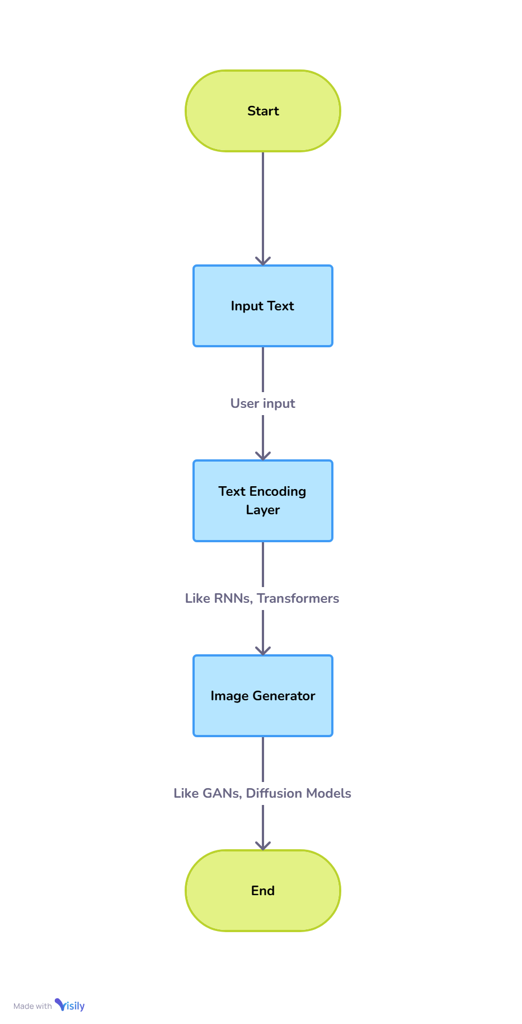
Flow Diagram

Slide 8
ALGORITHMS USED
Stable Diffusion to generate synthetic data from text and image prompts.
Stable Diffusion is a self-supervised method that learns from its own iterative refinement process.
6-Jun-24

Slide 9
Why stable diffusion
Efficiency and Accessibility
Scalable Resolution and Quality
Flexibility in Customization and Fine-Tuning
Advanced Diffusion Process with High-Quality Outputs
Wide Range of Creative and Practical Applications

Slide 10
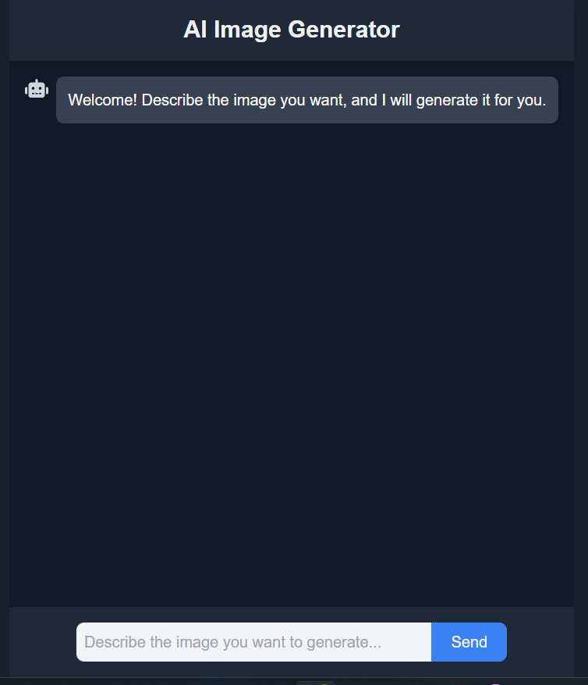
Implementation

Slide 11
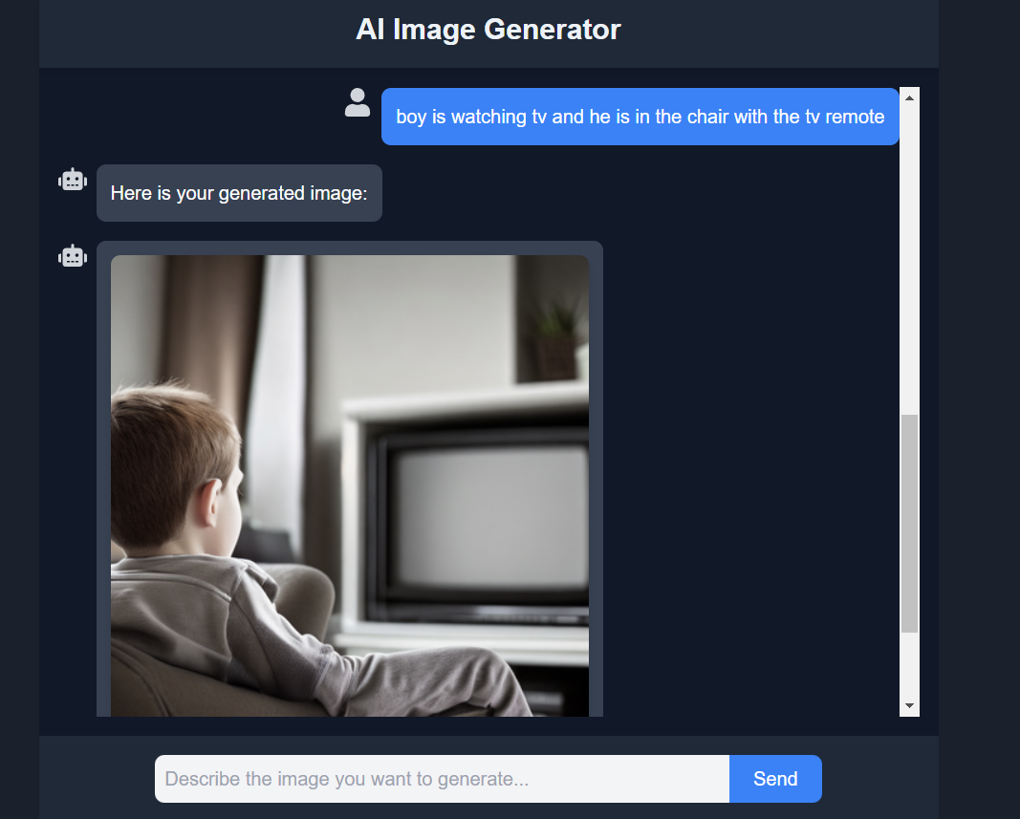

Slide 12
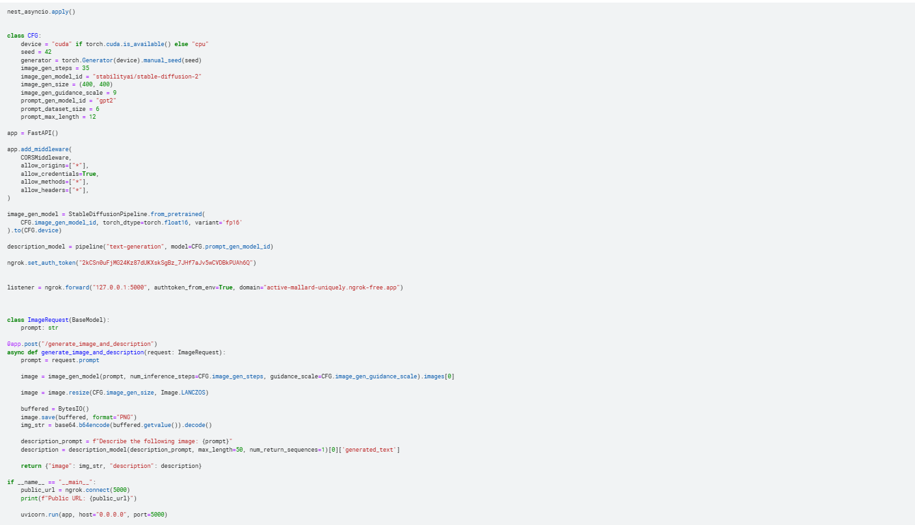

Slide 13
Links
Github: https://github.com/arsath-02/text-to-image-generator
Host: https://text-to-image-generator02-6469.vercel.app

Slide 14
Reference
Ho, J., Jain, A., & Abbeel, P. (2020). Denoising diffusion probabilistic models. Advances in Neural Information Processing Systems, 33, 6840-6851
Ramesh, A., Pavlov, M., Goh, G., Gray, S., Voss, C., Radford, A., ... & Sutskever, I. (2021). Zero-shot text-to-image generation. In International Conference on Machine Learning (pp. 8821-8831). PMLR.
Goodfellow, I., Pouget-Abadie, J., Mirza, M., Xu, B., Warde-Farley, D., Ozair, S., ... & Bengio, Y. (2014).Generative adversarial nets. Advances in neural information processing systems, 27.
Reed, S. E., Akata, Z., Yan, X., Logeswaran, L., Schiele, B., & Lee, H. (2016). Generative adversarial text to image synthesis. arXiv preprint arXiv:1605.05396.

Slide 15
THANK YOU

