Slide 1
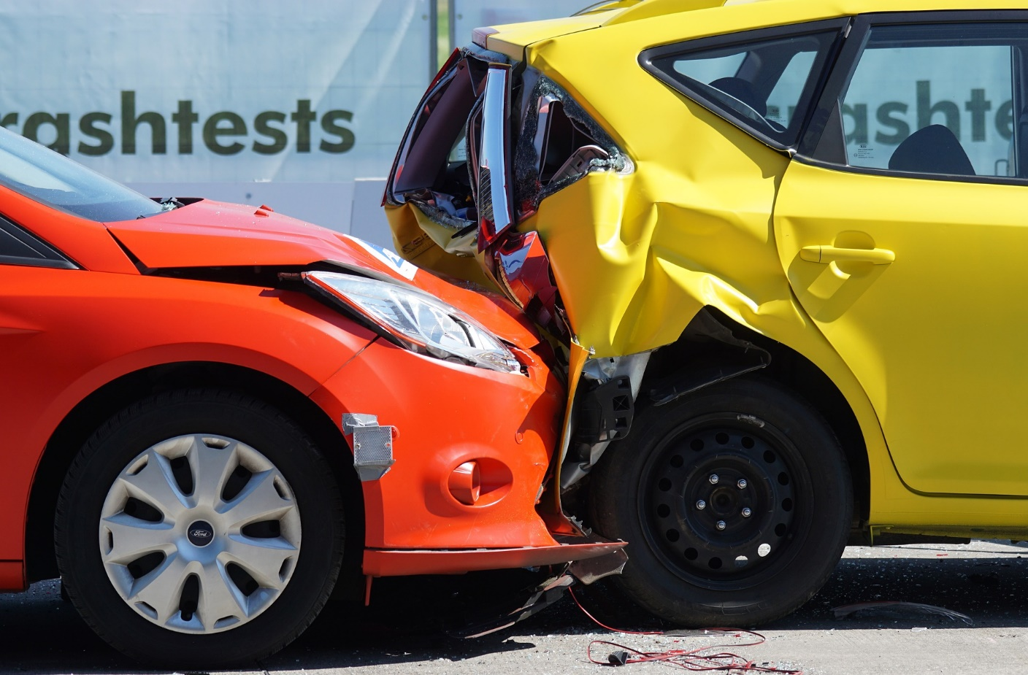
Balanced and Unbalanced Forces
© The Science Duo

Slide 2



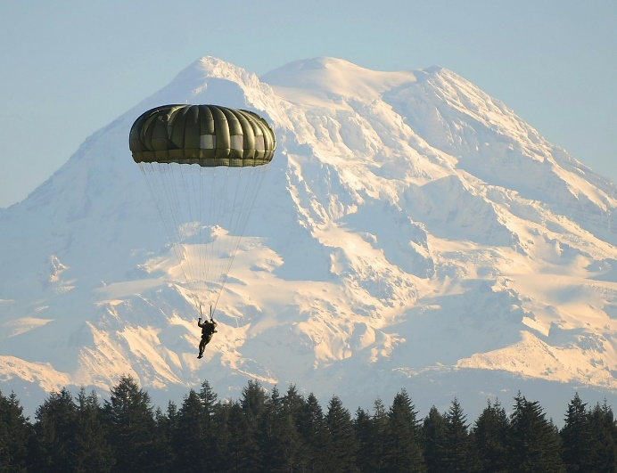
Force
A push or pull on an object
Able to change the motion of an object
Gravity, friction, and air resistance are three common forces on Earth
Gravity
Friction
Air Resistance

Slide 3
Net Force
The overall force exerted on an object; measured in Newtons (N)
If the net force is 0, then a change in motion will not occur
If the net force is greater than 0, then a change in motion will occur
Net Force
5 N + 7 N = 12 N

Slide 4
Net Force
How to calculate net force from a picture or diagram
Subtract the forces if the arrows are pointed toward each other or pointed away from each other
Add the forces together if the arrows are all pointed the same direction
OR
OR
Practice problem(s) on checkpoint at the end.

Slide 5
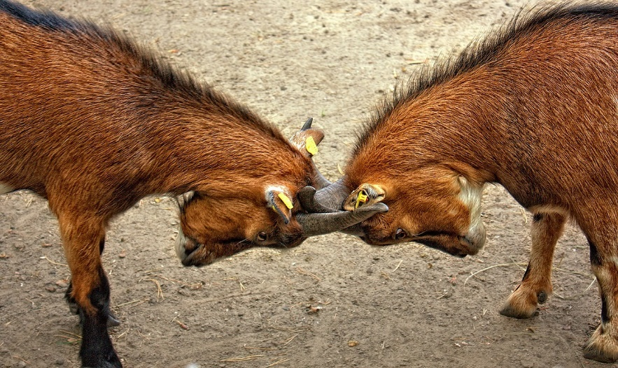
Balanced Forces
Equal forces that do not cause a change in an object’s motion (Net Force = 0 Newtons)
The net force on an object must be calculated in order to determine if it is balanced or unbalanced
BALANCED
50 N
50 N
50 N – 50 N = 0 N

Slide 6
Balanced Forces Examples
Forces are balanced when the net force = 0 Newtons
A cell phone resting on the counter
Tying an arm wrestling match
A picture hanging on the wall
Any object with no motion
Any object moving at a constant speed

Slide 7

Unbalanced Forces
Unequal forces that cause a change in an object’s motion
Cause a change in speed and/or direction of an object – moves the direction of the greater force
UNBALANCED
100 N
50 N
100 N – 50 N = 50 N

Slide 8
Unbalanced Forces Examples
Forces are unbalanced when the net force does not equal 0 Newtons
A football player tackling a quarterback
Pushing a lawnmower across the yard
A skydiver falling toward the ground
Any object that is speeding up, slowing down, or changing direction (accelerating)

Slide 9

Checkpoint
5 checkpoint questions
Discuss each question with a partner
Write a complete answer to each question on your notes page

Slide 10

Question 1
Calculate the net force exerted on the box.
65 N
30 N
Which direction will the box move?

Slide 11
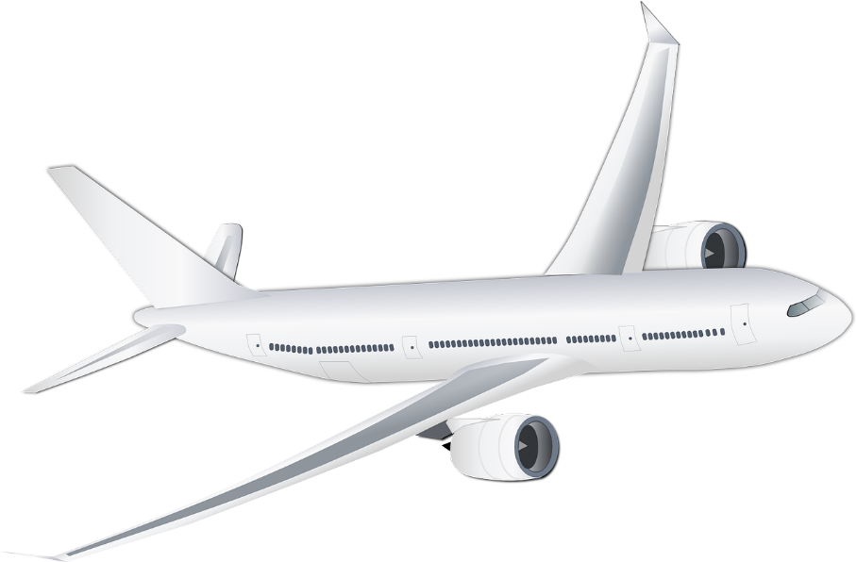
Question 2
Balanced or Unbalanced Forces?
75 N
200 N
50 N
175 N

Slide 12
Question 3
Which direction will the airplane move?
75 N
200 N
50 N
175 N

Slide 13
Question 4
Why would an object moving at a constant speed experience balanced forces?

Slide 14
Question 5
Identify one example of balanced and unbalanced forces in the room.

