Slide 1


Final Project Discussion
of NLDC:
UNIVERSITÀ DEGLI STUDI DI NAPOLI FEDERICO II
Analysis and Control of a Non-Linear Active Suspension System
Student : Hudyma Arsen
DIPARTIMENTO DI INGEGNERIA ELETTRICA E DELLE TECNOLOGIE dell’Informazione
Corso di Laurea Magistrale in Ingegneria dell'Automazione e Robotica (P38)

Slide 2
Introduction
The goal of this project is to analyze and develop and Active Suspension System, which function is to improve comfort and also maintain contact between tire and the road for stability and safety issues.
In the next slides there will be the mathematical model of the quarter car enhanced with Non-Linearities, then an Open-Loop analysis will be perfomed to prove stability and also to see the reference performance of the passive system.
The implemented controllers are respectively an LQR controller on the linearized system but also a Non-Linear MPC which will be tested also in the case of parametric uncertainties and disturbances.
Here’s a general example on how it works:
1

Slide 3
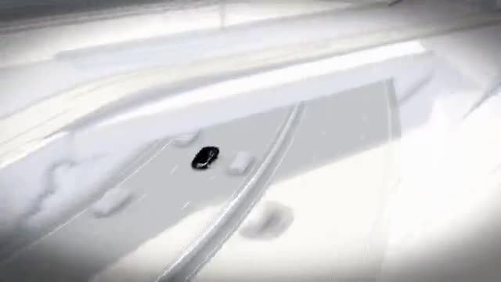
Introduction
2

Slide 4
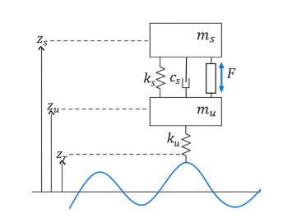
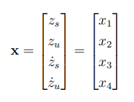

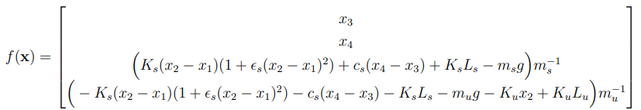
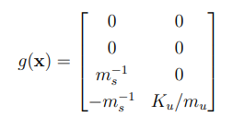

NL Quarter Car Model
The Quarter-Car model of a suspension can be visualized as this scheme of two masses, which represent the car and the tire:
In order to present it’s ISO form, the states and inputs are respecitvely:
Thus:
3

Slide 5
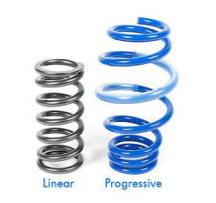
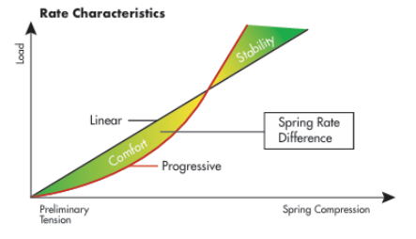
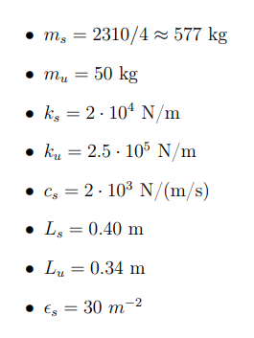
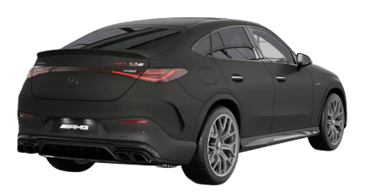
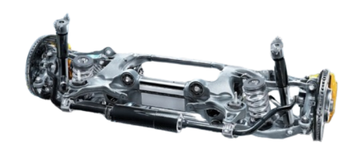
NL Quarter Car Model
In this model there’s a Non-Linear spring, which is obtained for example via the progressive springs:
The parameters were taken from this Mercedes model:
4

Slide 6
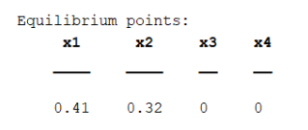
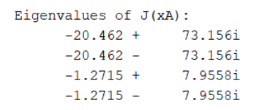
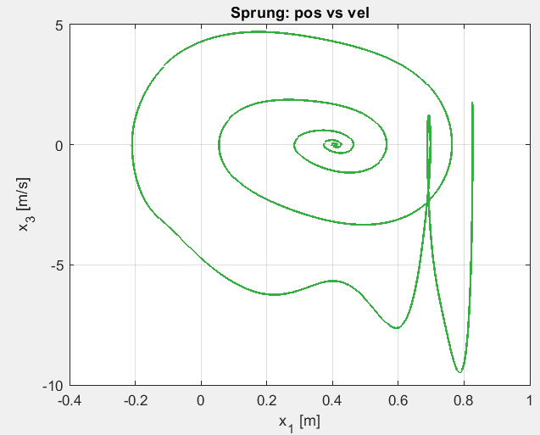
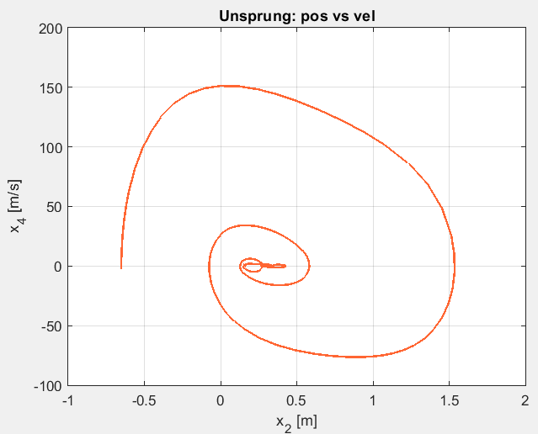
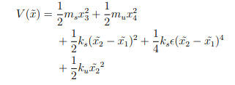


Open-Loop Analysis
The natural, single equilibrium point of the system is also intuitively locally stable, being a spiral sink:
Through Lyapunov and La Salle we can even prove that the system is GAS:
5

Slide 7




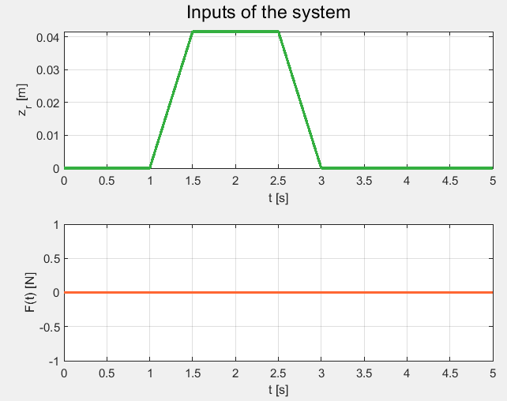
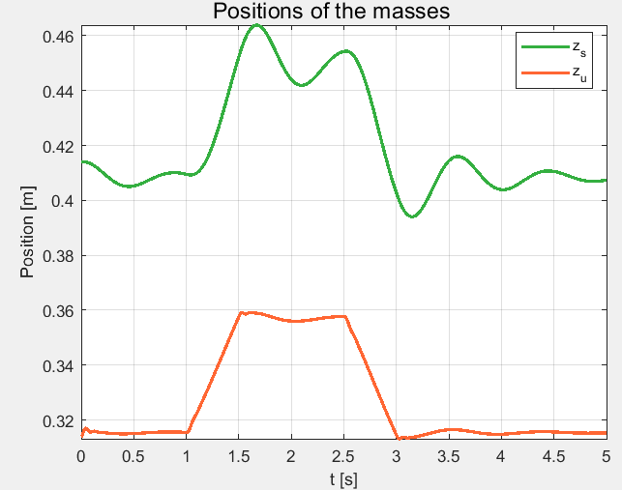
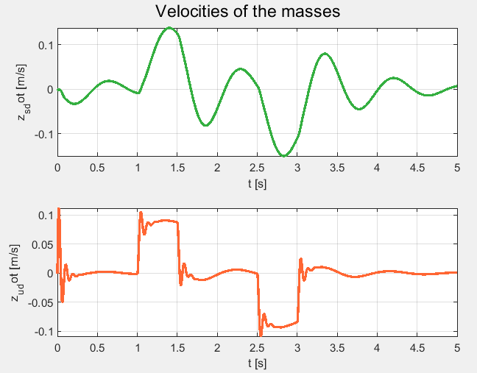
Open-Loop Analysis
If we consider those performance indexes:
Then we can evaluate the passive suspension performance:
6

Slide 8


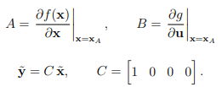
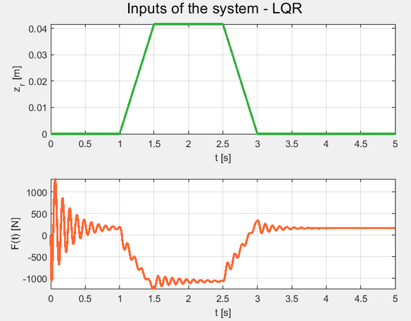
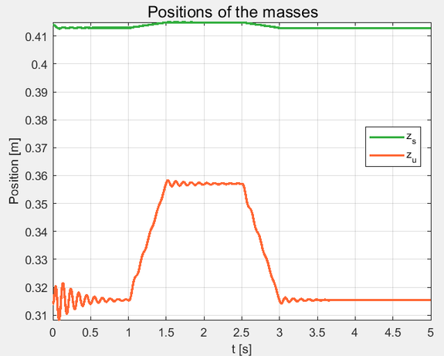
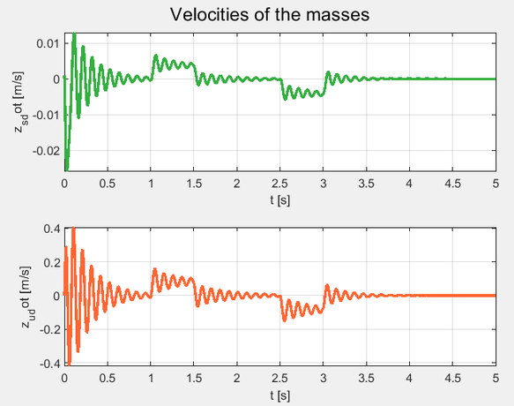
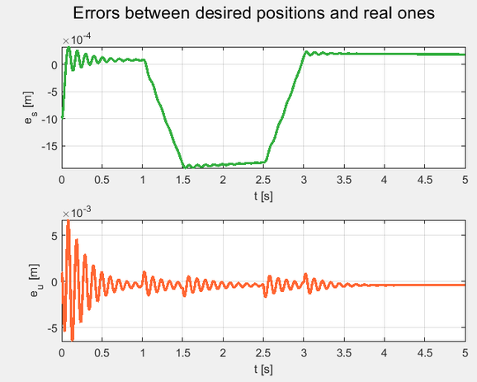
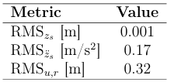



Synthesis
The first controller to be implemented is LQR and it’s developed around the system’s equilibrium point, an integral action is also added to robustenss:
7

Slide 9
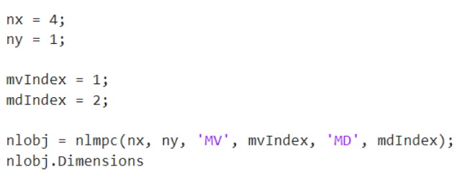
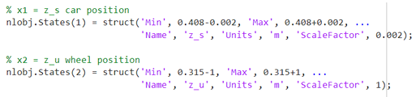
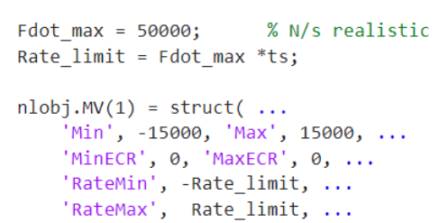
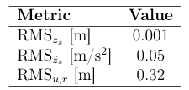
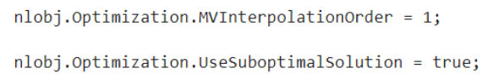
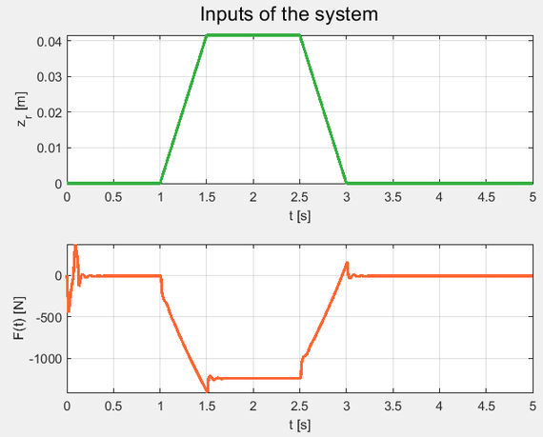
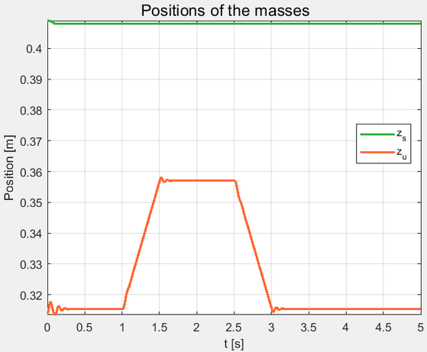
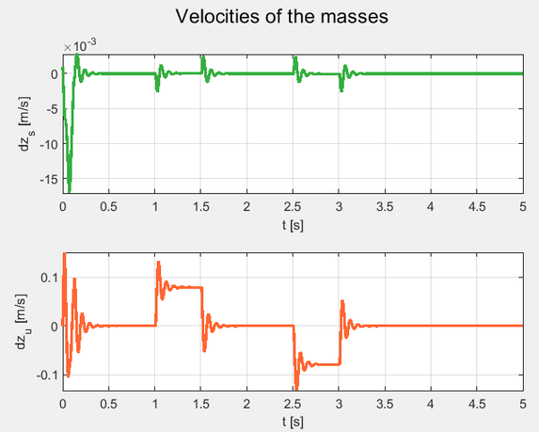
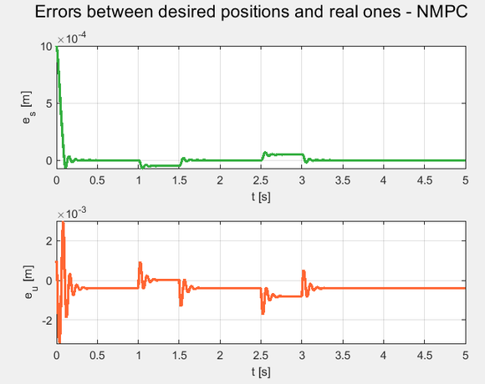
Synthesis
NLMPC was instead implemented via the hononimous matlab’s object class, thus for example it was easy to implement weights on the states, inputs and extra options like suboptimal solutions:
8

Slide 10
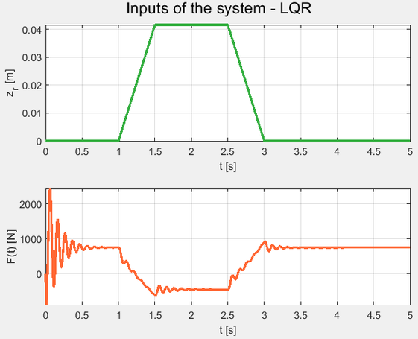
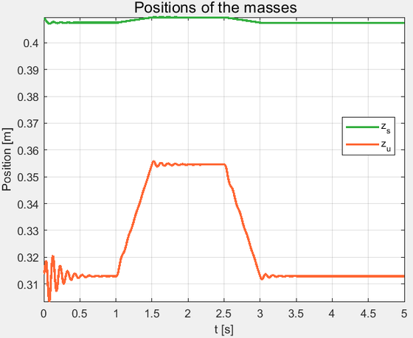
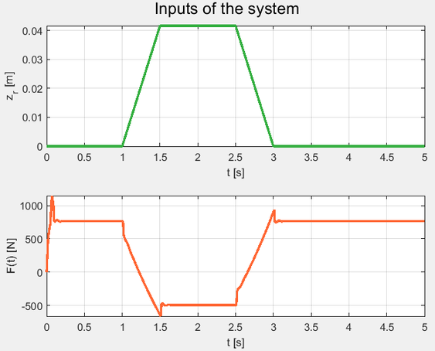
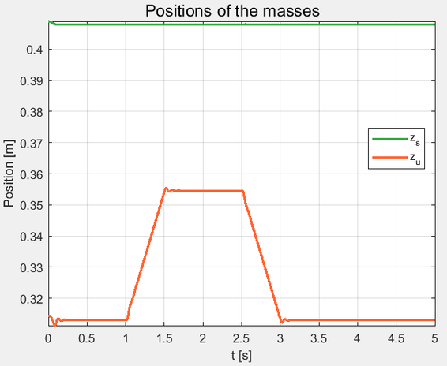
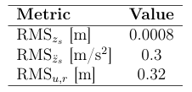
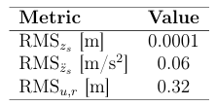
Robustness
The first unpredicted situation that was considered consists in taking into account also the mass of each person sitting next to each wheel, on the left there’s LQR and on the right NLMPC:
9

Slide 11
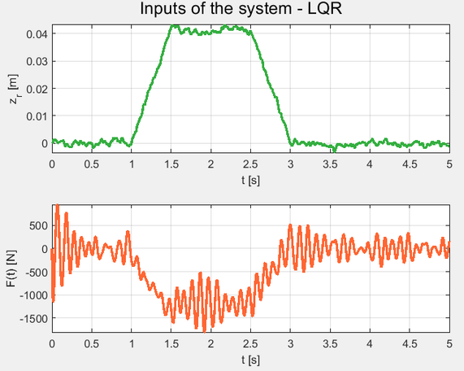
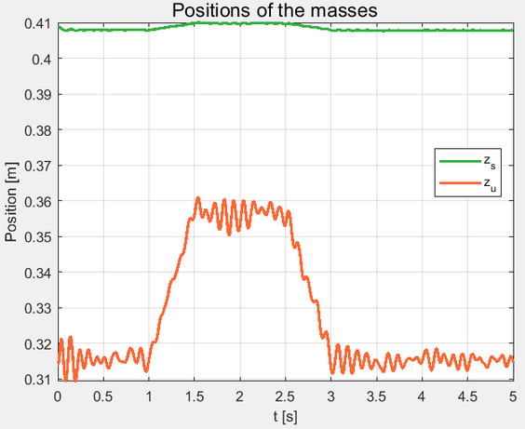
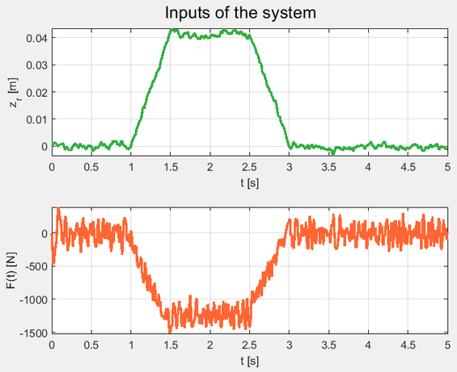
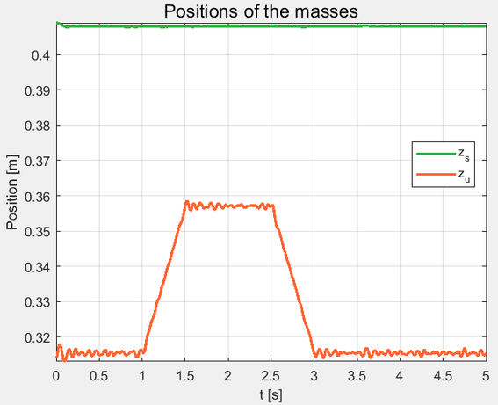
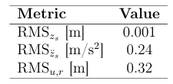
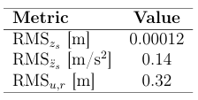
Robustness
The secont situation consistes in adding to the control system the noise from the road sensor (3mm):
10

Slide 12



Conclusions
The optimality of the choosen controllers seems to perform really fine with respect to the passive system, even LQR. The main advantage of NLMPC is the prediction capabilities, by which it can act better and with a lower force.
The uncertainty of the parameters affect the force mainly, without losing performance, but one problem that could arise is the saturation, that gets worse with a greater weight of the car but also with a worse and bigger amplitude of the road profile.
The sensor’s noise instead is more critical, so there is the need to treat appropriately this kind of problem, because it generates greater vibrations.
Since by construction the wheel tends to follow the road profile, here’s the comparison in terms of the RMS of the car’s position (up) and acceleration (low) respectively of LQR (left) and NLMPC (right):
11

