Slide 1
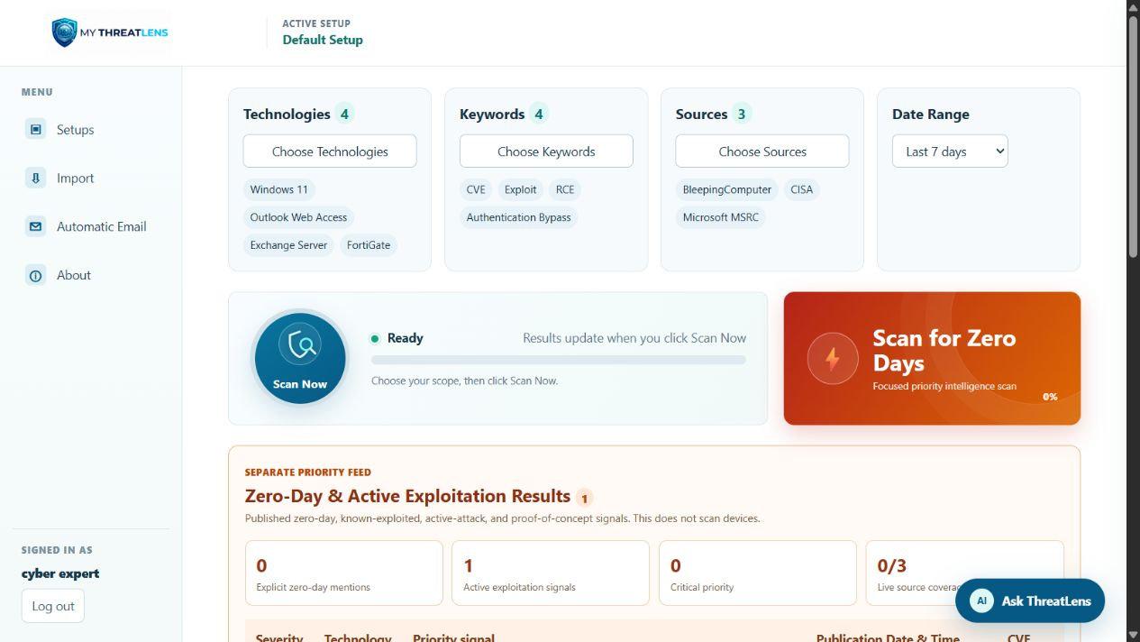
CYBERSECURITY INTELLIGENCE WORKSPACE
My ThreatLens
Every security headline.
One clear view.
A technical and non-technical guide to monitoring, prioritizing, reviewing, and sharing relevant public threat intelligence.
Local security intelligence workspace
2026
Notes:
Introduce the project as a focused review layer for public cybersecurity intelligence. Emphasize that the product organizes evidence around the user's technology scope.
[Sources]
- My ThreatLens local application and repository (accessed 2026-08-16)
[/Sources]

Slide 2
PRODUCT OVERVIEW
02
One workspace, four jobs
01
Monitor
02
Prioritize
Collect matching public advisories and security reporting.
Surface severity, exploitation signals, and the biggest current threat.
03
Investigate
04
Communicate
Open evidence, CVEs, relevance explanations, and finding-specific questions.
Email one or many findings or export the filtered view to Excel.
MY THREATLENS · LOCAL EDITION
Notes:
Explain the product in plain language before discussing technical architecture. Each stage maps to a visible user action in the application.
[Sources]
- My ThreatLens local application and repository (accessed 2026-08-16)
[/Sources]

Slide 3
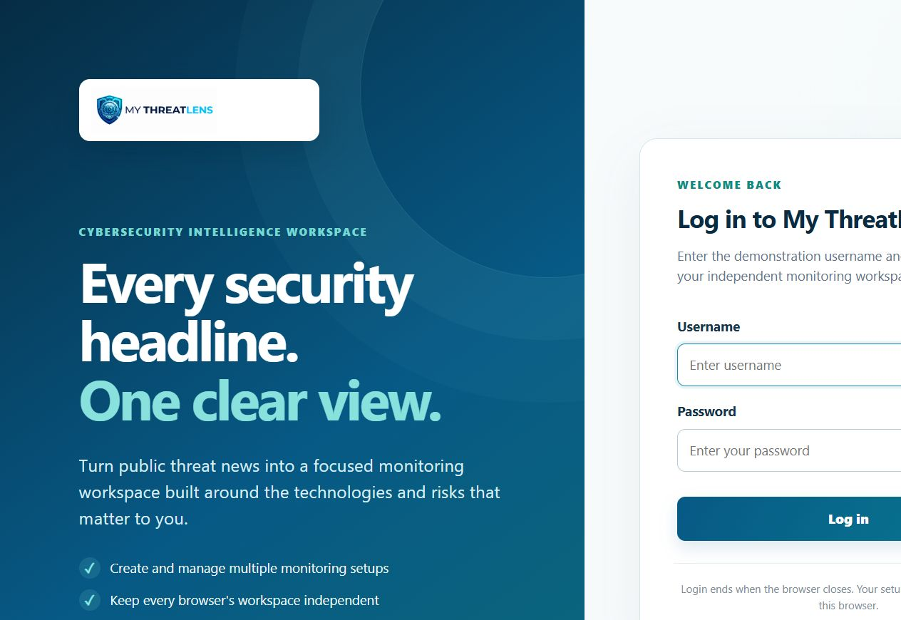
ACCESS MODEL
03
Local accounts, independent workspaces
What happens
Local account login
Each user creates a unique username and strong password; no email address is required.
Account-owned workspace
Every setup and automatic-email configuration is scoped to its owning account.
Database persistence
Search parameters and setups remain available after logout, browser closure, or restart.
MY THREATLENS · LOCAL EDITION
Notes:
Each local user creates a unique account. The authenticated user ID scopes setup and automation records in SQLite.
[Sources]
- My ThreatLens local application and repository (accessed 2026-08-17)
[/Sources]

Slide 4
USER WORKFLOW
04
From scope to supervisor-ready output
1 · SCOPE
2 · SCAN
3 · REVIEW
4 · SHARE
Choose relevance
Collect intelligence
Validate evidence
Communicate action
Technologies, keywords, sources, and dates
Normal or focused zero-day intelligence scan
Severity, CVE, source, exploit status, AI context
Single finding, selected findings, filtered email, or Excel
MY THREATLENS · LOCAL EDITION
Notes:
Walk left to right. The key control is that changing the scope requires a new scan, preventing old and new results from being silently mixed.
[Sources]
- My ThreatLens local application and repository (accessed 2026-08-16)
[/Sources]

Slide 5
DASHBOARD
05
A scoped view of what deserves attention
Scope cards
Technology, keywords, source, and date-range choices.
Biggest threat
The highest-priority result with a one-click email action.
Findings table
Filterable evidence with CVE, source, AI relevance, and review actions.
MY THREATLENS · LOCAL EDITION
Notes:
Use the screenshot to orient the audience. The dashboard does not declare a system vulnerable; it displays relevant published findings for analyst validation.
[Sources]
- My ThreatLens local application and repository (accessed 2026-08-16)
[/Sources]

Slide 6
TECHNICAL PIPELINE
06
How a scan becomes a finding
INPUT
COLLECT
NORMALIZE
MATCH
PRIORITIZE
OUTPUT
Saved setup scope
→
Approved public feeds
→
Title, text, CVEs, date
→
Technology + keyword aliases
→
Severity, KEV, exploitation
→
Dashboard, email, Excel
Collector failures are isolated. Results report which sources answered, so incomplete coverage is visible.
MY THREATLENS · LOCAL EDITION
Notes:
Technically, FastAPI coordinates collectors, matching aliases, scoring, persistence, and output APIs. The collector safety wrapper prevents one source exception from leaving a scan stuck.
[Sources]
- My ThreatLens local application and repository (accessed 2026-08-16)
[/Sources]

Slide 7
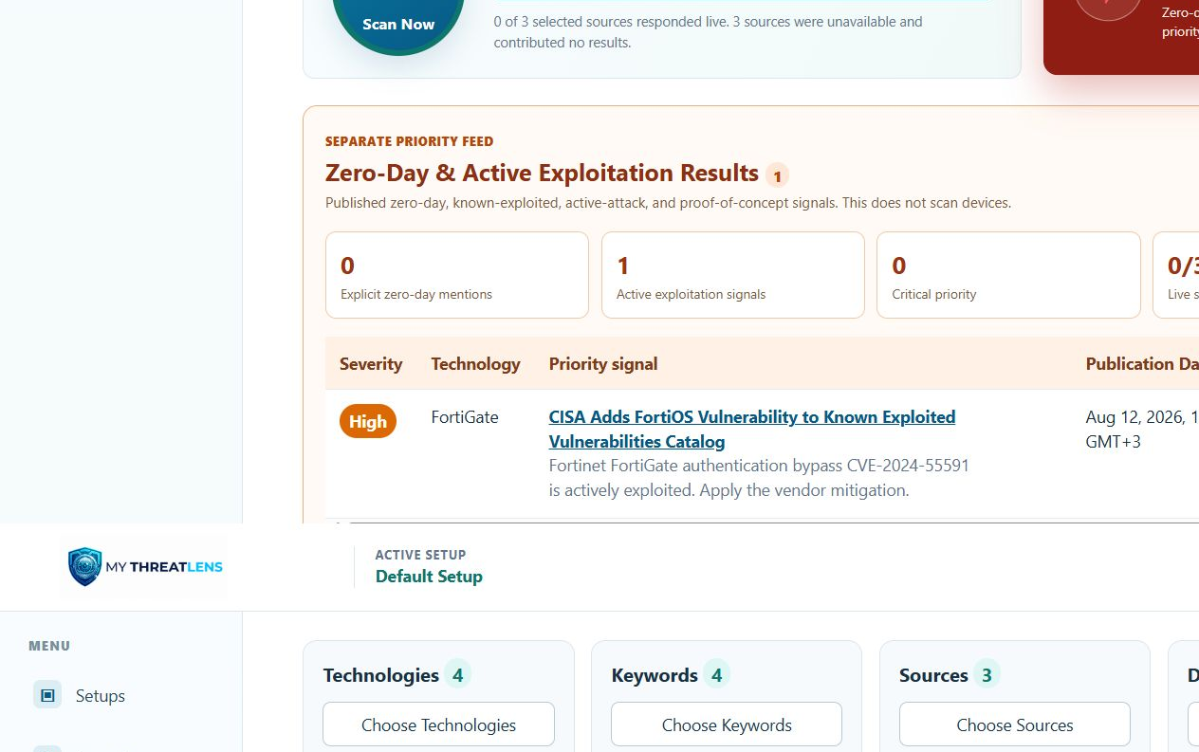
FOCUSED INTELLIGENCE
07
Zero-day & active-exploitation scan
What it detects
• explicit zero-day mentions
• active exploitation language
• CISA KEV signals
• public proof-of-concept reporting
What it cannot prove
It monitors published intelligence. It does not inspect devices or prove whether a specific asset is exposed.
MY THREATLENS · LOCAL EDITION
Notes:
Distinguish a zero-day intelligence scan from endpoint or network scanning. The application reports explicit signal counts and live source coverage separately.
[Sources]
- My ThreatLens local application and repository (accessed 2026-08-16)
[/Sources]

Slide 8
INTERPRETING RESULTS
08
Three questions before acting
Treat every finding as a decision-support object. Priority improves when evidence, exposure, and source reliability agree.
01
02
03
Is it relevant?
Is exploitation real?
What is the response?
Does the affected technology and version exist in the monitored environment?
Look for KEV status, explicit active exploitation, credible vendor evidence, and dates.
Validate impact, follow vendor guidance, document ownership, and track remediation.
MY THREATLENS · LOCAL EDITION
Notes:
This is the human validation checkpoint. Severity alone is not enough; environment exposure and primary-source confirmation determine actual action.
[Sources]
- My ThreatLens local application and repository (accessed 2026-08-16)
[/Sources]

Slide 9
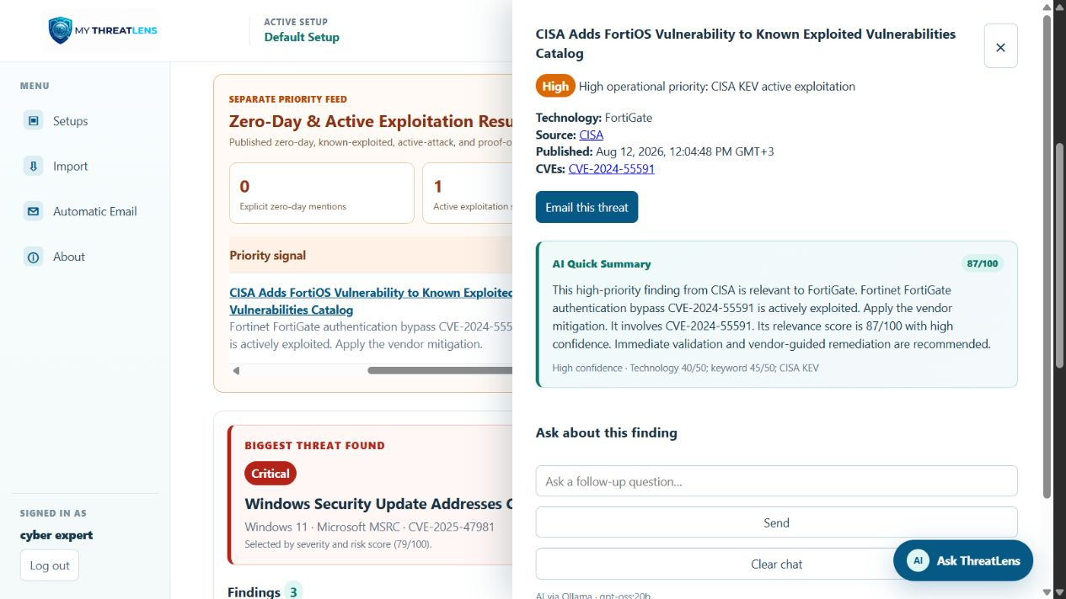
INVESTIGATION
09
One finding becomes an evidence packet
Evidence first
Title, affected technology, publication time, source link, CVE, severity basis.
Action in context
Email this threat alone when it is the only item a supervisor needs.
AI as support
Ask about impact or next steps, then verify the answer against primary evidence.
MY THREATLENS · LOCAL EDITION
Notes:
Explain that the review drawer keeps the source URL and CVE visible. The AI quick summary is secondary and explicitly disclosed as potentially incorrect.
[Sources]
- My ThreatLens local application and repository (accessed 2026-08-16)
[/Sources]

Slide 10
COMMUNICATION
10
Send only what the recipient needs
ONE
Email a single threat
Best for an urgent escalation.
Compact email anatomy
Subject
Clear threat and affected technology
Why it matters
Severity and exploitation signal
Evidence
CVE, publication date, and source
Next action
Validate exposure and follow vendor guidance
SELECTED
Email checked threats
Best for a short, curated briefing.
FILTERED
Email all visible results
Best for a scoped status report.
EXPORT
Download Excel
Best for offline analysis or an approved attachment channel.
MY THREATLENS · LOCAL EDITION
Notes:
The email format is intentionally concise. Provider credentials remain server-side; Zoho Mail API or SMTP performs delivery when configured.
[Sources]
- My ThreatLens local application and repository (accessed 2026-08-16)
[/Sources]

Slide 11
AI ASSISTANCE
11
Useful context—with visible guardrails
Site-wide assistant
Finding-specific assistant
• explains navigation and features
• summarizes current findings
• compares priorities
• suggests investigation steps
• answers about one threat
• explains likely impact
• describes remediation themes
• keeps the source and CVE in view
Uses workspace context
Uses finding context
Disclosure: generated text may be incomplete, outdated, or incorrect. Primary sources and the asset inventory remain authoritative.
MY THREATLENS · LOCAL EDITION
Notes:
The application uses an open model through Ollama when available and falls back to deterministic guidance when the provider is unavailable. Never use AI output as the sole remediation basis.
[Sources]
- My ThreatLens local application and repository (accessed 2026-08-16)
[/Sources]

Slide 12
SYSTEM ARCHITECTURE
12
A small web service with clear boundaries
BROWSER
HTML · CSS · JavaScript
Session login · user account · database-backed setups
APPLICATION
FastAPI
Routes · authentication · scan orchestration · email · export · AI
ANALYSIS
Python services
Collectors · aliases · CVE extraction · severity · prioritization
DATA & PROVIDERS
SQLite + environment secrets
Account-scoped records · Zoho/SMTP · local or API Ollama
MY THREATLENS · LOCAL EDITION
Notes:
The browser provides the user experience. FastAPI handles account authorization and APIs. Python services analyze content. SQLite stores account-scoped setup records; provider secrets remain in the local environment file.
[Sources]
- My ThreatLens local application and repository (accessed 2026-08-17)
[/Sources]

Slide 13
SECURITY MODEL
13
What is protected—and what is temporary
Authentication
Isolation
Secrets & data
✓
Unique local user accounts
✓
User ID owns the database workspace
✓
Provider keys stay in server environment settings
✓
Password stored as a one-way hash
✓
Every API query is scoped to that user
✓
No email address required for registration
✓
Protected session cookie without a persistent expiry
✓
Another account receives a separate workspace
✓
Findings, reviews, and chats are temporary
MY THREATLENS · LOCAL EDITION
Notes:
The local edition supports multiple user accounts with salted password hashes and account-scoped data. It is intended for a trusted local network unless an administrator adds production-grade network controls.
[Sources]
- My ThreatLens local application and repository (accessed 2026-08-17)
[/Sources]

Slide 14
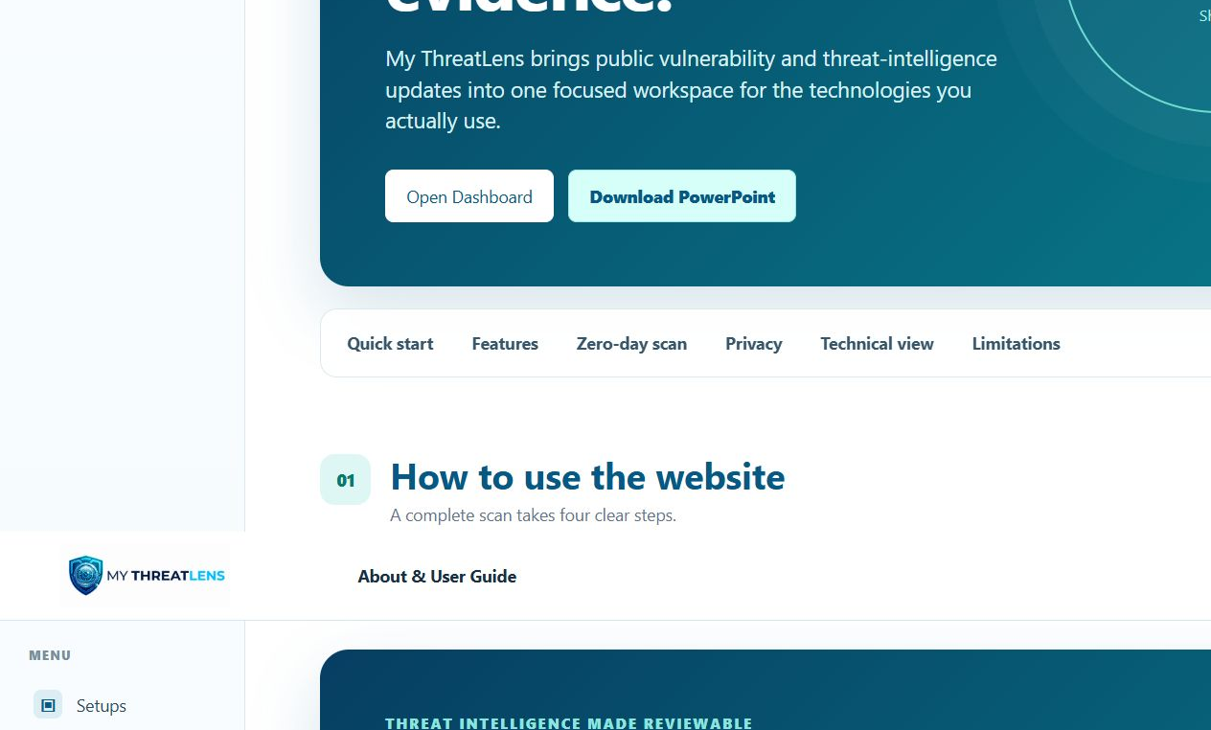
BUILT-IN DOCUMENTATION
14
The website explains itself
Quick-start guide
Four steps explain the complete scan workflow.
Technical transparency
Architecture, privacy, email, AI, and limitations are documented.
Portable briefing
The Download PowerPoint button serves this deck directly from the site.
MY THREATLENS · LOCAL EDITION
Notes:
The About page is now both onboarding and governance documentation. It avoids presenting the tool as a direct vulnerability scanner and provides this presentation for offline review.
[Sources]
- My ThreatLens local application and repository (accessed 2026-08-16)
[/Sources]

Slide 15

A clearer path from
headline to action.
Operate responsibly
1 Run a fresh scan after scope changes
2 Check source coverage
3 Validate against the asset inventory
4 Use primary advisories for action
Scope the technologies. Scan trusted intelligence. Validate the evidence. Share the necessary action.
LOCAL EDITION
Runs on port 8001
Account-owned setups
Local or API Ollama
Configurable email delivery
Notes:
Close with the operating discipline: focused scope, transparent coverage, human validation, and concise communication.
[Sources]
- My ThreatLens local application and repository (accessed 2026-08-16)
[/Sources]

