Slide 1
Lego Scrum

Slide 2
Agile Manifesto
Individuals and interactions
Working software
Customer collaboration
Responding to changes

Slide 3
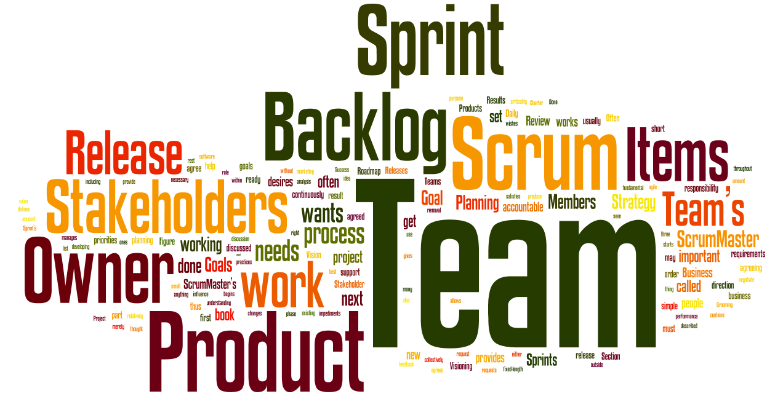
Scrum

Slide 4
Roles
Product Owner (PO)
Scrum Master
Scrum Team

Slide 5
Product owner
Possibly a Project Manager or Project Sponsor
That’s what we call an “analyst”
Marketing
Internal customer
Etc
Not a technical guy.

Slide 6
Scrum Master
Responsible for enacting SCRUM values and practices
Manages the sprint meetings
Does a sprint reporting
Typically a Project Manager or Team Leader

Slide 7
Scrum Team
Cross-functional:
QA
Developers
UI Designer
Architect
etc
5-10 members

Slide 8
Teams
3-4 people
Team name

Slide 9
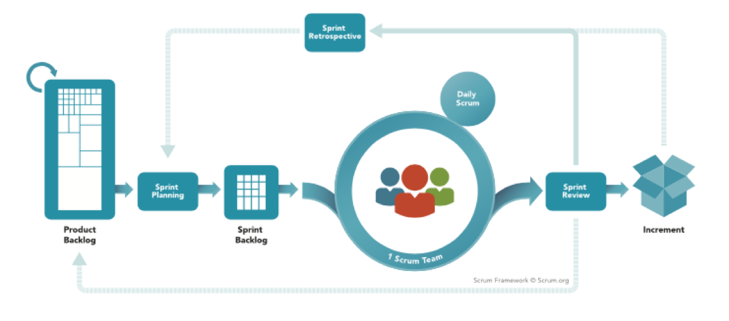
Scrum Process

Slide 10
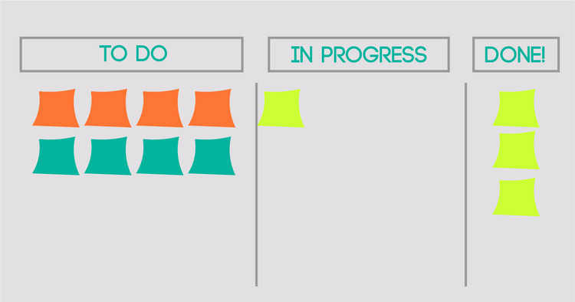
Scrum Board

Slide 11
Backlog/Sprint Planning
User stories
Tasks
Estimation
Prioritization
Choosing user stories
Tasks
Estimation
Assigning
sprint
backlog

Slide 12
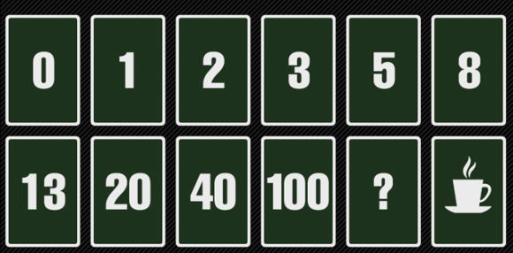
Scrum Poker

Slide 13
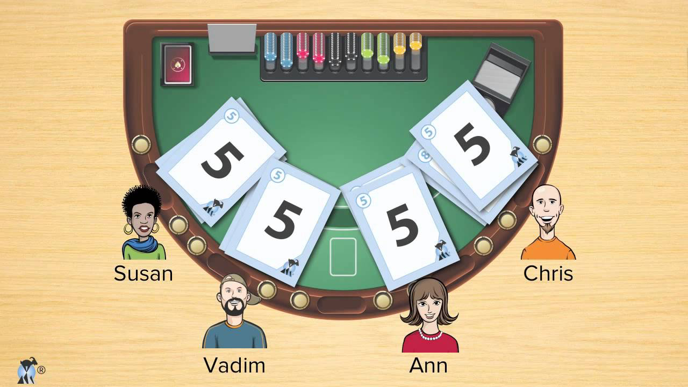
Scrum Poker

Slide 14
Backlog Planning
Story
time
value

Slide 15
Sprint Planning
Story
time
value
assigned to

Slide 16
Development
Test early and often
Build and deploy continuously
Test Driven Development
Pair programming
Refactor

Slide 17
Daily meeting
Stand up Meetings
15 min MAX
Entire Team + Scrum Master
English
What did you do Yesterday?
What will you do today?
Do you have any problems?

Slide 18
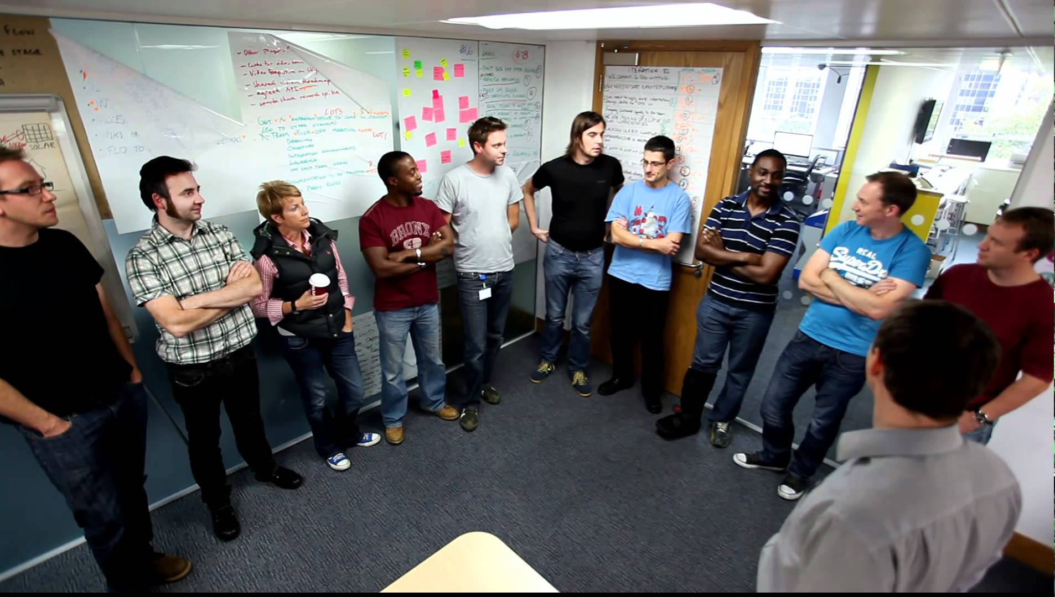
Daily meeting

Slide 19
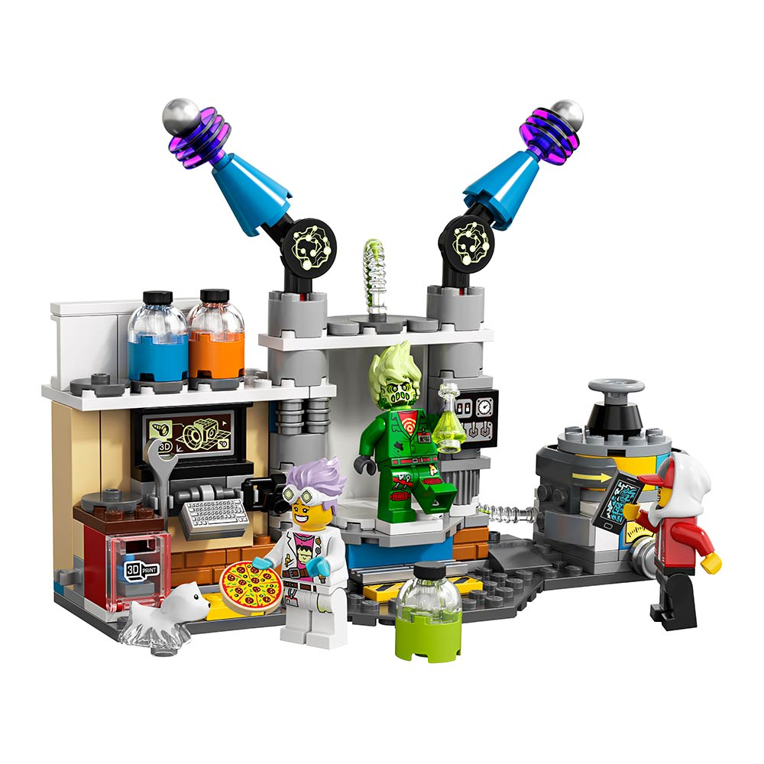
Demo meeting
All stakeholders take part
Show working copy

Slide 20

Retrospective meeting
Team + Scrum Master take part
What went well
What went wrong
How to improve

Slide 21
Grooming meeting
Team + Scrum Master take part
Check board
Check user stories
Remove unneeded

Slide 22
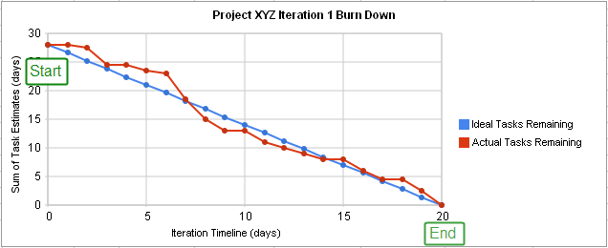
Burndown Chart

