Slide 1
Tasmacritic
Discover. Review. Explore Cinema.
Final project for the Introduction to Web Programming course
Made by Arsen Zhursunov

Slide 2
Problem & Motivation
Movie fans need a clean place to browse and review films.
The project demonstrates practical full-stack web development concepts.
Tasmacritic combines a polished UI with full-stack web functionality.

Slide 3
Web Solution
Name-only entry instead of password-based login.
Browse 10 default movies with local posters.
Add, edit, and delete movies.
Write reviews with color-coded star ratings.
Add new movies using TMDB lookup or poster upload.

Slide 4
System Architecture
Frontend: HTML, CSS, Bootstrap, Jinja templates.
Backend: Flask application factory, forms, routes, and validation.
Database: SQLite with SQLAlchemy ORM.
External API: TMDB used optionally for poster lookup.

Slide 5
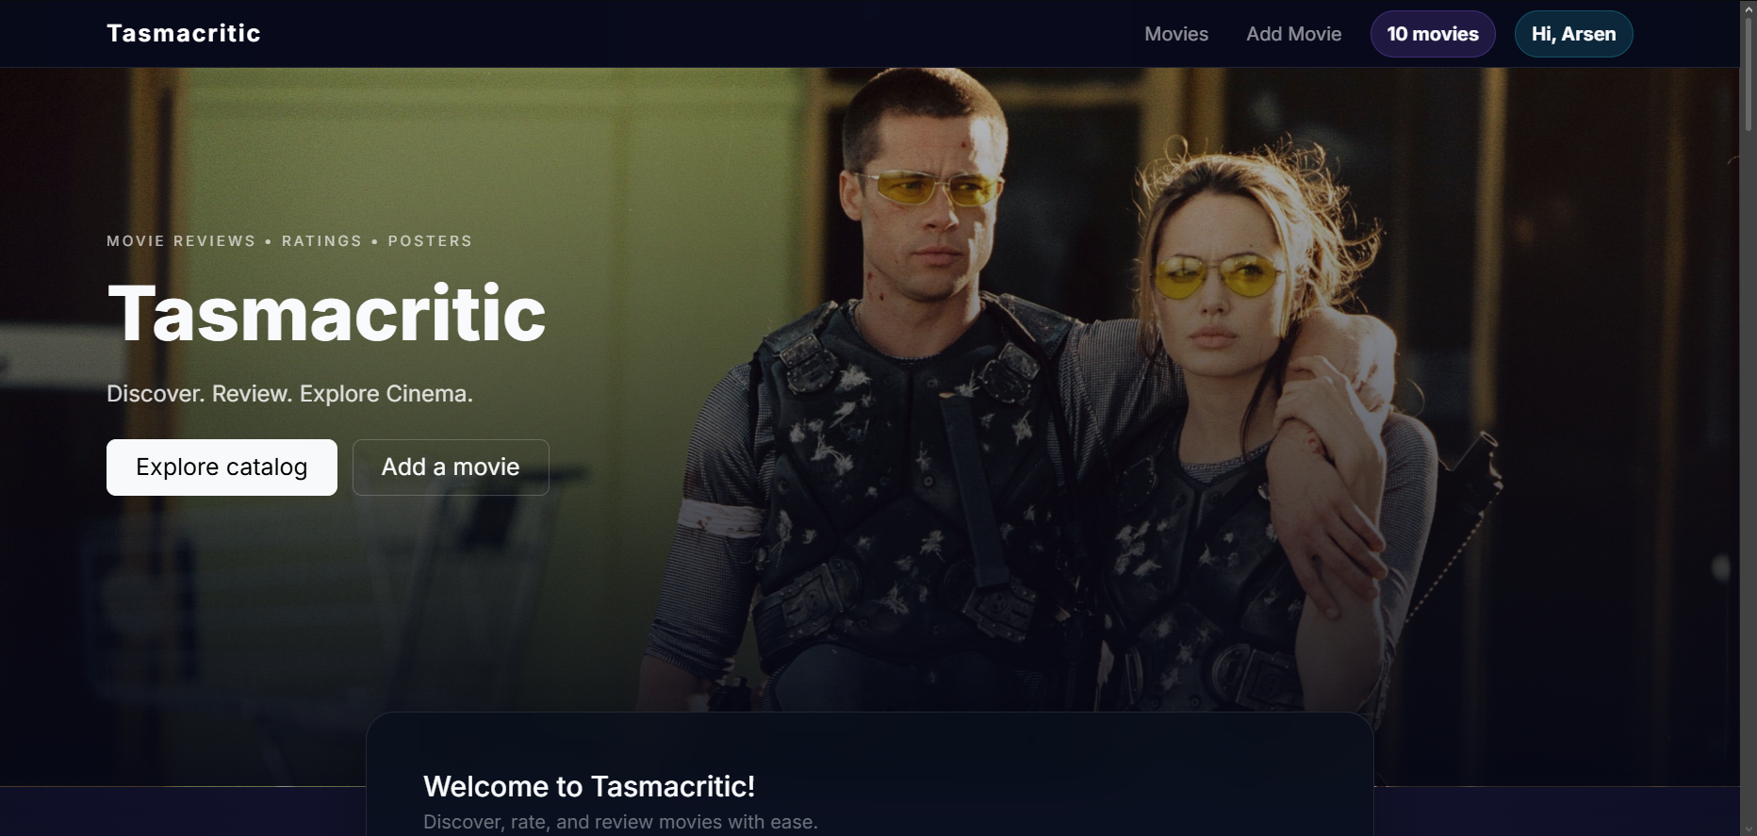
Demo / Results
Hero landing page with smooth scrolling to the catalog.

Slide 6
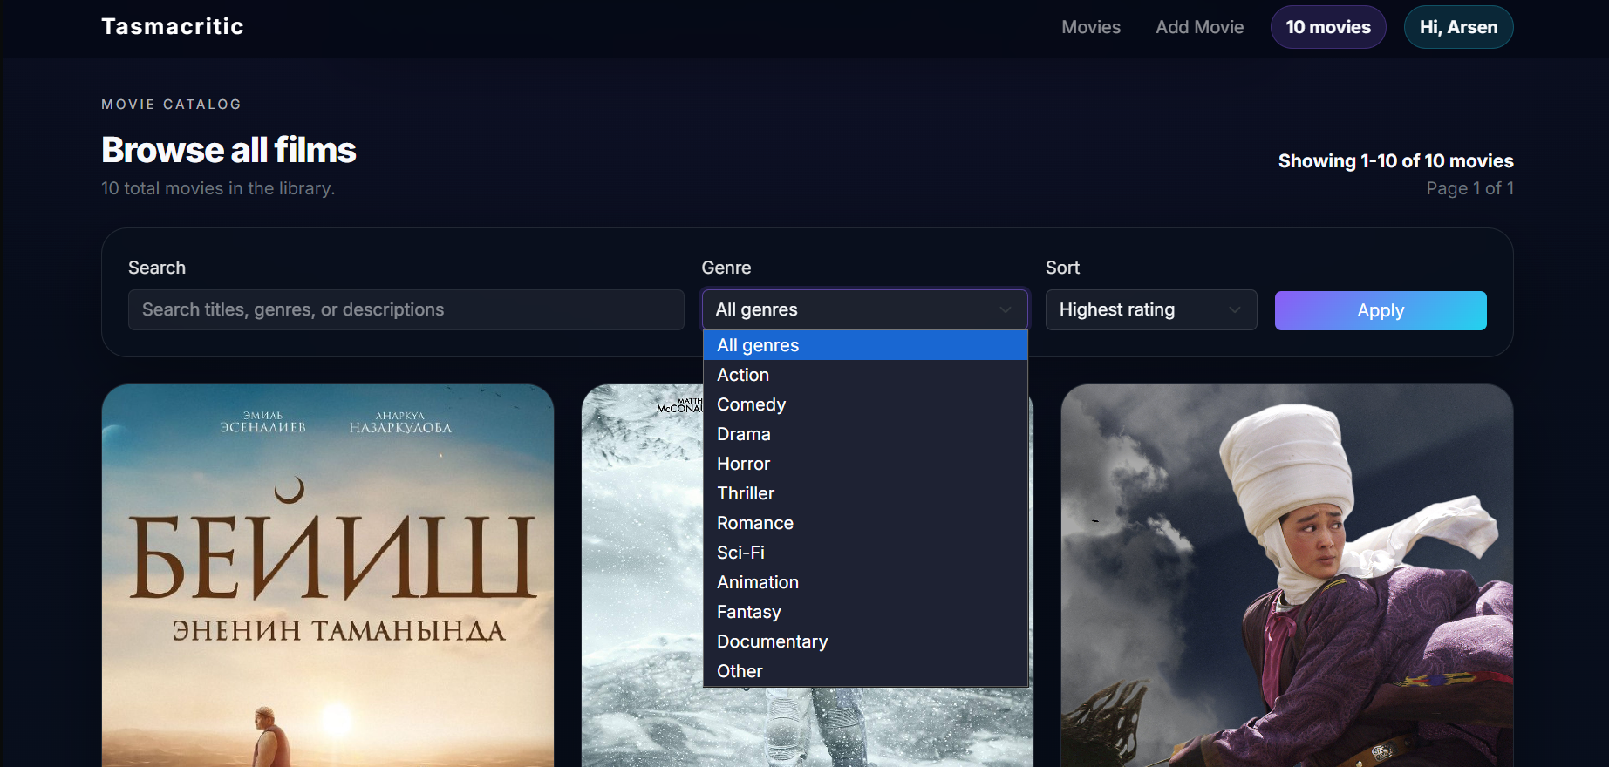
Demo / Results
Catalog with search, genre filter, sorting, rating colors, and pagination.

Slide 7
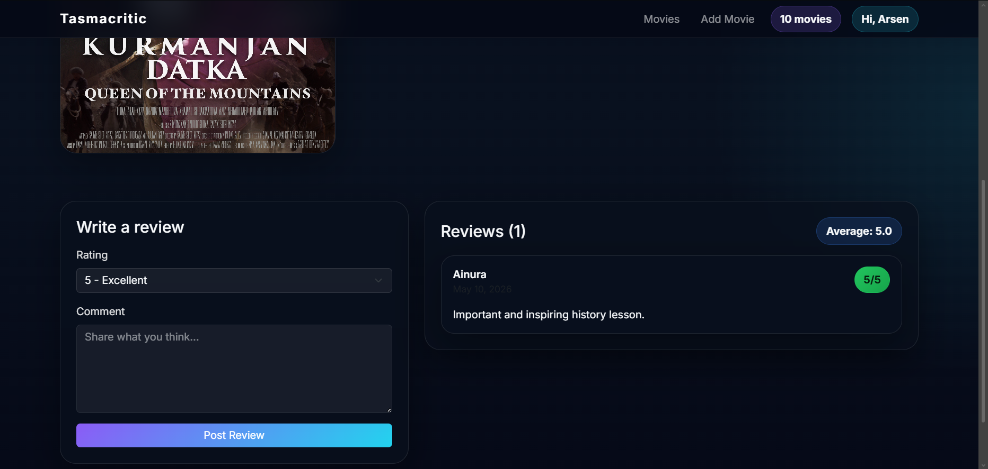
Demo / Results
Movie detail page with review creation and delete actions.

Slide 8
Demo / Results
Professional README and UI diagram included in the repository.

