Slide 1
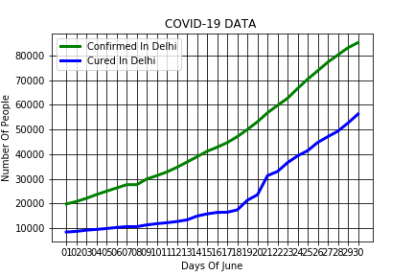
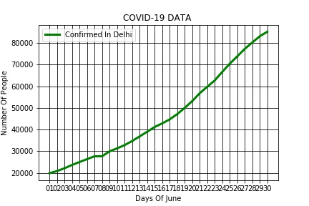
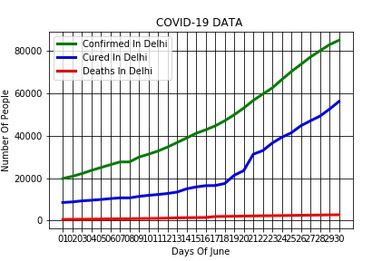
MINI PROJECT (STATE : DELHI)
CURED
CONFIRMED
DEATHS
COVID – 19 DATA : MONTH OF JUNE

