Slide 1
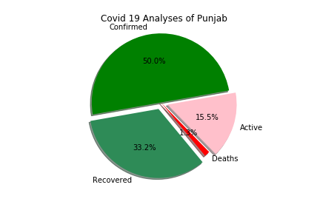
PRESENT STATE (PUNJAB) ANALYTICS

Slide 2
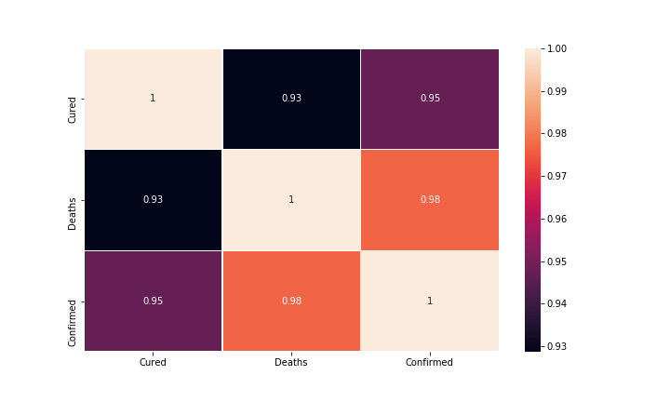
CORRELATION HEATMAP FOR VARIOUS
PARAMETER

