Slide 1
Finding people
by description
UPAR CHALLENGE 2027 · TRACK 2 · RWS @ WACV 2027
Attribute-based person retrieval with a fine-tuned CLIP ViT and likelihood ranking
Arsh Al Aman (23K-0078) · Rao Ghulam Mohiuddin (23K-0001) · Sheikh Naveed Azeemi (23K-0003)
FAST National University of Computer and Emerging Sciences · Computer Vision · Instructor: Mr. Syed Bilal Ahsan
Notes:
Hi, we are presenting our entry to Track 2 of the UPAR Challenge at the Real-World Surveillance workshop at WACV 2027: attribute-based person retrieval. In five minutes: the task, our approach, results, the problems we hit, and our submission.

Slide 2

The query is a description, not a photo
THE TASK
QUERY · 40 yes/no attributes
OUTPUT · ranked gallery
adult · female · long hair · red short-sleeved top · black trousers · backpack
Every pedestrian crop in the gallery, best matches first
Unseen domain
Metric: mADM
Code submission
Test gallery from cameras never seen in training
Like AP, but near misses earn partial credit
A10 GPU, no internet, 5-minute limit
Data: 97,669 training + 33,407 validation crops from PA-100K, PETA and Market-1501
Notes:
Track 2 is attribute-based person retrieval. A query is a full description with 40 binary attributes, like adult female with long hair, a red short-sleeved top, black trousers and a backpack. For each query we rank a whole gallery of pedestrian crops. The gallery comes from cameras we never see, the score is mADM, which gives partial credit for near misses, and we submit code that runs on their GPU without internet in under five minutes.

Slide 3

Two steps: recognise attributes, then rank
OUR APPROACH
1 · INPUT
2 · MODEL
3 · SCORE
4 · OUTPUT
Gallery crop
CLIP ViT-B/16
Likelihood ranking
Ranked list
Resized to 256×128, plus its mirror image
Fine-tuned; 40 attribute probabilities
One row per query, best first
Every query against every image
CLIP was pretrained on web-scale image–text data, so it copes with new cameras. The rules allow general foundation models as long as they were not trained for attribute recognition.
Notes:
Our pipeline has two steps. First, a CLIP ViT-B/16, fine-tuned by us, predicts 40 attribute probabilities for each gallery image; we average the image and its mirror. Second, we score every query against every image and sort. We chose CLIP because its web-scale pretraining generalises to unseen cameras, and the rules explicitly allow it.

Slide 4
A recipe tuned for surveillance footage
TRAINING
Low-resolution simulation
No hue changes
Shrink to 25–60% and blow back up, mimicking distant cameras
Colour is a label here, so we only jitter brightness and contrast
Gentle fine-tuning
Calibrated outputs
Layer-wise learning-rate decay keeps early CLIP layers close to pretraining
Plain BCE and weight averaging (EMA), because the ranking uses the probabilities
Free Colab T4 · ~12 min per epoch · CLIP re-implemented in plain PyTorch for the offline container
Notes:
Training choices follow the data. Surveillance crops are small and blurry, so we simulate low resolution. Colour is one of the labels, so we never shift hue. We fine-tune gently with layer-wise learning-rate decay, and keep plain BCE plus an EMA of the weights, because our ranking relies on well-calibrated probabilities. Everything trained on a free Colab T4.

Slide 5
Rank by how likely the match is, not by distance
THE KEY IDEA
STARTER KIT · L1 DISTANCE
OURS · LOG-LIKELIHOOD
Σ |query − probability|
A confident mistake costs the same as an unsure guess
Σ log P(attribute agrees)
One confident contradiction sinks the image
+ agreement term: rewards near misses, which is exactly what mADM measures
+ query normalisation: each image belongs to one query, so images that fit many queries are pushed down
Notes:
This is the part we are proudest of. The starter kit ranks by L1 distance, which treats a confident mistake like an uncertain one. We use the log-likelihood that the image shows exactly the query, so one confident contradiction is enough to push an image down. We add an agreement term for near misses, which mADM rewards, and a normalisation across queries, since every image matches exactly one query. All weights were tuned on the validation set.

Slide 6
Each step adds mADM
VALIDATION RESULTS
0.113
0.694
0.735
0.746
Organiser baseline (no image model)
Our CLIP model + L1 distance
+ log-likelihood scoring
+ agreement + query norm (ours)
The scoring alone adds +0.053 mADM and lifts mAP from 0.233 to 0.360 over L1 with the same model, at zero extra compute.
Validation: 33,407 images, 3,462 queries · metrics re-implemented and checked against the official formulas
Notes:
On the validation set, the organiser baseline, which ignores the pixels, gets 0.113 mADM. Our CLIP model with the starter kit's L1 ranking reaches 0.694. Switching to likelihood scoring gives 0.735, and the agreement term with query normalisation gives 0.746. That last jump comes from the same model with no extra compute.

Slide 7
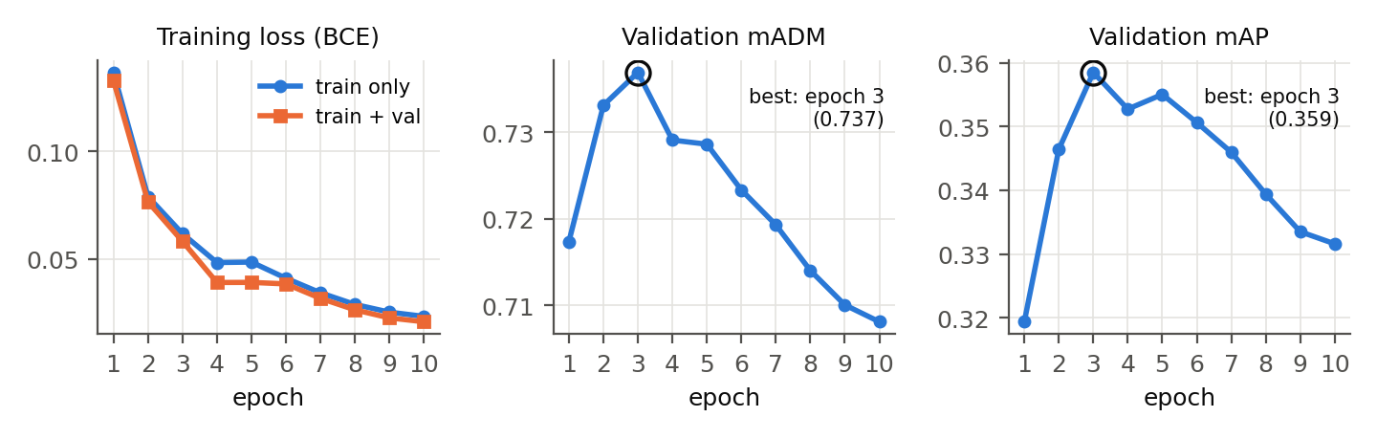
More training made retrieval worse after epoch 3
TRAINING BEHAVIOUR
Loss keeps falling, but the model over-fits the three training datasets. Under domain shift, the number of epochs is the key regulariser. All submitted models train for 3 epochs.
Notes:
Here is a surprise from training. The training loss keeps falling for all ten epochs, but validation mADM peaks after three epochs at 0.737 and then declines to 0.708. The model starts memorising the three source datasets. With a hidden test domain this matters a lot, so our submission uses the 3-epoch model.

Slide 8
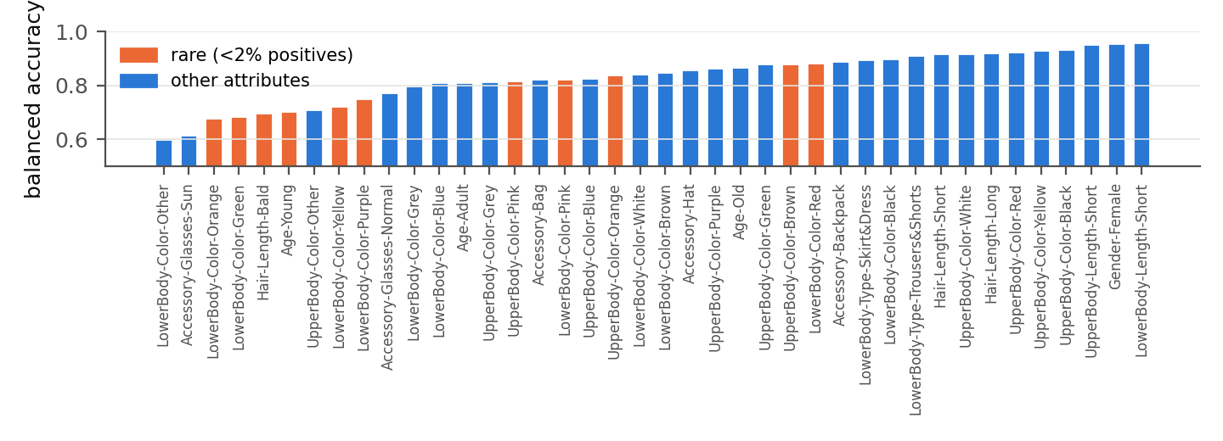
Rare attributes are the weak spot
WHERE IT FAILS
Gender and clothing length are above 95%. Sunglasses, “other” colours and colours with under 2% positives sit near 60–70%. A single wrong attribute breaks an exact match.
Notes:
Where does the model fail? This chart shows balanced accuracy per attribute on validation. Easy attributes like gender and clothing length are above 95 percent. The hardest are sunglasses, the catch-all other colour, and rare colours like orange or green trousers with under two percent positives. Because one wrong attribute breaks an exact match, these rare errors dominate the retrieval loss.

Slide 9
What made this hard
CHALLENGES
Unseen test cameras
A hidden 4.5× slowdown
Validation peaks after 3 epochs; longer training over-fits the source datasets
PyTorch reports bfloat16 on the T4, but it is emulated: 30 vs 139 img/s until we fixed it
Free-GPU quotas
Offline code submission
Colab cut us off mid-run, so training resumes from per-epoch checkpoints on Drive
Plain PyTorch only, 5 minutes: we rebuilt CLIP from scratch and verified it exactly
Notes:
Four things made this hard. The test cameras are unseen, and validation showed longer training hurts. A subtle one: PyTorch says the T4 supports bfloat16, but it is emulated, which made training four and a half times slower until we caught it. Free Colab quotas cut us off, so we made training resumable. And the evaluation container is offline with only plain PyTorch, so we re-implemented CLIP ourselves and checked it matches the official outputs exactly.

Slide 10
Final result: 0.624 mADM, rank 32
CODABENCH · HIDDEN TEST SET
Submission | mADM | mAP | Rank-1
Train only, 3 epochs | 0.619 | 0.348 | 0.378
Train + val, 3 epochs | 0.613 | 0.339 | 0.359
Ensemble of both (final) | 0.624 | 0.353 | 0.385
Winner, for reference | 0.699 | 0.416 | 0.397
More source data alone did not help; averaging two models did, on every metric. Test mAP matches validation, so the remaining gap is how the model orders near misses on new cameras.
Notes:
On the hidden test set our final submission, an ensemble of the train-only and the train-plus-val models, reaches 0.624 mADM and finished 32nd; the winner had 0.699. Adding the validation data alone was slightly worse, because it is more of the same three datasets, while averaging the two models improved every metric. Our test mAP is as good as on validation, so the remaining gap is in how near misses are ordered on new cameras.

Slide 11
What we would do with more time
NEXT STEPS
Ensembles of seeds or ViT-B + ViT-L/14 for better-calibrated probabilities
Group-aware heads for one-of-many attributes such as age and clothing colour
Rare-attribute training with balanced or focal loss, then re-calibration
A retrieval-aware loss that optimises the ranking directly
Thank you · Questions?
Notes:
With more time we would ensemble several models for better-calibrated probabilities, add heads that respect one-of-many attribute groups, train harder on rare attributes, and try a loss that optimises the ranking directly. Thank you, we are happy to take questions.

