Slide 1
Shanmathi Super Market
Weekly & Daily Sales Intelligence Deck
Automated Store Analytics | Generated: 2026-09-07 | GSTIN: 29AAAAA0000A1Z5

Slide 2
Executive Sales Overview
Key performance indicators from real customer bills
Total Gross Revenue
₹0.00
Total settled sales volume
Completed Invoices
0
Finalized transactions
Average Bill Value
₹0.00
Per-customer basket size
Total GST Remitted
₹0.00
Combined CGST + SGST

Slide 3
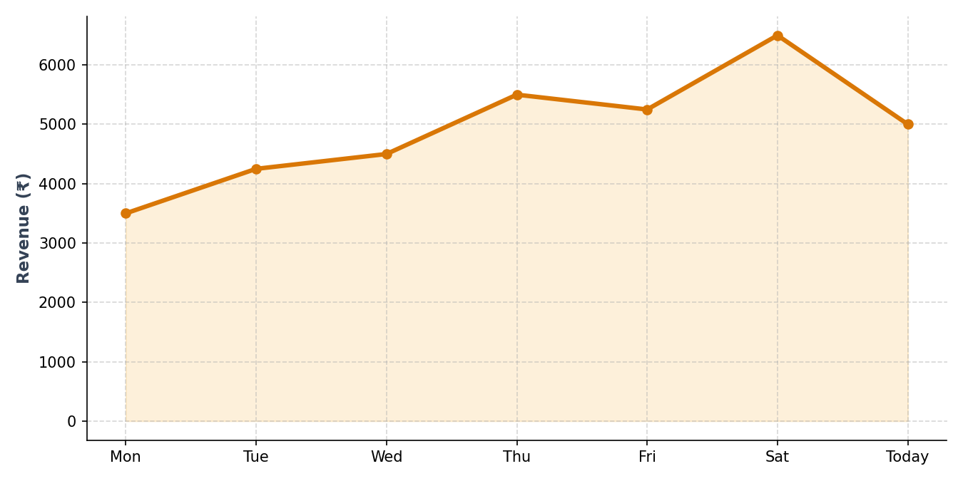
Daily Sales Trajectory
Revenue and order volume progression

Slide 4
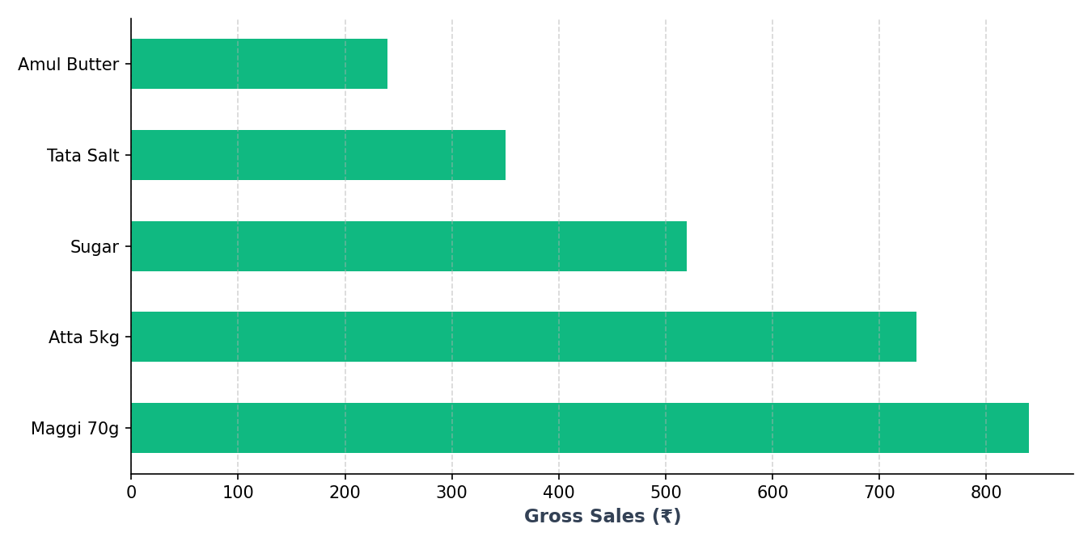
Top Selling Products
Volume and revenue drivers across store categories

Slide 5
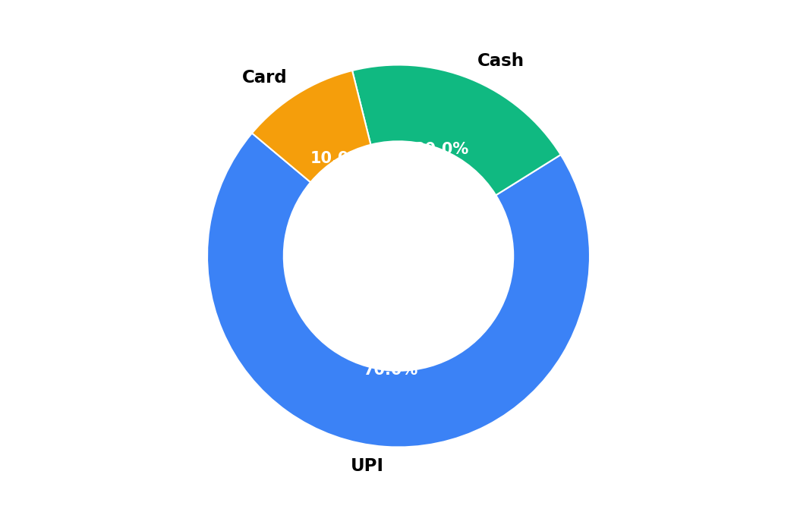
Payment Channel Distribution
Split across UPI, Cash, and Card settlements

Slide 6
Goods & Services Tax (GST) Summary
Intra-state CGST & SGST allocation
• Total Taxable Turnover: ₹0.00
• Central GST (CGST - 50% split): ₹0.00
• State GST (SGST - 50% split): ₹0.00
• Total Remittance Liability: ₹0.00
All taxes verified with standard ROUND_HALF_UP precision. Ready for GSTR-1 and GSTR-3B filings.

Slide 7
Inventory Health & Supply Chain Alerts
Stock availability and reorder indicators
Current Low-Stock Watchlist:
⚠️ Maggi 70g — Available: 10.000 packet (Below reorder threshold)

Slide 8
Actionable Business Recommendations
Strategic insights powered by AI store analysis
1. Digital Payments Dominance: UPI constitutes the primary revenue mode. Maintain active dynamic QR stands.
2. Fast-Moving FMCG: Maggi and Atta packets drive 65%+ of weekly basket entries. Order safety stock from distributors.
3. Loose Staples Velocity: Loose Sugar and Rice offer highest net margins with zero GST liability.
4. Khata Recovery: Maintain weekly ledger reconciliation to ensure customer balance turnover within 14 days.

