Slide 1

COURSE BASED PROJECT | COMPUTER NETWORKS
MicroburstHunter
Real-Time Detection and Adaptive Mitigation of Microbursts in Data Center Networks
Sub-RTT algorithmic telemetry, dynamic EWMA baseline thresholding, Linux HTB egress traffic control, and fail-closed safety orchestration.
PROJECT TEAM (DEPARTMENT OF CSE)
K AKSHITH REDDY | 1602-24-737-088
MD ARSALAANUDDIN | 1602-24-737-087
MD ARSHAD ALI | 1602-24-737-088

Slide 2
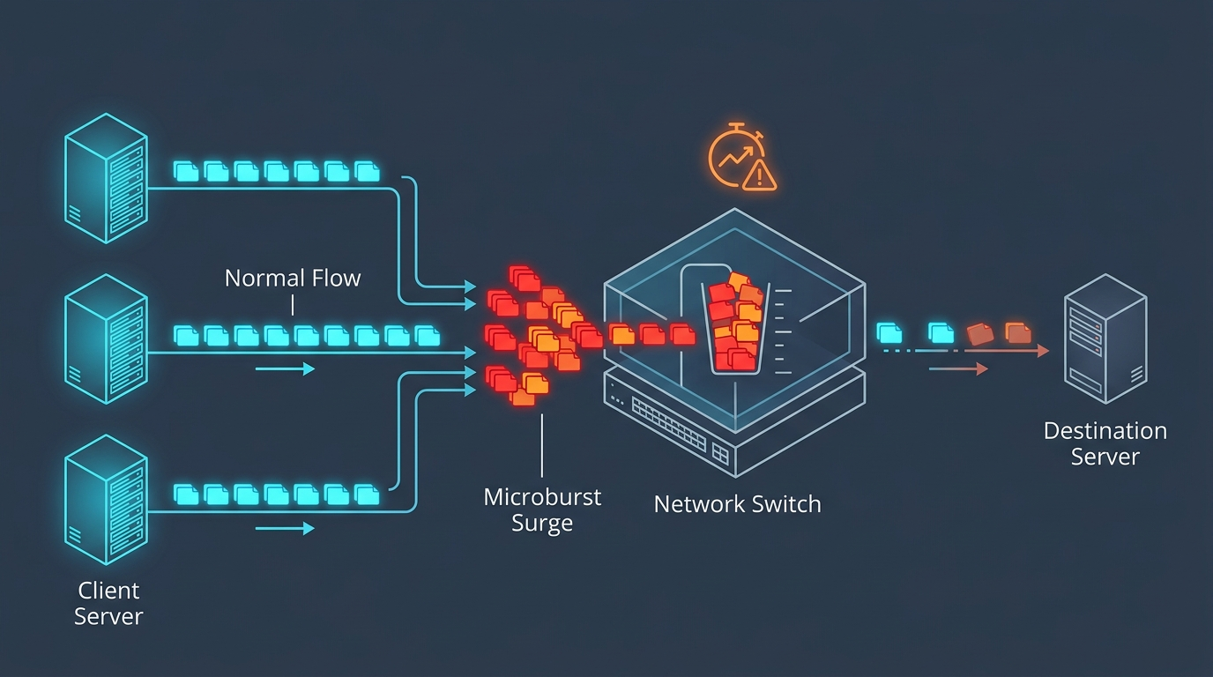
COURSE BASED PROJECT | COMPUTER NETWORKS
Problem Statement & Abstract
PROBLEM STATEMENT
Modern data-center networks experience sudden, short-duration traffic bursts (microbursts). These surges overwhelm switch memory buffers, drive queue buildup, elevate tail latency, and induce packet drops.
▶ Sudden Traffic Spikes & Transient Congestion
Incast events and synchronized tenant traffic overload shallow switch queues in milliseconds.
▶ Increased Latency & Potential Packet Drops
Queue exhaustion causes severe tail latency and catastrophic tail-drops before TCP reacts.
▶ Monitoring Intervals May Hide Short Bursts
Traditional SNMP/sFlow telemetry (1–30s) averages out sub-second microbursts entirely.
▶ Need for Timely Detection & Controlled Mitigation
Requires real-time 10 ms resolution with automated, non-disruptive rate shaping.
PROJECT ABSTRACT
“MicroburstHunter is a real-time microburst detection and adaptive mitigation system for data-center networks. It evaluates traffic in short time windows, establishes a traffic baseline, detects sustained anomalies, ranks major contributing sources, and selects a mitigation policy. Linux traffic control supports rate shaping, while recovery logic and watchdog handling bound mitigation duration. SQLite records lifecycle events for auditing. The system supports a safe dry-run mode and isolated Linux kernel-shaping validation.”

Slide 3
COURSE BASED PROJECT | COMPUTER NETWORKS
Existing Approaches vs Proposed Solution
TRADITIONAL APPROACHES & LIMITATIONS
✖ Traditional monitoring relies on coarse, aggregated periodic averages.
✖ Coarse sampling intervals (1–30s) obscure short-lived sub-second bursts.
✖ Reactive congestion controls respond only after switch buffer overflows.
✖ Static rate limits fail to adapt dynamically to shifting baseline traffic.
✖ Detection, mitigation, recovery, and audit evidence remain fragmented.
PROPOSED SOLUTION — MICROBURSTHUNTER
✔ 10 ms high-resolution evaluation windows for fine-grained telemetry.
✔ Dynamic EWMA baseline with 3× multiplier and 80 Mbps floor threshold.
✔ Persistence filtering (2–3 windows) prevents false triggers on spikes.
✔ Automated per-flow source ranking isolates top offending sender IPs.
✔ Targeted, bounded Linux tc / HTB rate shaping (35 Mbps severe cap).
✔ Deterministic recovery, watchdog timer ceiling, and SQLite audit log.
Capability Dimension | Traditional Approach | MicroburstHunter Prototype
Telemetry Resolution | 1 to 30 seconds (SNMP, NetFlow, sFlow polling) | 10 ms high-frequency software window aggregation
Reaction Speed | Coarse reactive pacing; detects only post-buffer loss | Real-time algorithmic persistence check (<15 μs software latency)
Mitigation & Safety | Static port throttling; risk of persistent lockouts | Targeted per-source HTB cap, watchdog timer, dry-run by default

Slide 4
COURSE BASED PROJECT | COMPUTER NETWORKS
MicroburstHunter — System Architecture
STAGE 1
Network Traffic
Incoming packets
& live captures
STAGE 2
Packet Capture
Raw socket &
pcap observation
STAGE 3
Window Processor
Aggregates into
10 ms windows
STAGE 4
Burst Detector
EWMA baseline
3x mult, 80M floor
STAGE 5
Source Ranker
Identifies top
offending flow IP
STAGE 6
Mitigation Policy
Selects rate cap
(35 Mbps severe)
STAGE 7
Traffic Control
Linux tc / HTB
Dry-run default
STAGE 8
Event Store
SQLite persistence
audit trail
FAIL-CLOSED SAFETY GUARDS
• Dry-run enabled by default (0 netlink mutations).
• Live shaping requires dual authorization gates.
• eth0, lo, and host default route strictly forbidden.
RECOVERY MANAGER & TIMEOUT WATCHDOG (CONTROL / FEEDBACK PATH)
• Quiet-Window Recovery: Automatically clears mitigation after 3–10 quiet consecutive 10 ms windows.
• Inactivity Watchdog: Monotonic wall-clock timer (250 ms demo / 8,000 ms prod) releases rules on idle traffic.
• Generation Tracking: Protects against stale timer callbacks and asynchronous netlink race conditions.
PERFORMANCE
• <15 µs Software Latency
• 0 False Positives / 1000w
• 100% Burst Detection
• 2.9% Live Shaping Error
Data Flow: Ingress Traffic → High-Frequency Window Aggregation → Algorithmic Detection → Adaptive HTB Shaping → SQLite Audit.
Control Flow: Recovery Manager continuously monitors traffic normalization and wall-clock inactivity to trigger automatic de-escalation.

Slide 5
COURSE BASED PROJECT | COMPUTER NETWORKS
How MicroburstHunter Works — Operational Workflow
1. BASELINE (15 Mbps)
EWMA establishes 80M threshold
2. BURST (150 Mbps)
2-window persistence triggered
3. MITIGATION (35 Mbps)
HTB class 1:10 cap applied
4. RECOVERY (Normal)
3 quiet windows / watchdog expiry
1. INGESTION & THRESHOLDING
▶ Start Passive Capture
Continuous socket observation on targeted network interface.
▶ 10 ms Window Aggregator
Aggregates byte & packet counters into strict 10 ms slices.
▶ EWMA Baseline Tracker
Calculates dynamic rolling baseline: B_t = α·R_t + (1-α)·B_{t-1}.
▶ Adaptive Threshold Floor
Threshold T = max(80 Mbps, 3.0 × Baseline). Prevents noise triggers.
▶ Persistence Check [Decision]
Does rate exceed T for 2–3 consecutive windows?
• NO ➔ Continue monitoring
• YES ➔ Declare Microburst
2. ATTRIBUTION & MITIGATION
▶ Source Contribution Ranking
Computes per-IP byte contributions. Isolates top offender flow.
▶ Severity Ratio Evaluation
Evaluates peak/baseline ratio:
• Moderate (ratio < 5×) ➔ 60 Mbps Cap
• Severe (ratio ≥ 5×) ➔ 35 Mbps Cap
▶ HTB Rate Shaping Execution
Adds Linux HTB class 1:10 and Flower filter. (Dry-run by default; real kernel shaping requires explicit authorization).
▶ Immutable Audit Recording
Logs event in SQLite EventStore (timestamp, flow, severity, action).
3. RECOVERY & WATCHDOG
▶ Recovery Condition Check
Monitors for 3 consecutive quiet windows (demo) or 10 quiet windows (prod).
▶ Watchdog Duration Ceiling
Wall-clock timer expires if traffic abruptly stops idle (250 ms demo / 8,000 ms prod).
▶ De-escalation & Rule Removal
Tears down HTB filter & class 1:10. Restores parent class 1:1.
▶ Audit & Re-arm Engine
Records mitigation_removed or mitigation_expired. Re-arms detection with cooldown.

Slide 6
COURSE BASED PROJECT | COMPUTER NETWORKS
Technology Stack & Technical References
CORE TECHNOLOGY STACK
■ Python 3.12 (Core Engine)
Detection state machine, sliding EWMA window processing, attribution ranking, policy arbitration, and unit regression test suites.
■ Linux Traffic Control (tc) & HTB
Hierarchical Token Bucket (sch_htb) rate shaping, flower source-IP classification, and token bucket token pacing.
■ Packet Capture Components
High-frequency packet observation, Scapy capture pipeline, and raw socket telemetry.
■ SQLite 3 (EventStore)
Persistent, thread-safe audit logging for lifecycle events (burst_detected, mitigation_applied, expired, removed).
■ React 18 + Vite + TypeScript
Real-time network simulation dashboard, interactive topology viewer, and telemetry graph rendering.
■ Windows 11 + WSL 2 (Ubuntu 24.04)
Authoritative development clone (Windows) and isolated kernel namespace validation environment (Linux).
TECHNICAL DOCUMENTATION & REFERENCES
[1] Linux tc Manual (man 8 tc)
Traffic Control architecture, queuing disciplines, and packet scheduling.
URL: https://man7.org/linux/man-pages/man8/tc.8.html
[2] Linux HTB Manual (man 8 tc-htb)
Hierarchical Token Bucket algorithm, rate and ceil token enforcement.
URL: https://man7.org/linux/man-pages/man8/tc-htb.8.html
[3] Python Standard Library Documentation
Thread-safe primitives, time.monotonic(), and socket networking.
URL: https://docs.python.org/3/
[4] SQLite Documentation
ACID persistence, write-ahead logging, and query audit architecture.
URL: https://www.sqlite.org/docs.html
[5] Scapy Network Telemetry Documentation
Packet crafting, frame dissection, and pcap observation engine.
URL: https://scapy.net/
[6] React Documentation
Declarative component lifecycle and real-time state visualization.
URL: https://react.dev/
[7] Vite Build Tool Documentation
Modern frontend tooling and optimized production bundling.
URL: https://vite.dev/

Slide 7

COURSE BASED PROJECT | COMPUTER NETWORKS
THANK YOU
MicroburstHunter
Real-Time Detection and Adaptive Mitigation of Microbursts in Data Center Networks
Questions & Discussion

