Slide 1

SMART INDIA HACKATHON 2026
.
Problem Statement ID – 26167
Problem Statement Title- SatQuery AI - An Interactive Vision-Language Assistant for Multimodal Remote Sensing Image Analysis through Text Queries
Theme- Space Technology
PS Category- Software
Team ID- SIH-EL 15
Team Name - Heisenbugs

Slide 2
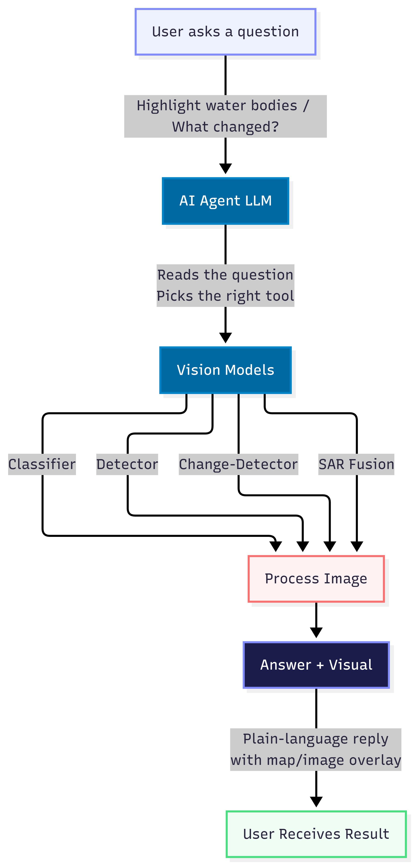
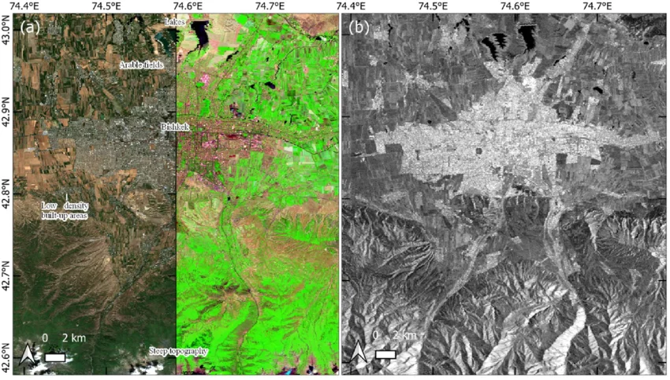
SatQuery AI
Heisenbugs
Proposed Solution
Ask a question in plain English and upload the image required, get an answer with respective model, no GIS software needed.
An AI agent reads the question and picks the right model: classifier, detector, change-detector, or SAR + optical fusion.
Innovation & Uniqueness
The agent chooses its own tool for each question, and sees through clouds/night using radar data
Every answer highlights exactly where on the image it's looking, so results can be checked
HOW IT WORKS
Illustrative example — what a change-detection query returns:

Slide 3
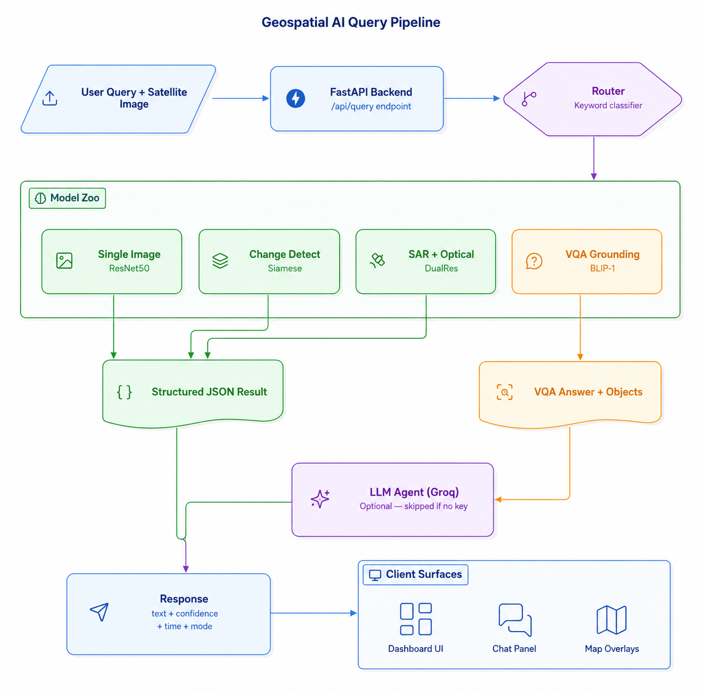




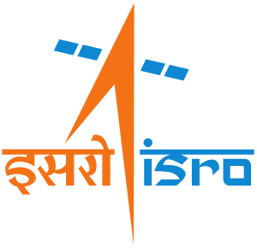


TECHNICAL APPROACH
Heisenbugs
Technology Stack
Frontend: HTML5, CSS3, JavaScript, Leaflet.js, React
Backend: Python, FastAPI, Uvicorn
AI/ML: PyTorch, HuggingFace Transformers, BLIP-1 (VQA), ResNet-50 via timm (EuroSAT), MobileNet-V3 (Change Detection), Dual ResNet-18 (SAR Fusion), SAM (Segmentation)
Data Sources: Esri WorldImagery, NASA EONET v3, NASA GIBS (MODIS/NDVI), Nominatim/OSM
Datasets: EuroSAT, LEVIR-CD, SEN12MS, RSVQA-LR, DOTA v2, ISRO Bhuvan
LLM: Groq (llama3-70b), OpenAI GPT-4o
HOW A QUERY GETS PROCESSED, STEP BY STEP
User
Types a Query
Any language,
plain text along an
image
AI Agent
Reads It
Figures out what
tool is needed
Right Model
Runs
Classify • Detect •
Change • SAR-Fuse
Result Is
Marked
Mask / box /
heatmap on image
Answer
Shown
Plain text +
visual overlay

Slide 4
FEASIBILITY AND VIABILITY
Heisenbugs
Feasibility
If the model fails, there a classical CV fallback model that acts as a backup and provide accurate results.
All data is free and public: Sentinel-1/2, LEVIR-CD, RSVQA, SEN12MS | Runs anywhere, no special hardware needed.
CHALLENGES WE EXPECT, AND HOW WE PLAN TO HANDLE THEM
Challenge | Our Plan
Radar and optical images don't line up perfectly — different sensors, different geometry | Align them using SIFT/ORB feature matching, and warn the user if the alignment quality is low
Running 3-4 models plus an LLM together can be slow | Keep the models light, run them in parallel, use a free T4 GPU
Pixel-perfect change maps are still an open research problem | Show an approximate change area for now, and say clearly that it's approximate
There's no ready-made dataset for teaching the AI which tool to call | Guide it with careful prompting instead of training a separate routing model

Slide 5
IMPACT AND BENEFITS
Heisenbugs
Who Benefits
Disaster teams, defense and urban bodies, farmers, and researchers can all ask a question and get an answer straight away — no GIS training, no waiting on a specialist analyst
REAL-WORLD IMPACT
Economic
Crop-insurance checks and infrastructure audits take minutes, not days
Social
Puts ISRO-grade satellite data in the hands of ordinary citizens and local officials
Environmental
Spot deforestation, shrinking water bodies, and flood or cyclone damage faster
Strategic
Radar sees through clouds and darkness, so monitoring never stops

Slide 6

RESEARCH AND REFERENCES
Heisenbugs
What We Read and Built On
RSVQA — Remote Sensing VQA dataset & paper
https://rsvqa.sylvainlobry.com/ • arxiv.org/abs/2003.07333
GeoChat — grounded remote-sensing vision-language model
github.com/mbzuai-oryx/GeoChat • arxiv.org/abs/2311.15826
RS-Agent — agentic remote-sensing orchestration architecture
github.com/intellisensing/rs-agent • arxiv.org/abs/2406.07089
LEVIR-CD / WHU-CD — bi-temporal building change-detection benchmarks
0.5m resolution, 637 image pairs (Google Earth)
SEN1-2 / SEN12MS — curated SAR–optical fusion datasets
mediatum.ub.tum.de (TU Munich)
ISRO Bhuvan / VEDAS — national EO data & value-added products
bhuvan.nrsc.gov.in

