Slide 1
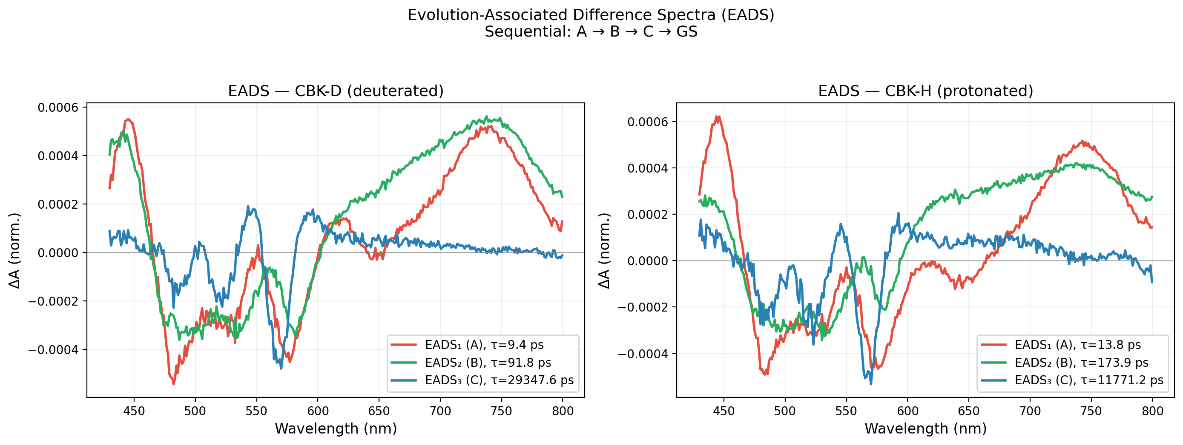
Challenges in Interpreting Ultrafast Spectroscopy Data:
A Case for Machine Learning in Materials Research • Muhammed Arshad T. • Inst. Macromolecular Chemistry, CAS
THE PROBLEM
Transient Absorption (TA) spectroscopy:
• 2D data: ΔA(wavelength, time)
• Multiple kinetic models fit the same data
• Expert manually guesses model → hours/sample
• Subjective, slow, doesn't scale
OUR SYSTEM
• H/D-substituted porphyrin (CBK-H, CBK-D)
• Sequential: A → B → C → Ground State
• Question: Can ML automate model selection?
THREE ML APPROACHES TESTED
1. CNN Classification (DeepSKAN v1)
• Treat TA as image → classify into 21 topologies
• Trained on 50k synthetic samples
2. Physics-Informed (PINN)
• Embed kinetic ODEs into the loss function
• No training data needed — fits single dataset
3. Improved CNN (DeepSKAN v2)
• Regression (predict τ directly, not class label)
• Realistic spectra from SVD of real data
• 2-channel input (signal + time axis)

Slide 2
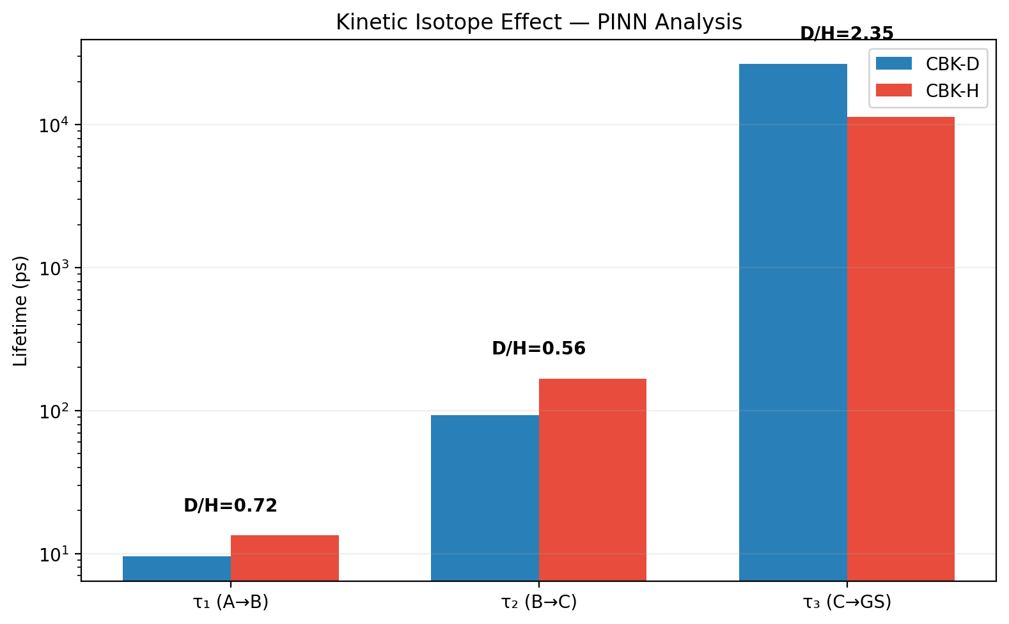
Results: What Worked, What Failed, and Why
ML4MatSci PhD School • Sarajevo, June 10-12, 2026
RESULTS COMPARISON (CBK-D, chirp-corrected)
Method τ₁ τ₂ τ₃ Status
─────────────────────────────────────────────────────
DeepSKAN v1 0.1 ps 0.0 ps — FAILED
Direct GA 6.8 ps 68.9 ps 6185 ps Partial
PINN 9.6 ps 92.6 ps >6 ns BEST
DeepSKAN v2 9.7 ps 348 ps 7265 ps Good
ISOTOPE EFFECT (D/H ratio):
τ₁: 0.72x (inverse KIE — D relaxes faster)
τ₂: 0.56x (inverse KIE)
τ₃: 2.35x (normal KIE — D lives longer)
KEY LESSONS
Why CNN v1 failed:
• Sim-to-real gap (random Gaussians ≠ real spectra)
• Preprocessing destroyed time-scale info
• Classification → wrong model → everything fails
What works:
• Physics-informed fitting (PINN) — best accuracy
• Realistic training data (from SVD of real spectra)
• Regression > Classification for this problem
FUTURE DIRECTION:
• Agentic AI: LLM reads literature →
proposes model → fits data automatically
• Eliminates sim-to-real gap entirely
• No training data needed

