Slide 1
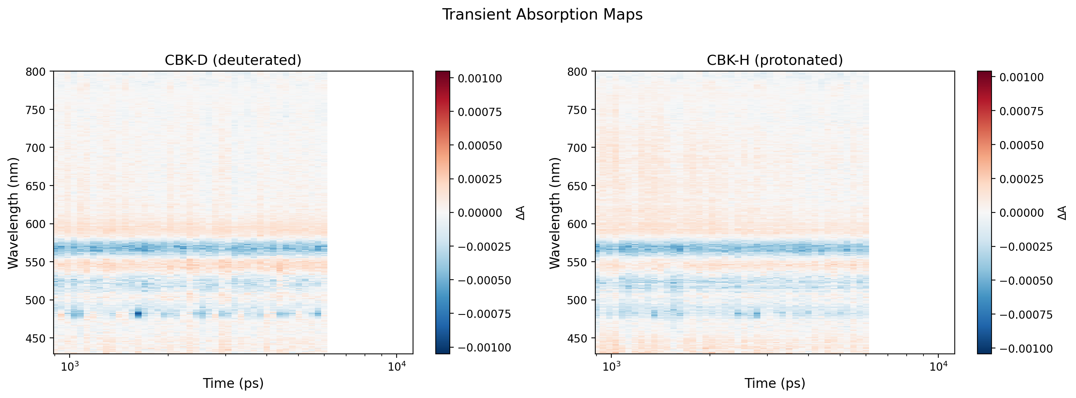
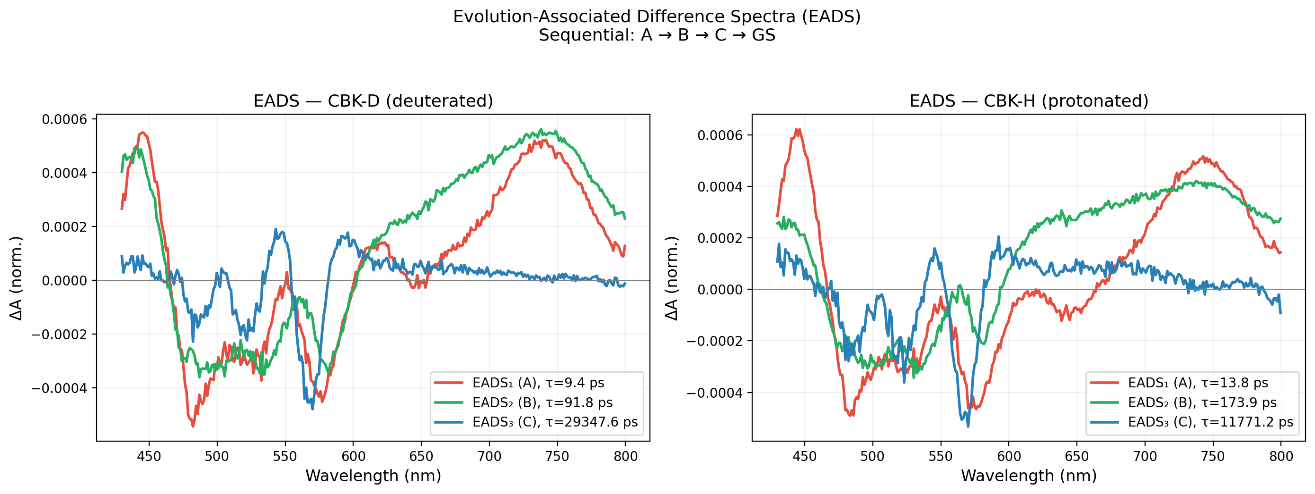
Ultrafast Dynamics of H/D-Substituted Porphyrin: An Anomalous Isotope Effect
Muhammed Arshad T. | Institute of Macromolecular Chemistry, Czech Academy of Sciences | ML4MatSci 2026
Transient Absorption Spectroscopy
System: CBK porphyrin complex
• CBK-H (protonated) vs CBK-D (deuterated)
• Excitation: 476 nm, WLC probe 430-800 nm
Forced Sequential Model: A → B → C → GS
(Global Analysis with 3 exponentials + IRF)
Results:
Component CBK-D CBK-H D/H
τ₁ (A→B) 9.6 ps 13.4 ps 0.72
τ₂ (B→C) 92.6 ps 166.8 ps 0.56
τ₃ (C→GS) >6 ns >6 ns 2.35
ANOMALY:
τ₁, τ₂: D is FASTER (inverse isotope effect)
Expected: D should be SLOWER
→ Suggests tunneling or mode-coupling
But: we had to FORCE the sequential model.
Can ML suggest the right model automatically?

Slide 2
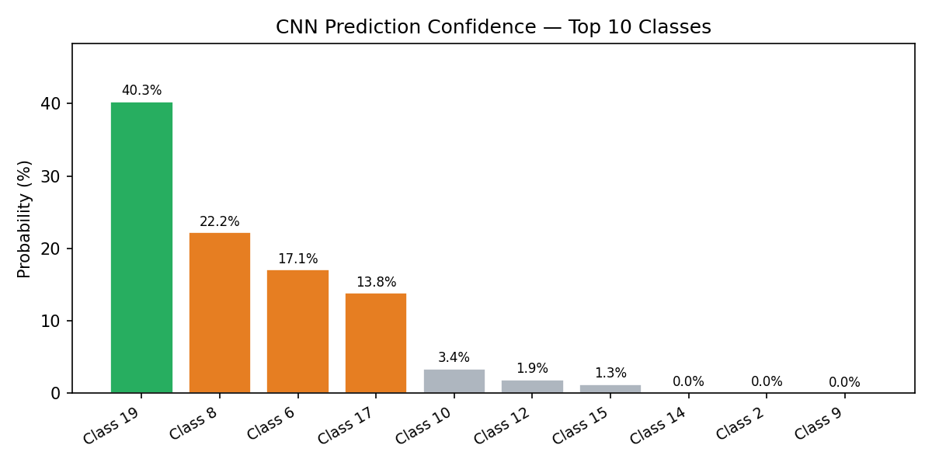
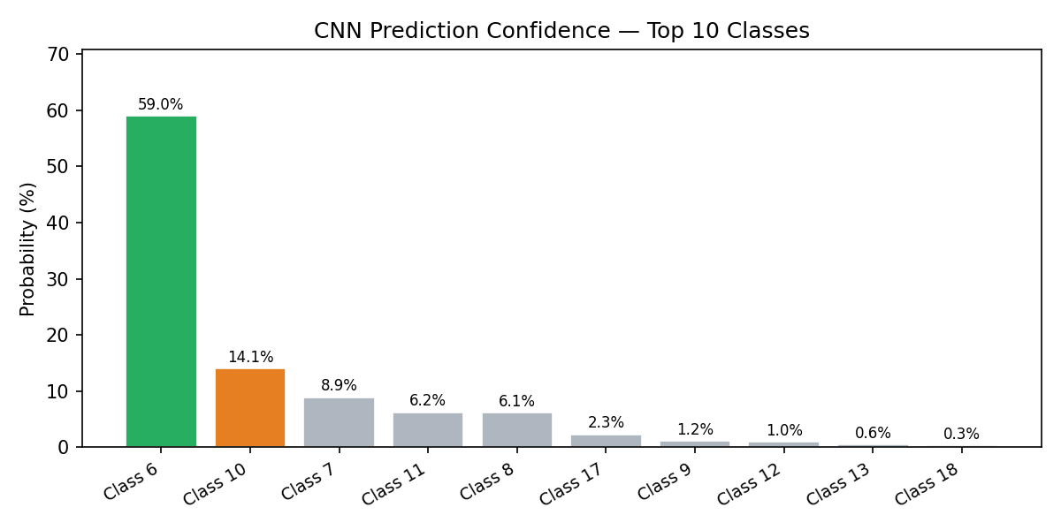
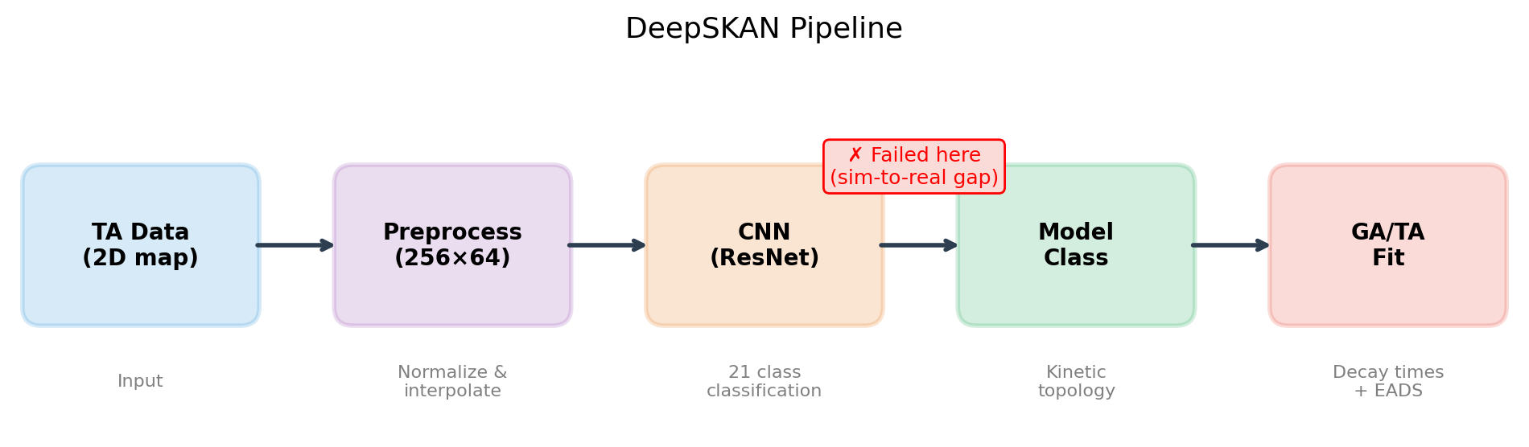
Can ML Automate Kinetic Model Selection?
From DeepSKAN (Kollenz et al. JPCB 2020) to our improved implementation
DeepSKAN: CNN for Kinetic Topology Classification
Kollenz et al., J. Phys. Chem. B (2020)
DOI: 10.1021/acs.jpcb.0c04299
Idea: Treat 2D TA map as IMAGE → classify topology
TA map (256×64) → ResNet CNN → 1 of 21 classes
Our Implementation:
• 7-block ResNet + BatchNorm + Dropout
• Trained on 100k synthetic samples (T4 GPU)
• 72% validation accuracy on 21 classes
Predictions on Real Data:
CBK-D: Class 19 (branching), confidence 40%
CBK-H: Class 6 (sequential), confidence 59%
CBK-H prediction is CLOSE to correct!
CBK-D prediction is WRONG (we know it's sequential)
Key Insight:
• Low confidence = model honestly reports uncertainty
• Sim-to-real gap: synthetic training ≠ real spectra
• Classification is hard; regression (predict τ) works better
Future: Agentic AI (LLM + literature → model suggestion)
→ No training data, no sim-to-real gap

