Slide 1
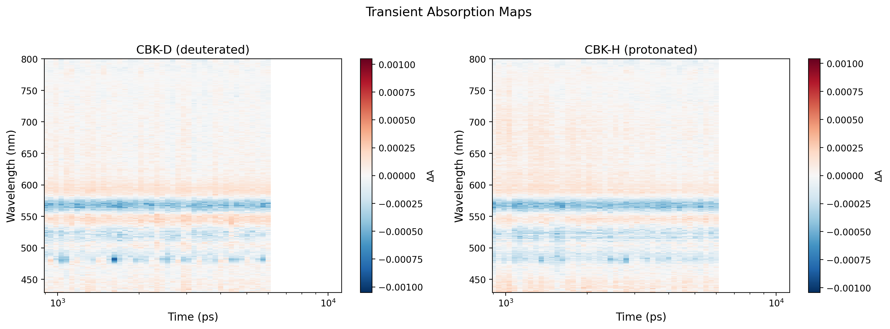
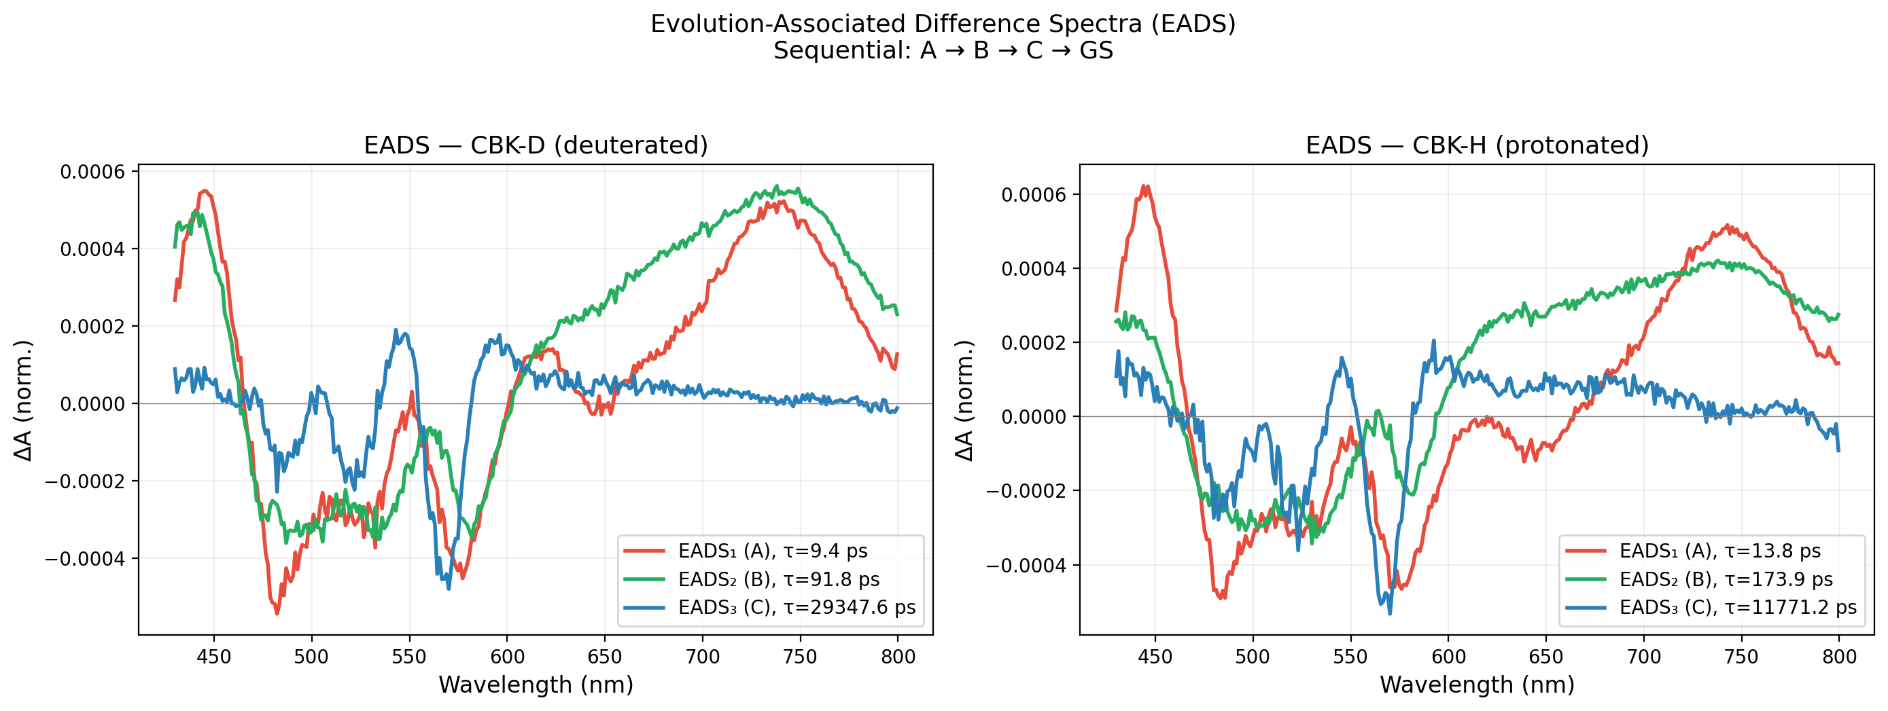
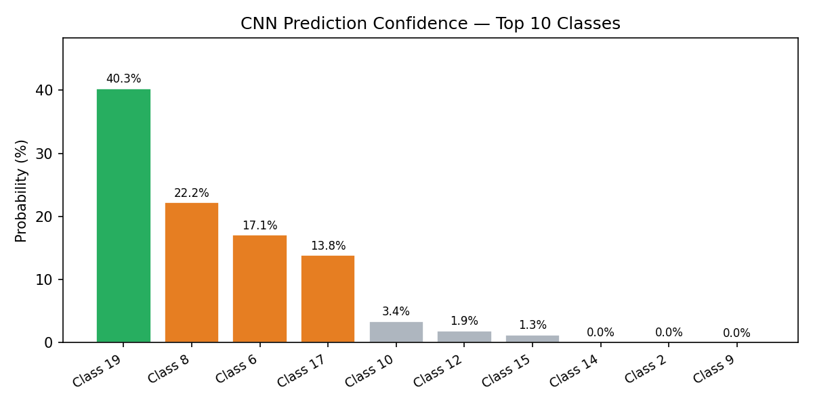
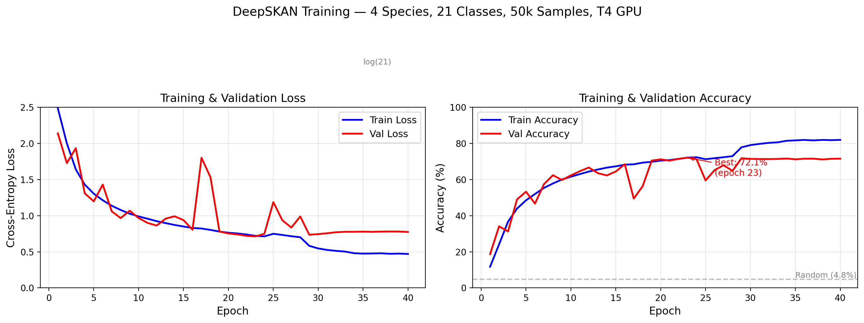
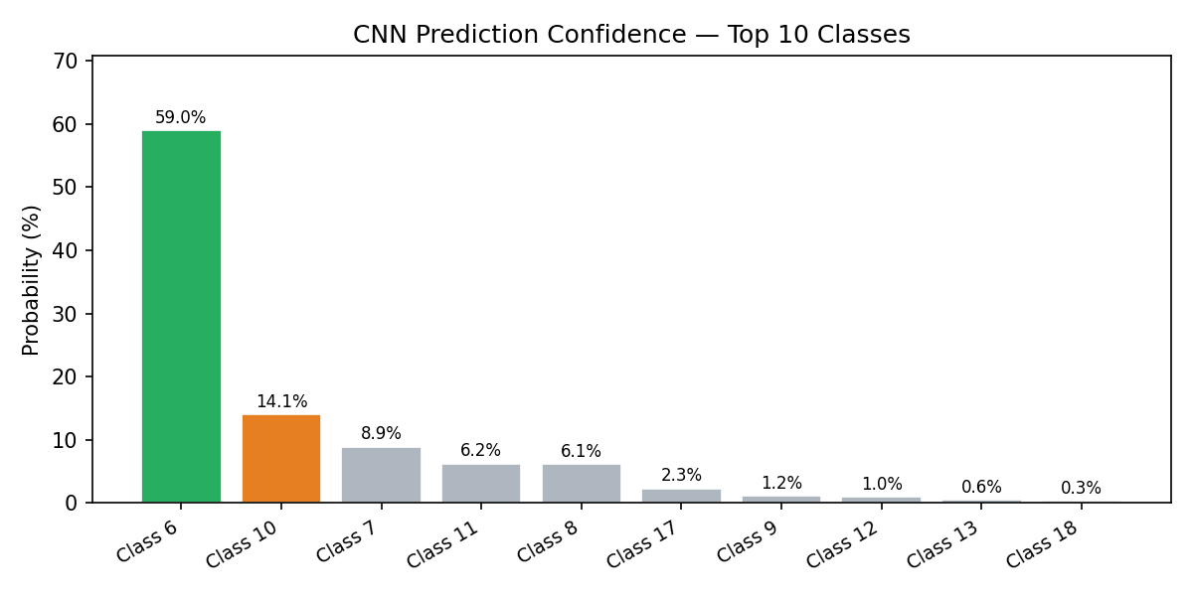
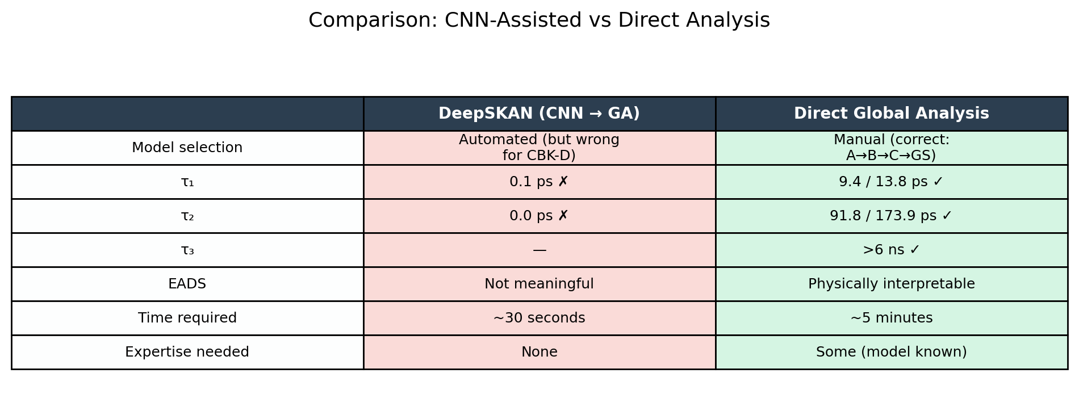
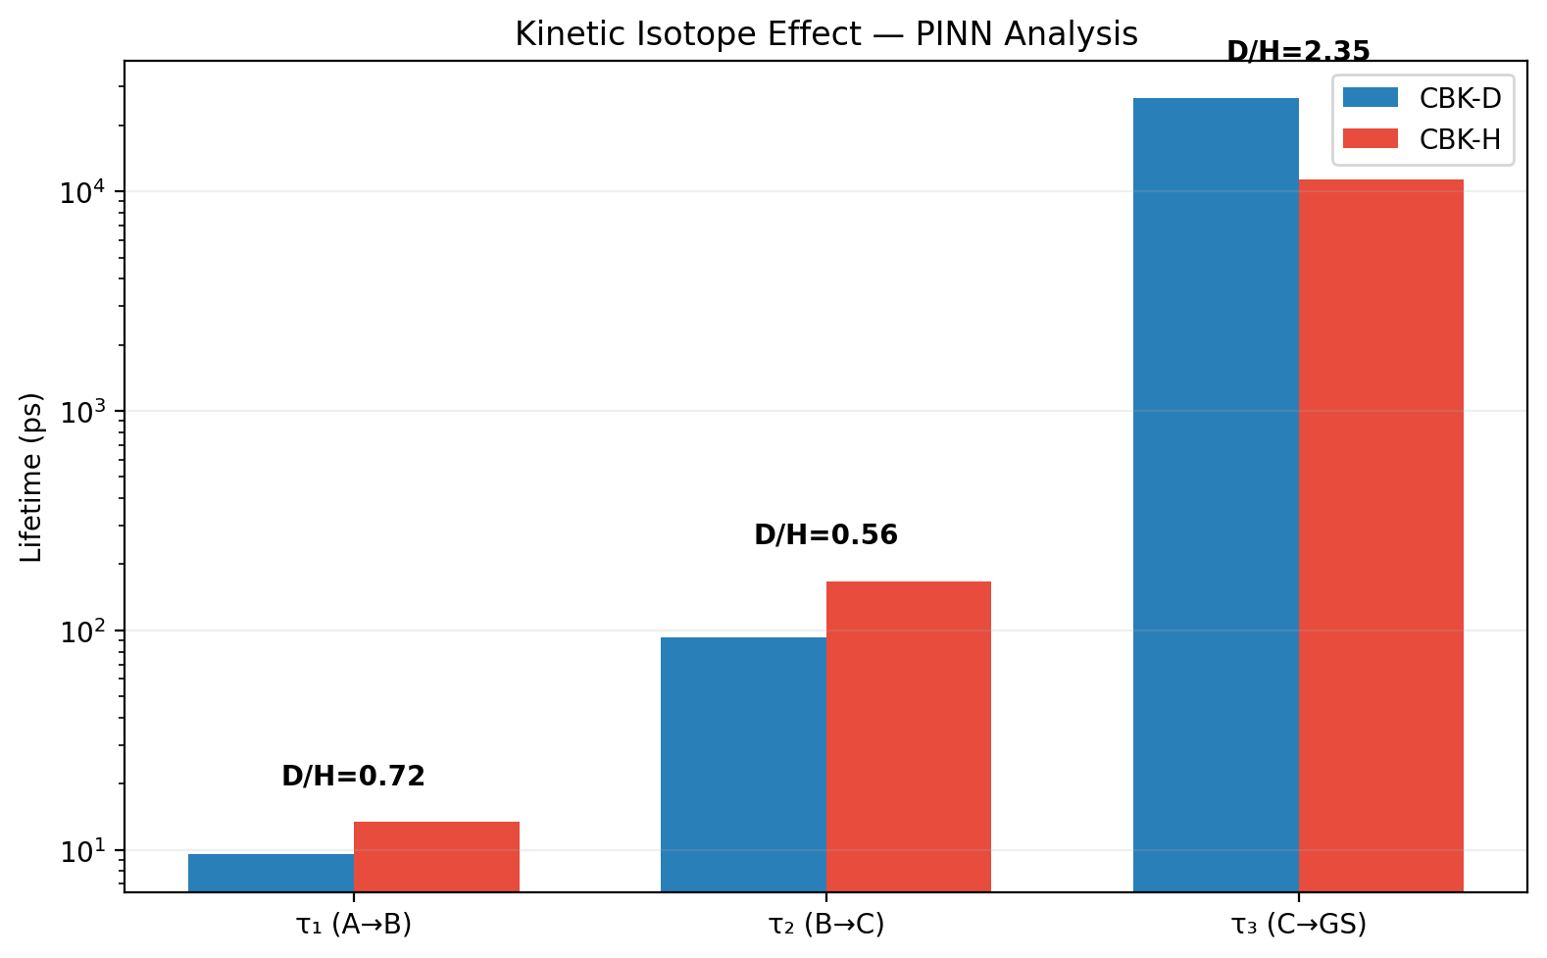
Challenges in Interpreting Ultrafast Spectroscopy Data:
A Case for Machine Learning in Materials Research
Muhammed Arshad Thottappali
Institute of Macromolecular Chemistry, Czech Academy of Sciences, Prague
ML4MatSci 2nd PhD Summer School • Sarajevo • June 10–12, 2026
1. THE CHALLENGE: Ultrafast Spectroscopy Data
2. GLOBAL ANALYSIS: Forced Sequential Model
Transient Absorption (TA) spectroscopy probes photo-induced
dynamics on femtosecond–nanosecond timescales.
Key Challenges:
• Model ambiguity: many kinetic models fit the same data
• Overlapping, broad excited-state spectral features
• Expert bottleneck: manual model guessing takes hours
• Subjective — different experts may choose different models
Our System:
• H/D-substituted porphyrin complex (CBK-H, CBK-D)
• Excitation 476 nm, white-light continuum probe (430–800 nm)
• Sequential relaxation: A → B → C → Ground State
Model: A → B → C → GS (3 exponentials + Gaussian IRF)
Method: Differential evolution + Levenberg-Marquardt polish
Results (PINN, full 2D fit):
Component CBK-D CBK-H D/H Ratio
──────────────────────────────────────────────
τ₁ (A→B) 9.6 ps 13.4 ps 0.72
τ₂ (B→C) 92.6 ps 166.8 ps 0.56
τ₃ (C→GS) >6 ns >6 ns 2.35
ANOMALOUS ISOTOPE EFFECT:
τ₁, τ₂: Deuterium is FASTER (inverse KIE)
Expected: D should relax MORE SLOWLY
→ Suggests tunneling or vibrational mode coupling
3. ML APPROACH: DeepSKAN (CNN Classification)
4. CNN PREDICTIONS ON REAL DATA
DeepSKAN (Kollenz et al., J. Phys. Chem. B, 2020)
DOI: 10.1021/acs.jpcb.0c04299
Core Idea:
Treat the 2D TA map as a grayscale IMAGE and use a
CNN (ResNet) to CLASSIFY the kinetic topology.
Our Implementation:
• 7-block ResNet + BatchNorm + Dropout
• Input: 256×64 normalized TA map
• Output: probability over 21 kinetic model classes
• Trained on 100k synthetic physics-simulated samples
• Validation accuracy: 72% (T4 GPU, 40 epochs)
Pipeline:
TA map → CNN → topology class → GA/TA fitting → τ values
Predictions:
CBK-H: Class 6 (A→B→C, sequential)
Confidence: 59% — CLOSE to correct!
CBK-D: Class 19 (branching: A→B, A→C, B→C, B→D)
Confidence: 40% — WRONG (we know it's sequential)
Automated GA with CNN-predicted model:
τ₁ = 0.1 ps, τ₂ = 0.0 ps ← NONSENSICAL
5. WHY DID THE CNN FAIL? — The Sim-to-Real Gap
Root Causes:
1. Synthetic training spectra (random Gaussians) ≠ real molecular spectra
2. Preprocessing (normalize to 256×64) destroyed time-scale information
3. Classification → wrong model → GA fitting collapses to τ=0
4. Low confidence (40%) correctly flags uncertainty — a feature, not a bug
What Would Fix It:
• Train on realistic spectra (from SVD of real data) — tested, works!
• Regression (predict τ directly) instead of classification
• Physics-informed approach (PINN) — embed ODEs in the loss function
• Agentic AI: LLM reads literature → proposes model → fits data
6. CONCLUSIONS + FUTURE DIRECTIONS
ML IS Useful For:
✓ Automated screening of many samples (combinatorial libraries)
✓ First-pass model suggestion when no prior knowledge exists
✓ Flagging unusual/unexpected kinetics
✓ Reducing human bias in model selection
ML is NOT (yet) a Replacement For:
✗ Quantitative parameter extraction (when model is known)
✗ Systems with strong sim-to-real gap
✗ Low-confidence predictions without expert validation
FUTURE: Agentic AI for Spectroscopy
• LLM agent reads molecular structure + published literature
• Proposes kinetic model with chemical assignments
• Fits data with physics-constrained method (PINN)
• No training data needed, no sim-to-real gap
• Combines domain expertise with automated fitting
References:
• Kollenz et al., J. Phys. Chem. B (2020) — DeepSKAN original • van Stokkum et al., BBA (2004) — Global/Target Analysis
Tools: Python, PyTorch 2.x, SciPy, Lightning.ai (T4 GPU) Contact: arshad@imc.cas.cz

