Slide 1


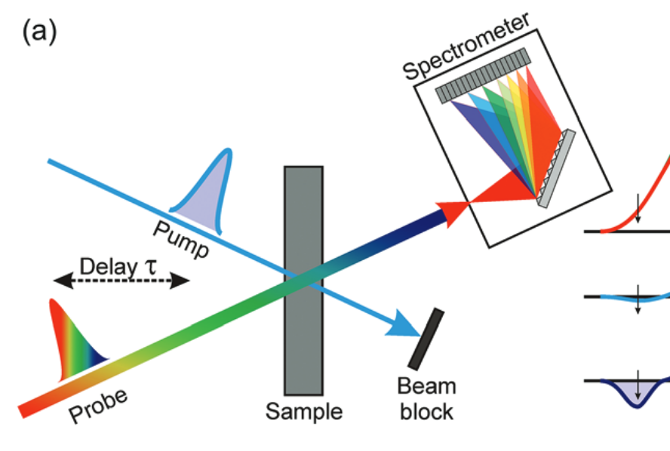
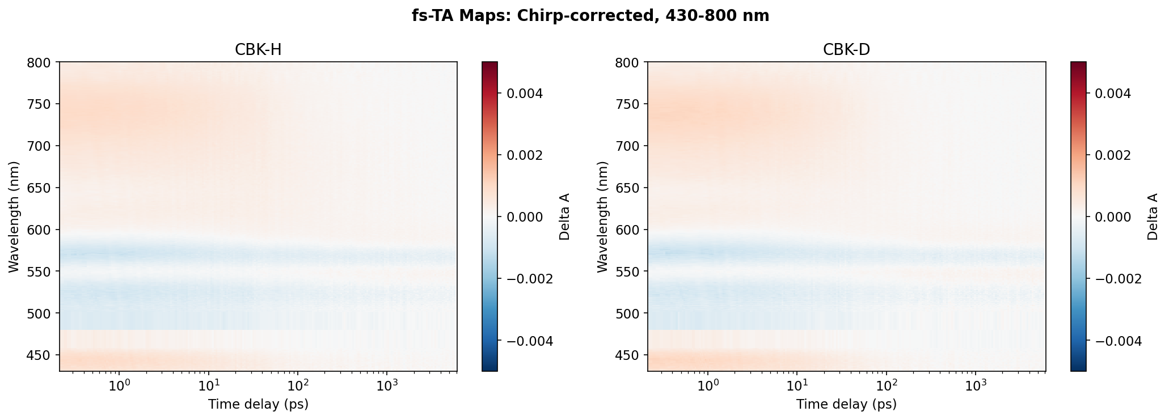
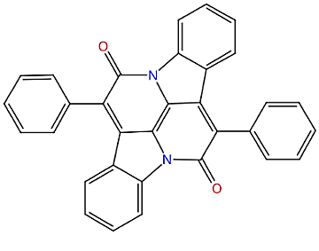
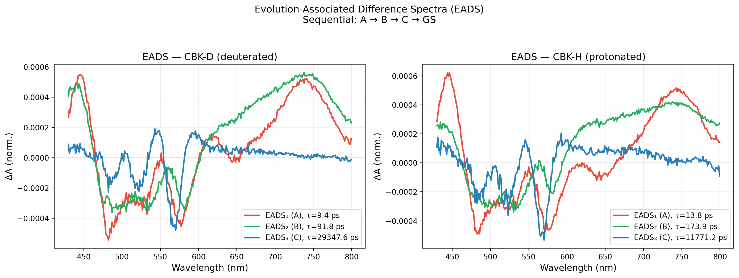
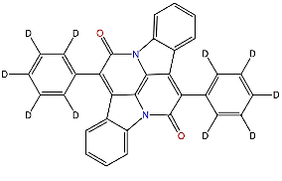
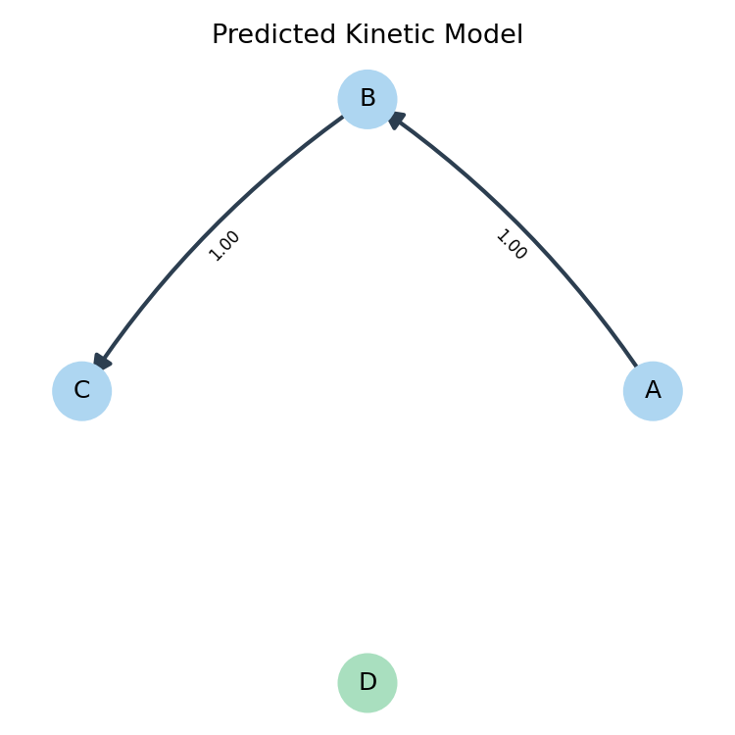
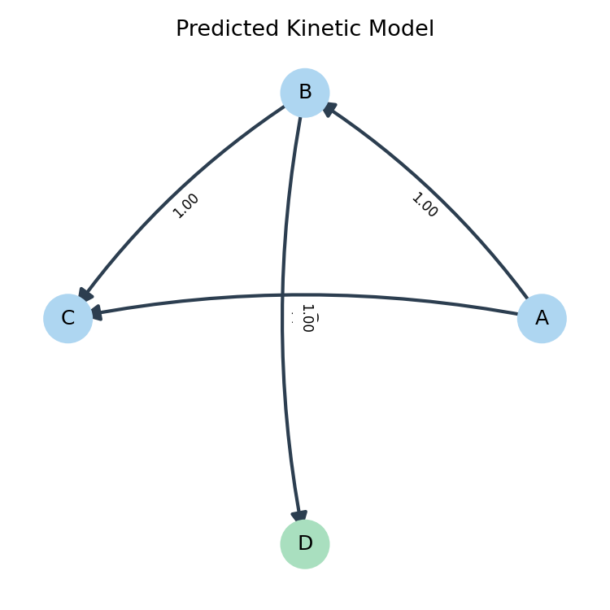
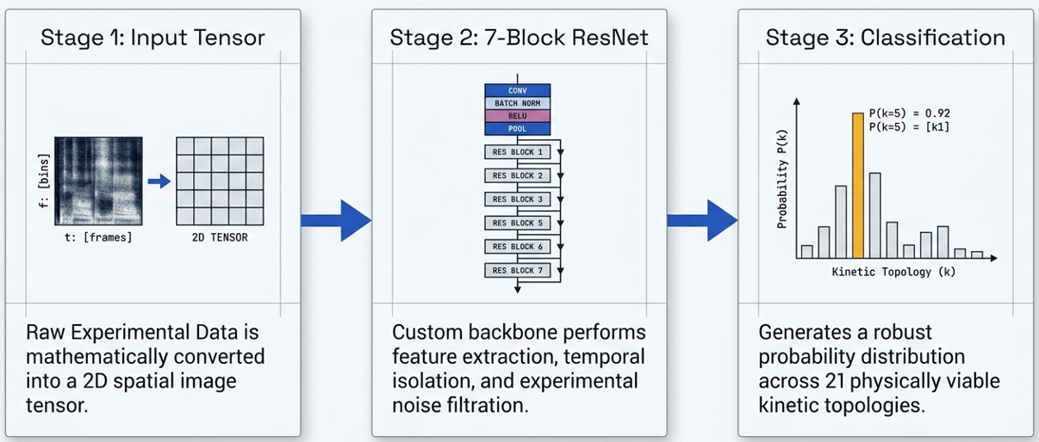
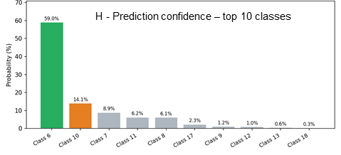
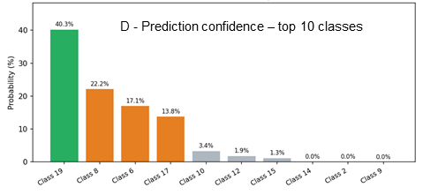
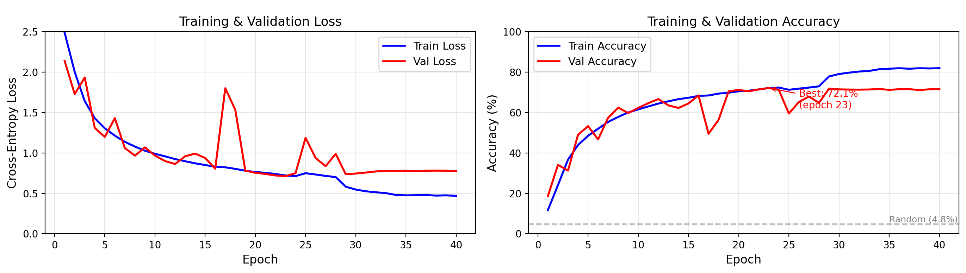

Challenges in Interpreting Ultrafast Spectroscopy Data: A Case for Machine Learning in Materials Research
Muhammed Arshad Thottappali¹
¹Institute of Macromolecular Chemistry CAS, Prague, 16200, Czech Republic.
Introduction
  Transient Absorption (TA) spectroscopy probes photo-induced dynamics on femtosecond-nanosecond timescales.
  Uncovering Mechanisms: It is considered one of the most powerful methods for elucidating the mechanisms of excited state dynamics
  Determining Kinetic Models: A primary use of the technique is to determine the underlying kinetic model, which explains exactly how a molecular system evolves, relaxes, or transitions between states after absorbing light
  Driving Technological Innovation: Due to its wide applicability, it is a crucial tool for characterizing and developing new materials for fields such as organic electronics, solar cell applications, data storage, medicine, etc.
Experiment - transient optical absorption spectroscopy
ESA
Singlet
S_{n}
T_{n}
$\text{∆}$Absorbance
ESA
Triplet
ESA
Singlet
S₁
ESA
Triplet
GSB
SE
GSB
SE
T₁
Wavelength
S₀
Pump-probe experimental arrangement.
Spectral features observed in transient absorption spectroscopy.
Classical approach
  Ultrafast spectroscopy generates massive, complex 2D datasets.
  Key Challenges:
  Model ambiguity: different kinetic models fit the same data
  Overlapping, broad excited-state spectral features
  Expert bottleneck: manual model guessing takes hours
  Subjective — different researchers may choose different models
  Molecular system under study :
  H/D-substituted indolonaphthyridines complex (CBK-H - Protonated, CBK-D - Deuterated ).
  Measure the Kinetics by comparing Protonated and Deuterated
  Excitation 476 nm, white-light continuum probe (430–800 nm).
  Sequential relaxation: A → B → C → Ground State
CBK-H
  Global analysis - Model: A → B → C → GS (3 exponentials + Gaussian IRF)
  Anomalous effect: τ₁, τ₂: excited state of Deuterium is decaying faster.
  Expected: Usually, deuterated organic molecules relax more slowly in the excited state than the normal hydrogen analogs
  Traditional Global Target Analysis relies on assuming a predefined kinetic model with an exponential decays.
  The Problem: How do we confirm this 3-state exponential model is chemically accurate in both case?
Component | CBK-H | CBK-D
τ₁ (A→B) | 13.8 ps | 9.9 ps
τ₂ (B→C) | 173.9 ps | 91.8 ps
τ₃ (C→GS) | >6 ns | >6 ns
CBK-D
ML APPROACH: DeepSKAN
Results
  The Inspiration: We turned to DeepSKAN (Kollenz 2020) for unbiased topological discovery. DeepSKAN (Kollenz et al., J. Phys. Chem. B, 2020) DOI: 10.1021/acs.jpcb.0c04299
  Image-Based Analysis: Treats raw 2D transient absorption heatmaps directly as images (Time vs. Wavelength).
  Custom 7-Block ResNet: Uses asymmetric 1D convolutional kernels to isolate temporal decays, then square 2D kernels to extract spatio-temporal features.
  Robust Architecture: Upgraded with Adaptive Pooling to accept any spectrometer resolution, and Batch Normalization/Dropout to stabilize against real-world noise.
  Artifact-Aware Training: Trained on a balanced dataset of 50,000 synthetic spectra injected with simulated experimental artifacts (baseline drifts, scatter spikes) to prevent the network from memorizing noise.
  Unbiased Output: Bypasses human curve-fitting by calculating the mathematical probability across 21 viable kinetic models (up to 4 molecular states).
  CBK-H (Protonated): When fed the CBK-H data, DeepSKAN predicted Class 6 with a dominant 59.0% confidence.
  Resulting Topology: A pure sequential decay (A→B → C), exactly matching the simple sequential model.
  CBK-D (Deuterated): When fed the CBK-D data, the network detected completely different visual patterns. The highest
  Prediction was Class 19 (40.3% confidence), with other branched models (Class 8, Class 17) making up the rest. Resulting Topology:
  A complex branched pathway where state B splits into multiple decay routes.
Predicted kinetic model - H
Predicted kinetic model - D
Conclusion
  DeepSKAN predicts that Deuteration might not simply slow down the reaction; it possibly alters the topological mechanism from sequential to branched.
  The 'Anomalous behavior' observed in the traditional analysis is likely an artifact of forcing an incorrect model.
  It provides a possible decay pathway which can be explored for a better understanding of excited state dynamics
Future Directions & Why I Am Here:
The "Vibe-Coding" Confession: As a spectroscopy major, I used AI to help me modernize and code this custom PyTorch architecture. It appeared to solved the problem, but I am largely "vibe-coding" the deep learning aspects!
Looking for Feedback: I came to this Summer School specifically to find out: Am I doing this right? I understand the physical chemistry perfectly, but I am looking for experts to help me understand exactly why my code works so well.
Call for Collaboration: Seeking ML/DL collaborators to help transition this from an AI-assisted experiment into a rigorously optimized, autonomous pipeline.
Notes:
B – lišty s nadpisy bez předlohy (vše je přímo ve snímku, lépe se chová při změně formátu posteru)

