Slide 1
HCI Group 5
Niran
Low-Fidelity Prototype
Team Members:
Arshad Abbas(2019300)
Arihant Singh(2019298)
Khushi Agarwal(2019312)
Kirti Gautam(2018291)
Sudeep Reddy(2019313)

Slide 2
Solution Statement:
Problem Statement:
Niran will help bridge the gap between the glories of our past and the younger generation’s interest. We have made use of gamification to let people tell the stories they know and let others learn about these. Our aim is to make historical stories, legends and local traditions easily accessible, interactive and bring them to life.
Our vast history and local traditions are getting lost in today’s fast and urbanised lifestyles. People have little to no time to pay attention to the glories of our past. The younger generation has little to no knowledge of the local histories and traditions of their area.

Slide 3
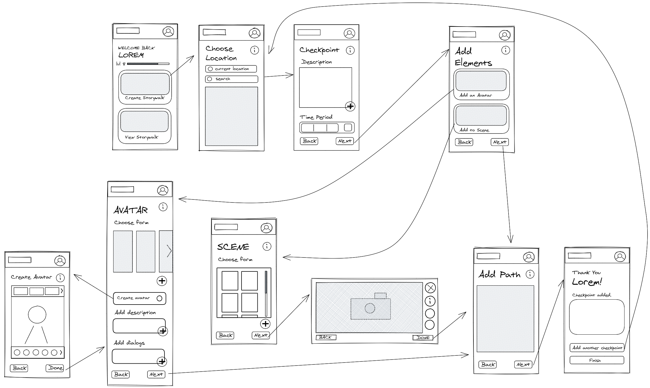
Start
Finish

