Slide 1
HCI Group 5
Niran
Middle-Fidelity Prototype
Team Members:
Arshad Abbas(2019300)
Arihant Singh(2019298)
Khushi Agarwal(2019312)
Kirti Gautam(2018291)
Sudeep Reddy(2019313)

Slide 2
Solution Statement:
Problem Statement:
Our vast history and local traditions are getting lost in today’s fast and urbanised lifestyles.
A youngster has little knowledge of the vast history and local traditions of their country as they have no time and interest, this makes them feel uniformed and at loss.
An elderly person has no way to tell the stories they know and have heard about their surrounding through their lives and this makes them feel frustrated and angry.
Niran will help bridge the gap between the glories of our past and the younger generation’s interest. We have made use of gamification to let people tell the stories they know and let others learn about these. Our aim is to make historical stories, legends and local traditions easily accessible, interactive and bring them to life.

Slide 3
Scenario steps To create and add a Checkpoint
Step 1 : Users are welcomed by the homepage. User picks the option to create a storywalk.
Step 2 : The user is given the option to choose between the current location they are at or another location to add the storywalk to . The user chooses the current location option.
Step 3 : They are asked to add the description of the checkpoint and the time period that they are creating the story walk from. The user adds the description and the time period and clicks next.
Step 4 : They are given the option to add an avatar or an element to the scene. They can do both. The user picks add an avatar.
Step 5 : While adding an avatar to the scene they are able to choose from an avatar library or create their own avatar and are asked to add a description and dialogs for the avatar. After choosing and adding these the user clicks next.
Continued...

Slide 4
Step 6 : While adding an element to the screen the user is able to choose from an element library from which they can select the various elements they want to add to the scene. The user selects a few elements and clicks next.
Step 7 : The user is then taken to his camera from which he is able to add elements onto the space in real time while being able to edit aspects of the elements. The user places all the elements that they picked into the scene via the camera with the proper orientation. The user clicks done.
Step 8 : The user is asked to add a path the viewer's need to follow to complete the storywalk that the user has created. The user adds a path on the map and clicks next.
Step 9 : The user is presented with a screen which tells them that their checkpoint has been added and they are asked whether they want to create another checkpoint or finish their storywalk.

Slide 5
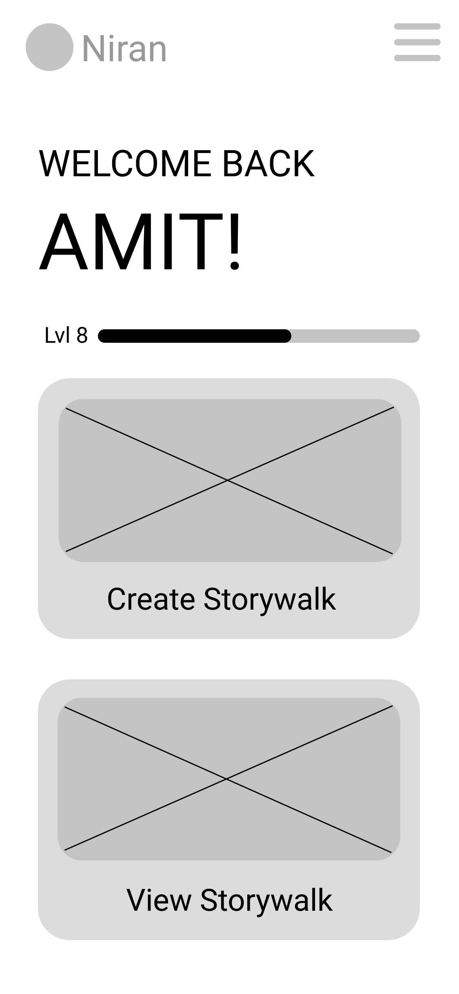
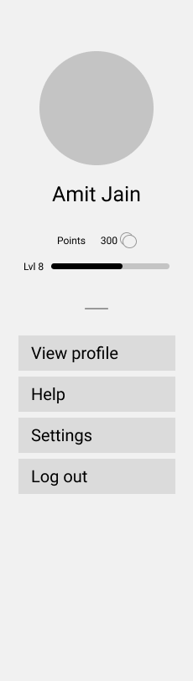
Hamburger Menu:
Displays the profile picture of the user
Shows the level and the number of points the user has at the moment
View profile button: to view the user profile
Help button: to visit the help page
Settings button: to change user settings
Logout button: to log out of the profile

Slide 6
Step 1 :
Users are welcomed by the homepage. User picks the option to create a storywalk.
Menu Button: Menu button expands a side menu, which has the following options:
View Profile
Settings
Help
Logout
Experience Bar: Experience increases as the user adds or completes more storywalks.
The user would click the Create Storywalk button
Create Storywalk*: Initiates the steps required to create a storywalk.
View Storywalk: The user would click this to view the number of storywalks that are available on our app
* A story walk is a story that is mapped onto a location that is made by other users that want to share the history that they know of a particular place.
Clicking on Create Storywalk results in moving to the screen on the slide 7.

Slide 7
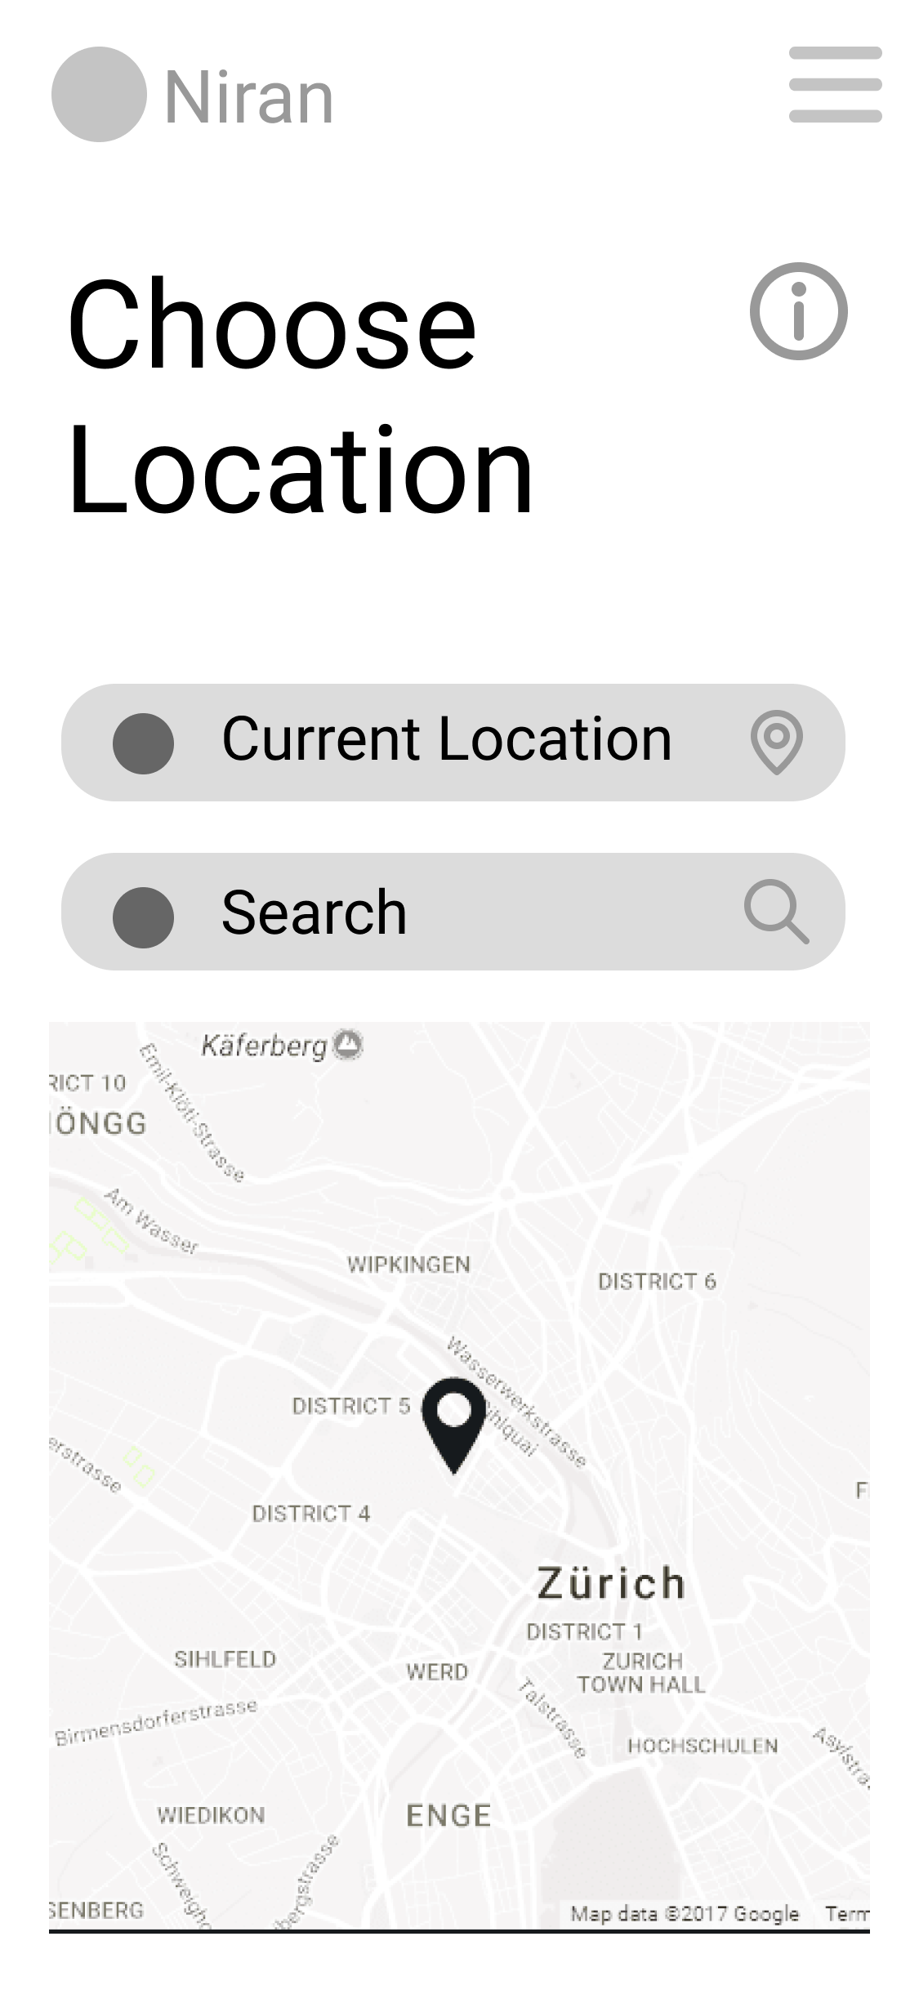
Step 2 :
The user is given the option to choose between the current location they are at or another location to add the storywalk to. The user chooses the current location option.
Information Button: Would give the user information on how to choose a location
The user would click the current location button.
Current Location : The user would be able to create the story walk in the current location they are in
Search : The user would be able to search for locations that they want to add their story walks to.
They would be able to pick and view the location on the map that they want to add their story walk to from the map.
Adding location results in moving to the screen on the slide 8.

Slide 8
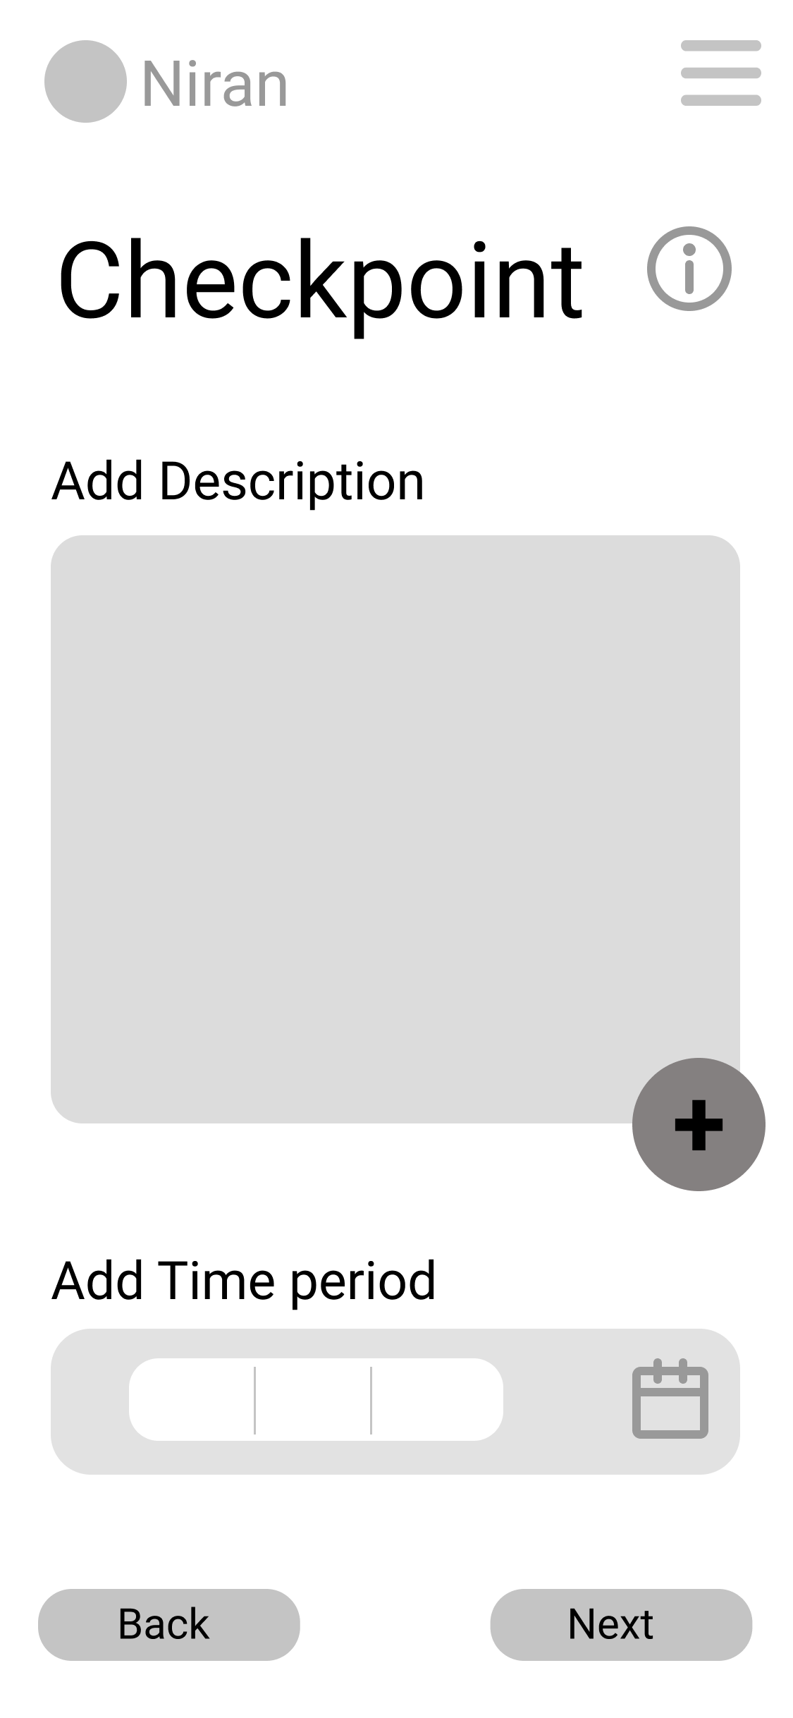
Step 3 :
They are asked to add the description of the checkpoint and the time period that they are creating the story walk from. The user adds the description and the time period and clicks next.
Information Button: Would give the user information on what a checkpoint is and how to create one.
Description : The user would be able to write a description of the checkpoint that they want to add.
The user would click the Add Description Button and add a description of the checkpoint.
Add Description Button: The user would be able to click this to add multiple descriptions of the checkpoint.
The user would click the Add Time Period Button and add the time period.
Add Time Period: The user would be able to pick the time period that they want their storywalk to be from.
Clicking on Back results in moving to the screen on the slide 7.
Clicking on Next results in moving to the screen on the slide 9.

Slide 9
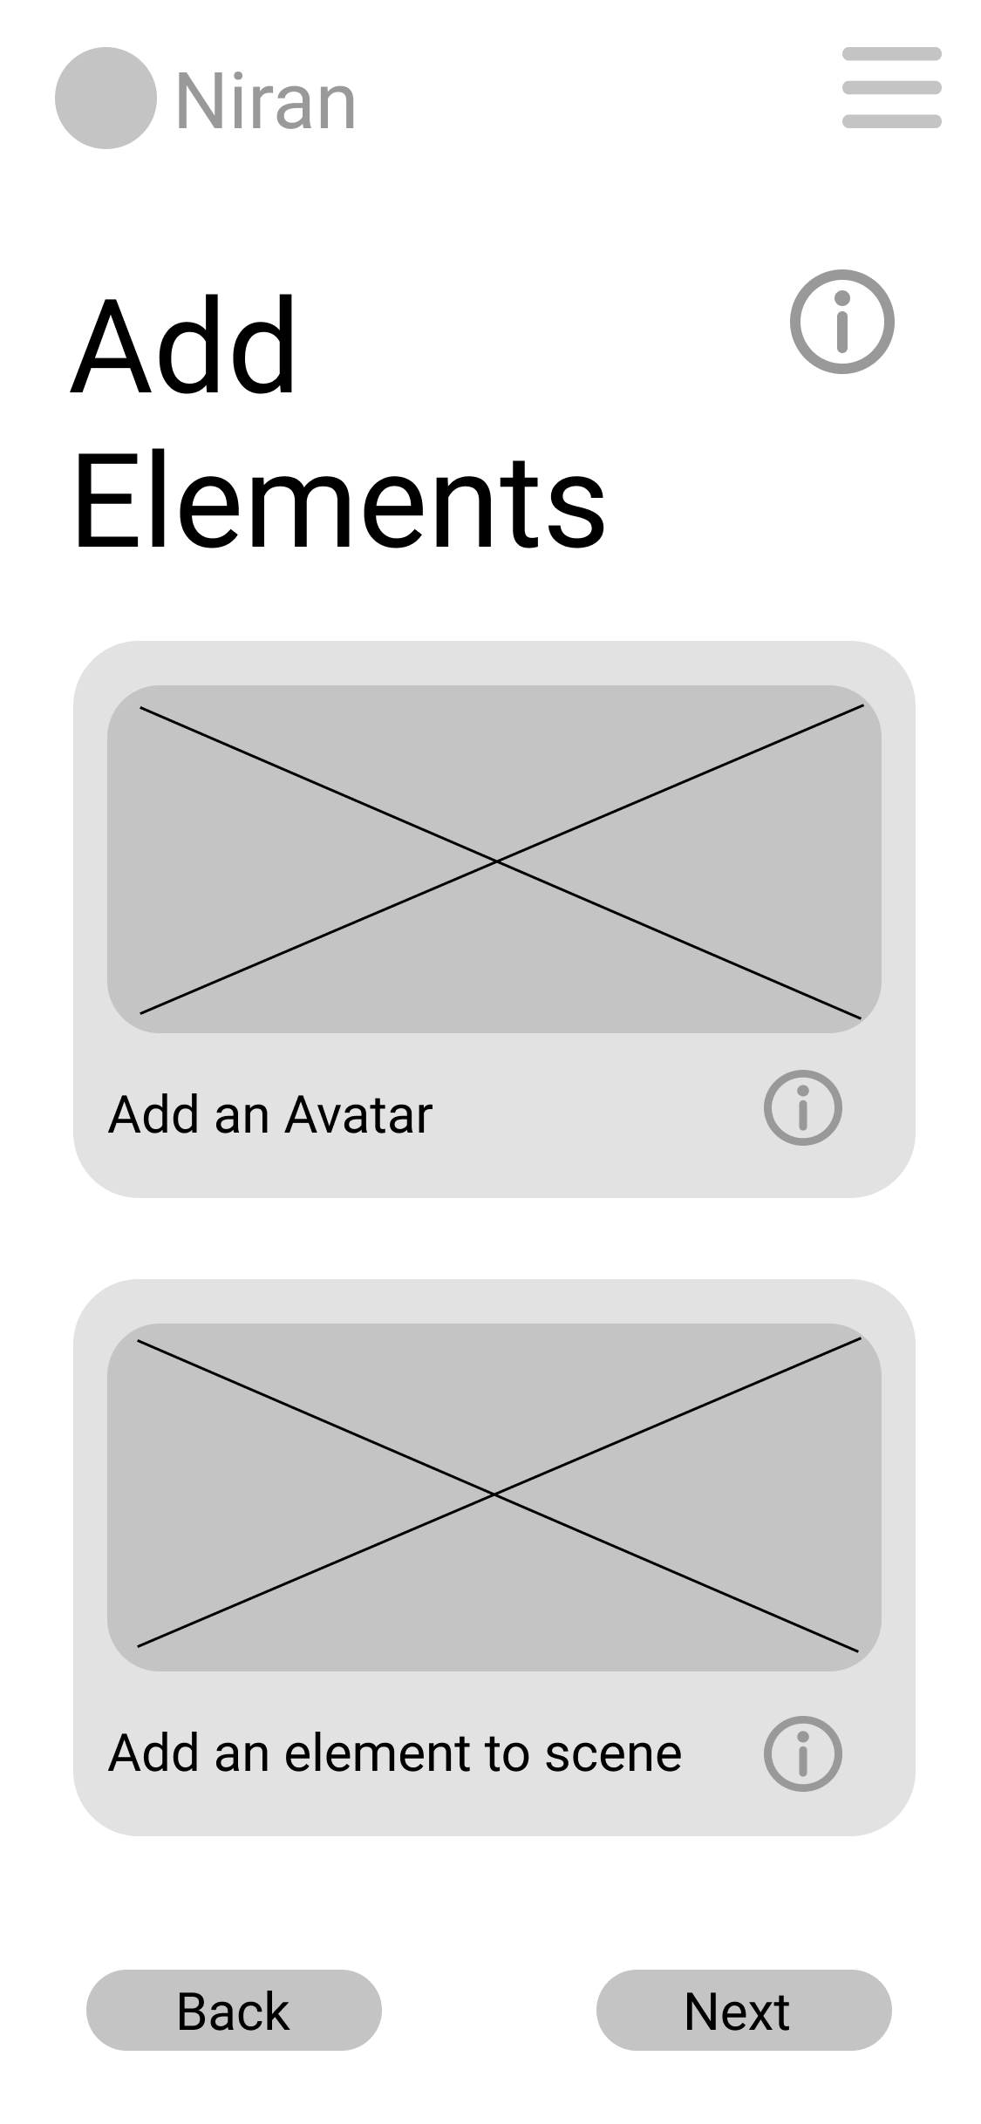
Step 4 :
They are given the option to add an avatar or an element to the scene. They can do both. The user picks add an avatar.
Help Button: Would give the user the information about adding elements and how to complete this step
Add Avatar Button: This button takes the user to to the page that allows the user to add an AR avatar
The user would click the “Add and Avatar” button to proceed to complete the task.
Add Element Button: This button takes the user to to the page that allows the user to add an AR object
Adding Add Avatar results in moving to the screen on the slide 10.
Clicking on Back results in moving to the screen on the slide 8.
Adding Add Element to scene results in moving to the screen on the slide 12.

Slide 10
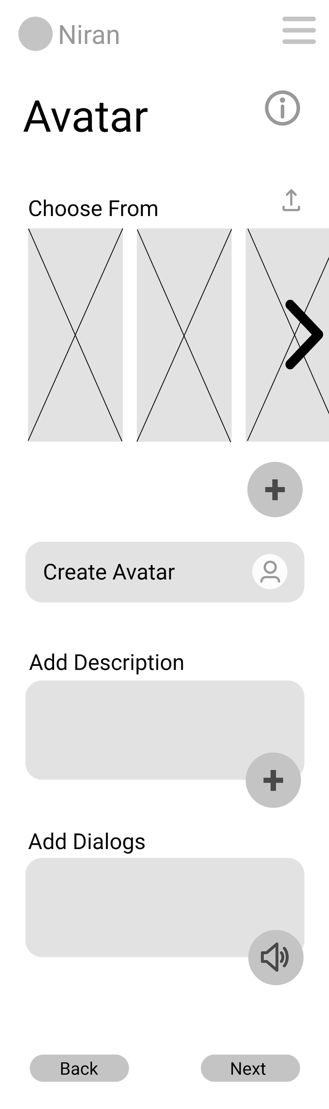
Step 5 :
While adding an avatar to the scene they are able to (a) choose from an avatar library or (b) create their own avatar and are asked to add a description and dialogs for the avatar.
Help Button: Would give the user the information choosing/creating avatar, adding description about the avatar and adding the dialogs for the the avatar.
Upload Button: The user can upload a 3D asset form his device if he is not satisfied with the avatars available from our database or he is not able to create a satisfactory avatar from our app.
Avatars present in our database.
Add Button: Lets users to add the selected avatars to the scene.
Create Avatar Button: Takes user to the “create avatar” page where the user can create an avatar from scratch.
Lets user add description about the avatar.
The user will click “Create Avatar ” button and proceed to complete the task.
Lets user record dialogs which will be stored with the avatar.
Clicking on Create Avatar results in moving to the screen on the slide 11.
Clicking on Back results in moving to the screen on the slide 9.
Clicking on Next results in moving to the screen on the slide 14.

Slide 11
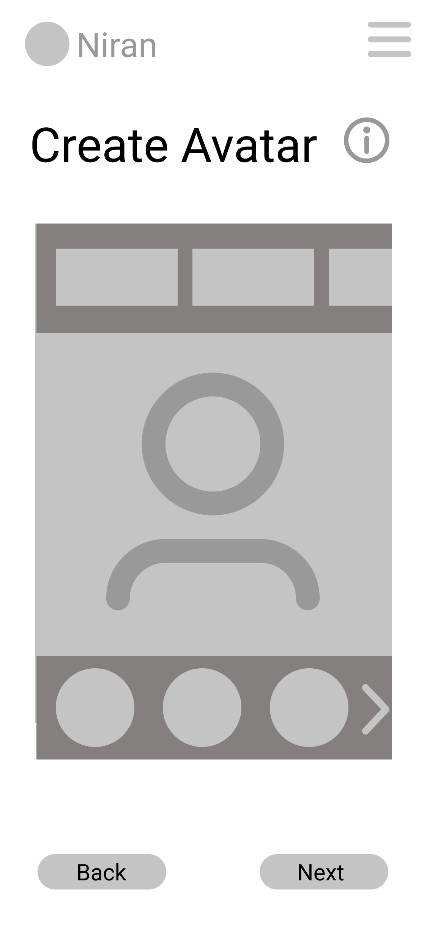
Step 5 :
While adding an avatar to the scene they are able to (a) choose from an avatar library or (b) create their own avatar and are asked to add a description and dialogs for the avatar.
Here the user chooses “Create-Avatar” option
Help Button: Walks the user through the process of creating an avatar.
The preview of the avatar.
The user changes the characteristics of the avatar like gender, face, height , shoulders, chest, eyes etc.
Clicking on Back results in moving to the screen on the slide 10.
Clicking on Next results in moving to the screen on the slide 14.

Slide 12
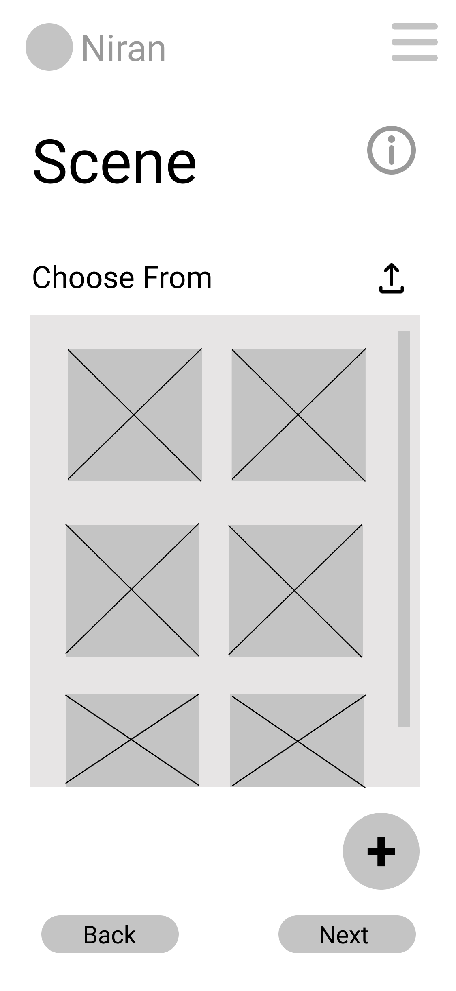
Step 6 :
While adding an element to the screen the user is able to choose from an element library from which they can select the various elements they want to add to the scene.
Information Button: Tells the user to select/upload one or more elements.
Upload Button: To upload the elements from the user’s device to the element library.
Element Library: choose and select the elements the user wants from the element library.
The user would select a few elements.
Add Button: to place in the scene
Clicking on Back results in moving to the screen on the slide 9.
Clicking on Next results in moving to the screen on the slide 13.

Slide 13
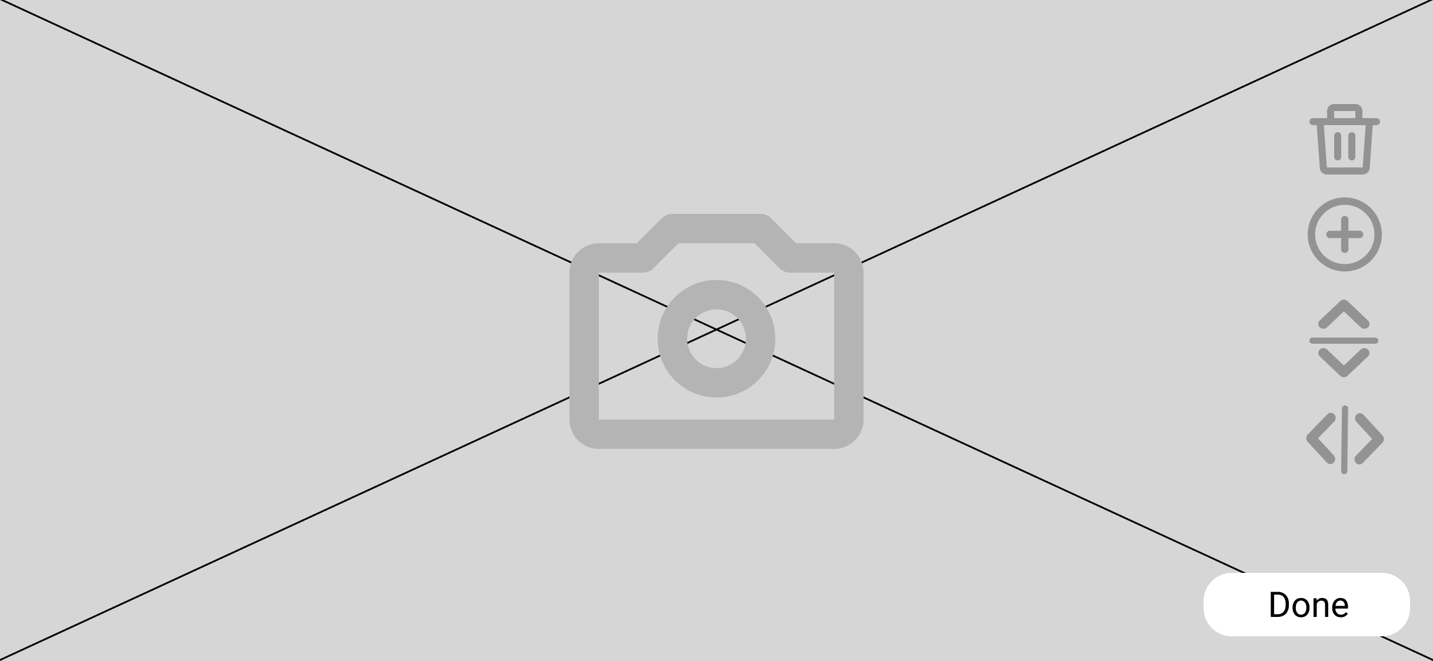
Step 7 :
The user is taken to his camera from which he is able to add elements onto the space in real time while being able to edit aspects of the elements.
Delete Button: To delete elements that are not needed.
The user places all the elements that they picked into the scene via the camera.
Add Button: To add more elements of the same type.
Vertical and horizontal flip button: To change the orientation of the elements.
Clicking on Done results in moving to the screen on the slide 14.

Slide 14
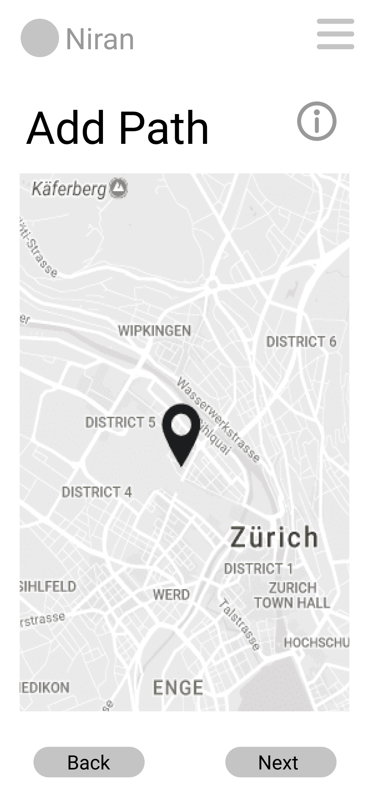
Step 8 :
The user is asked to add a path the viewer's need to follow to complete the storywalk that the user has created. The user adds a path on the map and clicks next.
Help Button: Would give the user the information about adding a path and how to complete this step
The user would click the click on a location on the map to add pointers to it
Place pointers on map: The user is able to select locations on the map and add a path for the storywalk
Next Button: This button takes the user straight to the final page of this task, and the user can review what he has added till now
Clicking on Back results in moving to the screen on the slide 9.
Clicking on Next results in moving to the screen on the slide 15.

Slide 15
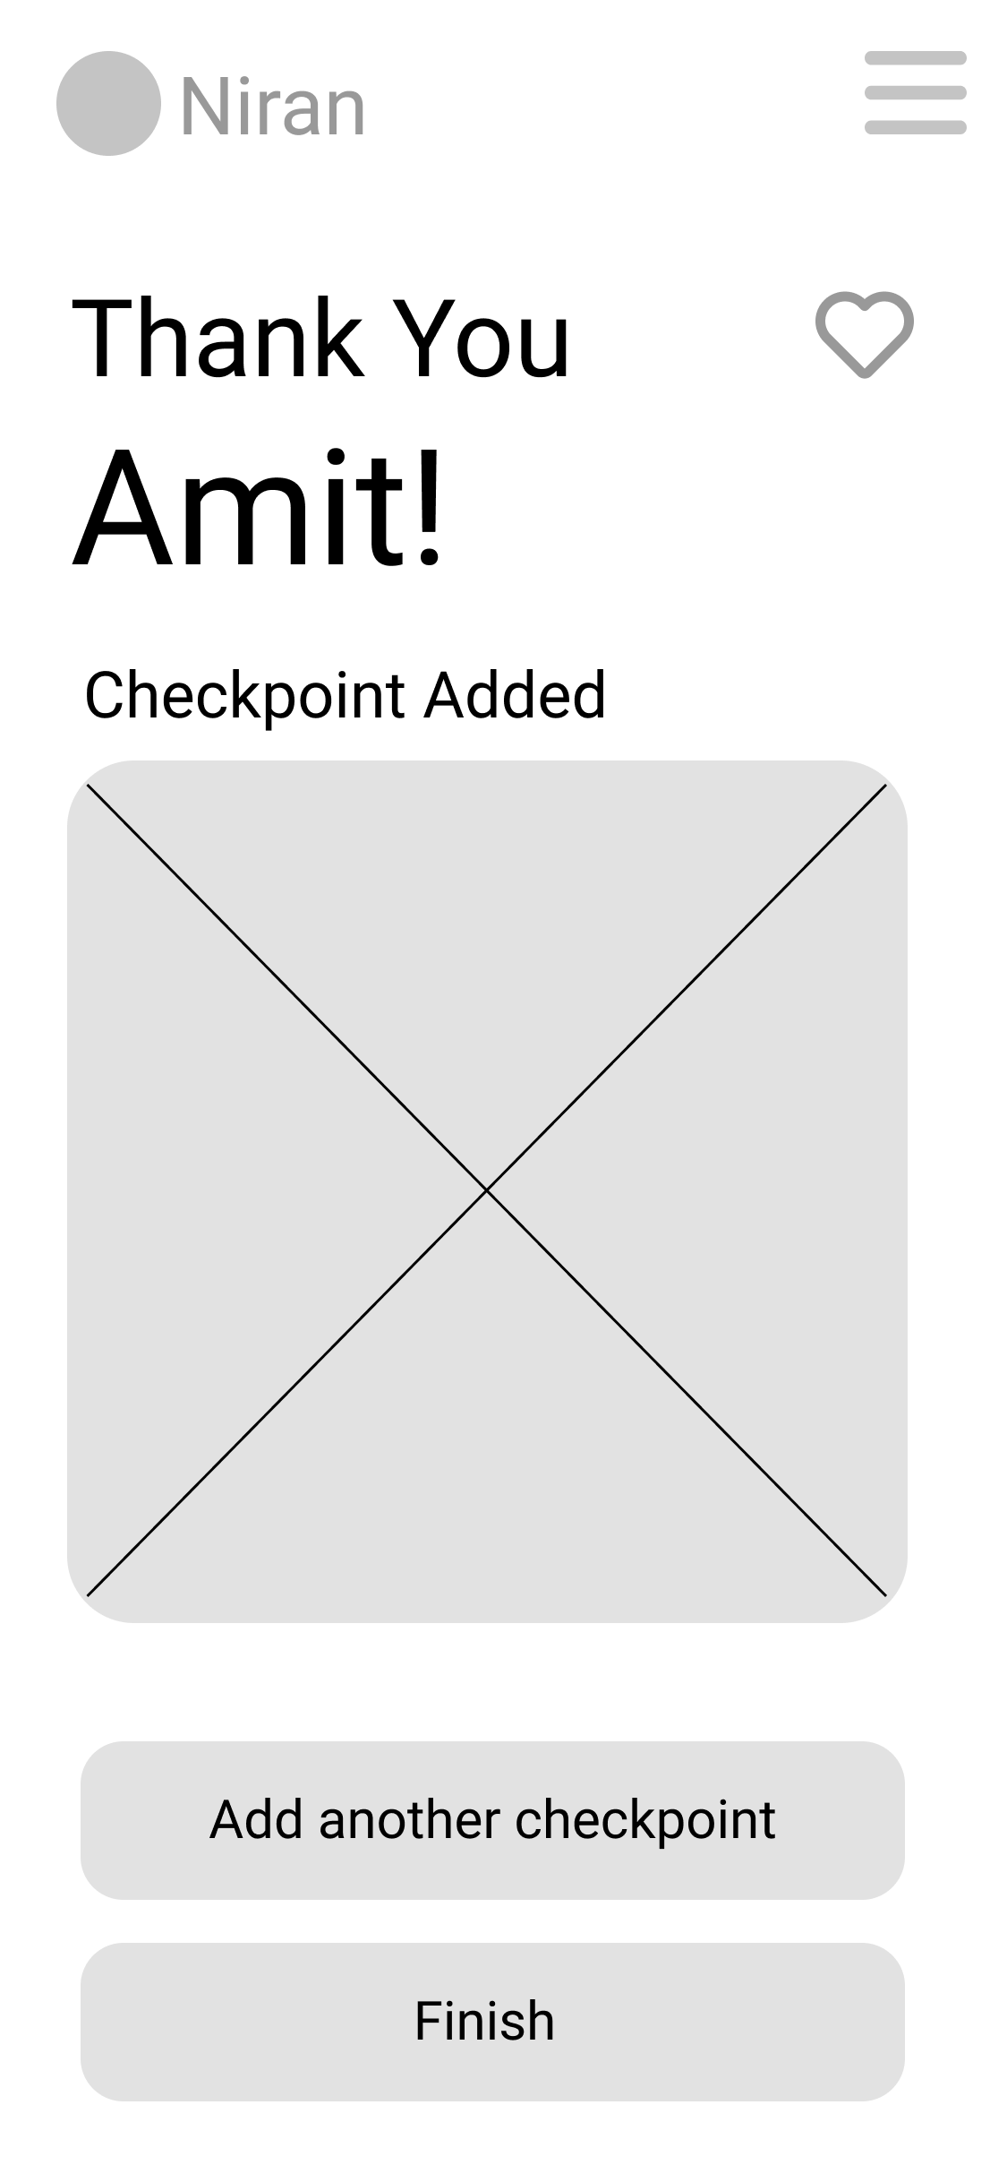
Step 9 :
The user is presented with a screen which tells them that their checkpoint has been added and they are asked whether they want to create another checkpoint or finish their storywalk.
Like button: The user can add the checkpoint to their favourite list if they want.
Summarizes the checkpoint the user has added in the form an illustration
Add another checkpoint button: Gives the user an option to add another checkpoint to the storywalk.
Finish button: Gives the user an option to finish adding checkpoints and move back to the home screen.

