Slide 1
Persona Mapping
Group 5

Slide 2
Project Description
Problem Statement:
Our vast history and local traditions are getting lost in today’s fast and urbanised lifestyles. People have little to no time to pay attention to the glories of our past.
Project Title:
Niran
Description:
Proof of the fact that this is viable and required(description)-> opportunity area
There are often some stories and legends known to the elderly people and local craftsmen that are unheard of. These stories and the local traditions get lost somewhere in the growing urbanisation and busy lifestyles. So gamification or some sort of broken-down easy way to get to know about such histories or even tell them could be a great way to revive our culture and antiques. Our users being the center of our system design would enhance this experience for one another.

Slide 3
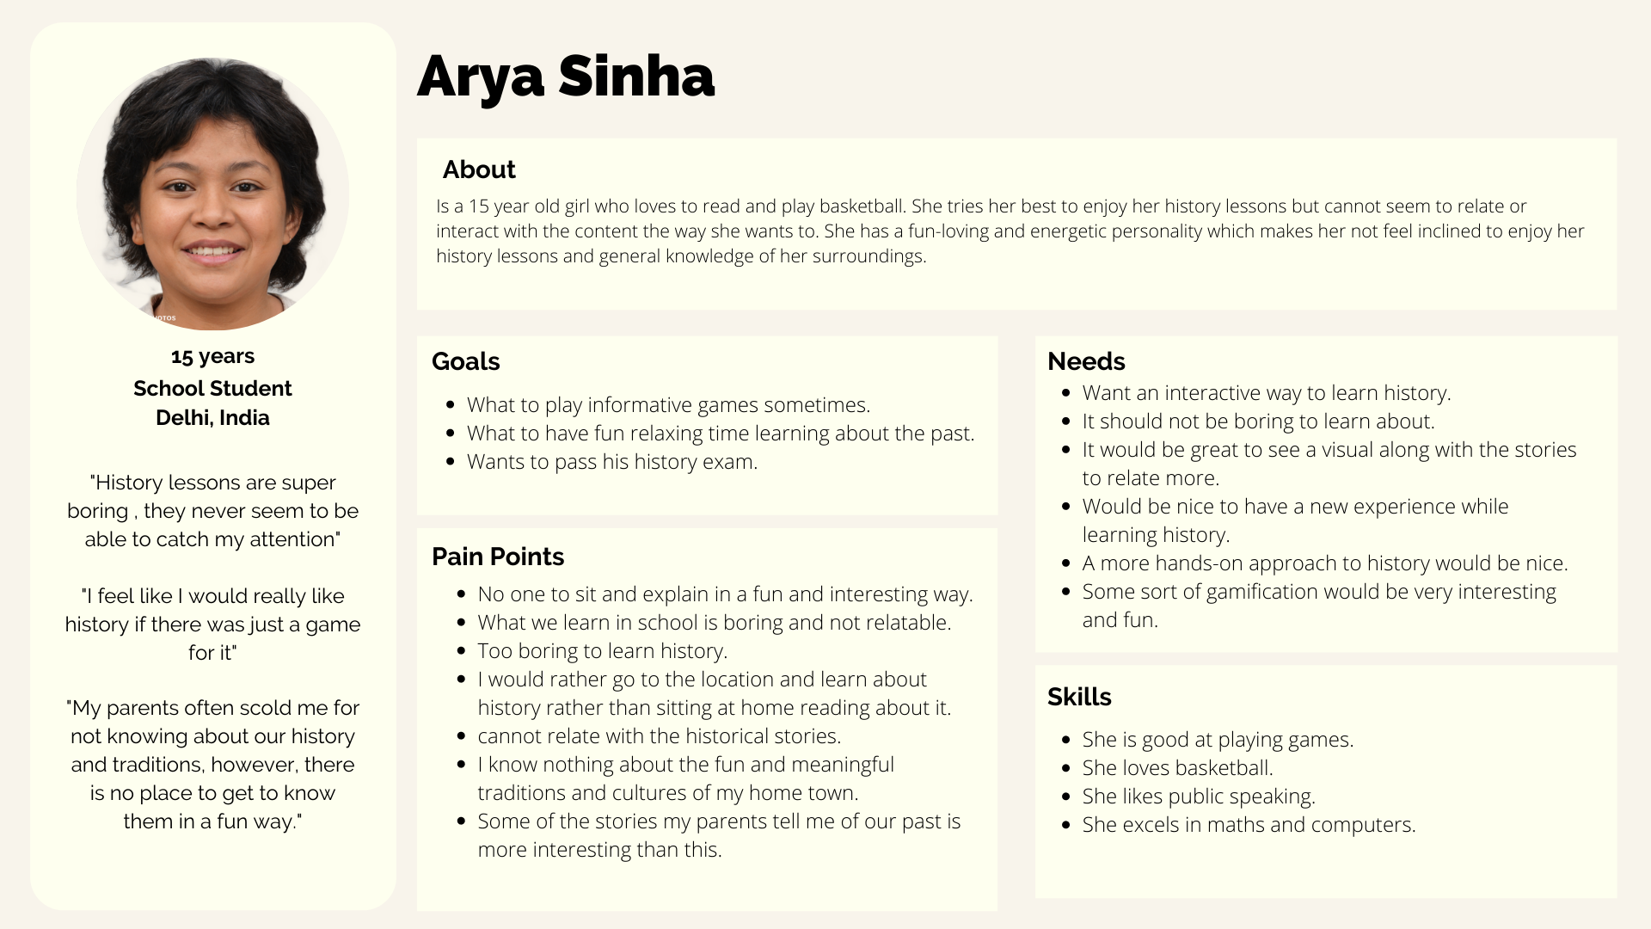

Slide 4
