Slide 1
Scenario
Group 5

Slide 2
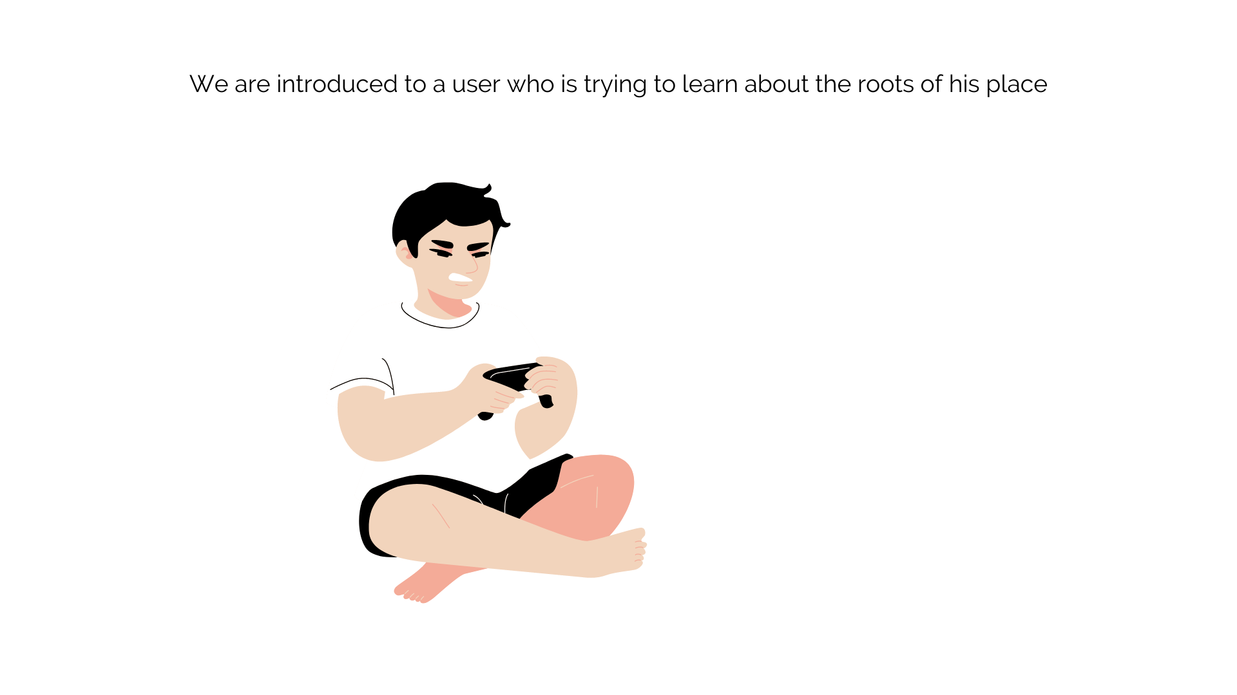

Slide 3
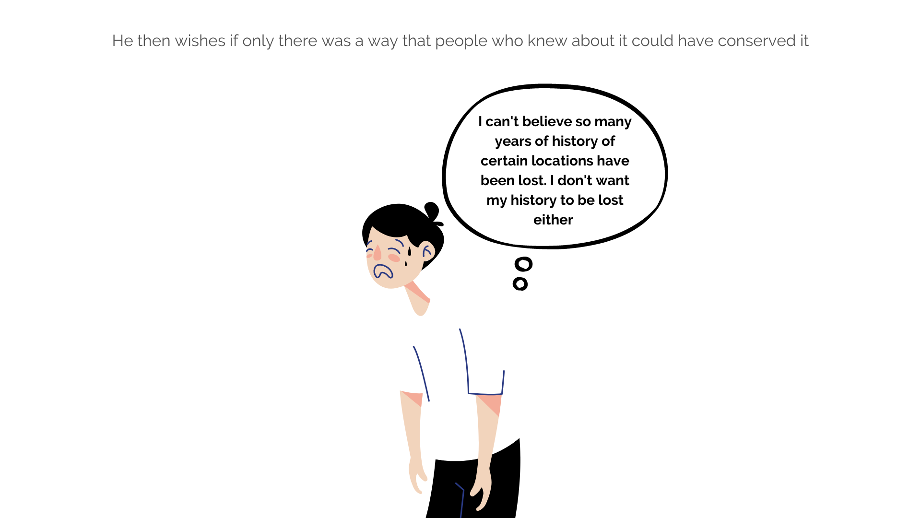

Slide 4
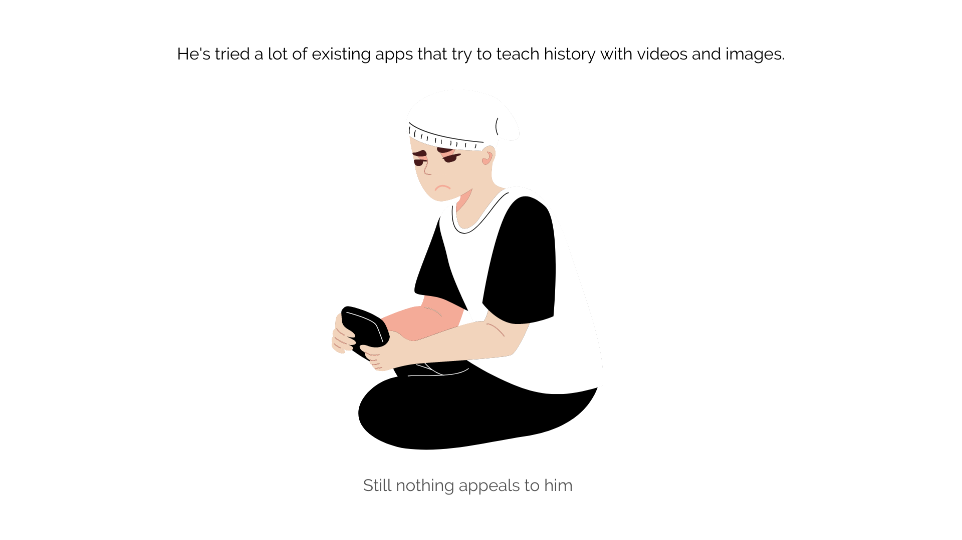

Slide 5
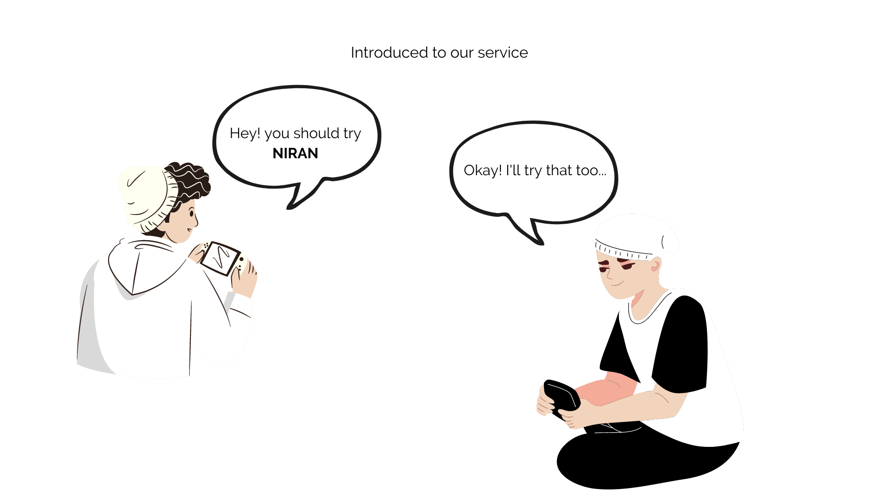

Slide 6
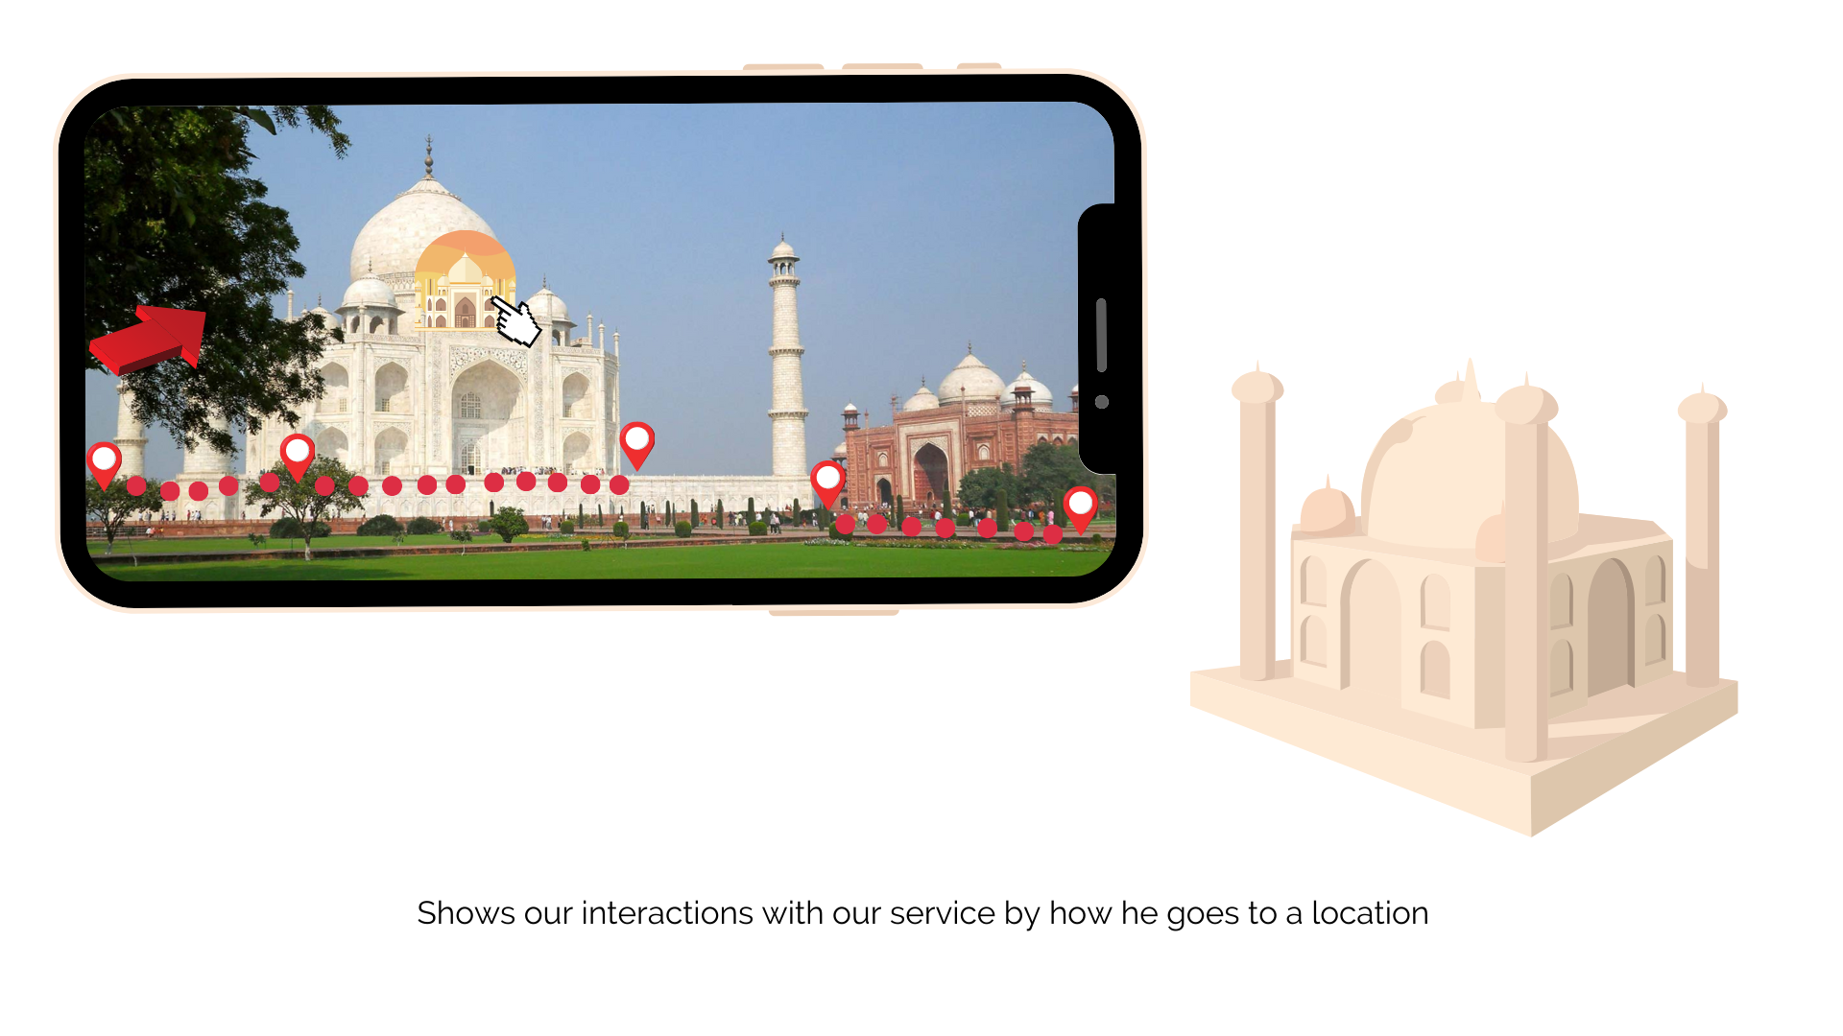

Slide 7
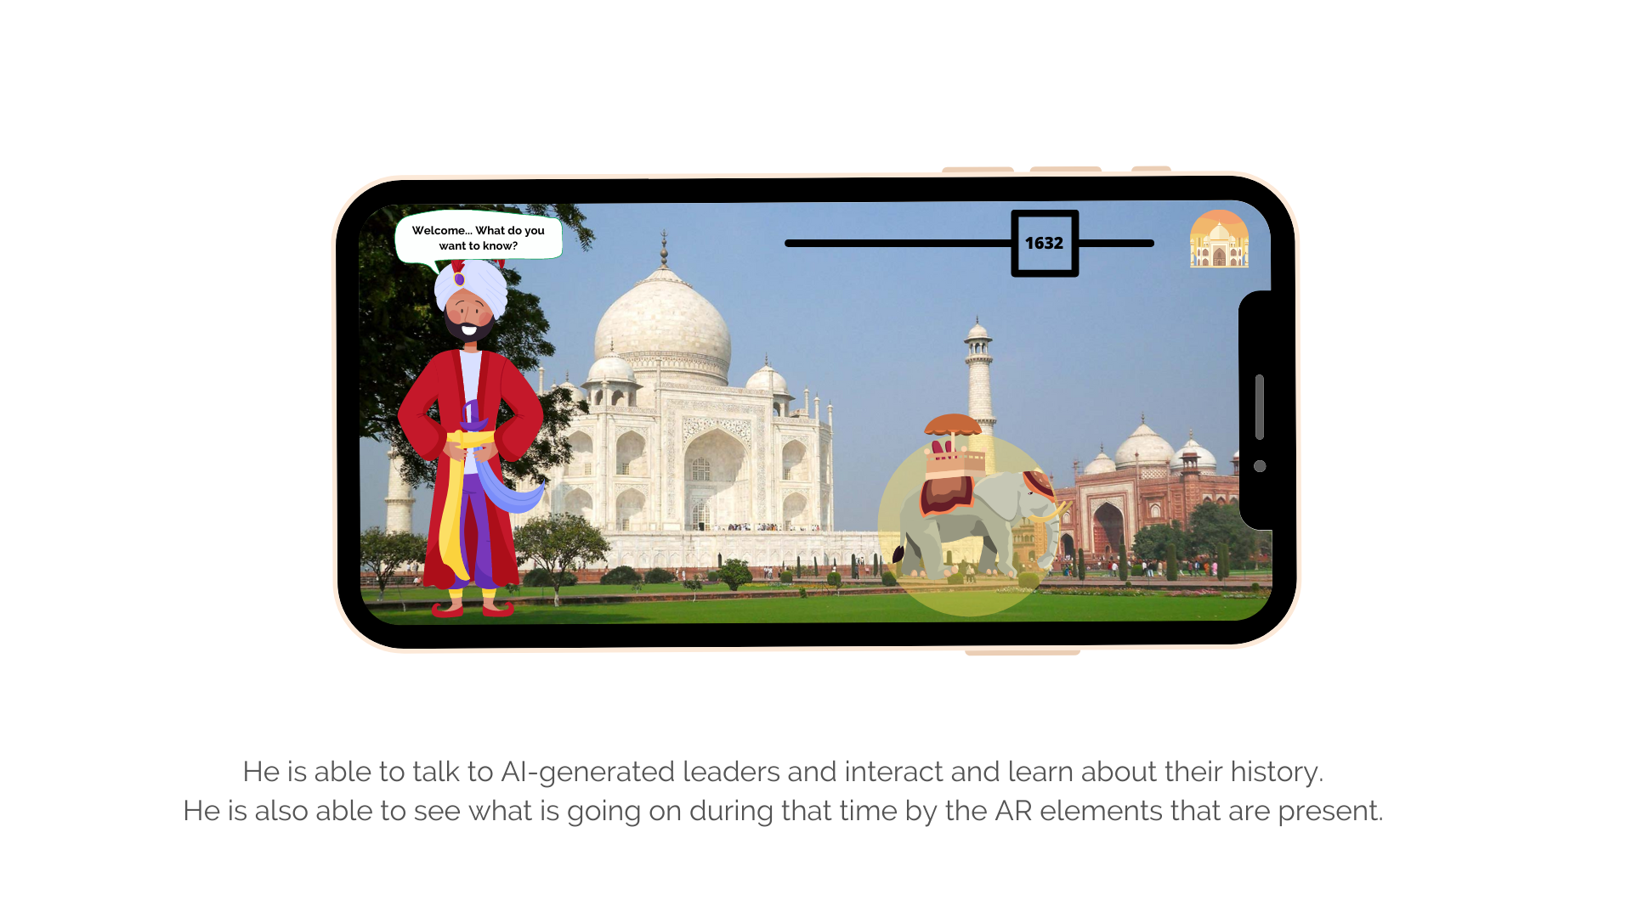

Slide 8
Sequence of steps to complete as tasks:
For the User who wants to learn about a place:
User finds our service
Explore the application
Goes to a location they want to learn about
Scans the checkpoint
Gets to know the history of that location
Completes the story walk
Post exploring the location
For the user who wants to add about a place:
User finds our service
Explore the application
Add a location to the app based on the story the user knows about
Adds a checkpoint
Completes the story walk
Post adding the location

Slide 9
Scenario Mapping

Slide 10
