Slide 1

Iowa Liquor Sales Analysis
Made By [Group A]:
Arshita Dixit
Abhishek Shah
Kaustubh Padhya
Project Guide:
Dr. Jongwook Woo

Slide 2
Table of Contents
1
Introduction
2
Specification of Dataset
3
Overall Flow
4
System Specification
5
Queries and Visualizations
6
Github link
7
References

Slide 3
Introduction
The goal of this project is to create a platform to visualize the complete liquor sales in the state Iowa to make a quick analysis on the amount and type of liquor sold every year.
This analysis could be helpful for future investors in spirit business to come up with best suitable locations for liquor sales and to approach vendors perfect for better revenues.

Slide 4
Specification of Dataset
Data set link: https://data.iowa.gov/Economy/Iowa-Liquor-Sales/m3tr-qhgy
Data set size: 1.4 GB | Format: CSV
Liquor sales for over 100 Million POS, of the state IOWA are analyzed.
The dataset includes Sales data from 2012 to 2015 for different vendors depending on the location type and volume of liquor are used for analysis.

Slide 5
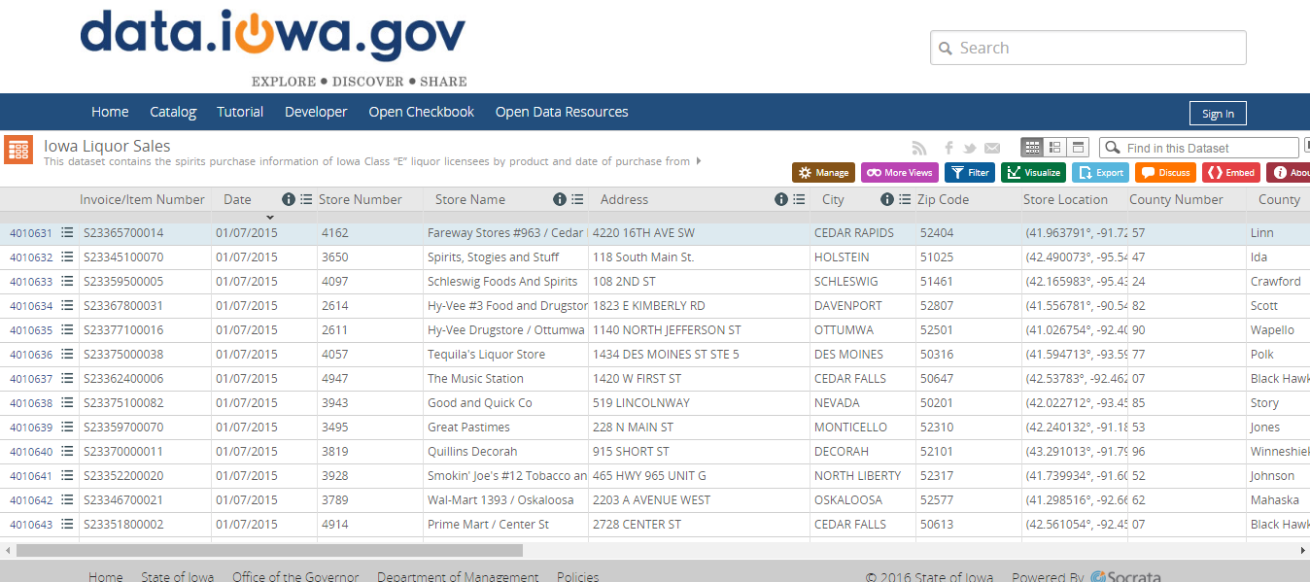
Dataset

Slide 6

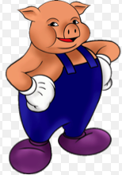




TOOLS
IBM Bluemix
Apache Hadoop, Hive & Pig
Tableau
FileZilla

Slide 7
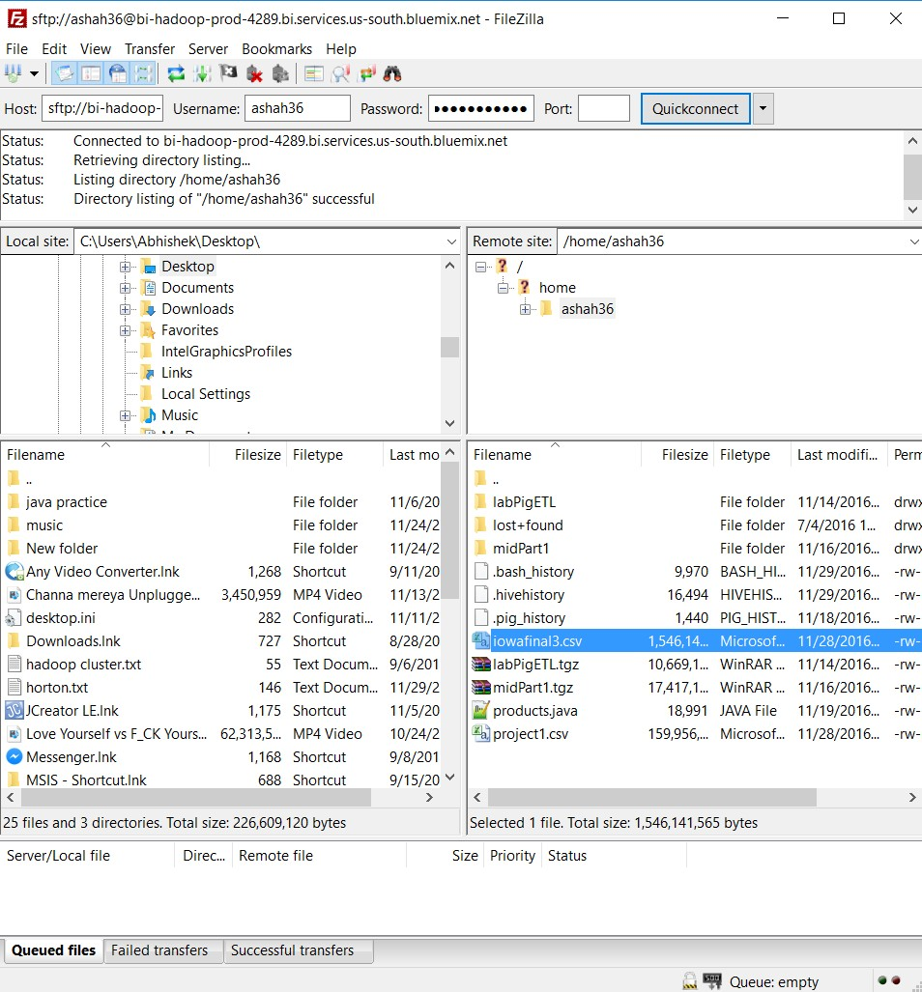
FileZilla SFTP:

Slide 8
Overall Flow
Data Research & Cleaning
Load data in Local File system using FileZilla
Data loading in HDFS
Creating Tables in Hive
Querying Data in Hive & Pig
Export Query results to MS Excel
Create Visuals using Tableau

Slide 9
System Specifications
No. of Data Nodes – 1 nodes | vCPU = 4( 24 GB RAM )
No. of Management Nodes- 1 | vCPU = 12 ( 48 GB RAM )
Cluster Type – Hadoop IBM Big Insights
Version – IOP 4.2 [IBM Open Version Platform]
Operating System – CentOS 6.6 [Linux]
Data Disk- 1 TB SATA | Data Storage- 244 GB

Slide 10
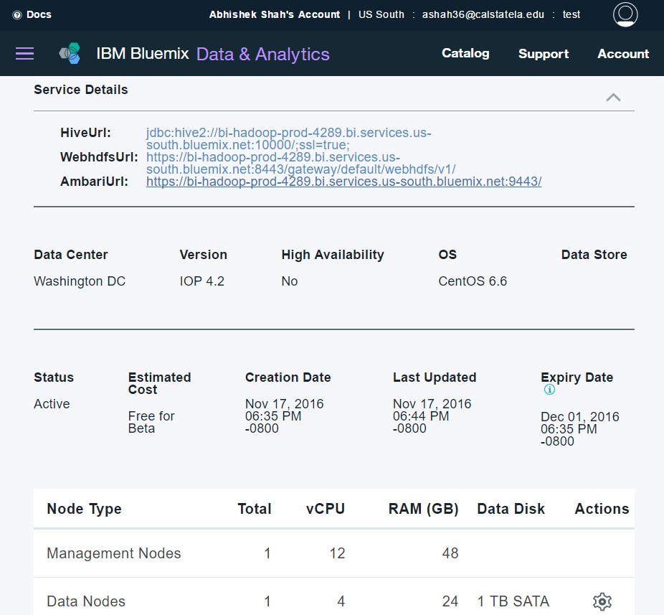
Hadoop BigInsights Cluster

Slide 11
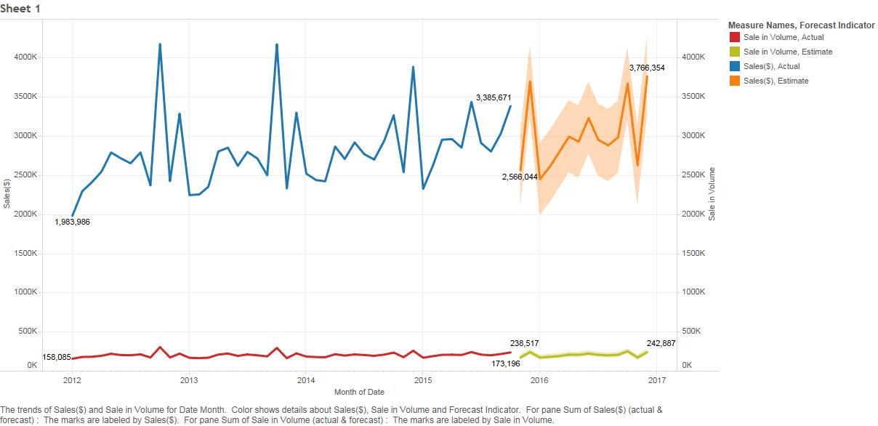
Annual Liquor Sales in Iowa from 2012 to 2015
This graph shows the trend of present and future sales. The highlighted graph represents the forecasted sale in dollars and volume for next 3 years. Looking at it a clear seasonality occurs during months of October- December due to which we suggest companies to plan their Production and supplies likewise.

Slide 12
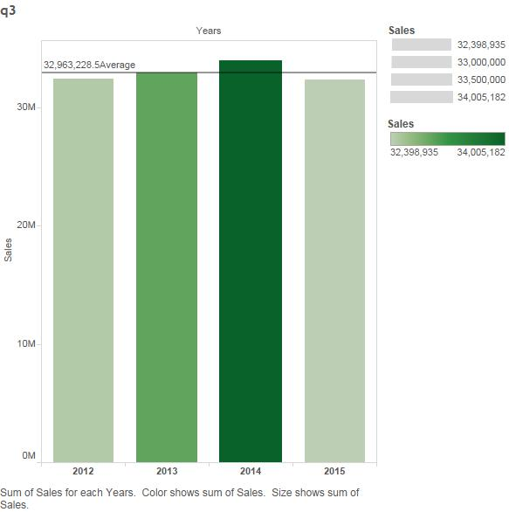


Yearly sales with Average as the Reference Line

Slide 13
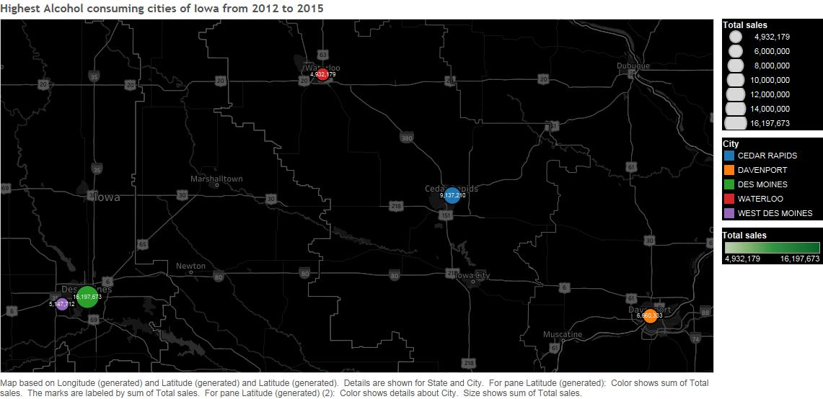
Top five cities in Iowa according to Sales
We are showing the five cities which have the highest sales. By this we concluded that city of Des Moines has highest sales for liquor. We suggest that these cities are best suitable to start a liquor store.

Slide 14
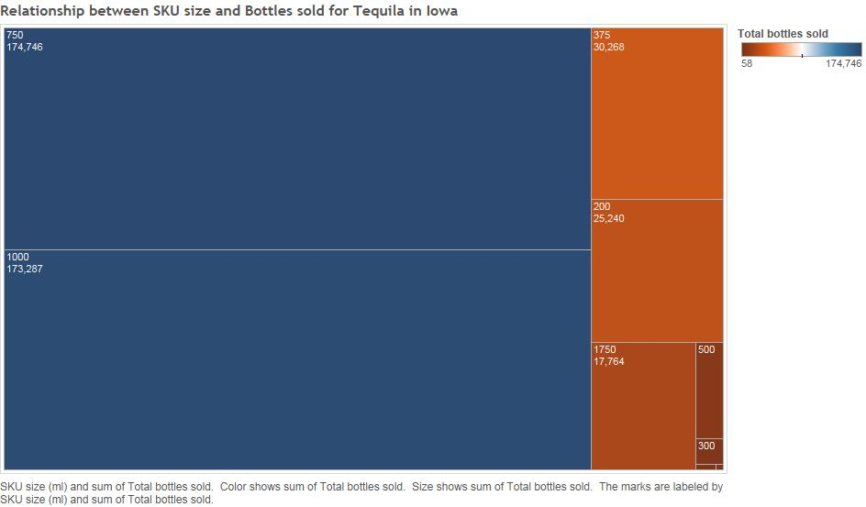
Relationship between SKU size and Bottles sold for Tequila
This analysis gives the relation between different sizes of tequila purchased. After this analysis we concluded that the tequila bottles for 750 ml are the most sold quantities followed by 1000 ml bottles. We also saw that 500ml, 300ml, 150 and 50ml are the least sold quantities for tequila, Hence we suggest to manufacture in the 750ml and 1000ml SKU sizes to enhance sales and profitability.

Slide 15
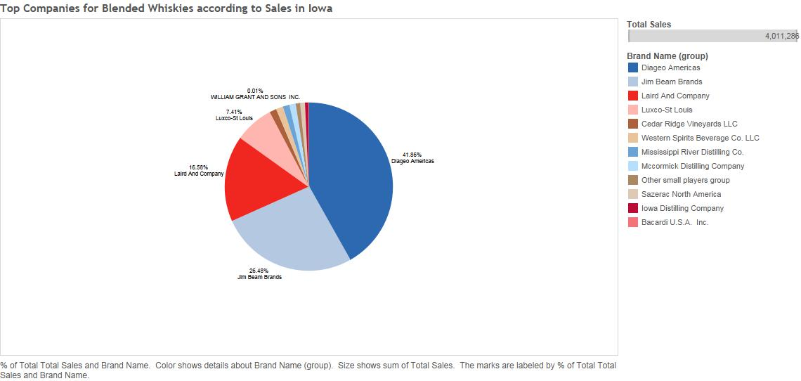
Market share of companies selling Blended Whiskies
This visual represents the companies who has the highest sales for blended whiskies. By this, we concluded that Diageo Americas has the highest market share of 41.8% followed by Jim Beam having 26.4%.

Slide 16
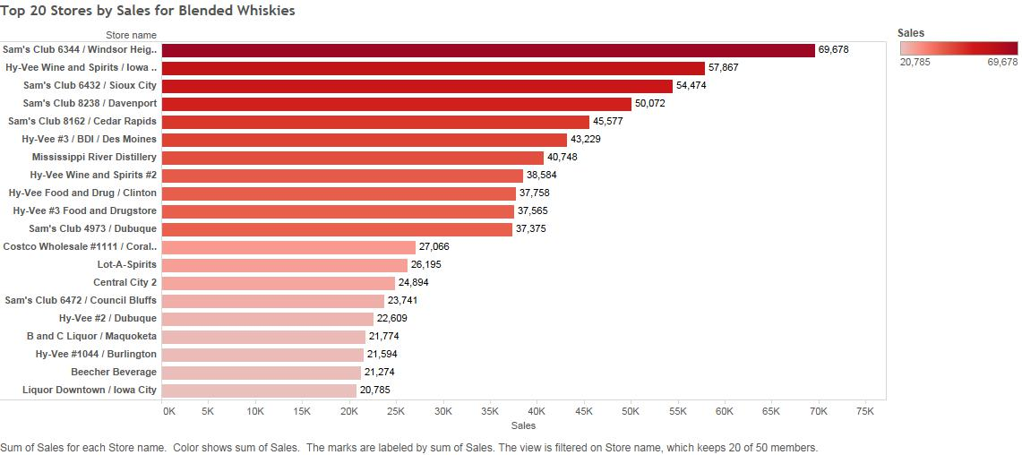
Top Dealers/Retailers of Blended Whiskies
This visual shows the top dealers for blended whiskies, which gives a conclusion that the store named Sam’s Club has the highest sales followed by Hy-vee wine and spirits. We suggest that the company salespersons should target these stores for better business in the Blended whiskies category.

Slide 17
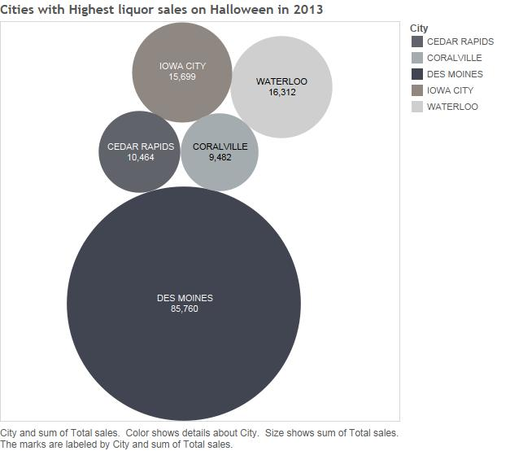
Cities having Highest liquor sales on the Halloween
The cities with highest liquor sales on Halloween 2013 are visualized in this. We noticed the highest sales in Des Moines on the day of Halloween, which prompts that distributors should focus on sales in this city on the day of Halloween.

Slide 18
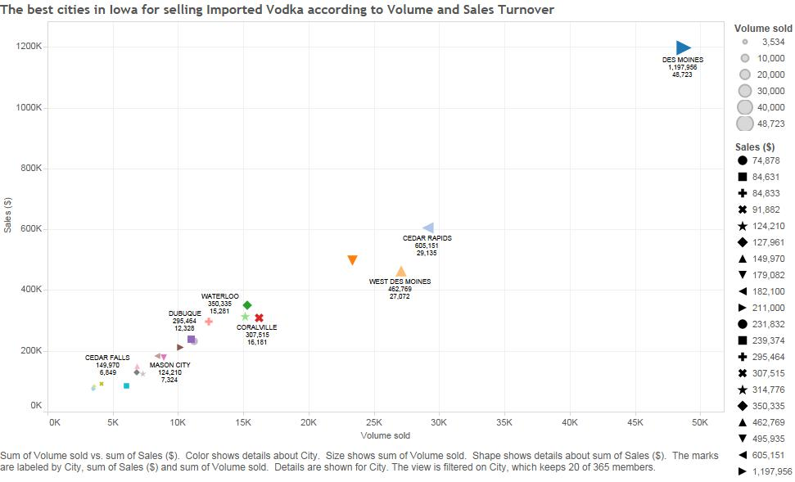
Relation between Volume and Sales Turnover for Imported Vodka
Here, visualization for volume and sales turnover for imported vodka are represented in a scatter plot showing Des Moines having highest turnover for imported vodka. Hence, Vodka companies should target these cities.

Slide 19
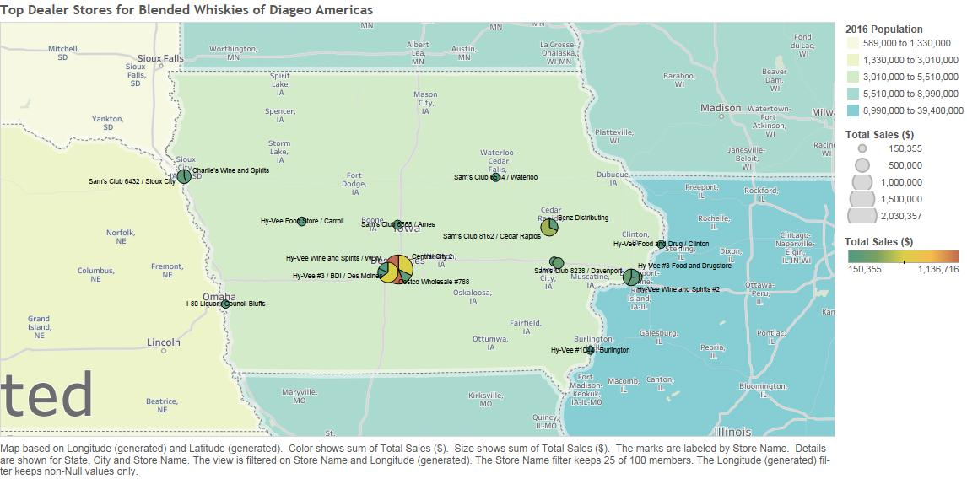
Best Dealers/Retailers of Diageo Americas Blended Whiskies
This Geospatial visual shows the top dealer store for Blended Whiskies of Diageo Americas. Here we suggest that if Diageo Americas wants to Award its dealers and run a Loyalty program for them, it should start with these champion stores starting with Hyvee Des moines giving them a business of 1.13 Billion in 4 years.

Slide 20
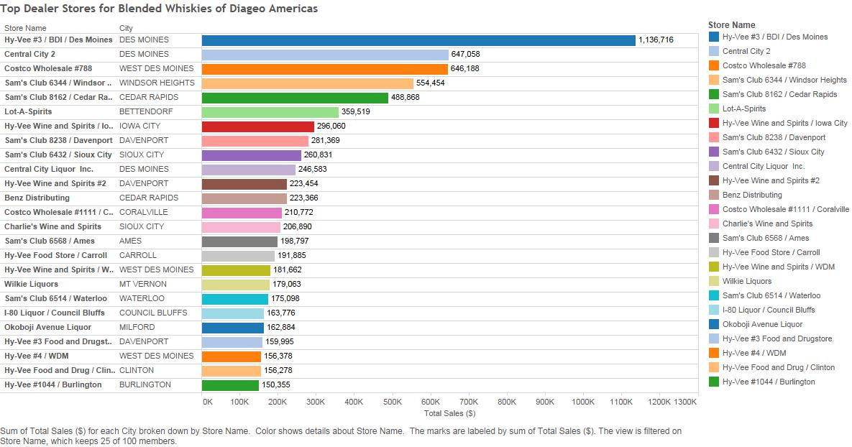
SELECT city, storename, sum(sale) AS s1 FROM iowa1 WHERE vendorname = 'Diageo Americas' GROUP BY storename, city ORDER BY s1 DESC LIMIT 100;

Slide 21
GitHub Link
https://github.com/arshah137/CIS_5200

Slide 22
References
https://data.iowa.gov/Economy/Iowa-Liquor-Sales/m3tr-qhgy
https://filezilla-project.org/
https://console.ng.bluemix.net/catalog/services/biginsights-for-apache-hadoop
http://onlinehelp.tableau.com/current/pro/desktop/en-us/help.htm#maps_geographicroles.html

Slide 23

Thank You

