Slide 1
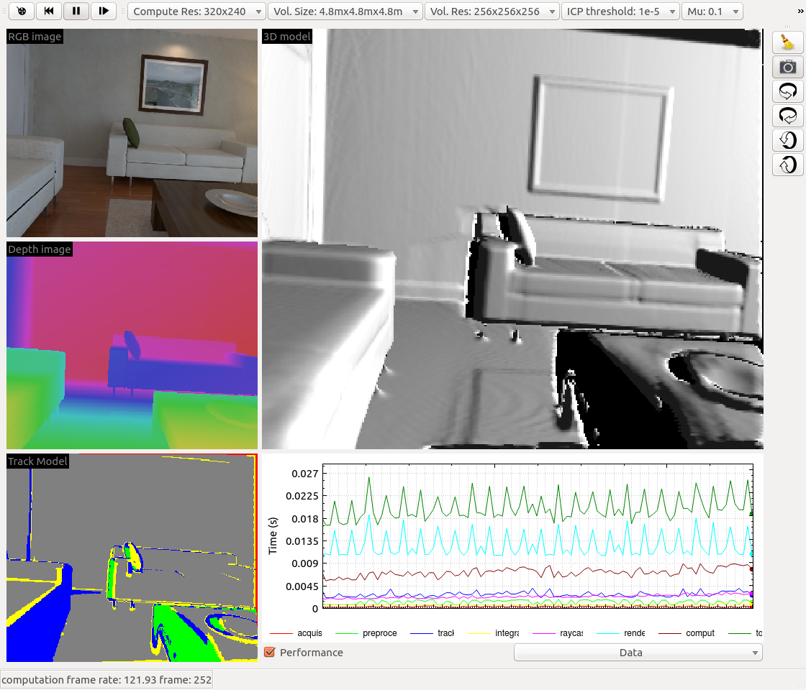
Camera input
Restart
Pause
Step
Reset
volume
Toggle
viewpoint
of 3D model

