Slide 1
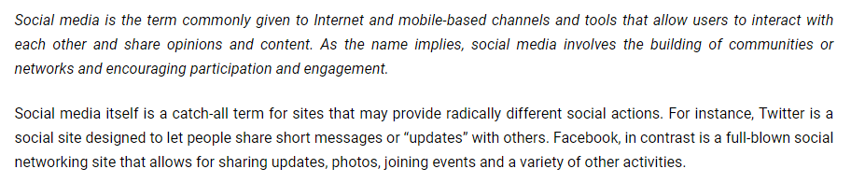
Social Media Marketing

Slide 2
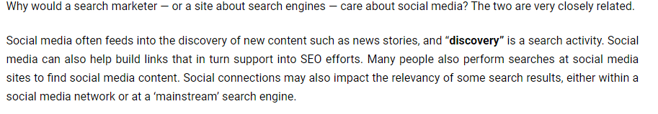
How are search and social media marketing related?

Slide 3
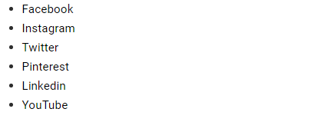
Social Media Marketing at market land

Slide 4
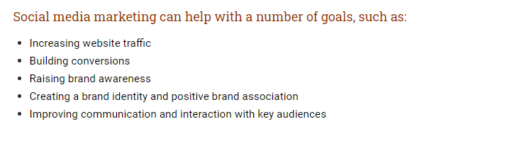

Slide 5
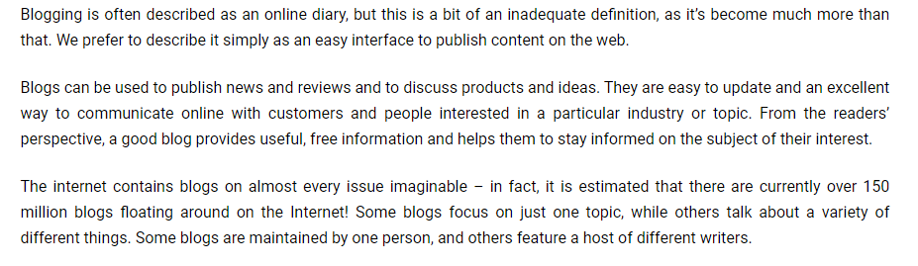
Blogging

Slide 6
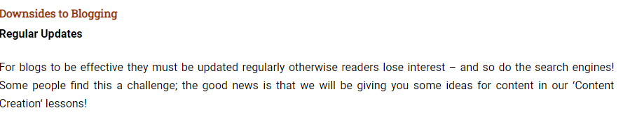
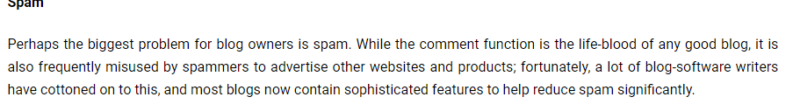

Slide 7
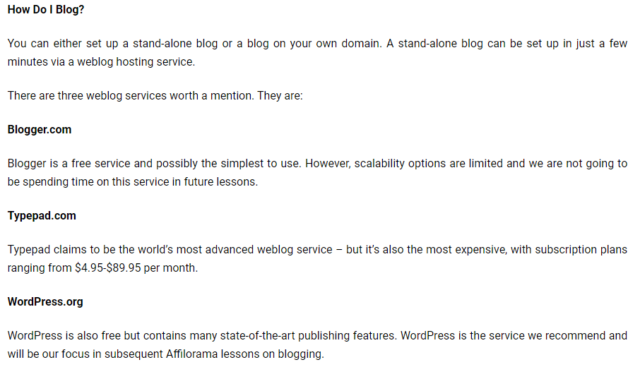

Slide 8
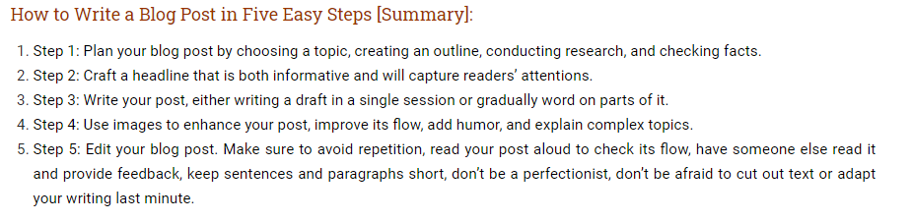

Slide 9
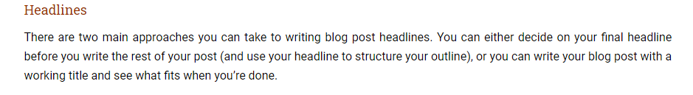

Slide 10
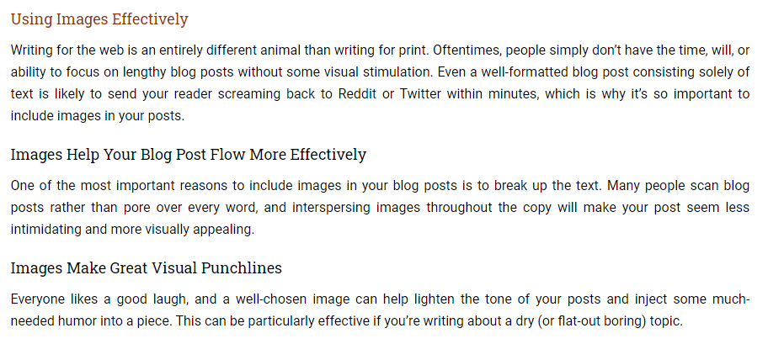

Slide 11
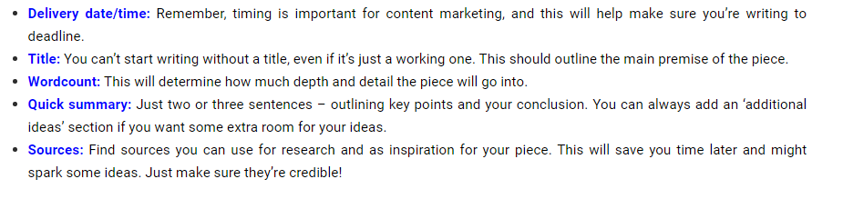

Slide 12
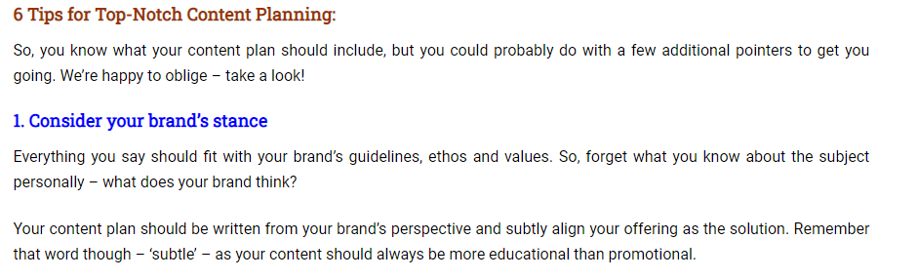

Slide 13
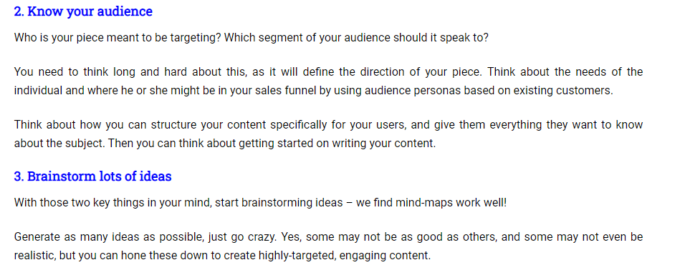

Slide 14
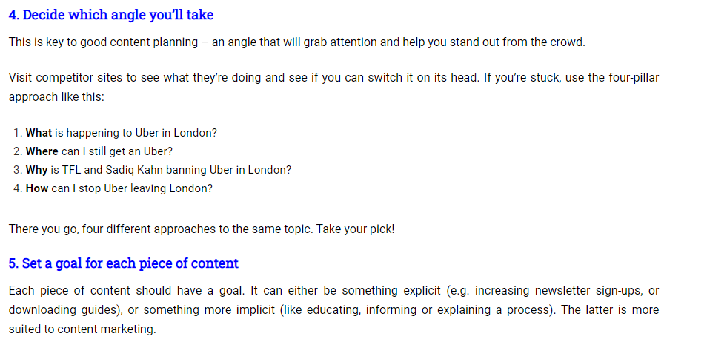

Slide 15
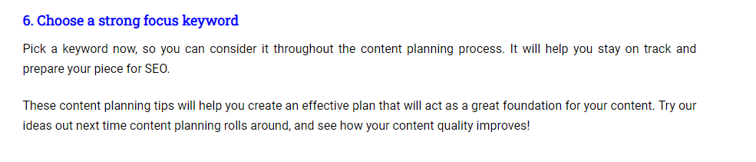

Slide 16
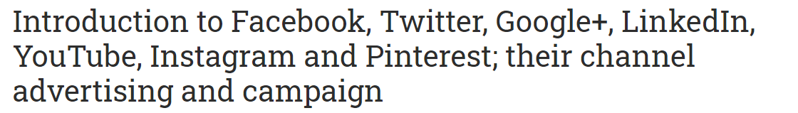

Slide 17
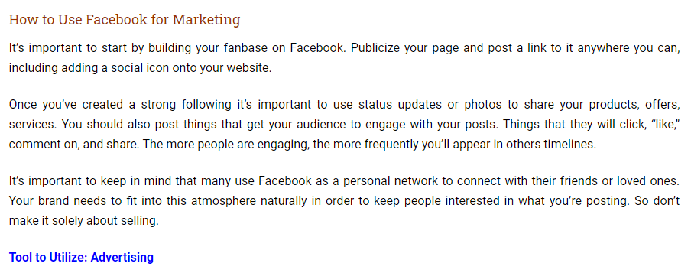

Slide 18

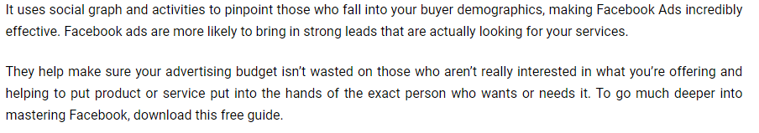

Slide 19
Side banner showing the company details such as what we are, what we do, contact us etc
We can include our new product details - banner
We can publish notes and create groups.
We can put like box in out site.
We can create page for products, organization, celebrity etc
We can upload photos, post links that direct to our site/blog.
We can create events like recent activities, upcoming events etc.
Create advertisements about the new & existing & upcoming products (adds are paid based on click & rate /day).
View insight menu consist of daily, monthly, weekly user details, pageviews, unique page view etc
We can create multiple admin for a page.
We can apply theme for the fan pages based on product introduction, product description etc.
We can send links, products details to the members, groups for getting opinion , reviews etc

Slide 20
We can send offers, promotional codes, discounts coupon to the members, groups etc.
Facebook allows to send messages to users you have no connection with we can make use of it.
Facebook provides classified add services.
We can make friends from our competitors. We have to send request to many friends (through competitors or through search ).
Try to implement cross selling in website/product page (comparisons of
products).
We need to add personal touch in marketing for it to work. Customize our communication inorder to stand out.
Highlight our brand we cannot make any compromise in quality and Brand
establishment.

Slide 21
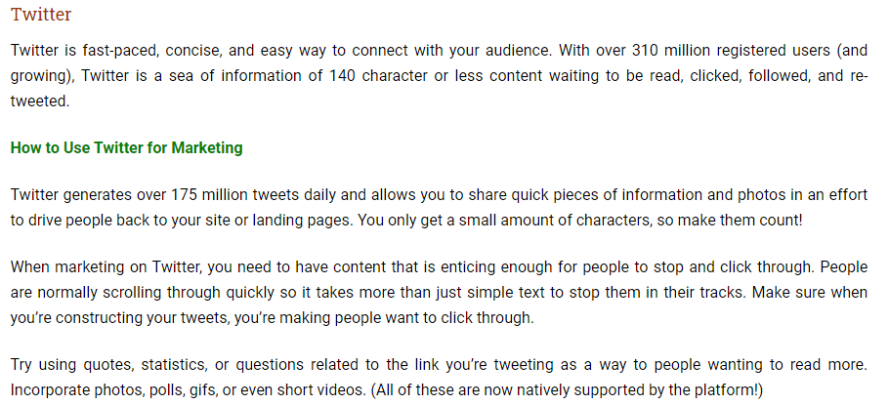

Slide 22
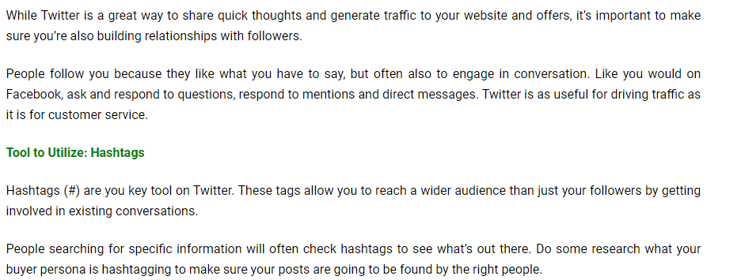

Slide 23
Focus on Brand promotions & microblogging (140 characters).
Build strong & powerful relation ship with prospective customers.
Attractive bio increases popularity .
Educate them with our new product their uses, advantages etc and create an awareness and necessity
Filling up the page with quick technique & tips.
Use search.twitter.com & twellow.com to find more users.
We can easily gain followers by following the active members in twitter.
We will get followers by following the followers of experts, gurus or of our competitors in twitter.
When we follow 100 members we will get atleast 70 followers.
For getting the followers we have to follow many in a consecutive manner.
We can post a product, link etc and ask for opinion and reviews.
We can use affiliate marketing & micro blogging.
Create banner about products, organizations etc
We can post promotional codes for products such as discount coupon, buy 3 get
1 etc

Slide 24
Build a personal relation ship with the followers & create a trustworthiness
among them.
Upload genuine photo, company logo or product logo.
Try to be human and give respect the values.
Don’t take the customer directly to the product page. Give them details description before taking them to the product page.
The followers want something from us so we always want to sell some thing
more than they expect.
Try to implement cross selling in website (pack include coke when we buy pizza).
We need to add personal touch in marketing for it to work. Customize our communication inorder to stand out.
Highlight our brand we cannot make any compromise in quality and Brand establishment.

Slide 25
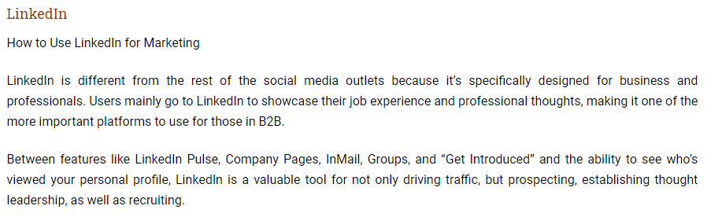

Slide 26
We can create group and make others to follow us
We can request for the opinion and suggestion.
We can expose our skill set.
We can follow the companies and make other to follows us
We can create a professional network ask for opinion and reviews etc.
Increase your visibility.
Improve your connect ability.
Improve your Google Page Rank.
Enhance your search engine results.
Perform blind, “reverse,” and company reference checks.
Increase the relevancy of your job search.
Make your interview go smoother.
Gauge the health of a company.
Gauge the health of an industry.
Track startups.
Ask for advice. (LinkedIn Answers)

Slide 27
YouTube
YouTube is the leading video-sharing platform in the world.
On your channel, your brand can share and edit its own videos, create playlists, and prompt discussions.
Since it was bought over by Google in 2006, YouTube is another platform that the search gives priority to in its search results so take advantage of it!

Slide 28
How to use YouTube for marketing
YouTube for your business is a great way to get your face out there. Videos are a lot more engaging and shareable than text content and they also aid your search rank in Google.
When creating videos for YouTube quality matters.
Make sure there’s a purpose and value to what you’re uploading and sharing. Also make sure to pay attention to your production value.
Both the video and audio of what you upload should be crisp, clear, and easy to understand. No shaky cameras!
Tool to utilize: Teaching opportunities
YouTube gives you a gateway to be an educator in your industry. Upload webinars or videos speaking on important topics that further the education of your audience.

Slide 29
Pinterest
Pinterest is one of the more unique marketing platform on this list. Instead of posting content for your audience to read, on Pinterest, you’re posting just a clickable picture and a short caption. This is a very popular platform for brands with a tangible product, i.e. clothing and food brands, restaurants, those in eCommerce, etc.

Slide 30
How to use Pinterest for marketing
Pinterest is a superficial platform, so every image you post has to be high-quality and striking to stand out in your feed.
When you start posting images make sure they link back to a related blog or page on your website. As people click through from your image to your site they want to see or read something that’s related to the image that caught their eye.
Once you begin posting organize your Pinterest by dividing it into boards. Each board should have a category relative to different aspects of your business. Make it simple for your followers to find what they're looking for.
Also make sure that your caption is keyword optimized. Like any other search engine, Pinterest cannot crawl images. This caption is how your pin will show up when people are browsing.

Slide 31
Tools to utilize: Business analytics
Pinterest added a tool for businesses to better track exactly which pins are working and which aren’t. This way you’re able to collect data on what images people are clicking on. Once you know what your audience is interested in you can make sure to use more images that are along those same lines.

Slide 32
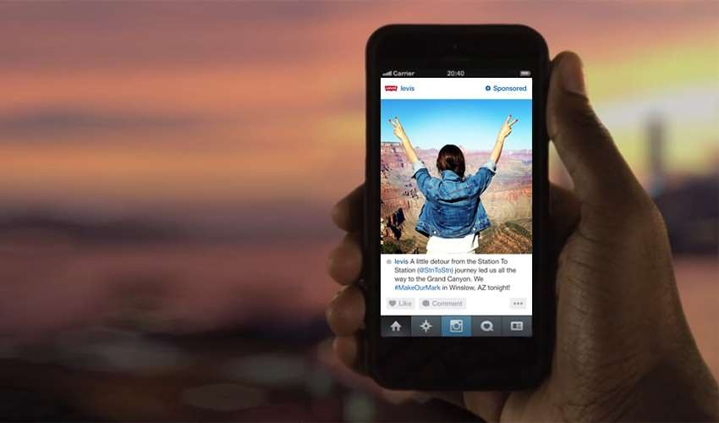

Instagram Ads
1
Image Source: how-to-start-advertising-on-instagram/

Slide 33



Instagram Ads
Drive awareness, increase customers and share your story among a highly engaged audience.
Awareness
Consideration
Conversion
Source: Business Instagram/ Advertising Images Source: https://www.flaticon.com/
2

Slide 34
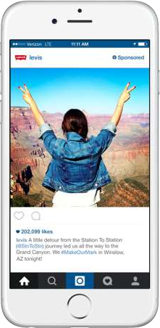

Photo Ads
Sponsored posts featuring products or services
Include Call to action such as “Learn More”,
“Shop Now”, etc.
Photo Characteristics:
Jpeg or Png
max. of 2200 characters.
Image size is 1080 x 1080 pixels for square ads, and 1200 x 628 pixels for landscape ads.
Image aspect ratio of 1:1
Resolution: 600 x 600 pixels
Source: what-are-the-different-types-of-instagram-ads/ https://klientboost.com/ppc/instagram-ads/ Image Source: http://blog.usabilla.com/7-sponsored-instagram-ads-get-right/
3

Slide 35

Carousel Ads
Showcase multiple photos and/or videos in a single ad.
“Tell a Story”with a sequence
More visual information of a product or service
Min. number of cards is 2 and max. is 10.
Source: https://www.techwyse.com/blog/social-media-marketing/what-are-the-different-types-of-instagram-ads/ https://klientboost.com/ppc/instagram-ads/ Image Source: https://blog.socioboard.com/instagram-rolled-out-video-carousel-ads-what-should-you-know/
4

Slide 36
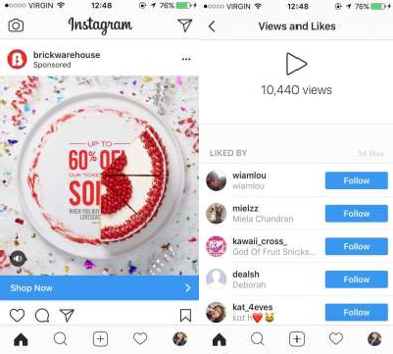

Video Ads
Up to 60 seconds long in landscape or square format
Sound or Without Sound
Recommended image size is 1080 x 1080
pixels for square videos and 1200 x 628 for
landscape videos
Min. resolution of 600 x 600 pixels and image aspect ratio is 1:1.
Sources: instagram-ads-guide and Business Instagram/ Advertising Image Source: Own source
5

Slide 37


Stories Ads
Full Screen Ads that show up while scrolling through
stories.
15-second video. Images shown for 5 sec. By default. Format is a 9:16 full screen vertical ad
File types are .mp4 and .mov for video and .jpg and
.png for a photo with file size max 4GB for video
and 30MB for a photo
Recommended resolution is 1080 x 1920 with minimum of 600 x 1067
Source: instagram-ads-guide/
Image Source: http://www.adweek.com/digital/instagram-dropping-ads-its-stories-feature-now-150-million-daily-users-strong-175461/
6

Slide 38







Segmentation
Location
Custom Audience
Demographics
Lookalike Audience
Lists: Mashfeed Iconosquare
Behaviours and
Interests
Automated Targeting
Source: Business Instagram/ Advertising l how-to-create-custom-instagram-feeds/ Images Source: https://www.flaticon.com/
7

Slide 39

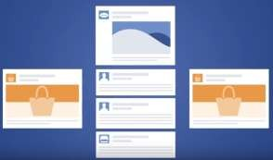
Advertising pricing options
How does pricing works on instagram?
After establishing the campaign objectives and selecting
the desired audience to reach companies must:
Instagram Ads works integrated with Facebook Ads.
Companies need to take part in an auction in order to reach the desired target audience.
Choose a budget
Let facebook bid on their behalf or the companies can bid by themselves
As their ad reach people on instagram their budget will be spent
Important features:
Change your budget
Stop the ads
The average CPM (cost per thousand views) is $6,7
Sources: How Much Ads Cost: A Facebook Overview | Facebook for Business and How much does it cost to advertise on Instagram Image Source: How Much Ads Cost: A Facebook Overview | Facebook for Business
8

Slide 40
How organizations can buy Instagram Ads (Step by Step)
Companies don't need to buy ads on this platform, they just need to have a facebook business page and follow the next 9 steps
1
To create Instagram Ads you can use: Ads Manager, Power Editor, Facebook Ads API
3
Location, age, gender, language, relationship, education,etc.
Select an editor and create your campaign
Choose your audience
2
Boost your posts, send people to your website, increase conversions on your website, get installs of your app, etc.
4
Here companies can select if they want to use facebook or if they want to use instagram for their ad
Choose an objective
Set your placement
Sources: A Step-by-Step Guide to Advertising on Instagram
9

Slide 41
How organizations can buy Instagram Ads (Step by Step)
5
Set your Budget and Schedule
Companies can select between daily budget and Lifetime value
8
Once companies reach this point, they are already set
Place the order
6
Here is where companies can decide how the ad is going to look like.
Set your Ad creative
9
This helps companies need to evaluate the performance of their ads To look at the results of the ads companies can go to:
Report on the Performance
7
Here is where companies will connect their instagram account to their facebook ad account.
Set your page and
link
Facebook Ads
Manager
Marketing Softwares
10
Sources: A Step-by-Step Guide to Advertising on Instagram

Slide 42
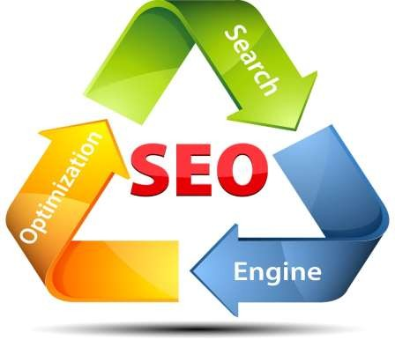
WHAT IS SEO
◆ SEO stands for “search engine optimization.” It is the process of getting traffic
from the “free,” “organic,” “editorial” or “natural” search results on search engines.

Slide 43
NEED OF SEO
◆ SEO helps to ensure that a site is accessible to a search engine and improves the
chances that the site will be found by the search engine.
◆ It is common practice for Internet users to not click through pages and pages of search results, so where a site ranks in a search is essential for directing more traffic toward the site. The higher a website naturally ranks in organic results of a search, the greater the chance that that site will be visited by a user.

Slide 44
SEARCH ENGINE IN MARKET LIKE
◆ GOOGLE
◆ YAHOO
◆ BING
◆ ASK
◆ YANDEX

Slide 45
SEARCH ENGINE MARKET SHARE
◆ Google: 85.82% (85.38%)
◆ Yahoo!: 6.58% (6.99%)
◆ Bing: 6.39% (6.39%)
◆ AOL: 0.46% (0.46%)
◆ DuckDuckGo: 0.35% (0.37%)
◆ Other: 0.4% (0.42%)

Slide 46
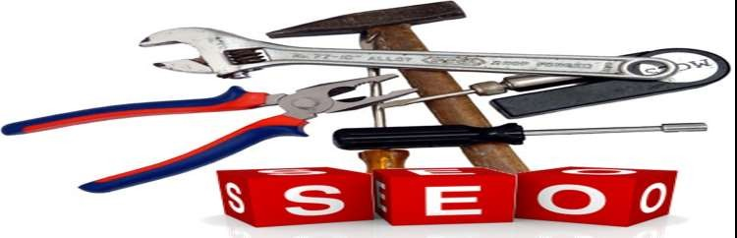
SEO TOOLS
◆ SEM Rush Rocks!
◆ Free Firefox Extensions
◆ Free Web-based SEO Tools
◆ Listings of additional SEO tools by category

Slide 47
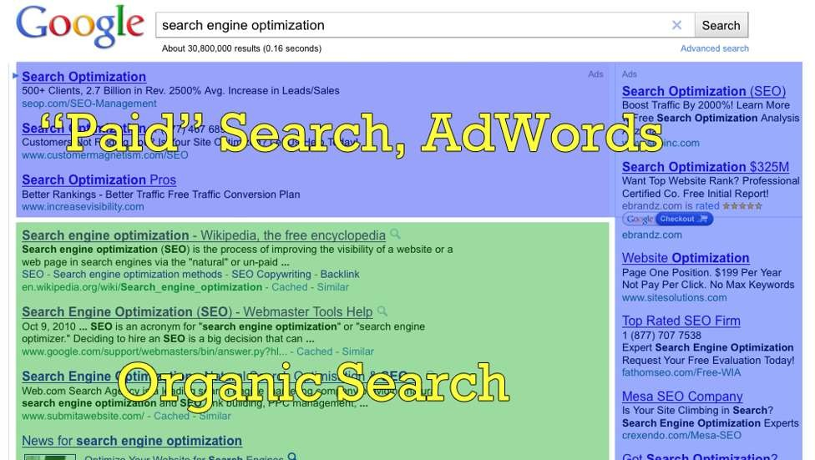
OPTIMIZED PAGE

Slide 48

SEO TECHNIQUES
◆ Audit Your Site Framework
◆ Data Research Via End User Value
◆ Create More Optimized Landing Pages
◆ Make Your Site Responsive and Mobile-Friendly
◆ Double Your Infographic Power
◆ Implement Latent Semantic Indexing
◆ Spy and Target Competitor’s Live Keywords

Slide 49
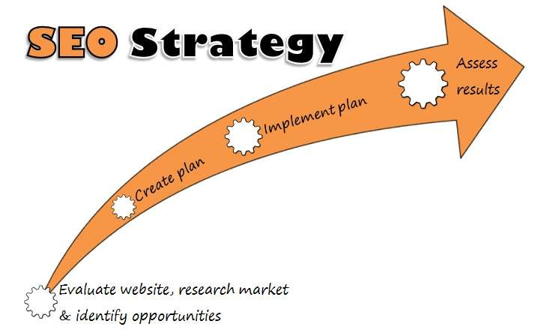
SEO STRATEGY
◆ :DEFINE YOUR TARGET AUDIENCE AND THEIR INTERESTS
◆ START CREATING RECOMMENDATIONS IN YOUR STRATEGY DOCUMENT
◆ Categorized Keyword Research
◆ Define Competitors
◆ Prioritize and Summarize
◆ Must-have SEO Recommendations

Slide 50

SERP
◆ A search engine results page (SERP) is the page displayed by a search engine in response to a query by a searcher. The main component of the SERP is the listing of results that are returned by the search engine in response to a keyword query, although the page may also contain other results such as advertisements

Slide 51
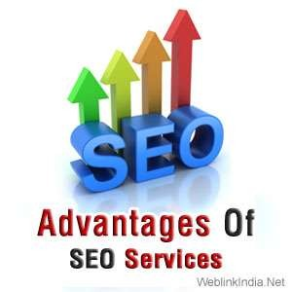
ADVANTAGES OF SEO
◆ Brand Awareness
◆ Increased site usability
◆ Cost effectiveness
◆ ROI
◆ Increased traffic

Slide 52


DISADVANTAGES OF SEO
◆ Getting noticed by more than your target audience
◆ Over Success
◆ Black Hats and White Hats
◆ COSTLY

Slide 53
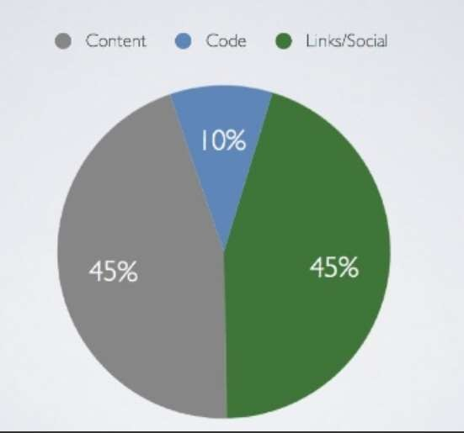
SEO RANKING FACTOR

Slide 54
CONCLUSION
◆ Search engine optimization is a hard and tedious job, it can take a large amount of
your time, there are too many pieces of the puzzle that you need to piece
together. I once read “Promoting a site that writers on the web are unlikely to link to is as deadly as creating a fantastic website no one will see.” I think the writer said it all in this simple sentence. There is no use in making the best website in your niche when you are not promoting it.

