Slide 1
Digital Marketing
Measure and monitor KPIs for driving ROI

Slide 2
What are KPIs?
KPIs, or Key Performance Indicators are metrics that tell us how effective we are at achieving business objectives.
They should be: Challenging Achievable
Marketer can control or influence

Slide 3
What’s the Purpose of Analytics?
Removes guess work
Helps in data driven decision making Course Correction
A/B Testing

Slide 4
What should a Marketer be looking for?
Traffic & Visits Avg Session Duration
Source of Traffic Click Through Rate Engagement

Slide 5








What should a CMO be concerned about?
Return On Investment Cost of Acquisition
Marketing influenced Leads & Cost/Lead Customer Lifetime Value

Slide 6

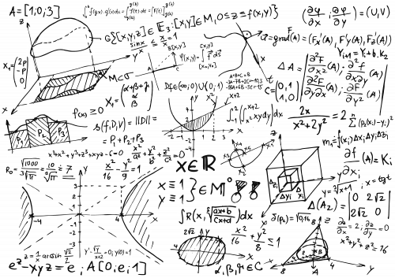
Don’t be lost in the world of online metrics
Vanity Metrics
Good to have but not profitable to the business or convertible to Money.
Eg. No. of Followers;
Global visitors for a local store in California;
Device type and changes.
Actionable Metrics
Help in decision making, increase ROI for the spends.
Eg. Cart Transactions; Referral traffic; Conversion Rate.
6

Slide 7




KPIs differ for different Business types
Information
Blog, News
E-Commerce
Online Shop
Subscription
SaaS, ISP Carrier
Community
Social Network, Forum
Source/medium Engagement Pages per Session
Subscribe to Newsletter
Conversion Rate Revenue Transactions
Customer Lifetime Value
Cost of Acquisition Leads Generated Avg. Revenue per
Month
Churn Rate
Subscribers Engagement Source of Traffic Session Duration
Think of your business and figure out which metrics are important to you
7

Slide 8
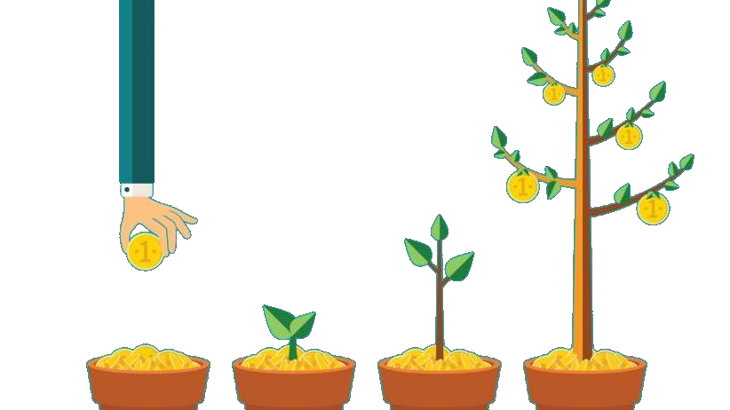
KPIs change at different stages
Attention
Interest
Desire
Action
Impressions
Reach
Unique Visitors
Clicks
Engagement
Sessions
Duration Pageviews
Leads
Downloads
Emails
Purchase
Download
Subscription
Calls
8

Slide 9








For easier learning – Segment your KPIs
Traffic Source Interactions per visit Bounce Rate
Cost of Acquisition Customer Lifetime Value Attribution System Leads in Pipeline
Conversion
ROI
KPI
Groupings
Revenue
(ecommerce)
Brand
Total Revenue Transactions Time to Purchase
Product Performance
Recommendation
New & Returning Visitors
Sentiments Visitor Loyalty
9

Slide 10
Competitive Analysis
Look around before you start building your Content Strategy

Slide 11

Competition has Changed
11

Slide 12
How to Analyze your competition?
Research their website
Understand where they keep their data – all navigations
Audit Content – quantity, frequency and distribution
Evaluate Quality
Establish their SEO Focus
Research integration with Social
Source: Hubspot’s blog post on competition analysis
12

Slide 13


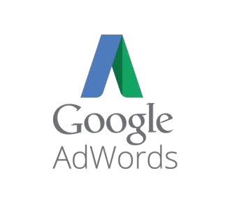


Tools for understanding Competitor Strategies
Google AdWords Keyword Planner (free)
Google Trends (free)
SEMRush
SpyFu
Moz
13

Slide 14
Google Analytics
An overview

Slide 15
Key Definitions – Digital Analytics
Attribution – assign credit to a step/action for sales and conversions
Dimension – description attribute or characteristic of data (locations, pages,
sessions, browsers, etc)
Metrics – quantitative measure of your data, sums or ratios (views, sessions, avg. time per session, etc.)
Conversion – completed activity online or offline
Goal: newsletter subscription; or
Sales: purchase on e-commerce
Goal – configuration setting, to track valuable actions happening on your site, which are related to your business objectives (visit 5+ pages, or spends $x on your site)
Events – a hit used to track user interaction with your content
15

Slide 16
Key Definitions – Digital Analytics
Segments – subset of users that share common attributes (segment by channel, geography, etc.)
Hit – an interaction on your site which sends data to Google analytics (viewing a page, playing video, etc.)
Pageviews – every time a page is loaded or reloaded is counted towards
pageviews
Sessions – period of time a user is active on your site, return after 30 minutes of idle time will lead to a new session
Source/medium – origin or source of traffic, medium is the category of that
source (Facebook/social, bing/organic, etc.)
16

Slide 17
Google Analytics – Account Setup
Account
Users
Property
Raw Data View
Master View
Filtered View
17

Slide 18
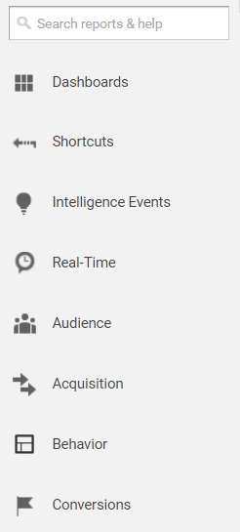
How are reports structured in GA?
What do you need to track?
Audience Reports
All information about your users can be found here
Acquisition
Where the traffic came from: referrals, Social, Ads, SEO, Campaigns
Behavior
How visitors played with your website: pages, duration, flow, events, speed,
Conversion Reports
This is what matters, key metrics your CMO should be concerned about: Goals, Ecommerce, Marketing Promotion, Attribution
18

Slide 19


Segments in GA
Subset of data captured
Geographic Segmentation Channel Segmentation
All Data All Data
USA Social
California
Facebook
Design your segments around your core Business Goals
19

Slide 20
Conversion Reports
Goals are a completed activity, called a conversion that contributes to the success of the business. A series of actions which leads to objective.
e.g. fill out a form, purchase, download, sign up etc.
KPIs generated
Conversion Rate
No. of Conversions
ROI
Event Tracking – user interaction with content that can be tracked independently
e.g. download, play video, button pushes etc.
20

Slide 21
Search Console
Getting familiar with the interface

Slide 22

Important Elements of Search Console
Search Analytics – this can be accessed via Google Analytics as well
Keyword Queries
Dimensions: Pages, Countries, Devices, Search type
Metrics: Impression, CTR, Position
Links
Crawl
Errors
Stats
Robots.txt tester
Sitemaps
Search Appearances
HTML Errors
Site Enhancements: Structured Data, Rich Cards, Data Highlighter
24

Slide 23
AdWords
Focus on Reporting

Slide 24


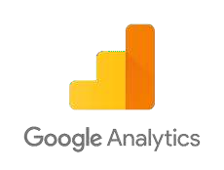



Conversion Tracking
Monitoring spend is critical and so it tracking conversions
Some of the ways to do this are:
Conversion Tracking in AdWords
Link Google Analytics
Conversion Tracking tools

Slide 25
KPIs in AdWords
Conversion
Impression Share
Quality Score (QS)
CPC or CTC – Cost per Click
AdRank – Max CPC x Quality Score + Extensions impact
Keyword (KW)
Search Term
Max CPC
CTR – Click Through Rate
SERP Page – Search Engine Result Page
CPA – Cost per Acquisition
CTA – Call to Action
Clicks – Hit on your ad on SERP
Impressions – visibility of your ad on SERP
ROI – Return on Investment

Slide 26
Link Google Analytics & AdWords
See ad and site performance data in the AdWords reports in Analytics.
Import Analytics Goals and Ecommerce transactions directly into your AdWords account.
Import valuable Analytics metrics – such as Bounce Rate, Avg. Session Duration, and Pages/Session—into your AdWords account.
Take advantage of enhanced Remarketing capabilities.
Get richer data in the Analytics Multi-Channel Funnels reports.
Use your Analytics data to enhance your AdWords experience.

Slide 27
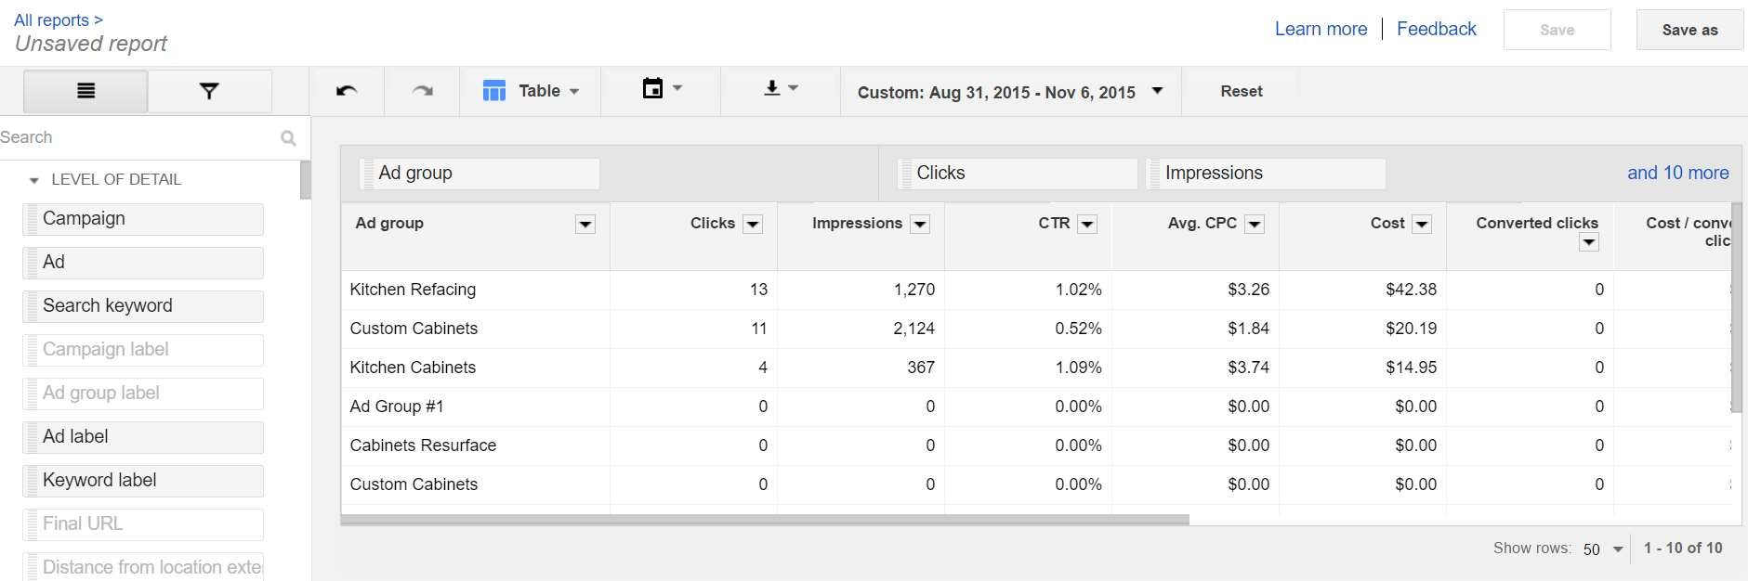
Leverage Pre-defined reports in AdWords
Reports > Pre-defined Reports > Ad Groups report

Slide 28
Tips for calculating ROI
General Performance - Traffic, leads, Reach
Channel Based - Website, blog, social networks, search engines
Source based performance - Direct traffic, Organic search, referrals, email, PPC
Campaign based performance - Lead generation, click throughs, conversions, conversion rates
Setting realistic and measurable goals

Slide 29
Campaign Tracking
Social Media, AdWords, Email, Newsletters and more…

Slide 30
How you do it?
You need to be able to track your organic content, your campaigns, emails & ads separately
Custom URL (bit.ly, tinyurl.com, ow.ly, goo.gl)
Landing page
UTM Tracking – Urchin Tracking Module
UTM
+
TAG
Example URL:
http://sitename.com/blog/campaign-tracking/
?utm_source=facebook&utm_medium=social
&utm_campaign=iamlearning
Google Analytics
Notes: You build a killer product, set up the landing page and start sending the url and promoting it. You send out 20 tweets, 100 emails, 15 Facebook posts and get 5000 visits to your page. BUT which tweet, which worked best would be impossible to track if you send out the same link. UTM helps you set up unique tracking for each and every action, and then measure it.
32

Slide 31

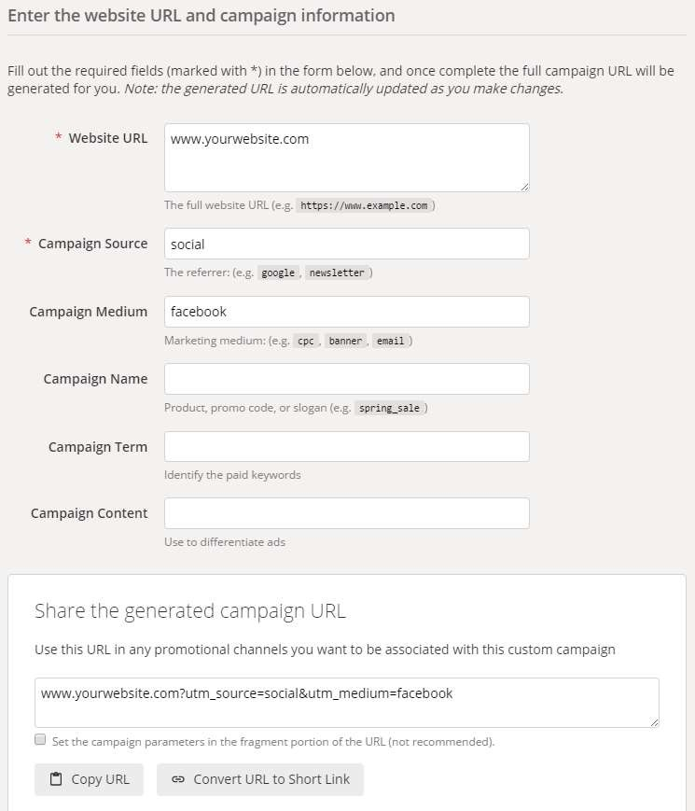
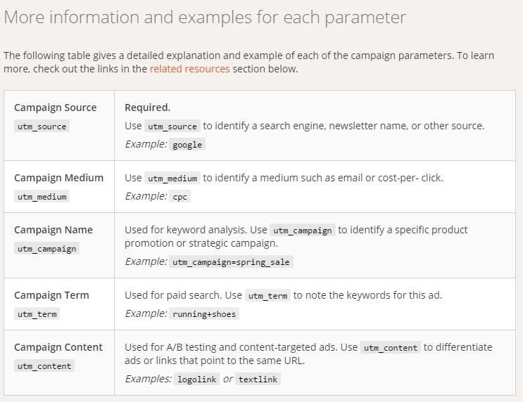
Campaign URL builder
31

Slide 32
Organizing your Campaigns
Campaigns
IAmLearning
Medium
Email
Social
AdWords
Source
Twitter
Facebook
LinkedIn
32

Slide 33
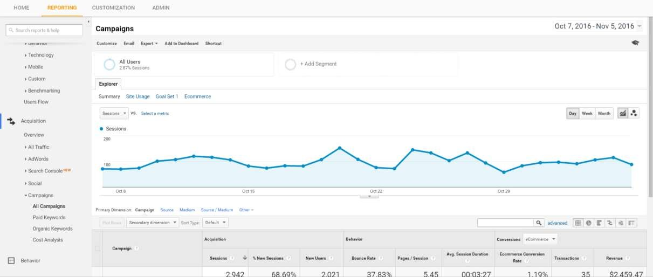
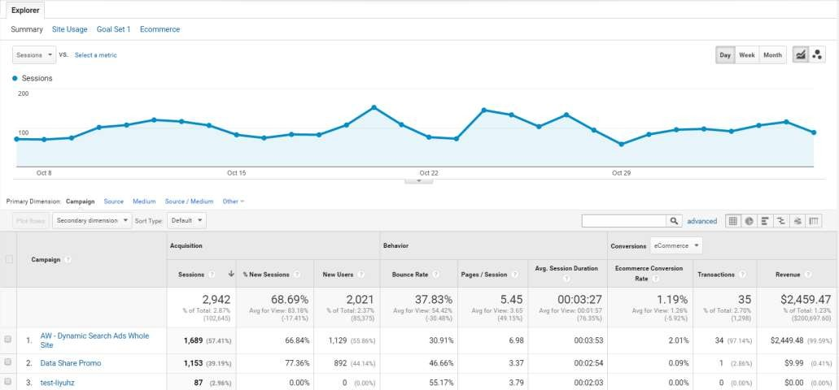
Tracking in Google Analytics
33

Slide 34
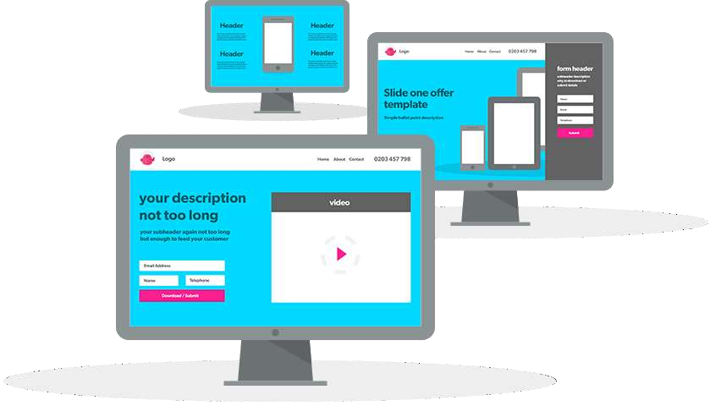
Landing Page Optimization
Notes: A landing page is where a website visitor is taken when you want them do something (typically to convert).
34

Slide 35
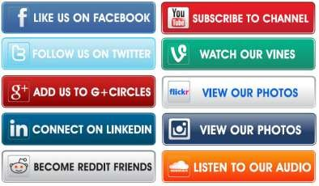
Call to Action (CTA) Optimization
Notes: A Call to Action is the name used in digital marketing for something that pushes you closer to giving a company your information. For example it could be a form that you submit to download a PDF or it could be as simple as clicking to watch a video, or opening a blog post.
CTA is the catchall phrase for the marketing effort required to make the action take place. Testing and optimization is a massive part of creating any CTA.
You need to take a number of things into account when
creating CTAs:
Where the lead is in your sales funnel
Does the content your CTA offers match their position
How much information are you asking from them in exchange for the content (this needs to match - eg. filling in a form to look at a paragraph of text isn’t a ‘fair ’ exchange. But filling in a form for a downloadable PDF with 10 pages of information is.
All pages on your website should have some kind of CTA.

Slide 36
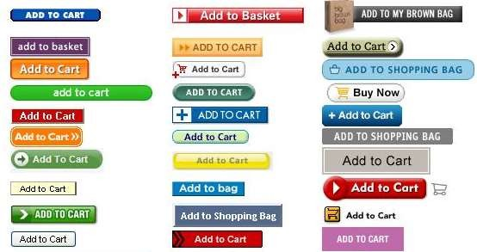
Button Text Optimization
Notes: Optimization can go as far as you would like, or you have time, to take it.
One particularly interesting aspect is
button text optimization.
While simple text like “Download here” or “Get Your Download Now” may appear the same to the untrained eye, there is still space for optimization and AB testing. You’re not going to turn a 5% conversion rate into a 25% conversion rate by changing button text, but you make be able to squeeze out an extra percent or two from getting the wording perfect!
The same attention can also be given to the size of the button, the font and the color of the button. So if you ever think you’ve got the perfect landing page, you’re wrong. There’s always something you can improve on.

Slide 37

What is a Dashboard?
A dashboard is a streamlined snapshot of what’s going on with your marketing at any one time. The best dashboards will automatically update, ideally pulling information out of CRMs, social media, or AdWords themselves. Or they will require minimal manual updates.
An aggregation of metrics that tells us about business performance
Notes: A dashboard is a streamlined snapshot of what’s going on with your marketing at any one time. The best dashboards will automatically ₃₉
update, ideally pulling information out of CRMs, social media, or AdWords themselves. Or they will require minimal manual updates.

Slide 38

What does your boss care about?
38

Slide 39
How should a CMO’s dashboard look like?
Marketing ROI
Traffic-to-Lead Ratio
Customer Value
Mobile Traffic, Leads & Conversions
Organic Traffic
Key Metrics for evaluating performance and achievement of Business Objectives
Social Media Traffic & Conversion Rates
Landing Page
Conversion Rates
Sales Revenue
Cost Per Lead
Lead-to-Customer Ratio
39

Slide 40
How should a CMO’s dashboard look like?
SEO
Social
Conversions
ROI
Marketing ROI
Sales Revenue Cost Per Lead
Customer Value
Mobile Traffic, Leads & Conversions
Organic Traffic
Social Media Traffic & Conversion Rates
Lead-to-Customer Ratio
Landing Page Conversion Rates
Traffic-to-Lead Ratio
40

Slide 41
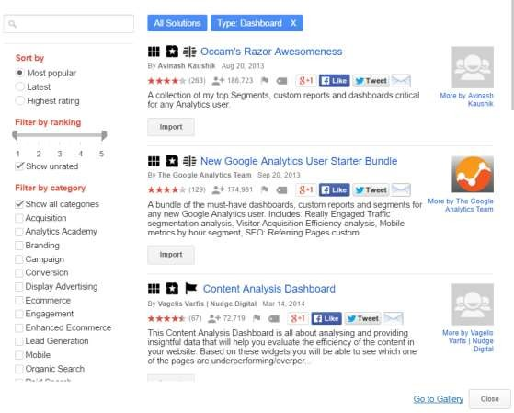
Using Dashboards in GA
Leverage the power of predefined dashboards in Google’s dashboard gallery
Find your KPI requirements and identify a dashboard for corresponding data
Reporting > Dashboards > + New
Dashboard > Import from Gallery
Notes: Your dashboard should be for you. You have to work out what you need to see on a daily basis to do your job. If you’re running a PPC account, you need to check it’s profitable. If you’re creating and sharing content you need to know how it’s being received.
The idea of the dashboard, as explained above, is to give you a snapshot of what’s going on. So pick out the metrics that your performance is judged on. Don’t worry about any more detail than that.
41

Slide 42
Social Media KPI’s
Number of fans/followers
Number of mentions
Reach
Inbound links
Blog subscribers
Retweets
Social share
Comments
Referral traffic
Share of voice
Net promoter
Sentiment
Number of social influencers
Post reach
Potential reach
Video views
Conversions
Sales revenue
Issues resolved
Cost per lead
Lead conversion rate
Customer lifetime value
Number of posts
Blog posts
Videos
Social Media budget
Social media posts
42

Slide 43
SEO KPIs
Page views
Click through rate
Average session time
Bounce rate
New sessions
Returning visitors
Referral Source
Sessions
Pages per Session
Devices
Acquisition Source
Conversions
Traffic Sources
43

Slide 44
SEM KPIs
Conversion
Impression Share
Quality Score (QS)
CPC or CTC – Cost per Click
AdRank – Max CPC x Quality Score + Extensions impact
Keyword (KW)
Search Term
Max CPC
CTR – Click Through Rate
SERP Page – Search Engine Result Page
CPA – Cost per Acquisition
CTA – Call to Action
Clicks – Hit on your ad on SERP
Impressions – visibility of your ad on SERP
ROI – Return on Investment
44

Slide 45
Email KPIs
Open rate
Bounce rate
Number of opens
Links Clicked
Forwards
Replies
Time spent open
Time to reply
Unsubscribes
45

Slide 46
How to Calculate CLV
Average length of Relationship
Customer Revenue
Marketing Costs
Customer Lifetime Value
Support Costs

Slide 47
Marketing ROI
This is simply how much money marketing can say it brings to the company. This can vary in complication if you have a sales team.
Customer
Revenue
Marketing
Costs
Marketing
ROI

Slide 48
SMART Goals
Specific - is your goal specific enough. Can it be defined?
Measurable - can you measure the goal?
Achievable - is it realistic to expect you achieve the goal?
Relevant - does the goal actually help your business?
Timely - by when do you need to achieve this goal?
52

