Slide 1
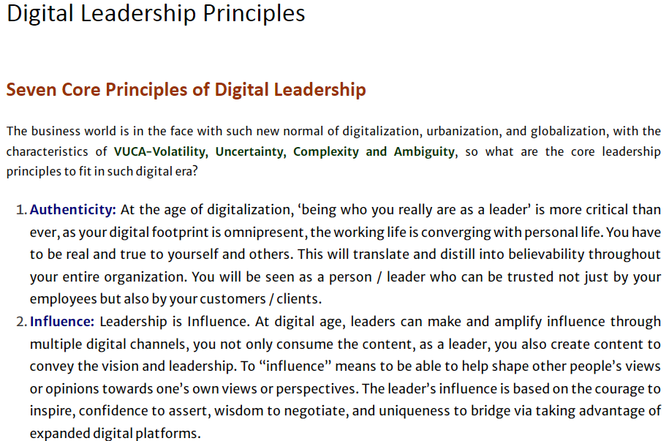

Slide 2
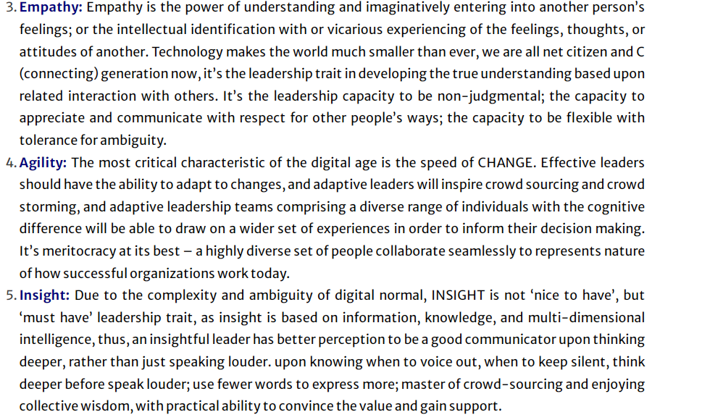

Slide 3
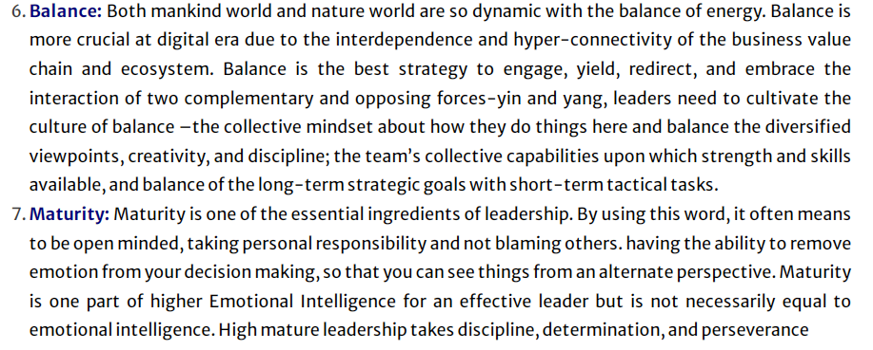

Slide 4



Online Reputation Management
Do You Know What People Are Saying About Your Business Online?

Slide 5


What is Online Reputation Management?
Wikipedia Definition of Online Reputation Management
Online reputation management (or monitoring) is the practice of monitoring the Internet reputation of a person, brand or business, with the goal of suppressing negative mentions entirely, or pushing them lower on search engine results pages to decrease their visibility.

Slide 6

Did You Know?...
The 2011 “Social Shopping Study” indicates that 50% of consumers spend 75% or more of their total shopping time conducting online product research?
70% of Consumers Trust Other Consumer Opinions that are Posted Online

Slide 7

Why is Online Reputation Management So Important?
Your Prospects Are Online Your Competitors Are Online Your Customers Are Online
… That Includes Your UNHAPPY Customers

Slide 8






The Internet Has Changed EVERYTHING
Before the Internet, Businesses Controlled Their Messages via One-way Communication Channels
Thanks to the Internet, EVERYONE Controls the Message via Blogs, Social Media, and Customer Reviews

Slide 9











What Are People Saying About Your Business?
Bloggers
Forums
Your Company’s Online Reputation
Former
Employees
Social
Media
Customer Reviews

Slide 10
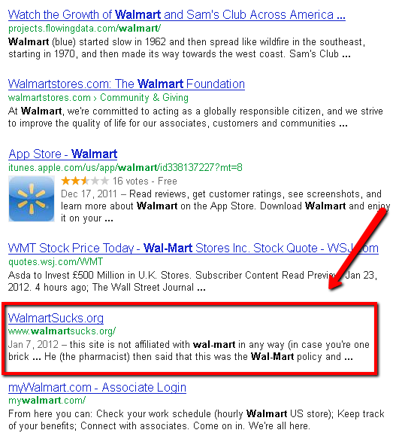
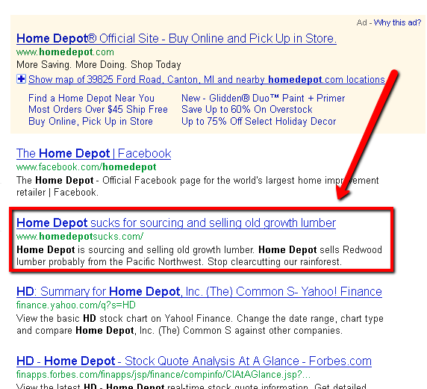
Online Reputation is Even Crucial for the BIG BOYS

Slide 11






Negative Effects of a Bad Online Reputation
Bad Customer Experience
Unresolved Customer Issues
Bad Reputation
LOST REVENUE

Slide 12
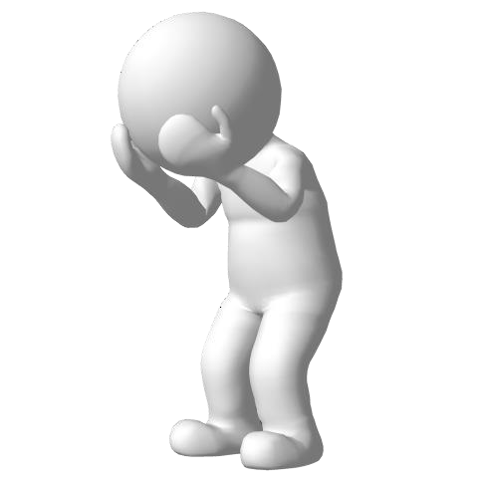
Negative Effects of a Bad Online Reputation
Could Lose Existing Customers
Difficulty Getting New Customers
Business Can Suffer Financial Loss

Slide 13


Positive Effects of a Good Online Reputation
Retain Existing Customers
Easier to Get New Customers
Maintain a Positive Brand Image

Slide 14

How to Maintain Your Reputation
Be PROACTIVE instead of REACTIVE
Monitor Online Conversations About Your Business
Respond and Interact with Consumers Online
Create and Distribute POSITIVE Content Regularly

Slide 15

Actively Seek Reviews
Actively Seek Reviews from Satisfied Customers
Boost Conversions
Provide Feedback about Your Product or Service
Consumers TRUST and EXPECT Online Reviews

Slide 16
How to Get Customer Reviews
Offer an Incentive in Exchange for Reviews
Coupons, Discounts, Free Samples, etc.
Ask Customers to Review Products by Placing a Calls to Action on Your Product Pages
Send Customers to Your Business Listings on Google Places, Yelp, CitySearch, and Others
Link Your Business Listing Profiles to Your Website

Slide 17
Create Positive, Branded Content
Flood the First Page of the Search Engines with Positive, Branded Content
Well-Ranked Website
On-Going Search Engine Optimization (SEO)
Articles, Videos, Press Releases, Photos, etc.
Tips, Tools, Helpful Tutorials, and Other Useful content

Slide 18

Monitor Online Conversations
Find Out What People Are Saying About Your Business
Do a Google Search for Your Business Name… What Comes Up?
Check Articles, Blogs, Forums, and Customer Review Sites
Frequently Check Your Own Blog / Website for Comments
Pay Close Attention to the Social Network Sites

Slide 19
Respond and Interact
Listen to What People are Saying
Respond to Both Positive and Negative Comments
Be Respectful and Display a Helpful, Friendly Demeanor
Always Quickly Offer a Solution any Problems

Slide 20
Why Respond and Interact?
Builds Relationships
Allows You to Actively Manage and Control Your Brand
Shows that You Care
Allows Other People to See Your Point of View

Slide 21
How to Improve Your Reputation
Already Have Some Negative Online Comments and Reviews?
Make Brand Optimization Your Main Focus
Use SEO to Drive Down the Negativity
Create and Submit Press Releases, Articles, and Videos
Create a Blog and Submit Fresh, Unique Content Regularly
Engage in Social Media and Build a Loyal Following

Slide 22
How to Improve Your Reputation
Ask for Negative Reviews to be Removed
Don’t Ignore Your Unhappy Customers
Promptly Address Issues
Know When to Walk Away
Don’t Argue with Customers
Can’t Please Everyone

Slide 23
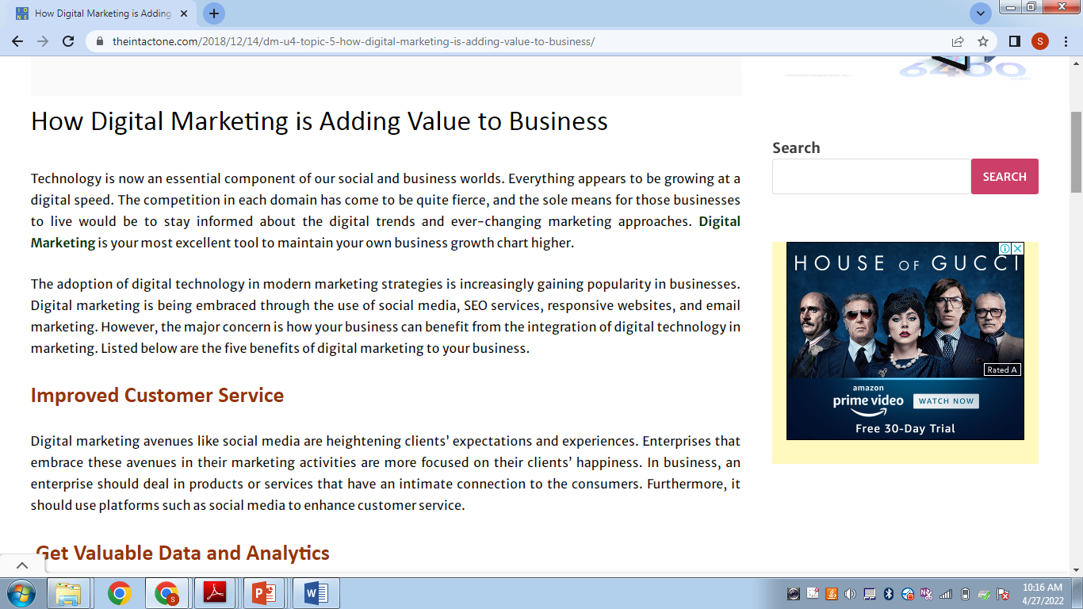

Slide 24
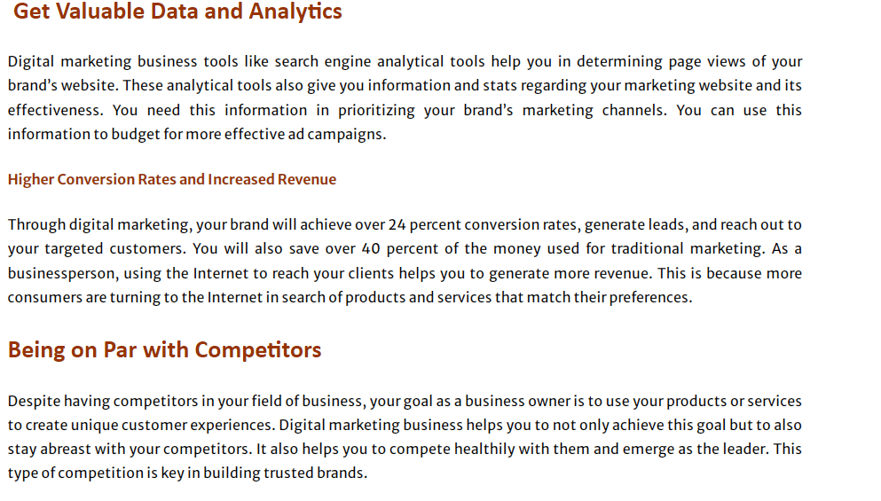

Slide 25
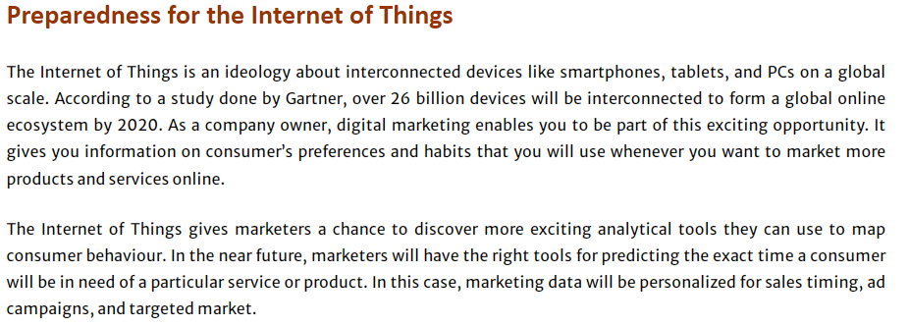

Slide 26
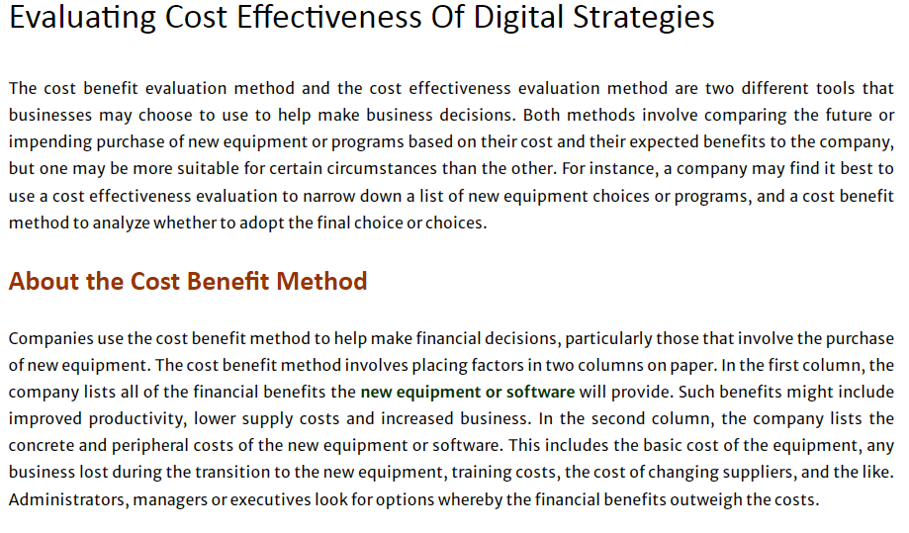

Slide 27
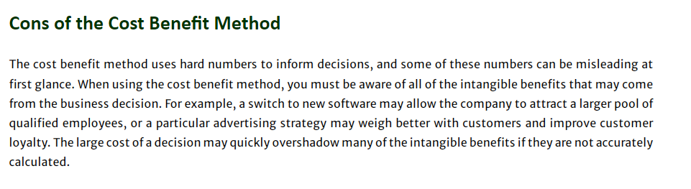

Slide 28
