Slide 1
What is .NET ? - .NET is a developer platform made up of tools, programming languages. and libraries for building many different types of applications.
What is .NET Framework?
.NET Framework is the execution and development environment for .NET applications. It supports running websites, services, desktop apps, and more on Windows.
By : Dr. Vikrant
3

Slide 2

Introduction to .NET Framework
Architecture of .NET Framework
VB | C++ | c# | JScript | ■ ■ ■
Common Language Specification
ASP.NET: Web Services and Web Forms
Windows
Forms
ADO.NET: Data and XML
Base Classes
Common Language Runtime
By : Dr. Vikrant
4

Slide 3
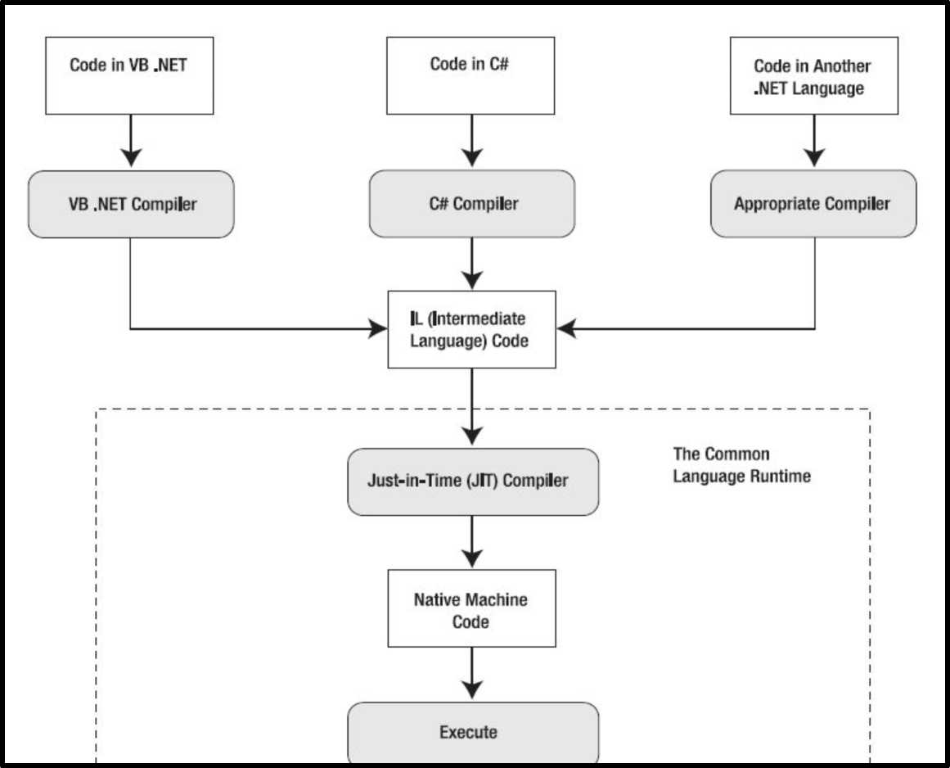
Intermediate Language (IL)
By : Dr. Vikrant

Slide 4
Intermediate Language (IL)
Two stages of compilation:
1. VB or C# code you write is compiled into an intermediate language
called Microsoft Intermediate Language (MSIL) code, or Common Intermediate Language (CIL). The compiled file with IL code is an assembly (.dll or .exe file)
2. IL code is compiled into low-level native machine code. This stage is known as just-in-time (JIT) compilation
By : Dr. Vikrant

Slide 5
Common Language Runtime(CLR)
•The heart of the .NET Framework is the CLR • It is a runtime environment that executes MSIL code •CLR is present in every .NETframework version
By : Dr. Vikrant

Slide 6
Common Language Runtime(CLR)
JIT Compilation
The .NET CLR utilizes Just In Time (JIT) compilation technology to convert the IL code back to a platform/device-specific code. Three types of JIT compilers:
1. Pre-JIT : This JIT compiles an assembly's entire code into native code at one stretch. You would normally use this at installation time.
2. Econo-JIT : You would use this JIT on devices with limited resources. It compiles the IL code bit-by-bit, freeing resources used by the cached native code when required.
3. Normal JIT : The default JIT compiles code only as it is called and places the resulting native code in the cache.
By : Dr. Vikrant
8

Slide 7
Common Language Runtime(CLR)
Garbage Collection and Memory Management
•The CLR implements dynamic memory management through the use of garbage collection. The programmer is responsible for allocating memory, but it is the CLR that clears up unused memory.
•Code that is run under the garbage collection system is known as managed code
• However, at times you may want to force the garbage collector to run, perhaps before starting an operation that is going to require a large amount of memory. To do this, just call GC.Collect()
By : Dr. Vikrant
9

Slide 8
Common Language Runtime(CLR)
Application Domains (or AppDomain)
•This are like lightweight processes
•An AppDomain, which may contain one or more assemblies, is completely isolated from any other AppDomains running in the same process so there's no sharing of memory or data.
•In fact, the separation is so complete that another AppDomain running in the same process is treated in exactly the same way as one residing on another machine
By : Dr. Vikrant
10

Slide 9
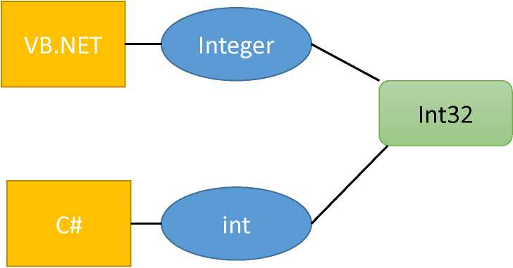
Common Language Runtime(CLR)
Common Language Specification (CLS)
It is responsible for converting the different .NET programming language syntactical rules and regulations into CLR understandable format. In simple words, CLS enables cross-language integration or Interoperability.
Common Type System (CTS)
Every programming language has its own data type system, so CTS is responsible for understanding all the data type systems of .NET programming languages and converting them into CLR understandable format which will be a common format.
Language Data types CLR Data type
Figure : Common Type System
By : Dr. Vikrant
11

Slide 10
Common Language Runtime(CLR)
Security
• Security for .NET applications starts as soon as a class is loaded by the CLR.
• Before the class loader instantiates a class, security information—such as accessibility rules and self-consistency requirements—are checked.
• Essentially system of security policies that can be set by an administrator to allow certain levels of access based on the component's assembly information. The policies are set at three levels:
• the enterprise
• the individual machine
• the user
By : Dr. Vikrant
12

Slide 11
Assembly
•.NET applications are deployed as assemblies, which can be a single executable or a collection of components and form a logical unit of functionality
•Assemblies take the form of executable (.exe) or dynamic link library {.dll) files, and are the building blocks of .NET applications.
• When you create a .NET application, you are actually creating an assembly, which contains a manifest that describes the assembly.
•This manifest data contains the assembly name, its versioning information, any assemblies referenced by this assembly and their versions, a listing of types in the assembly, security permissions, its product information (company, trademark, and so on), and any custom attributes
By : Dr. Vikrant
13

Slide 12
Assembly
Types of Assemblies:
1. Private : requires us to copy separately in all application folders where we want to use that assembly's functionalities. Without copying, we cannot access the private assembly features and power. Private assembly means every time we have one, we exclusively copy into the BIN folder of each application folder.
2. Shared : Only one copy is required in system level, there is no need to copy the assembly into the application folder. Shared assembly should install in GAC. Shared assemblies (also called strong named assemblies) are copied to a single location (usually the Global assembly cache).
By : Dr. Vikrant
14

Slide 13
Assembly
Types of Assemblies:
3. Satellite : used for deploying language and culture-specific resources for an application.
By : Dr. Vikrant
15

Slide 14
Session-2
Introduction to Visual Studio
and
.NET technologies

Slide 15
Contents
• Introduction to Visual Studio
• .NET Framework, .NET Code and Xamarin •Managed and Unmanaged Code •Using ILDASM utility
By : Dr. Vikrant

Slide 16
Introduction to Visual Studio
Microsoft has a family of code editors and Integrated Development Environments (IDEs), which include:
• Visual Studio Code
• Visual Studio 2019
• Visual Studio 2019 for Mac
By : Dr. Vikrant

Slide 17
Introduction to Visual Studio
Visual Studio Code
•The most modern and lightweight code editor and the only one from Microsoft that is cross-platform
•It is able to run on all common operating systems, including Windows, macOS, and many varieties of Linux, including Red Hat Enterprise Linux (RHEL) and Ubuntu.
•It has an extensive and growing set of extensions to support many languages beyond C#
•Using Visual Studio Code means a developer can use a cross-platform code editor to develop cross-platform apps.
By : Dr. Vikrant

Slide 18
Introduction to Visual Studio
Visual Studio 2019
• Microsoft Visual Studio 2019 only runs on Windows.
•You must run it on Windows 10 to create Universal Windows Platform (UWP) apps.
• It is the only Microsoft developer tool that can create Windows apps.
Visual Studio 2019 for Mac
To create apps for the Apple operating systems like iOS to run on devices like iPhone and iPad, you must have Xcode, but that tool only runs on macOS.
•Although you can use Visual Studio 2019 on Windows with its Xamarin extensions to write a cross-platform mobile app, you still need macOS and Xcode to compile it.
By : Dr. Vikrant
5

Slide 19
Differences .NET Framework, .NET Core and Xamarin
.NET Framework
•.NET Framework is a development platform that includes a Common Language Runtime (CLR), which manages the execution of code, and a Base Class Library (BCL), which provides a rich library of classes to build applications.
•All of the apps on a computer written for the .NET Framework share the same version of the CLR and libraries stored in the Global Assembly Cache (GAC), which can lead to issues if some of them need a specific version for compatibility.
By : Dr. Vikrant

Slide 20
Differences .NET Framework, .NET Core and
Xamarin
.NET Core
•Today, we live in a truly cross-platform world where modern mobile and cloud development have made Windows, as an operating system, much less important.
• Because of that, Microsoft has been working on an effort to decouple .NET from its close ties with Windows.
•While rewriting .NET Framework to be truly cross-platform, they've taken the opportunity to refactor and remove major parts that are no longer considered core.
•This new product was branded .NET Core and includes a cross-platform implementation of the CLR known as CoreCLR and a streamlined library of classes known as CoreFX.
By : Dr. Vikrant
7

Slide 21
Differences .NET Framework, .NET Core and
Xamarin
.NET Core
•NET Core is smaller than the current version of .NET Framework due to the fact that legacy technologies have been removed.
•For example, Windows Forms and Windows Presentation Foundation (WPF) can be used to build graphical user interface (GUI) applications, but they are tightly bound to the Windows ecosystem, so they have been removed from .NET Core on macOS and Linux.
• One of the new features of .NET Core 3.0 is support for running old Windows Forms and WPF applications using the Windows Desktop Pack
By : Dr. Vikrant
8

Slide 22
Differences .NET Framework, .NET Core and
Xamarin
.NET Core
•ASP.NET Web Forms and Windows Communication Foundation (WCF) are old web application and service technologies that fewer developers are choosing to use for new development projects today, so they have also been removed from .NET Core.
• Instead, developers prefer to use ASP.NET MVC and ASP.NET Web API. These two technologies have been refactored and combined into a new product that runs on .NET Core, named ASP.NET Core.
By : Dr. Vikrant
9

Slide 23
Differences .NET Framework, .NET Core and
Xamarin
Xamarin
•Microsoft purchased Xamarin in 2016 and now gives away what used to be an expensive Xamarin extension for free with Visual Studio 2019.
•Microsoft renamed the Xamarin Studio development tool, which could only create mobile apps, to Visual Studio for Mac and gave it the ability to create other types of apps.
By : Dr. Vikrant
10

Slide 24
Differences .NET Framework, .NET Core and Xamarin
We can summarize and compare .NET technologies, as shown in the following table:
Technology | Description | Host OS
.NET Core | for cross-platform and new apps and services | Windows, macOS, Linux
. NET Framework | for legacy apps | Windows only
Xamarin | Mobile apps only. | Android, iOS, macOS
By : Dr. Vikrant
11

Slide 25
Managed Code and Unmanaged Code
Managed Code:
• It is executed by managed runtime environment CLR.
• It provides security to the application written in .NET Framework.
• Memory buffer overflow does not occur.
•It provide runtime services like Garbage Collection, exception handling, etc.
•It also provides reference checking which means it checks whether the reference point to the valid object or not
•The application is written in the languages like C#, VB.Net, etc. are always managed code.
By : Dr. Vikrant
12

Slide 26
Managed Code and Unmanaged Code
Unmanaged Code:
• It is executed directly by the operating system.
• It does not provide security to the application.
•In unmanaged code, the memory allocation, type safety, security etc are managed by the developer. Due to this, there are several problems related to memory occur like buffer overflow, memory leak etc.
• It provides the low-level access to the programmer.
•The application written in VB 6.0, C, C++, etc are always in unmanaged code
By : Dr. Vikrant
13

Slide 27
ILDASM Utility
•The ILDASM (Intermediate Language Disassembler) is an utility which shows the information of Assembly in human-readable format by parsing any .NET Framework DLL.
•It also shows the namespaces and types and as well as their interfaces.
•The advantage of ildasm.exe utility is that it can examine some native assemblies like such as Mscorlib.dll, as well as .NET Framework assemblies provided by others or created by yourself.
By : Dr. Vikrant
14

Slide 28
ILDASM Utility
Steps to see the use of ildasm utility in C#:
1. Firstly open the Visual Studio 2013 Command Prompt and write the command like this.
J
SB Developer Command Prompt forVS2013
C:\Program Files (x86)\Microsoft Visual Studio 12.0>ildasm C:\Program Files (x86)\Microsoft Visual Studio 12.0>
By : Dr. Vikrant
15

Slide 29
ILDASM Utility
2. Then a ildasm window will open. In it select the File menu and click on open menu option.
By : Dr. Vikrant

Slide 30
f ILDASM - □ X
File View Help
Open Ctrl+O
Dump Ctrl+D
Dump TreeView Ctrl+T
Exit Ctrl+X
16

Slide 31
ILDASM Utility
3. Then go to the location of the assembly and select the assembly to open it.
4. A window will be opened which shows the information of the assembly.
By

Slide 32
j/ E:\MyPract\PrivateAssemb\PrivateAssemb\... File View Help
□
X
itth
MyPract\PrivateAssem
• ►
MANIFEST
6 9 PrivateAssemb
S £ PrivateAssemb.Student
► .class public auto ansi beforefieldinit
■ .ctor: void()
■ addition : int32(int32,int32)
■ subtraction : int32(int32,int32)
.assembly PrivateAssemb
{
Dr. Vikrant
17

Slide 33
Session-3
Introduction to C# Basics

Slide 34
Contents
• Console Applications and Class Libraries (Demo)
• C# Basics
• Data types and CTS equivalents
• Access Specifiers
• Project References, using Classes (Demo)
• Methods
• Method overloading
• Optional parameters
• Named parameters and positional parameters
• Using params
• Properties
• Constructors and Destructors
• Object Initializers
By : Dr. Vikrant

Slide 35
C# Basics
What is C#?
•C# (pronounced "C sharp") is a programming language that is designed for building a variety of applications that run on the .NET Framework.
• C# is simple, powerful, type-safe(No uninitialized variables, unsafe casts), and object-oriented.
•The first "Component oriented" language in the C/C++ family
•Everything is an object
By : Dr. Vikrant

Slide 36
C# Basics
C# - Programming Structure
•Namespace declaration
•A class or structs or interfaces or enums, or delegates
•Members : Constants, fields, methods, properties, indexers, events, operators, constructors, destructors
•Statements & Expressions
•Comments
By : Dr. Vikrant

Slide 37
C# Basics
C# - Sample Program
using System;
namespace HelloWorldApplication
{
class Hello
{
static void Main(string[] args) {
/* my first program in C# */
Console.WriteLine("Hello world"); Console.Read();
>
>
>
By : Dr. Vikrant
5

Slide 38
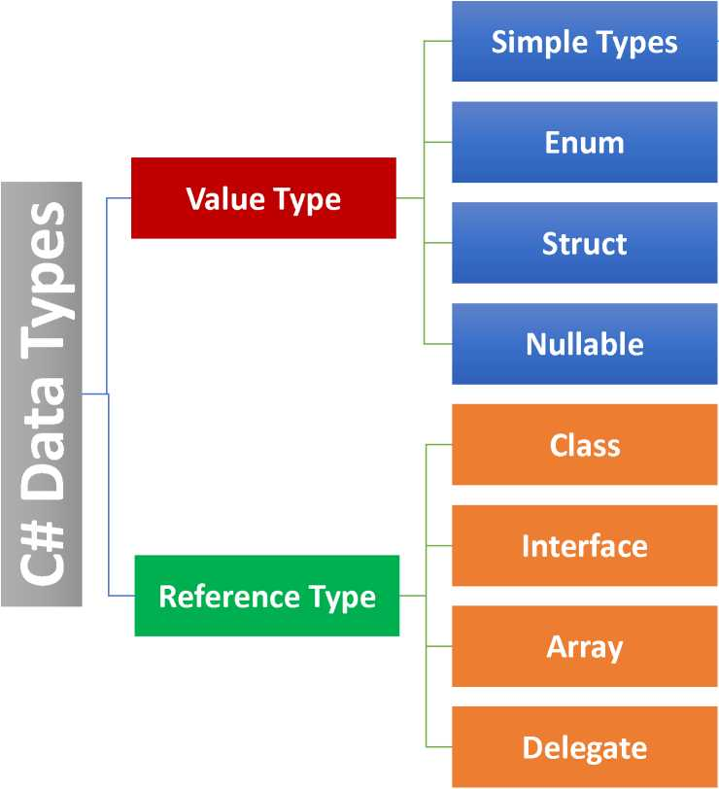
Data Types and CTS Equivalent
Integer, Float, Char, Boolean
By : Dr. Vikrant

Slide 39
Data Types and CTS Equivalent
Predefined Data Types
Type | Description | Range | .NET Type
byte | 8-bit unsigned integer | 0 to 255 | System. Byte
sbyte | 8-bit signed integer | -128 to 127 | System.SByte
short | 16-bit signed integer | -32,768 to 32,767 | System.Intl6
ushort | 16-bit unsigned integer | 0 to 65,535 | System.Ulntl6
int | 32-bit signed integer | -2,147,483,648 to 2,147,483,647 | System. Int32
uint | 32-bit unsigned integer | 0 to 4,294,967,295 | System.Ulnt32
By : Dr. Vikrant

Slide 40
Data Types and CTS Equivalent
Predefined Data Types
Type | Description | Range | .NET Type
long | 64-bit signed integer | -9,223,372,036,854,775,808 to 9,223,372,036,854,775,807 | System.lnt64
ulong | 64-bit unsigned integer | 0 to 18,446,744,073,709,551,615 | System.Ulnt64
float | 32-bit Single-precision floating point type | -3.402823e38 to 3.402823e38 | System.Single
double | 64-bit double-precision floating point type | -1.79769313486232e308to 1.79769313486232e308 | System.Double
char | 16-bit single Unicode character | Any valid character, e.g. a, b, * | System.Char
By : Dr. Vikrant
8

Slide 41
Data Types and CTS Equivalent
Predefined Data Types
Type | Description | Range | .NET Type
bool | 8-bit logical true/false value | True or False | System.Boolean
object | Base type of all other types. |  | System. Object
string | A sequence of Unicode characters |  | System.String
DateTime | Represents date and time | 0:00:00am 1/1/01 to 11:59:59pm 12/31/9999 | System. DateTime
By : Dr. Vikrant

Slide 42
Data Types and CTS Equivalent
# Boxing : Value type is converted to object type, it is called boxing. Allocates box, copies value into it.
object obj;
obj = 100; // this is boxing
# Unboxing : when an Object type is converted to a value type, it is called unboxing. Checks type of box, copies value out
int i = 123;
object obj = i; //boxing int j = (int)obj; //unboxing
By : Dr. Vikrant
10

Slide 43
Access Specifiers
•Encapsulation, in object oriented programming methodology, prevents access to implementation details.
•Abstraction allows making relevant information visible and encapsulation enables a programmer to implement the desired level of abstraction.
•C# supports the following access specifiers:
□ Public
□ Private
□ Protected
□ Internal
□ Protected internal
By : Dr. Vikrant
11

Slide 44
Access Specifiers
Internal:
•allows a class to expose its member variables and member functions to other functions and objects in the current assembly.
• In other words, internal members can be accessed from any class or method defined within the application in which the member is defined.
Protected Internal:
The protected internal access specifier allows a class to hide its member variables and member functions from other class objects and functions, except a child class within the same application. This is also used while implementing inheritance.
By : Dr. Vikrant
12

Slide 45
Methods
• Methods are members of a type that execute a block of statements.
• Methods can return a single value or return nothing.
• A method that performs some actions but does not return a value indicates this with the void type before the name of the method.
• A method that performs some actions and returns a value indicates this with the type of the return value before the name of the method.
By : Dr. Vikrant
13

Slide 46
Methods
Elements of Method:
• Access Specifier - This determines the visibility of a variable or a method from another class.
• Return type - A method may return a value. The return type is the data type of the value the method returns. If the method is not returning any values, then the return type is void.
• Method name - Method name is a unique identifier and it is case sensitive. It cannot be same as any other identifier declared in the class.
• Parameter list - Enclosed between parentheses, the parameters are used to pass and receive data from a method. The parameter list refers to the type, order, and number of the parameters of a method. Parameters are optional; that is, a method may contain no parameters. •
• Method body ⁻ This contains the set of instructions needed to complete the required activity.
By : Dr. Vikrant
14

Slide 47
Methods
Example of Method:
public int calculateFactorialCint num)
{
int factorial = 1;
for (int i = 1; i <=num; i++)
{
factorial=factorial*i;
}
return factorial;
By : Dr. Vikrant
15

Slide 48
Methods
Method Overloading
•Instead of having two different method names, we could give both methods the same name. This is allowed because the methods each have a different signature.
•A method signature is a list of parameter types that can be passed when calling the method (as well as the type of the return value).
By : Dr. Vikrant
16

Slide 49
Methods
Method Overloading
public int addNumbers(int x,int y)
{
return x+y ;
}
1 reference
public int addNumbersCint x, int y,int z)
{
return x + y + z ;
}
By : Dr. Vikrant
17

Slide 50
Methods
Method Overloading
static void Main(string [] args)
{
Program obj = new ProgramO;
int resultl = obj.addNumbers(12, 21);//calling function with 2 parameters int result2= obj.addNumbersCll,22,33);//callling function with 3 parameters Console.WriteLine("Result-l: " + resultl);
Console.WriteLine("Result-2: " + result2);
}
By : Dr. Vikrant
18

Slide 51
Methods
Optional Parameters are not compulsory parameters, they are optional. It helps to exclude arguments for some parameters. Or we can say in optional parameters, it is not necessary to pass all the parameters in the method
By : Dr. Vikrant
19

Slide 52
Methods
Optional Parameters
class Program
{ // This method contains three regular // parameters, i.e. roll,age and name // And one optional parameters branch.|
2 references
public void displayStudentDetailsCint roll,int
{
Console.WriteLineC'Roll No:" + roll); Console.WriteLineC'Age + age);
Console.WriteLineC'Name: " + name);
Console.WriteLineC"Branch :" + branch);
}
0 references
static void MainCstring [] args)
{
Program obj = new ProgramO;
obj.displayStudentDetailsClOl, 22, "Alex")
obj.displayStudentDetails(102, 23, "Smith"
}

Slide 53
age,string name,string branch="Mechanical")
EE3 Microsoft Visual Studio Debug Console
Roll No:101
Age :22
Name: Alex
Branch :Mechanical
Roll No:102
Age :23
Name: Smith
Branch :Computer Science
"Computer Science");

Slide 54
Methods
Named and positional parameters
•Generally, while calling the method we need to pass all the method arguments in the same sequence of parameters in the method definition.
• If we use named parameters, we don't need to worry about the order or sequence of parameters while calling the method.
•In named parameters, the parameter values will map to the right parameter based on the parameter name. So, while calling the methods, we can send the parameters in any sequence or order
By : Dr. Vikrant
21

Slide 55


Methods
Named and positional parameters
class Program
{
1 reference
public void displayStudentDetailsCint roll,int age,string name,string branch)
{
Console.WriteLine("Roll No:" + roll);
Console.WriteLineC'Age :" + age);
Console.WriteLineC'Name: " + name);
Console.WriteLineC'Branch + branch);
}
Sending the
0 references
parameters in any sequence or order
static void MainCstring [] args)
{
Program obj = new ProgramC);
obj.displayStudentDetailsCage:23,name:"Ken",branch:"Civil",roll:1G
}
By: Dr. Vikrant
22

Slide 56
Methods
params : It is used as a parameter which can take the variable number of arguments.
•It is useful when programmer don't have any prior knowledge about the number of parameters to be used.
•Only one params keyword is allowed and no additional params will be allowed in function declaration after a params keyword.
•The length of params will be zero if no arguments will be passed.
By : Dr. Vikrant
23

Slide 57
Methods
params :
class Program
{
1 reference
public void displayStudentMarks(params int [] marks) {
for(int i = 0; i < marks.Length; i++)
Console.WriteLine(marks[i]);
}
ED Microsoft Visual Studio Debug Console
0 references
34
44
55
33
static void MainCstring [] args)
{
Program obj = new ProgramO; obj.displayStudentMarks(34, 44, 55, 33);
}
}

Slide 58
Properties
•Property in C# is a member of a class that provides a flexible mechanism for classes to expose private fields.
•Internally, C# properties are special methods called accessors. A C# property have two accessors,
• get property accessor : returns a property value
• set property accessor: assigns new value
•The value keyword represents the value of a property.
•Properties can be read-write, read-only, or write-only. The read-write property implements both get and set accessor. A write-only property implements a set accessor, but no get accessor. A read-only property implements a get accessor, but no set accessor.
By : Dr. Vikrant
25

Slide 59
Constructors and Destructors
•Constructor is a special method which is invoked automatically at the time of object creation. It is used to initialize the data members of new object generally. The constructor in C# has the same name as class or struct.
•Destructors in C# are methods inside the class used to destroy instances of that class when they are no longer needed. The Destructor is called implicitly by the .NET Framework's Garbage collector and therefore programmer has no control as when to invoke the destructor.
By : Dr. Vikrant
26

Slide 60
Constructors and Destructors
•There can be five types of constructors in C#.
• Default Constructor - It has no arguments and It is invoked at the time of creating object.
• Parameterized Constructor - A constructor which has parameters is called parameterized constructor.
• Copy Constructor - used to copy one object's data into another object
• Static Constructor -There is no matter how many numbers instances (objects) of the class are created, static constructor is going to be invoked only once and that is when the class is load for the first time. The static constructor is used to initialize the static fields of the class.
• Private Constructor - When a class contains a private constructor then we cannot create an object for the class outside of the class. So, private constructors are used to creating an object for the class within the same class
By : Dr. Vikrant
27

Slide 61
Object Initializer
In object initializer, you can initialize the value to the fields or properties of a class at the time of creating object without calling constructor.

Slide 62
class Program
{
0 references
static void MainCstring [] args) {
Emp emp = new EmpO
: ; {
EmpID = 10,
EmpName = "Alex"
t
Console.WriteCemp.EmpID); Console.WriteCemp.EmpName);
}
>
By : Dr. Vikrant
28

Slide 63
References
1. C# 8.0 and .NET Core 3.0 - Modern Cross-Platform Development Fourth Edition by Mark J. Price
By : Dr. Vikrant
29

Slide 64
Session-4
Static keyword and Inheritance

Slide 65
Contents
•Static members of the class
• Fields/Variables
• Methods
• Properties
• Constructors
•Static Class
• Inheritance
• Access Specifiers
• Constructors in Hierarchy
• Overloading in derived class
• Override
• Sealed class and methods
• Abstract class and methods

Slide 66
By : Dr. Vikrant
2

Slide 67
Static Members
Static variables
•Single copy(instance) of the variable is created and shared among multiple objects.
•Static variables are accessed with the name of the class, they do not require any object for access.

Slide 68
|namespace FirstConsoleApp
{
0 references
class Program
{
static int x = 1; //static variable
0 references
static void MainCstring [] args)
{
Console.WriteLine(x);
}
}
}_
Dr. Vikrant
3

Slide 69
Static Members
Static Methods
• Static methods are accessed with the name of the class.
• A static method can access static and non-static fields, static fields are directly accessed by the static method without class name whereas non-static fields require objects.
namespace FirstConsoleApp
{
3 references
class Program
{
static int x = 1; //static variable int y=2;//non-static variable
1 reference
static void count()//static method
{
Console.WriteLine(x++);
}
0 references
static void MainCstring [] args)
{
Progran.countO;//calling static method Program obj = new ProgramO;
Console.WriteLineCobj.yD;//Accessing non-static variable
}
}
>l
By : Dr. Vikrant
4

Slide 70
Static Members
Static Properties
•Similar to static methods
•Static properties use the same get and set tokens as instance properties
namespace FirstConsoleApp
{
2 references
class Program
{
static int empID;
2 references
public static int EmpID { get => empID; set => empID = value; }
0 references
static void MainCstring [] args)
{
Prograr .EmpID = 101;//Accessing static properties Console.WriteLineC³rograi .EmpID);
}
}
>1
By : Dr. Vikrant
5

Slide 71
Static Members
namespace ursuconsoieApp
{
Static Constructor
•There is no matter how many numbers instances (objects) of the class are created, static constructor is going to be invoked only once and that is when the class is load for the first time.
•The static constructor is used to initialize the static fields of the class.
6 references
class Program {
0 references
static ProgramO {
Console .Writel_ine("Static Constructor");
}
2 references
Program()
{
Console.WriteLineC"De-Fault Constructor") ;
}
0 references
static void Main(string [] ar ^
{
Microsoft Visual Studio Debug Console
Program obj=new ProgramO; Program objl=new ProgramO;
Static Constructor Default Constructor Default Constructor
}
By : Dr. Vikrant
6

Slide 72
Static Class
3 references
static class Program
{
0 references
static ProgramO {
Console.WriteLineC'Static Constructor");
}
1 reference
public static void addNumbers(int x,int y)
{
Console.WriteLineC'Addition : "+(x + y));
}
•A static class can only contain static data members, static methods, and a static constructor.
•It is not allowed to create objects of the static class.
•Static classes are sealed, means you cannot inherit a static class from another class.
}
0 references ^
class Course: Program
<V\/V\A/VA/VA/V —'
{ ^
cannot derived from static class
0 references
static void Main(string[] args) {
}grai .addl\lumbers(12, 21);
}
}
By : Dr. Vikrant
7

Slide 73
Inheritance
•It is the mechanism in C# by which one class (child or derived) is allowed to inherit the features(fields and methods) of another class (parent or base).
•Inheritance is one of the primary concepts of object-oriented programming (OOP).
•Inheritance supports the concept of "reusability", i.e. when we want to create a new class and there is already a class that includes some of the code that we want, we can derive our new class from the existing class. By doing this, we are reusing the fields and methods of the existing class.
By : Dr. Vikrant
8

Slide 74
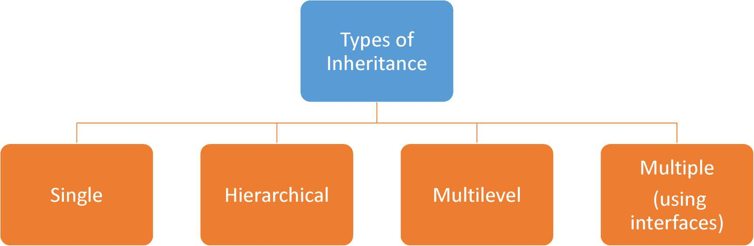
Inheritance
By : Dr. Vikrant
9

Slide 75
Inheritance
Access Specifiers
 | public | protected | internal | protected internal | private | private protected
Entire program | Yes | No | No | No | No | No
Containing class | Yes | Yes | Yes | Yes | Yes | Yes
Current assembly | Yes | No | Yes | Yes | No | No
Derived types | Yes | Yes | No | Yes | No | No
Derived types within current | Yes | Yes | Yes | Yes | No | Yes
assembly
By : Dr. Vikrant
10

Slide 76
Inheritance
Constructors in Hierarchy:
Two different cases arise as follows:
Case 1: Only derived class contains a constructor. So the objects of the derived class are instantiated by that constructor and the objects of the base class are instantiated automatically by the default constructor.
Case 2: In this case, both the base class and derived class has their own constructors, so the process is complicated because the constructors of both classes must be executed. To overcome this situation C# provide a keyword known as a base keyword. With the help of base keyword, the derived class can call the constructor which is defined in its base class.
By : Dr. Vikrant
11

Slide 77
Inheritance
Overloading
•When the compiler goes looking for instance method overloads, it considers the compile-time class of the "target" of the call, and looks at methods declared there.
•If it can't find anything suitable, it then looks at the parent class then the grandparent class, etc.
•This means that if there are two methods at different levels of the hierarchy, the "deeper" one will be chosen first
By : Dr. Vikrant
12

Slide 78
Inheritance
Overriding:
• Overriding is a feature that allows a subclass or child class to provide a specific implementation of a method that is already provided by one of its super-classes or parent classes.
•When a method in a subclass has the same name, same parameters or signature and same return type(or sub-type) as a method in its super-class, then the method in the subclass is said to override the method in the super-class.
• Method overriding is one of the ways by which C# achieve Run Time Polymorphism(Dynamic Polymorphism).
By : Dr. Vikrant
13

Slide 79
Inheritance
Overriding:
•The overridden base method must be virtual, abstract, or override.
Parent Class
addNumQ
subNumQ
Overriden
Method
inheriting
Child Class
Overriding ► Method
addNumQ
muliplyNumQ
By : Dr. Vikrant
14

Slide 80
Inheritance
Overriding:
In C# we can use 2 types of keywords for Method Overriding:
•virtual keyword: This modifier or keyword use within base class method. It is used to modify a method in class for overridden that particular method in the derived class.
•override: This modifier or keyword use with derived class method. It is used to modify a virtual or abstract method into which
presents in base class.
By : Dr. Vikrant
15

Slide 81
Inheritance
Sealed Class
•Sealed classes are used to restrict the users from inheriting the class. A class can be sealed by using the sealed keyword.
• No class can be derived from a sealed class.
Sealed Method
•A method can also be sealed, and in that case, the method cannot be overridden.
• If you want to declare a method as sealed, then it has to be declared as virtual in its base class.
By : Dr. Vikrant
16

Slide 82
Inheritance
Abstract Class
•An Abstract class is never intended to be instantiated directly.
•This class must contain at least one abstract method, which is marked by the keyword or modifier abstract in the class definition.
•The Abstract classes are typically used to define a base class in the class hierarchy
Abstract Method
•A method which is declared abstract, has no "body" and declared inside the abstract class only.
• An abstract method must be implemented in all non-abstract classes using the override keyword
By : Dr. Vikrant
17

Slide 83
References
1. C# 8.0 and .NET Core 3.0 - Modern Cross-Platform Development Fourth Edition by MarkJ. Price
2. https://www.geeksforgeeks.org
By : Dr. Vikrant
18

Slide 84
Session-5
Interfaces and Operator
Overloading

Slide 85
Contents
• Interfaces
• Implementing interfaces
• Explicitly implementing interfaces
• Inheritance in interfaces
• Default interfaces methods
• IDisposable and IComparable
•Operator Overloading
By : Dr. Vikrant
2

Slide 86
Interface
•It is like abstract class because all the methods which are declared inside the interface are abstract methods. It cannot have method body but in C# 8.0 this feature has also been implemented using Default interface methods.
•They cannot be instantiated.
•It is used to achieve multiple inheritance which can't be achieved by class. It is used to achieve fully abstraction because it cannot have method body.
•Its implementation must be provided by class or struct. The class or struct which implements the interface, must provide the implementation of all the methods declared inside the interface.
By : Dr. Vikrant
3

Slide 87
Interface
•Interface methods are public and abstract by default. You cannot explicitly use public and abstract keywords for an interface method.
namespace FirstConsoleApp
{
2 references
internal interface ICalculate
{
2 references
double calculateArea(-float r);
2 references
double calculateAreaCint l,int b)
}
By : Dr. Vikrant

Slide 88
Implementing Interface
namespace FirstConsoleApp
{
1 reference
internal class Shape : ICalculate
{
2 references
public double calculateArea(float r)
{
return 3.14-f * r * r ;
}
2 references
public double calculateArea(int l, int b)
{
return l*b ;
}
}
}
namespace FirstConsoleApp {
0 references
class Program {
0 references
static void Main(string[] args)
{
ICalculate obj = new ShapeQ;
Console.WriteLine(obj.calculateAreaC2.3f)); Console.WriteLineC obj.calculateArea(3, 4))
}
}
}
By : Dr. Vikrant
5

Slide 89
Explicitly Implementing Interface
•Using <lnterfaceName>.<MemberName>
•Explicit implementation is useful when class is implementing multiple interfaces
•It is also useful if interfaces have the same method name coincidently.
•Do not use public modifier with an explicit implementation. It will give a compile-time error.
By : Dr. Vikrant

Slide 90
Explicitly Implementing Interface
namespace FirstConsoleApp
{
1 reference
internal class Shape : ICalShapePerimer
{
2 references
void ICalShapePerimer.calculatePerimeter(int l, int w)
{
Console.Write("Perimeter of Rec:" + (2 * (l + w)));
}
2 references
void ICalShapePerimer.calculateCircumference(int r)
{
Console.Write("Circumference of Circle:" + (2 * 3.14f * r));
}
}
}
namespace FirstConsoleApp {
O references
class Program {
O references
static void MainCstring[] args)
{
ICalShapePerimer p = new ShapeO p.calculatePerimeter(2, 3); p. calculateCircum-ference(2);
}
}
}
By : Dr. Vikrant
7

Slide 91
Inheritance in Interface
• C# allows the user to inherit one interface.into another interface.
•When a class implements the inherited interface then it must provide the implementation of all the members that are defined within the interface inheritance chain (i.e including the base interface methods) Otherwise, the compiler throws an error.
• If both derived interface and base interface declares the same member then the base interface member name is hidden by the derived interface member name.
By : Dr. Vikrant
8

Slide 92
Inheritance in Interface
namespace FirstConsoleApp
{
1 reference
interface A
i {
2 references
void showAO;
j >
1 reference
interface B : A
i {
void showBO;
}
>1

Slide 93
i reierences
class Program:B
{
2 references
public void showAO
{
Console.WriteLineC"Interface A Method")
}
2 references
public void showBO
{
Console.WriteLineC"Interface B Method")
}
0 references
static void MainCstring[] args)
{
Program obj= new ProgramO; obj . showAQ ; obj . showBQ;
}
}

Slide 94
Default Interface Methods
• C# 8.0 is allowed to add members as well as their implementation to the interface.
• Now you are allowed to add a method with their implementation to the interface without breaking the existing implementation of the interface, such type of methods is known as default interface methods(also known as the virtual extension methods).
• You are allowed to implement indexer, property, or event accessor in the interface.
•You are allowed to use access modifiers like private, protected, internal, public, virtual, abstract, override, sealed, static, extern with default methods, properties, etc. in the interface.
By : Dr. Vikrant
10

Slide 95
Default Interface Methods
•You are allowed to create static fields, methods, properties and events in the interface.
•The explicit access modifiers with default access are public.
• If an interface contains default method and inherited by some specified class, then the class does not know anything about the existence of the default methods of that interface and also does not contain the implementation of the default method.
•You are allowed to use the same name methods in the interface, but they must have different parameter lists
By : Dr. Vikrant
11

Slide 96
Default Interface Methods
i references
class Program:A
{
2 references
public void showAO
{
Console.WriteLine("Inter-face A Method")
}
0 references
static void Main(string[] args)
{
Program obj= new ProgramO; obj . showAO;
A obj2 = new ProgramO; obj2.addl\lum(22);
}
}
namespace nrstconsoieApp
{
2 references
interface A
{
2 references
void showAO;
1 reference
public void addNumfint num)//Default interface method
{
Console.WriteLine(num);
}
}
3 raforflnrflc
}
By : Dr. Vikrant
12

Slide 97
IDisposable Interfaces
• When the garbage collector runs it can clean up your managed resources. The garbage collector does not know how to free unmanaged resources (such as file handles, network connections and database connections).
•The term "unmanaged resource" is usually used to describe something not directly under the control of the garbage collector
• The following are two mechanisms to automate the freeing of unmanaged resources:
1. Declaring a destructor (or Finalizer) as a member of your class.
2. Implementing the System.lDisposable interface in your class.
By : Dr. Vikrant
13

Slide 98
IDisposable Interfaces
• IDisposable is an interface that contains only a single method i.e. Dispose(), for releasing unmanaged resources.
• IDisposable is defined in the System namespace.
•When your application or class library encapsulates unmanaged resources such as files, streams, database connections, etc, they should implement the IDisposable interface
• Inside the Dispose() method we can perform the resources clean-up
• If you are using a class that implements the IDisposable interface, you should call its Dispose() method when you are finished using the class by try/finally block or using statement.
•To prevent the dispose method from running twice (in case the object already has been disposed ), we add GC.SuppressFinalize(this)
By : Dr. Vikrant
14

Slide 99
IComparable Interface
• Use the IComparable Interface in C# to sort elements. It is also used to compare the current instance with another object of same type.
• It provides you with a method of comparing two objects of a particular type. Remember, while implementing the IComparable interface, CompareToQ method should also be implemented.
By : Dr. Vikrant
15

Slide 100
IComparable Interface
namespace Testlnterfaces
{
6 references
class Program:IComparable<Program>
{
int salary;
4 references
public int Salary { get => salary; set => salary = value;
0 references
static void Main(string[] args)
{
Program program=new ProgramO; program.Salary = 3400;
Program program2 = new ProgramO; program2.Salary = 3400;
int retval=program.CompareTo(program2);
Console. WriteLine(retval) ;
}
// i-f first obj //if first obj //if first obj
1 reference
val is greater than other then 1 val is less than other then -1 val is equal to other then 0
public int CompareTo(Proqram obj) {
return this.Salary.CompareToCobj.Salary);
}
By : Dr. Vikrant
16

Slide 101
Operator Overloading
• Ability to use the same operator to do various operations by providing special meaning to C# operators.
•It provides additional capabilities to C#operators when they are applied to user-defined data types.
•It enables to make user-defined implementations of various operations where one or both of the operands are of a user-defined class.
• Only the predefined set of C# operators can be overloaded
•An operator can be overloaded by defining a function to it. The function of the operator is declared by using the operator keyword.
By : Dr. Vikrant
17

Slide 102
Operator Overloading
Syntax:
Access_specifier Class_Name operator Operator_symbol (parameters)
{
//Code
}
Example . public static Calculator operator + (Calculator objl^Calculator obj2)
{
Calculator obj3 = new CalculatorQ; obj3.number = obj2.number + ob]l.number; return obj3;
}
By : Dr. Vikrant
18

Slide 103
Operator Overloading
Overloading ability of the various operators available in C#
• unary operators take one operand and can be overloaded.
• Binary operators take two operands and can be overloaded. •Comparison operators can be overloaded.
•Conditional logical operators cannot be overloaded directly •Assignment operators cannot be overloaded.
By : Dr. Vikrant
19

Slide 104
Session-6
Reference and Value Types

Slide 105
Contents
•Value Types
• enum
• struct
• Reference Types •Nullable Types
• ref and out
• Arrays
• Indexers

Slide 106
By : Dr. Vikrant
2

Slide 107

Value Types
•A data type is a value type if it holds a data value within its own memory space. It means the variables of these data types directly contain values.
0x233949
int x = 400;
Memory Allocation of Value Type
By : Dr. Vikrant
3

Slide 108
Value Types
enum (enumeration type):
• It is mainly used to assign the names or string values to integral constants, that make a program easy to read and maintain
•is defined using enum keyword directly inside namespace, class or structure
• Enums are lists of constants. When you need a predefined list of values which do represent some kind of numeric or textual data, you should use an enum.
•The default type is int, and the approved types are byte, sbyte, short, ushort, uint, long, and ulong
Example :
enum Days {Sun, Mon, Tue, Wed, Thu, Fri, Sat};
By : Dr. Vikrant
4

Slide 109
Value Types
struct
It helps you to make a single variable hold related data of various data types.
The struct keyword is used for creating a structure.

Slide 110
struct Book
{
public int bookID; public string title; public float price;
};
class Program
{
0 references
static void Main(string[] args)
{
Book obj;//Declaring obj of type Book obj.bookID = 101;
obj.title = "Operation Nanagenent"; obj.price = 340.50f;
Console.WriteLineCobj.title);
Console.WriteLineCobj.price);
Console.WriteLineCobj.bookID) ;
}
}
Dr. Vikrant
5

Slide 111
Value Types
struct
•Structures cannot inherit other structures or classes.
•Structures can have defined constructors, but not destructors. The default constructor is automatically defined and cannot be changed. It contain parameterized constructor or static constructor.
•A structure can implement one or more interfaces.
•Structure members cannot be specified as abstract, virtual, or protected
•Structures can have methods, fields and properties
By : Dr. Vikrant
6

Slide 112
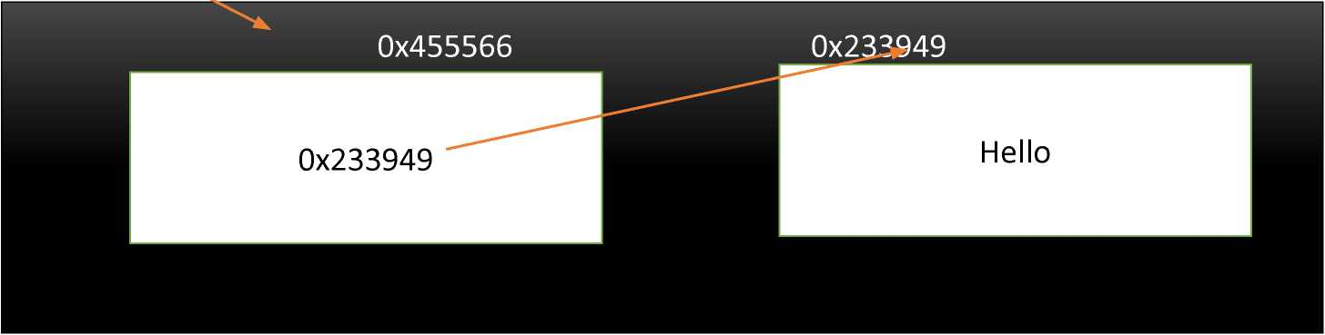
Reference Types
•Unlike value types, a reference type doesn't store its value directly. Instead, it stores the address where the value is being stored.
string str = "Hello";
Reference type variables Actual Value
contains address where the value is stored
By : Dr. Vikrant

Slide 113
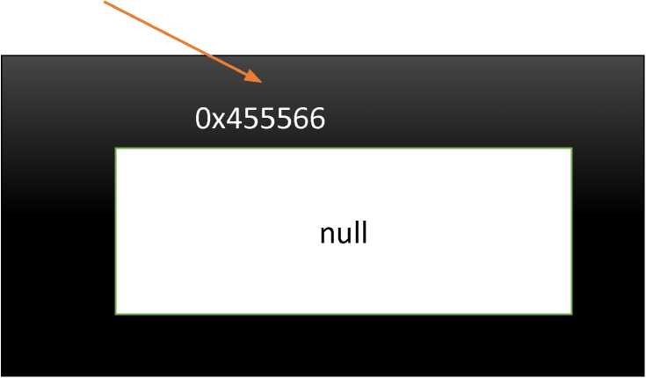
Reference Types
•Null Reference type
Student obj;
Null Reference type
By : Dr. Vikrant
8

Slide 114
Nullable Types
•The Nullable type allows you to assign a null value to a variable.
• Nullable types can only work with Value Type, not with Reference Type.
Syntax : Nullable <data_type> variable_name = null;
Or
data_type? variable_name=null;
you can also use a shortcut which includes ? operator with the data type:
By : Dr. Vikrant

Slide 115
Nullable Types
How to access the value of Nullable type variables?
You have to
use GetValueOrDefault( ) method to get an
original assigned value if it is not null. You will get the default value zero if it is null.
namespace Session6Demo
{
0 references
class Program
{
0 references
static void MainCstring[] args)
{
int? x = null;
Nullable<int> y = 12;
Console. WriteLineCx .GetValueOrDe-faultO) Console .Writ eLineCy .GetValueOrDe-faultO)
}
}
}
By : Dr. Vikrant
10

Slide 116
Nullable Types
Use the'??' (Null Coalescing Operator) to assign a nullable type to a
non-nullable type.
namespace SessionbUemo
{
0 references
class Program
{
0 references
static void Main(string[] args)
: : {
int? x = null;
int y = x ?? 7; //if x is null then assign 7 to y. Console.WriteLine(y);
}
i .}
}
By : Dr. Vikrant
11

Slide 117
Nullable Types
Advantage of Nullable Types:
•The main use of nullable type is in database applications. Suppose, a table a row fetched null values in application, then you can use nullable type to get the null values.
• Nullable types can only be used with value types.
•The HasValue property returns true if the variable contains a value, or false if it is null.
By : Dr. Vikrant
12

Slide 118
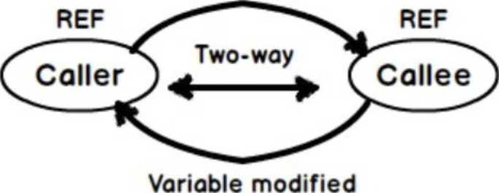
ref
The ref keyword passes
arguments to calling method by reference. But before calling the method, the arguments must be initialized with some values.
namespace Session6Demo
{
0 references
class Program
{
1 reference
static void reffunctionCref int i)
{
i = 50;
}
0 references
static void MainCstring [] args)
{
int r = 3;// Complier error if no value assigned reffunctionCref r);
Console.WriteLine(r);
}
}
}
Variable Data ♦
Reference
By : Dr. Vikrant
13

Slide 119
out
namespace Session6Demo
{
We need not to initialize the parameter before calling the method.
But C# compiler puts a constraint on the called method, that parameter must be initialize within the method.
0 references
class Program
{
1 reference
static void out-f unction (out int i)
| {
i = 50[//Compiler error if no value assigned
}
0 references
static void Mainfstring [] args)
{
int r;// No value assigned outfunctionCout r);
Console.WriteLine(r);
}
}
By : Dr. Vikrant
14

Slide 120
Arrays
•Array is a collection of variables of the same type stored at contiguous memory locations.
•Declaring array: datatype[] Arrayname; eg. int[] marks;
• Initializing array : int[] marks=new int[5];
•Assigning values to an array:
• Using index number: marks[0]=56; marks[l]=66;
• At the time of declaration : int[] marks={ 44, 55, 66};
• int[] marks=new int[3] {44, 55, 66};
• int[] marks=new int[] {44, 55, 66};
By : Dr. Vikrant
15

Slide 121
Arrays
Accessing Array Elements:
namespace Session6Demo
{
0 references
class Program
{
0 references
static void Main(string [] args)
{
int[] marks = new int[3];
marks[0] = 66; //assigning value at index 0
marks[1] = 77;//assigning value at index 1
marks[2] = 44;//assigning value at index 2
Console.WriteLine(marks[0] +" "+ marks[l]+ " " +marks[2]);
}
}
By : Dr. Vikrant
16

Slide 122
Arrays
Accessing Array Elements (using loops)
3namespace Session6Demo
{
0 references
class Program
{
0 references
static void MainCstring [] args)
{
int[] marks = new int[3] { 33, 44, 55 };
for Cint i=0; i<marks. Length;i++)
{
Console. Writel_ine(marks[i]);
}
1 >
}
}
17
■

Slide 123
namespace Session6Demo|
{
0 references
class Program
{
0 references
static void Main(string [] args)
{
int[,] marks=new int[4,2];//4 rows and 2 columns
marks[0,0] = 11; marks[0,1] = 22;
marks[1,0] = 33; marks[1,1] = 44;
marks[2,0] = 55; marks[2,1] = 66;
marks[3,0] = 77; marks[3,1] = 88;
-ForCint i = 0; i < 4;i++)
{
-ForCint j = 0; j < 2; j++)
j | {
Console.Write(marks[i,j] +"
}
Console .WriteLineO;
}
}
}
}
Arrays
Multidimensional
Array
• The
multi-dimensional array contains more than one row to store the values.
• To storing and accessing the values of the array, one required the nested loop
By : Dr. Vikrant
18

Slide 124
Arrays
namespace Session6Demo
{
0 references
class Program
{
0 references
static void Main(string[] args)
{
int[][] arr= new int[2][];//Jagged Array for 2 arrays
arr[0] = new int[5] { 23, 32, 44, 33, 22 }; arr[l] = new int[4] { 11, 2, 23, 21 };
for (int i = 0; i < arr.Length; i++)
{
for (int j = 0; j < arr[i].Length; j++)
Console.Write(arr[i][j] + "
Console .WriteLineO;
| }
}
}
}
Jagged Array
An array whose elements are arrays is known as Jagged arrays it means "array of arrays". The jagged array elements may be of different dimensions and sizes.
By : Dr. Vikrant
19

Slide 125
Indexer
•An indexer is a special type of property that allows a class or a structure to be accessed like an array for its internal collection.
•An indexer can be defined the same way as property with 'this' keyword and square brackets [].
• Modifiers can be private, public, protected or internal
By

Slide 126
Syntax:
<modifier> <return type> this
{
get
{
// your get block code
}
set
{
// your set block code
}
}
[argument list]
Dr. Vikrant
20

Slide 127
Indexer
class Program
{
private string [] names=new string[4];
5 references
public string this[int index] //creating indexer
| {
get { return names[index]; } set { names[index] = value; }
| }
0 references
static void Main(string[] args)
{
Program obj=new ProgramO; obj[0] = "Vikrant"; obj[l] = "Alex"; obj[2] = "Ken"; obj[3] = "Smith";
forCint i = 0; i < 4; i++)
Console.WriteLineCobj[i]);
}

Slide 128
Session-7
Generics and Collections

Slide 129
Contents
•Generics
•Generic classes
•Generic methods
•Generics constraints
•Collections ( generic and non-generic)
• Iterating collections using foreach
•Collections example based on ICollection, Hist, Idictionary
By : Dr. Vikrant

Slide 130
Generics
•Enables your types to be more safely reusable and more efficient.
•It means, generics allow you to write a class or method that can work with any data type.
•Generic has a performance advantage because it removes the possibilities of boxing and unboxing
By : Dr. Vikrant
3

Slide 131
-namespace Session7Demo
{
4 references
public class Program< > //Generic class
{
public data;
}
0 references
class TestProgram
{
0 references
static void Main(string[] args)
{
Program<int> p= new Program<int>(); p.data = 32;
Console.WriteLineCp.data);
Program<string> pi = new Program<string" pi.data = "Apple";
Console.WriteLineCpl.data);
Generic Class
•A generic class increases the reusability. The more type parameters mean more reusable it becomes.
•A generic class can be a base class to other generic or non-generic classes or abstract classes.
•A generic class can be derived from other generic or non-generic interfaces, classes, or abstract classes.
}
}

Slide 132
Generics class
class iescKrogram
{
0 references
static void MainCstring[] args)
{
Program<int> p= new Program<int>(); p.data = 32;
Console.WriteLineCp.process(32));
Program<string> pi = new Program<string>() pi.data = "Apple";
Console.WriteLineCpl.process("Apple"));
}
namespace Session7Demo
{
4 references
public class Program<T> where T : IComparable
{
public data;
I 'WWW *
2 references
public string process(T input)
{
if (data.CompareToCinput) == 0)
} }
QQ Microsoft Visual Studio Debug Console
return | "Same";
else
return | "Not Same";
>
Same
Same
By : Dr. Vikrant
5

Slide 133
Non-Generics class
class TestProgram
{
0 references
static void Main(string[] args)
{
Program p= new ProgramO; p.data = 32;
Console.WriteLineCp.process(32));
Program pi = new ProgramO; pi.data = "Apple";
Console.WriteLineCpi.process("Apple"))
}
} _
CD Microsoft Visual Studio Debug Console
namespace Session7Demo
{
4 references
public class Program
{
public object data;
I ^ 'WWW "
2 references
public string processfobject input)
{
if (data==input)
return | "Same";
else
return | "Not Same";
>
}
rt
Not Same Same
By : Dr. Vikrant
6

Slide 134
-namespace Session7Demo
{
4 references
public class Program< F>
{
2 references
public void showValues(T value ) //Type parameter
{
Console.WriteLine(value);
}
}
0 references
3 class TestProgram
{
0 references
static void Mainfstring[] args)
{
Program<int> p= new Program<int>(); p.showValues(lO);
Program<string> pi = new Program<string>(); pi.showValuesC'India");
Generic Methods
•A method declared with the type parameters for its return type or parameters is called a generic method.
}
}
\

Slide 135
Generic Constraints
If we want to restrict a generic class to accept only the particular type of placeholder, then we need to use Constraints
namespace Session7Demo
{
// T: class contraint means Program class will accept only referecence type
4 references
public class Program<T> where T : class
2 references
{ public void showValuesCT value ) //Type parameter
: ! {
Console.WriteLine(value);
}
}
0 references
class TestProgram
{
0 references
static void Main(string[] args)
{
Program<int> p= new Program<int>(); //Error as its a value type p.showValues(lO);
Program<string> pi = new Program<string>0; pi.showValuesO'India");
}
}
11
By : Dr. Vikrant
8

Slide 136
Generic Constraints
Constraint
where T: struct where T: class
where T: <base class name> where T: interface name>
By:

Slide 137
Description
The type argument must be a value type.
The type argument must be a reference type.
The type of argument must be or derive from the specified base class.
The type argument must be or implement the specified interface.
Dr. Vikrant

Slide 138
Generic methods with Constraints
namespace Session7Demo
{
4 references
public class Program<T>
{
//X:struct constraint means only value type is accepted
2 references
public void showValues<X>(T value D where X:struct
{
Console.WriteLine(value);
}
}
0 references
class TestProgram
{
0 references
static void Main(string[] args)
{
Program<int> p= new Program<int>0; p.showValues<int>(12);
Program<string> pi = new Program<string>0;
pi.showValues<string>C"India"D; //Error - method constraint is value type
I »\AAAAAA/WVAA/\AAAAA/WWAAAA/*t,VN ' ^ ■
}
d y o C71: y 11\ i ci 11 c
10

Slide 139
Collections (generic and non-generic)
• C# includes specialized classes that store series of values or objects are called collections.
• Collection classes serve various purposes, such as allocating memory dynamically to elements and accessing a list of items on the basis of an index etc.
• There are two types of collections available in C#: non-generic collections and generic collections.
• System.Collections - namespace contains the non-generic collection types
• System.Collections.Generic - namespace includes generic collection types.
By : Dr. Vikrant
11

Slide 140
Generic Collections
•C# includes the following generic collection classes in the namespace System.Collections.Generic
Generic Collections | Description
List<T> | Contains elements of specified type. It grows automatically as you add elements in it.
Dictionary<TKey,TValue> | Contains key-value pairs.
So rte d Li st <T Key,TVa 1 u e > | Stores key and value pairs. It automatically adds the elements in ascending order of key by default.
Queue<T> | Stores the values in FIFO style (First In First Out). It keeps the order in which the values were added. It provides an EnqueueQ method to add values and a DequeueQ method to retrieve values from the collection.
Stack<T> | Stores the values as LIFO (Last In First Out). It provides a PushQ method to add a value and Pop() & PeekQ methods to retrieve values.
Hashset<T> | Contains non-duplicate elements. It eliminates duplicate elements.
—
12

Slide 141
Generic Collections
& namespace Session7Demo
{
List<T>: Its a collection of strongly typed objects that can be accessed by index and having methods for sorting, searching, and modifying list.
It is the generic version of the ArrayList
s
0
class Program
{
0 references
static void Main(string[] args)
j (
List<int>list = new List<int>0 list.Add(17); list.Add(23); list.Add(31);
-ForeachCint i in list)
i {
Console.WriteLine(i);
}
: }
}
0
Note: foreach is useful for traversing each items in an array ora collection of items and displayed
one by one.
By : Dr. Vikrant
13

Slide 142
Generic Collections
Dictionary<Tkey,Tvalue>:
• Stores key-value pairs in no particular order.
• Implements IDictionarv<TK ev. TValue> interface.
• Keys must be unique and cannot be null.
• Values can be null or duplicate
• Elements are stored as KevVaIuePair<TKev. TValue> objects.
namespace Session7Demo {
0 references
class Program {
0 references
static void Main(string[] args)
{
Dictionary<string,string> items = new Dictionary<string, string>() items.AddO'India","Rupees"); items.Add("USA","Dollars"); items.Add("Japan".null);
-ForeachCKeyValuePair <string,string> i in items)
{
Console.WriteLine(i.key +" " + i.Value);
}
}
}
>1
By : Dr. Vikrant
14

Slide 143
Non-generic Collections
C# includes the following non-generic collection classes in the namespace System.Collections
Non-generic Collections | Usage
ArrayList | Stores objects of any type like an array. However, there is no need to specify the size of the ArrayList like with an array as it grows automatically.
SortedList | Stores key and value pairs. It automatically arranges elements in ascending order of key by default. C# includes both, generic and non-generic SortedList collection.
Stack | Stores the values in LIFO style (Last In First Out). It provides a PushQ method to add a value and Pop() & PeekQ methods to retrieve values. C# includes both, generic and non-generic Stack.
Queue | Stores the values in FIFO style (First In First Out). It keeps the order in which the values were added. It provides an EnqueueQ method to add values and a DequeueQ method to retrieve values from the collection. C# includes generic and non-generic Queue.
Hashtable | Stores key and value pairs. It retrieves the values by comparing the hash value of the keys.
By : Dr. Vikrant
15

Slide 144
Non-Generic Collections
ArrayList:
• Its a non-generic collection of objects whose size increases dynamically.
• It is the same as Array except that its size increases dynamically.
•can be used to add unknown data where you don't know the types and the size of the data.
By:

Slide 145
using System.Collections; namespace Session7Demo {
0 references
class Program
{
'_ ' 0 references
static void Main(string[] args)
ArrayList set = new ArrayListO set.AddC"India"); set.Add(32); set.Add("USA"); set.Add(nuVl);
-Foreach (object s in set)
{
Console.WriteLine(s);
}
}
}
Dr. Vikrant
16

Slide 146
Non-Generic Collections
using System.CoLLections; anamespace Session7Demo {
0 references
3 class Program {
0 references
static void Main(string[] args)
| | {
Hashtable set = new HashtableO;
set.Add(1,"India");
set.Add(2,32);
set.Add(3, "USA");
set.Add(4, null);
-Foreach (DictionaryEntry s in set)
! | {
Console.WriteLineCs.Key +" " +
}
}
}
}
Hashtable
• is a non-generic collection that stores key-value pairs, similar to generic Dictionary<TKey,
TValue> collection
• Implements IDictionary interfac e.
• Keys must be unique and cannot be null.
• Values can be null or duplicate.
• Elements are stored as DictionaryEntry objects.
.Value);
By : Dr. Vikrant
17

Slide 147
Collections example using ICollection
class Program
{
' 0 references ____
static void Main(string[] args)
{
//Emp data type in place o-f T in ICollection ICollection<Emp> list = new List<Emp>0; list.AddCnew Emp(19, "Alex")); list.Add(new EmpCll, "Ram")); list.AddCnew Emp(ld, "John")); foreach(Emp i in list)
{
Console.WriteLineCi.empID+" "+i.empName)
}
}
}
namespace Session7Demo
{
7 references
class Emp
{
public int empID; public string empName;
3 references
public EmpCint id,string ename)
{
this.empID = id; this.empName = ename;
}
By : Dr. Vikrant
18

Slide 148
Collections example using IList
namespace Session7Demo
{
7 references
class Emp
{
public int empID; public string empName;
3 references
public EmpCint id,string ename)
| | {
this.empID = id; this.empName = ename;
}
> >i
class urogram
{
static void Main(string[] args)
{
IList<Emp> list = new List<Emp>(); list.AddCnew Emp(19, "Alex")); list.AddCnew EmpCll, "Ram")); list.AddCnew Emp(14, "John"));
■ForeachCEmp i in list)
{
Console.WriteLineCi.empID+" "+i.empName);
}
}
}
By : Dr. Vikrant
19

Slide 149
Collections example using IDictionary
class Program
{
0 references
static void Main(string[] args)
{
// Create a new dictionary of strings, with string keys,
// and access it through the IDictionary generic interface. IDictionary< string,string> list = new Dictionary<string,string>0 list. AddC'Alex" , "Manager") ; list.AddC"John", "Clerk"); list.Add("Merry", "Operator");
// When you use foreach to enumerate dictionary elements,
// the elements are retrieved as KeyValuePair objects, foreach (KeyValuePair<string,string> i in list)
{
Console.WriteLineCi.Key +" "+i.Value);
}
}
}
By : Dr. Vikrant

Slide 150
References
1. C# 8.0 and .NET Core 3.0 - Modern Cross-Platform Development Fourth Edition by MarkJ. Price
2. https://www.geeksforgeeks.org
By : Dr. Vikrant
21

Slide 151
Session-8
Delegates

Slide 152
Contents
• Delegates
• Calling methods using delegates
• Uses of delegates
• Multicast delegates
• Action, func, Predicate delegates
•Anonymous methods
• Lambdas
By : Dr. Vikrant
2

Slide 153
Delegates
•Contains the memory address of methods that matches the same signature as the delegate so that it can be called safely with the correct parameter types
•The delegate is a reference type data type
•A delegate can be declared outside of the class or inside the class. Practically, it should be declared out of the class.
•Steps while working with delegates:
• Declare a delegate
• Set a target method
• Invoke a delegate
By : Dr. Vikrant

Slide 154
Delegates
namespace Session8Demo
{
public delegate int MyDelegateCint x,int y);//Declare a Delegate
2 references
class TestProgram
{
1 reference
public int calculateFunctionCint a,int b)//Target method
: {
return a + b ;
: }
0 references
static void MainCstring[] args)
| {
TestProgram obj=new TestProgramC);
//Create Delegate Instance that points to the Method MyDelegate d = new MyDelegate(obj.calculateFunction); //Invoke the Delegate, which calls the method ; Console.WriteLineCdCl2_{f} 22));
i >
i >
}

Slide 155
Uses of Delegates
• Delegates are reference type but instead of referencing objects it reference methods.
• Delegates have no method body.
• Delegates are type-safe, object-oriented and secure.
•A Delegate is a function pointer that allows you to reference a method.
•A Function that is added to delegates must have same return type and same signature as delegate.
By : Dr. Vikrant

Slide 156
Multicast Delegates
• A delegate that points multiple methods is called a multicast delegate
• It helps the user to point more than one method in a single call.
• Delegates are combined and when you call a delegate then a complete list of methods is called.
• All methods are called in First in First Out(FIFO) order.
• V or '+=' Operator is used to add the methods to delegates.
•or Operator is used to remove the methods from the delegates list.
Note: Remember, multicasting of delegate should have a return type of void otherwise it will return the value only from the last method added in the multicast.
By : Dr. Vikrant

Slide 157
Multicast Delegates
namespace Session8Demo
{
public delegate void MyDelegate(int x,int y);//Declare a Delegate
2 references
class TestProgram
{
1 reference
public void addFunctionCint a,int b)//Target methodl
{
Console.WriteLineC"Addition -Function" + (a+b));
}
1 reference
public void subFunctionCint a, int b)//Target method2
{
Console.WriteLine("Subtract -Function" +(a-b));
}
1 reference
public void mulFunctionCint a, int b)//Target method3
{
Console.WriteLine("Multiplication -Function:" + (a * b));
0 references
static void Main(string[] args)
{
TestProgram obj=new TestProgramO;
// call 1st method MyDelegate dl = obj.addFunction;
// call 2nd method
dl += obj.subFunction;//Multicasting // call 3rd method
dl += obj.mulFunction;//Multicasting // pass the values in three methods dl.Invoke(2, 3);
}
By : Dr. Vikrant

Slide 158
Func Delegate
• Func is a generic delegate included in the System namespace.
• It has zero or more input parameters and one out parameter. The last parameter is considered as an out parameter.
•A Func delegate type can include 0 to 16 input parameters of different types. However, it must include an out parameter for the result.
By : Dr. Vikrant
8

Slide 159
Func Delegate
J 0 references
static void Main(string[] args)
{
Func<int, int,int> add = addNum;//2 input and 1 out parameter int result = add(10, 10);
Console.WriteLine(result);
Func<string,string> -Func = display;// 1 input and 1 out parameter string message = func("Hello world");
Console.WriteLine(message);
Func<float> obj = calculateTax; //No input and 1 out parameter float res = obj();
Console.WriteLine(res);
}
}
}
^namespace Session8Demo {
0 references
class TestProgram
{
1 reference
static int addNumfint x, int y)
{
return x + y;
}
1 reference
static string displayfstring msg) {
return msg;
}
1 reference
static float calculateTaxO {
return 0.5f * 1300 ;
}
By : Dr. Vikrant
9

Slide 160
Action Delegate
• Action is a delegate type defined in the System namespace.
• An Action type delegate is the same as Func delegate except that the Action delegate doesn't return a value. In other words, an Action delegate can be used with a method that has a void return type.
• An Action delegate can take up to 16 input parameters of d fferent types.

Slide 161
namespace Session8Demo
{
0 references
class TestProgram
{
1 reference
-
static void addNumCint x, int y)
{
Console .Writel_ine(x + y);
}
1 reference
static void displayCstring msg)
{
Console.WriteLineCmsg);
}
0 references
3
static void Main(string[] args)
{
Action<int,int> objl = addNum objlClO, 12);
Action<string> obj2 = display obj2("Hello World");
}
}

Slide 162
Predicate Delegate
• It represents a method containing a set of criteria and checks whether the passed parameter meets those criteria.
• A predicate delegate methods must take one input parameter and return a boolean - true or false.
• Predicate delegate is defined in the System namespace.
By : Dr. Vikrant
11

Slide 163
namespace Session8Demo
{
Predicate Delegate
0 references
class TestProgram
{
1 reference
static bool checkValuesCint x)
| i {
bool Flag=false; i-F (x > 0)
flag= true;
else
flag= -False; return -Flag;
| | }
u references
static void Main(string[] args)
i j (
Predicate<int> objl = checkValues; Console.WriteLineCobjlCl©));
}
}
}

Slide 164
Anonymous Method
EinamespacG Session8Demo {
public delegate void MyDelegateCint val)[//Declare delegate
0 references
class TestProgram {
0 references
static void Main(string[] args)
{
//Anonymous method
MyDelegate d = delegate (int val) {
Console.WriteLine(val);
>;
d(10);
}
}
}
• As the name suggests, an anonymous method is a method without a name.
•Anonymous methods in C# can be defined using the delegate keyword and can be assigned to a variable of delegate type
•Anonymous method can be passed as a parameter.
By : Dr. Vikrant
13

Slide 165
Anonymous Method as parameter
namespace Session8Demo
{
public delegate void MyDelegateCint val);//Declare delegate
0 references
class TestProgram
{
1 reference
static void printValues(MyDelegate obj,int val)
: : {
obj(val);
: ! }
0 references
static void Main(string[] args)
; | {
//Passing Anonymous method values
printValuesCdelegate (int val) { Console.WriteLineCval); }, 400);
i }
}
}
Dy . U\. V IMdIIL
J.H

Slide 166
Lambda
• A lambda expression in C# describes a pattern.
• Lambda Expressions has the token => in an expression context. This is read as "goes to" operator and used when a lambda expression is declared.
• Lambda expression is a better way to represent an anonymous method.
• Both anonymous methods and Lambda expressions allow you define the method implementation inline, however, an anonymous method explicitly requires you to define the parameter types and the return type for a method
• Syntax:
Parameter => expression eg. sum=> sum+3;
Parameter-list => expression eg. (a, b) => a * b;
By : Dr. Vikrant
15

Slide 167
Lambda
namespace Session8Demo
{
public delegate void MyDelegateCint
0 references
class TestProgram
{
0 references
static void MainCstring[] args) {
//Lambda expressions MyDelegate dl = x =>
| {
Console.WriteLine(x);
};
dlC8);
}
}
}

Slide 168
val);//Declare Delegat

Slide 169
References
1. C# 8.0 and .NET Core 3.0 - Modern Cross-Platform Development Fourth Edition by MarkJ. Price
2. https://www.geeksforgeeks.org
By : Dr. Vikrant
17

Slide 170
Session-9
Exception Handling

Slide 171
Contents
• Exceptions
•Checked and Unchecked
• Exception Hierarchy and classes
• Exception handling
• Try-catch-finally
• Do's and Don'ts of Exception Handling •User-defined Exception classes
• Events
• Declaring and raising the events
By : Dr. Vikrant
2

Slide 172
Exceptions
An exception is an abnormal condition that arises in a code sequence at run time.
In other words, an exception is a run-time error
When an exceptional condition arises, an object representing that exception is created and thrown in the method that caused the error
By : Dr. Vikrant

Slide 173
Checked and Unchecked
•To handle integral type exceptions in C#, the checked and unchecked keywords are used.
•They thus define the checked context where arithmetic overflow raises an exception and the unchecked context where the arithmetic overflow is ignored and the result is truncate
namespace Session9Demo {
0 references
class Program {
0 references
static void Main(string[] args)
{
int n = int.MaxValue;
Console.WriteLine(n);//output : 2147483647 Console.WriteLineCn + 10);//output: -2147483639
}
}
}
By : Dr. Vikrant
4

Slide 174
Checked and Unchecked
-namespace Session9Demo
Checked
{
0 references
To check the overflow explicitly, the checked keyword is used in C#.
class Program
{
0 references
static void HainCstring[] args)
{
checked
It also checks the conversion of the integral type values at compile time
{
int n = int.MaxValue;
Console.WriteLineCn + 10);
}
}
>
}
Unhandled Exception:
System.OverflowException: Arithmetic operation resulted in an overflow.
By : Dr. Vikrant
5

Slide 175
Checked and Unchecked
namespace sessionyuemo {
0 references
class Program {
0 references
static void Main(string[] args)
{
unchecked
{
int n = int.MaxValue;
Console.WriteLinefn + 10);
}
}
}
}
Unchecked
The integral-type arithmetic exceptions are ignored by the C# Unchecked keyword.
It may thus produce a truncated or wrong result, as it does not check explicitly.
Output:
-2147483639
By : Dr. Vikrant

Slide 176
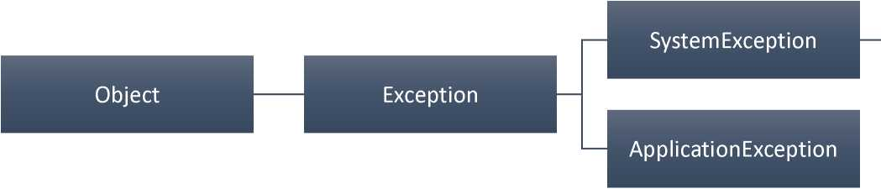
Exception Hierarchy
By : Dr. Vikrant

Slide 177
IndexOutOfRangeException
NullReferenceException
InvalidCast Exception
OutOfMemoryException
ArgumentNull Exception
ArgumentException
ArgumentOutOfRangeException
DivideByZeroException
ArithmeticException
OverflowException
FormatException
7

Slide 178
Exception classes
Exception Class | Description
ArgumentException | Raised when a non-null argument that is passed to a method is invalid.
ArgumentNullException | Raised when null argument is passed to a method.
ArgumentOutOfRangeException | Raised when the value of an argument is outside the range of valid values.
DivideByZeroException | Raised when an integer value is divide by zero.
FileNotFoundException | Raised when a physical file does not exist at the specified location.
FormatException | Raised when a value is not in an appropriate format to be converted from a string by a conversion method such as Parse.
IndexOutOfRangeException | Raised when an array index is outside the lower or upper bounds of an array or collection.
By : Dr. Vikrant
8

Slide 179
Exception classes
Exception Class | Description
NullReferenceExceptio n | Raised when program access members of null object.
OverflowException | Raised when an arithmetic, casting, or conversion operation results in an overflow.
OutOfMemoryExceptio n | Raised when a program does not get enough memory to execute the code.
StackOverflowExcepti on | Raised when a stack in memory overflows.
InvalidCast Exception | Handles errors generated during typecasting.
By : Dr. Vikrant

Slide 180
Exception handling (key definitions)
try | Used to define a try block. This block holds the code that may throw an exception.
catch | Used to define a catch block. This block catches the exception thrown by the try block.
finally | The finally block is used to execute a given set of statements, whether an exception is thrown or not thrown. For example, if you open a file, it must be closed whether an exception is raised or not.
throw | Used to throw an exception manually. -ru# ■ n- \/\i.-xx

Slide 181
Exception handling
Assuming a block raises an exception, a method catches an exception using a combination of the try and catch keywords.
A try/catch block is placed around the code that might generate an exception.

Slide 182
try
{
// statements causing exception
}
catch (ExceptionName el)
{
// error handling code
}
catch (ExceptionName e2)
{
// error handling code
}
catch (ExceptionName eN)
{
// error handling code
}
-finally
{
// statements to be executed
}
Dr. Vikrant
11

Slide 183
Exception Handling
namespace Session9Demo
{
0 references
class Program
{
0 references
static void Main(string[] args)
{
try
{
int x = 45; int y = 0; int z = x / y;
}
catch (ArithmeticException el)
{
Console.WriteLine("Error: " + el.Message);
}
catch (Exception ex)
{
Console.WriteLine(ex.Message);
}
}
By : Dr. Vikrant

Slide 184
}
finally
{
Console.WriteLine("Code ends
}
}
Microsoft Visual Studio Debug Console
Error: Attempted to divide by zero. Code ends___
12

Slide 185
Exception Handling
namespace Session9Demo { 0 references class Program { 0 references static void Main(string[] args) { try { int[] arr = new int[3]; arr[0] = 33; arr[l] = 53; arr[2] = 99; arr[3] = 11; -foreach (int i in arr) { Console.WriteLine(i); } } | } catch (IndexOutOfRangeException el) { Console.WriteLineC"Error: ¹¹ + el. Message); } catch (Exception ex) { Console.WriteLineCex.Message); } finally { Console.WriteLineC"Code ends..."); } } } }
 | EQ Microsoft Visual Studio Debug Console
 | Error: Index was outside the bounds of the array. Code ends...
By : Dr. Vikrant
13

Slide 186
Do's and Don't of Exception Handling
Do's
• Use try/catch/finally blocks to recover from errors or release resources
• Throw exceptions instead of returning an error code
• Use the predefined .NET exception types
• End exception class names with the word "Exception"
• Include three constructors in custom exception classes
• ExceptionO. which uses default values.
• Exception(String). which accepts a string message.
• ExceptioniStrine. Exception), which accepts a string message and an inner exception.
By : Dr. Vikrant
14

Slide 187
Do's and Don't of Exception Handling
Don't
• Don't throw an exception when a simple if statement can be used to check for errors. For example, a simple if statement to check whether a connection is closed is much better than throwing an exception for the same.
• Don't catch Exception. Always use the most specific exception for the code you are writing. Remember good code is not code that doesn't throw exceptions. Good code throws exceptions as needed and handles on y the exceptions it knows how to handle.
• Don't swallow an exception by putting an empty catch block
By : Dr. Vikrant
15

Slide 188
User-Defined Exception Classes
• Define your own exception. User-defined exception classes are derived
from the Exception class.
namespace Session9Demo
{
3 references
class MyException : Exception
{
1 reference
public MyExceptionCstring message)
{
Console.WriteLine(message);
}
}
0 references
class Program
{
0 references
static void Main(string[] args)
{
int x = 0;
try
{
i-f(x==0)
throw new MyException("This is incorrect.
}catch(MyException ex)
{
Console.WriteLineC"Error: " + ex.Message)
}
}
}
By : Dr. Vikrant
16

Slide 189
Events
• Events are user actions such as key press, clicks, mouse movements, etc., or some occurrence such as system generated notifications. Applications need to respond to events when they occur
•The class that sends or raises an event is called a Publisher and class that receives or handle the event is called "Subscriber".
•A publisher is an object that contains the definition of the event and the delegate. A publisher class object invokes the event and it is notified to other objects.
•A subscriber is an object that accepts the event and provides an event handler. The delegate in the publisher class invokes the method (event handler) of the subscriber class.
By : Dr. Vikrant
17

Slide 190
Events
Declaring and Raise Events
To declare an event inside a class, first of all, you must declare a delegate type for the event as:
public delegate string MyDelegate(string str) ;
then, declare the event using the event keyword -
event MyDelegate MyEvent;
then, raise the event using the invoke
MyEvent.invoke("India");
By : Dr. Vikrant
18

Slide 191
Events
namespace Session9Demo
{
3 references
class PublisherClass//Publisher Class
{
// Declare Delegate
public delegate void MyDelegate(string msg);
// Declaring Event
public event MyDelegate myevent;
I r J V^AA/WWW I
1 reference
public void displayMessageO
{
myevent.Invoke("Welcome to India");// Raise event
}
class Program //Subscriber Class
{
//Event handler
//Delegate call this method when event raised
1 reference
static void messageCstring str)
{
Console.WriteLine(str);
}
0 references
static void Main(string[] args)
{
PublisherClass obj = new PublisherClassO ;
// Event gets binded with delegate
obj.myevent += new PublisherClass.MyDelegate(message); obj .displayMessageO;
}
By : Dr. Vikrant
19

Slide 192
Session-10
Partial Classes and LINQ

Slide 193
Contents
•Anonymous types •Extension methods
• Partial classes
• Partial methods •LINQ
•Writing LINQ queries
• LINQ to objects
• Deferred execution •PLINQ

Slide 194
Anonymous Types
•Anonymous type is a type without any name that can contain public read-only properties only. It cannot contain other members, such as fields, methods, events, etc.
•You create an anonymous type using the new operator. The implicitly typed variable- var is used to hold the reference of anonymous types.
•The properties of anonymous types are read-only and cannot be initialized with a null, anonymous function, or a pointer type.
By : Dr. Vikrant

Slide 195
Anonymous Types
namespace SessionlQDemo
{
0 references
class Program
{
0 references
static void Main(string[] args)
| | {
var student = new { rollNo = 100, name = "Alex", address = "Pune" }; Console.WriteLine(student.rollNo);
Console.WriteLine(student.name);
Console.WriteLineCstudent.address);
student.rollNo = 33; //Error : Its a read-only and cannot be changed
}
}
}
Dy . U\. V IM dill
H-

Slide 196
Extension Methods
'Extension method concept allows you to add new methods in the existing class or in the structure without modifying the source code of the original type
•You need to create a new class which is static and contain lets say two methods which you want to add in the existing class, now bind this class with the existing class.
•After binding you will see the existing class can access the two new added methods
By : Dr. Vikrant

Slide 197
Existing Class/Structure
M1(), M2(), M3()
Static Class
M4(), M5()

Slide 198
Extension Methods
namespace SessionlODemo
{
4 references
public class ExistingClass
{
1 reference
public void Ml() { Console.WriteLine("Ml method"); }
1 reference
public void M2() { Console.WriteLine("M2 method"); }
1 reference
public void M3() { Console. Writel_ine("M3 method"); }
class TestProgram
{
0 references
static void Main(string[] args)
{
ExistingClass obj=new ExistingClassO;
obj .MlO;
obj .M20;
obj,M3();
obj.MdO;
obj,M5("M5 Method");
}
0 references
public static class StaticClass
{
1 reference
public static void MdCthis ExistingClass c) { Console.WriteLine("M4 method"); }
1 reference
public static void M5(this ExistingClass g,string str) { Console.WriteLine(str); }
}
}
}
By : Dr. Vikrant
6

Slide 199
Partial Class
• Its is possible to split the implementation of a class, a struct, a method, or an interface in multiple (.cs) files using the partial keyword.
•The compiler will combine all the implementation from multiple (.cs) files when the program is compiled
By : Dr. Vikrant
7

Slide 200
Partial Class
Rules for Partial Classes
• All the partial class definitions must be in the same assembly and namespace.
• All the parts must have the same accessibility like public or private, etc.
• If any part is declared abstract or sealed then the whole class is declared of the same type.
• Different parts can have different base types and so the final class will inherit all the base types.
• The Partial modifier can only appear immediately before the keywords class, struct, or interface.
• Nested partial types are allowed.
By : Dr. Vikrant
8

Slide 201
Partial Class
namespace SessionlQDemo
{
4 references
public partial class Student
{
public int studentID; public string studentName;
1 reference
public Student(int id, string name)
{
this.studentID = 1; this.studentName = name;
}
}
4 references
public partial class Student
{
1 reference
public void displayStudentsO
{
Console.WriteLineC'ID:" + studentID); Console.WriteLineC'Name:" + studentName)
}
}

Slide 202
0 references
class TestProgram
{
0 references
static void MainCstring[] args)
{
Student obj = new Student(101,"Alex"); obj .displayStudentsO;
}
}
}

Slide 203
Partial Method
C# contains a special method is known as a partial method, which contains declaration part in one partial class and definition part in another partial class
By : Dr. Vikrant
10

Slide 204
Partial Method
namespace SessionlGDemo
{
4 references
public partial class Student
{
public int studentID; public string studentName;
1 reference
public Student(int id, string name)
{
this.studentID = 1; this.studentName = name;
}
2 references_
public partial void displayStudentsO;
}
4 references
public partial class Student
{
2 references
public partial void displayStudentsO
{
Console.WriteLineC'ID:" + studentID); Console.WriteLineO'Name:" + studentName);
}

Slide 205
J
}
0 references
class TestProgram
{
0 references
static void Main(string[] args)
{
Student obj = new Student(101,"Alex") obj .displayStudentsO;
}
}
11

Slide 206
UNO
• LINQ is a Language Integrated Query.
• LINQ provides the new way to manipulate the data, whether it is to or from the database or with an XML file or with a simple list of dynamic data.
• LINQ is a uniform query system in C# to retrieve the data from different sources of data and formats such as XML, generics, collections, ADO.Net DataSet, Web Service, MS SQL Server, and other databases server.
• LINQ provides the rich, standardized query syntax in a .NET programming language such as C# and VB.NET, which allows the developers to interact with any data sources.
By : Dr. Vikrant
12

Slide 207

LINQ
l“N
Developer
Object Collection | ADO.NET DataSet | XML Document | Entity Framework | SQL Database | Other Data- Sources
LINQ to Objects | LINQ to DataSet | LINQ to XML | LINQ to Entity | LINQ to SQL | By implementing IQueryable
By : Dr. Vikrant

Slide 208
LINQ
Advantages of LINQ
• We do not need to learn new query language syntaxes for different sources of data because it provides the standard query syntax for the various data sources.
• In LINQ, we have to write the Less code in comparison to the traditional approach.
• LINQ provides the compile-time error checking as well as intelligence support in Visual Studio. This powerful feature helps us to avoid run-time errors.
• LINQ provides a lot of built-in methods that we can be used to perform the different operations such as filtering, ordering, grouping, etc. which makes our work easy.
• The query of LINQ can be reused.
By : Dr. Vikrant
14

Slide 209
LINQ
Writing LINQ Query:
• LINQ queries return results as objects. It enables you to uses object-oriented approach on the result set and not to worry about transforming different formats of results into objects.
• Each Query is a combination of three things; they are:
1. lnitialization(to work with a particular data source)
2. Condition(where, filter, sorting condition)
3. Selection (single selection, group selection or joining)
• There are two basic ways to write a LINQ query to lEnumerable collection or IQueryable data sources.
1. Using Query Syntax
2. Using Method Syntax
By : Dr. Vikrant
15

Slide 210
LINQ
Writing LINQ Query:
1. Using Query Syntax
Example :
Result variable
x
var result =
Standard Query Operators•

Slide 211
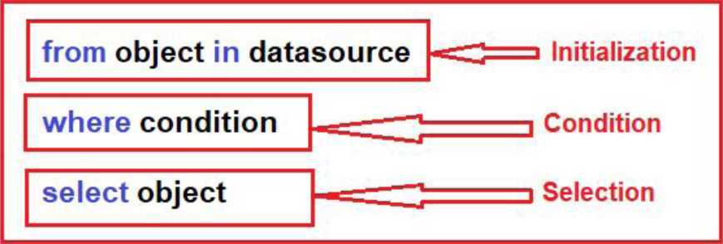

Range variable
Sequence ((Enumerable or iQueryable collection)
from s in strList
where s.Contains("Tutorials")
^select s;
Conditional expression
By : Dr. Vikrant
16

Slide 212
Example -1
UNQ
^namespace SessionlODemo
O references
3{ class Program
: {
0 references
static void Main(string[] args)
| {
List<string> list = new List<string>();
list.Add("Java");
list.Add(".NET");
list.Add("Python");
list.Add("SQL");
// LINQ Query Syntax
var result =-From items in list
where items.Contains("Java") select items;
-Foreach (var item in result)
| {
Console.WriteLine(item);
}
}
}
_
Writing UNQ Query:
1. Using Query Syntax

Slide 213
LINQ
Writing LINQ Query:
1. Using Query Syntax

Slide 214
Example -2
namespace SessionlQDemo
0 references
{ class Program
{
I
0 references
static void Main(string[] args)
| {
List<int> list = new List<int>();
list.Add(34);
list.Add(44);
list.Add(75);
list.Add(20);
// LINQ Query Syntax var result =from items in list where items >= 44 select items;
i
foreach (var item in result)
i {
Console.WriteLine(item);
i }
I
}
}
}

Slide 215
UNO
Points to Remember (FOR QUERY SYNTAX)
•As name suggest, Query Syntax is same like SQL (Structure Query Language) syntax.
•Query Syntax starts with from clause and can be end with Select or GroupBy clause.
• Use various other opertors like filtering, joining, grouping, sorting operators to construct the desired result.
• Implicitly typed variable - var can be used to hold the result of the LINQ query.
By : Dr. Vikrant
19

Slide 216
UNO
Writing LINQ Query:
2. Using Method Syntax
• Method syntax uses extension methods included in
the Enumerable or Queryable static class, similar to how you would call the extension method of any class.
• The extension method Where() is defined in the Enumerable class.
Example :
var result = strList.Where(s => s.Contains("Tutorials"));
t \_I
i -v-
Extension method Lambda expression
By : Dr. Vikrant
20

Slide 217
Example -1
UNQ
namespace SessionlQDemo
0 references
{ class Program
{
0 references
static void Main(string[] args)
j {
List<string> stringList = new List<string>()
{
"C# Tutorials",
"VB.NET Tutorials",
"Learn C++",
"MVC Tutorials" ,
"Java"
};
// LINQ Method Syntax
var result = stringList.WhereCs => s.ContainsO'Tutorials")); foreach (var item in result)
{
Console.WriteLine(item);
}
}
}
Writing UNQ Query:
2. Using Method Syntax
1
By : Dr. Vikrant
21

Slide 218
LINQ to Object
•UNQto Objects offers usage of any LINQ query supporting IEnumerable<T> for accessing in-memory data collections without any need of LINQ provider (API) as in case of LINQ to SQL or LINQ to XML
•Queries in LINQ to Objects return variables of type usually IEnumerable<T> only
•There are also many advantages of LINQ to Objects over traditional foreach loops like more readability, powerful filtering, capability of grouping, enhanced ordering with minimal application coding.
By : Dr. Vikrant
22

Slide 219

LINQ to Object
namespace SessionlODemo
rence
{ class Program
{
static void Main(string[] args)
{
string[] str= { "India", "Japan", "USA",
"UK"
var result = -from items in str
select items;
-foreach (var item in result)
{
Console.WriteLineCitem);
}
}
}
}
23

Slide 220
Deferred Execution
• In Deferred Execution, the query is not executed when declared. It is executed when the query object is iterated over a loop.
• Deferred execution is applicable on any in-memory collection as well as remote LINQ providers like LINQ-to-SQL, LINQ-to-Entities, LINQ-to-XML, etc.
•Deferred Execution returns the Latest Data
By : Dr. Vikrant
24

Slide 221
Deferred Execution
namespace SessionlODemo
{ class Program
{
static void Main(string[] args)
{
List<int> list = new List<int>();
list.Add(34);
list.Add(44);
list.Add(75);
list.Add(20);
// LINQ Query Syntax var result =-from items in list where items >= 44 select items;
-foreach (var item in result)
{
Console.WriteLine(item);
}
}
}
}
In this example, you can see the query is materialized and executed when you iterate using the foreach loop. This is called deferred execution
Query does not executes here
Query executes here
By : Dr. Vikrant
25

Slide 222
PLINQ. (Parallel LINQ)
• Parallel LINQ (PLINQ) is a parallel implementation of LINQ to Objects.
• PLINQ supports Parallel programming and is closely related to the Task Parallel Library.
• In very simple words, PLINQ enables a query to automatically take advantage of multiple processors.
• PLINQ can significantly increase the speed of LINQ to Objects queries by using all available cores on the host computer more efficiently.
Sequential Linq execution
Parallel Linq execution
var results = from c in customers
var results = from c in customers.AsParallel()
where c.FirstName.StartsWith("San")
select c;
where c.FirstName.StartsWith("San")
select c;
By : Dr. Vikrant
26

Slide 223
Session-11
Reflection and File 10

Slide 224
Contents
• Creating Shared Assembly •Creating Custom Attributes
• Reflection
• Dynamic Assembly Loading using Reflection
• Files 10 and Streams
• Reading and Writing files
• Working with Drives, Directories and Files
By : Dr. Vikrant

Slide 225
Creating Shared Assembly
•A shared assembly is an assembly that resides in a centralized location known as the GAC (Global Assembly Cache) and that provides resources to multiple applications.
• If an assembly is shared then single copy can be used by multiple applications.
•The GAC folder is under the Windows folder.
By : Dr. Vikrant

Slide 226
Steps to create and use Shared Assembly
Step 1: Open VS.NET and Create a new Class Library
Step 2: Generating Cryptographic Key Pair using the tool SN.Exe
• Make sure that you start Administrator "Developer Command Prompt for VS 2022"
• Write the following command on command prompt
C:\> sn -k "C:\mynewkey.snk"
Step 3: Sign the component with the key and build the class library project (Go to properties of the project in solution explorer -> select signing -> Check the checkbox of Sign the assembly and browse for the key).
Step 4: Host the signed assembly in Global Assembly Cache C:\>gacutil -i "E:\MyClassLibrary\bin\Debug\MyClassLibrary.dH"
By : Dr. Vikrant

Slide 227
Steps to create Shared Assembly
Step 5 : Test the assembly by creating the client application. Just add the project reference and browse for the shared assembly recently created.
Step 6 : Execute the client program
By : Dr. Vikrant

Slide 228
Creating Custom Attributes
• Custom attributes are essentially traditional classes that derive directly or indirectly from System.Attribute
•Attributes are metadata extensions that give additional information to the compiler about the elements in the program code at runtime.
•Attributes are used to impose conditions or to increase the efficiency of a piece of code
•The primary steps to properly design custom attribute classes :
a. Applying the AttributeUsageAttribute
b. Declaring the attribute class
c. Declaring constructors
d. Declaring properties
By : Dr. Vikrant
6

Slide 229
Custom Attributes
Applying the AttributeUsageAttribute :
A custom attribute declaration begins with the System.AttributeUsageAttribute, which defines some of the key characteristics of your attribute class. For example, you can specify whether your attribute can be inherited by other classes or specify which elements the attribute can be applied to.
[AttributeUsage(AttributeTargets.AII, Inherited = false, AllowMultiple = true)]
The AttributeUsageAttribute has three members that are important for the creation of custom attributes: AttributeTargets, Inherited, and AllowMultiple.
By : Dr. Vikrant
7

Slide 230
Custom Attributes
Applying the AttributeUsageAttribute :
AttributeTargets.AII is specified, indicating that this attribute can be applied to all program elements.
AttributeTargets.Class, indicating that your attribute can be applied only to a class
AttributeTargets.Method, indicating that your attribute can be applied only to a method.
By : Dr. Vikrant
8

Slide 231
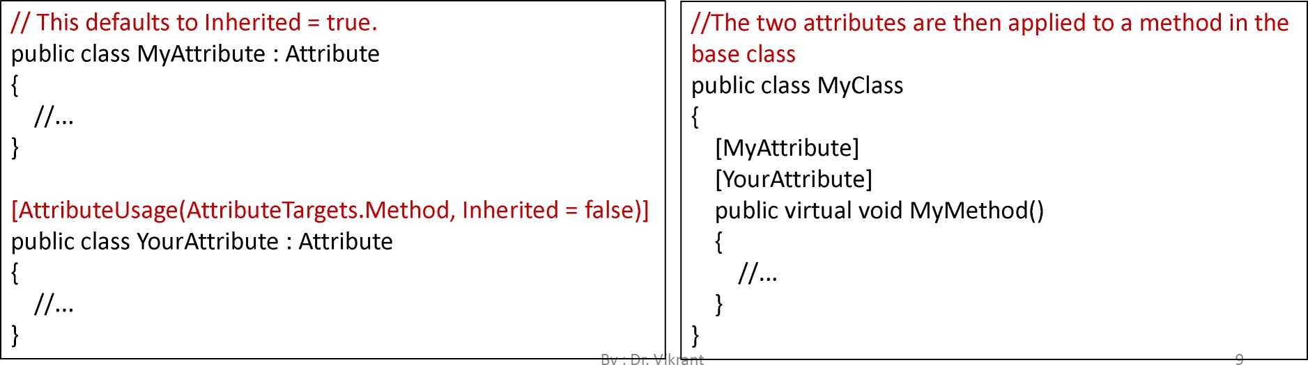
Custom Attributes
Applying the AttributeUsageAttribute :
AttributellsageAttribute.Inherited property indicates whether your attribute can be inherited by classes that are derived from the classes to which your attribute is applied.

Slide 232
Custom Attributes
Applying the AttributellsageAttribute :
Finally, the class YourClass is inherited from the base class MyClass. The method MyMethod shows MyAttribute but not YourAttribute
public class YourClass : MyClass
{
// MyMethod will have MyAttribute but not YourAttribute. public override void MyMethodQ
{
//•••
}
}
By : Dr. Vikrant
10

Slide 233
Custom Attributes
public class MyClass {
// This produces an error.
// Duplicates are not allowed. [MyAttribute]
[MyAttribute] public void MyMethodQ {
//■■■
}
// This is valid.
[YourAttribute]
[YourAttribute] public void YourMethodQ {
//■■■
}
Applying the AttributeUsageAttribute :
AttributeUsageAttribute.AllowMultiple property indicates whether multiple instances of your attribute can exist on an element. If set to true, multiple instances are allowed; if set to false( default), only one instance is allowed.
//This defaults to AllowMultiple = false, public class MyAttribute : Attribute
{
j
[AttributeUsage(AttributeTargets.Method, AllowMultiple = true)]
public class YourAttribute : Attribute
{
}
By : Dr. Vikrant
11

Slide 234
Custom Attributes
Declaring the Attribute class :
[Attributellsage(AttributeTargets. Method)] public class MyAttribute : Attribute
{
//...
}
By : Dr. Vikrant
12

Slide 235
Custom Attributes
Declaring Constructor:
public MyAttribute(bool myvalue)
{
this.myvalue = myvalue;
}
By : Dr. Vikrant
13

Slide 236
Custom Attributes
Declaring Properties
public bool MyProperty
{
get {return this.myvalue;} set {this.myvalue = value;}
By : Dr. Vikrant
14

Slide 237
Reflection
•Reflection objects are used for obtaining type information at runtime. The classes that give access to the metadata of a running program are in the System.Reflection namespace.
• Reflection has the following applications :
• It allows view attribute information at runtime.
• It allows examining various types in an assembly and instantiate these types.
• It allows late binding to methods and properties
• It allows creating new types at runtime and then performs some tasks using those types.
By : Dr. Vikrant
15

Slide 238
Reflection
•The Memberlnfo object of the System.Reflection class needs to be initialized for discovering the attributes associated with a class.
System.Reflection.Memberlnfo info = typeof(MyClass);
By : Dr. Vikrant
16

Slide 239
Reflection
namespace SessionllUemo
{
[AttributeUsage(AttributeTargets.All,AllowMultiple =false,Inherited =true)]
2 references
public class FirstAttribute:Attribute
{
private string name=null;
1 reference
public FirstAttribute(string names)
{
Name = names;
}
1 reference
public string Name { get => name; set => name = value; }
}
By : Dr.
}

Slide 240
[AttributeUsage(AttributeTargets. AH)]
2 references
public class SecondAttribute : Attribute
{
private string address=null;
1 reference
public SecondAttributeCstring addr)
{
Address = addr;
}
1 reference
public string Address { get => address; set => address = value; }
}
[FirstAttributeC"Vikrant")]
[SecondAttribute("Pune")]
1 reference
public class MyClass
{
}
0 references
public class YourClass
{
0 references
static void Main(string[] args)
{
System. Reflection. Memberln-fo memberlnfo = typeof(MyClass)
var obj = memberlnfo.GetCustomAttributes(true);
foreach (var i in obj)
{
Console.WriteLine(i);
}
}
}

Slide 241
Dynamic Assembly Loading using Reflection
the act of loading external assemblies on demand is known as Dynamic Loading. Using the Assembly class, we can dynamically load both private and shared assemblies from the local location to a remote location as well as, explore its properties.
using System . Re-Flection ; namespace SessionllDemo {
0 references
public class Program {
0 references
static void MainCstring[] args)
{
Assembly assembly = Assembly.LoadFile(@"E:\MSVS2022CDAC\SharedAssemblyDemo.dll");
Type[] t = assembly.GetTypesO ;
-Foreach Cvar i in t)
{
Console.WriteLine(i);
}
}
}
}
18

Slide 242
Files 10 and Streams
Files
•A file is a collection of data stored in a disk with a specific name and a directory path.
•System.10 namespace has various classes that are used for performing numerous operations with files, such as creating and deleting files, reading from or writing to a file, closing a file etc.
By : Dr. Vikrant
19

Slide 243
Files 10 and Streams
Basic file operations:
•Reading-data is read from a file.
•Writing-data is written to a file. By default, all existing contents are removed from the file, and new content is written.
•Appending-writing information to a file. The only difference is that the existing data in a file is not overwritten. The new data to be written is added at the end of the file.
By : Dr. Vikrant
20

Slide 244
Files
{ Reading text files}
using System.IO; namespace SessionllDemo {
O references
public class Program
O references
static void MainCstoring C] a.rgs)
string filepath = @"E:\MSVS2022CDAC\Session7Demo\Session7Demo\abc.txt"; stringC] tines;
//Check i-F -Fite exist or not i-F CFite . Exists C-Fitepa.th) 3 {
//Read Att tines o-F text -Fite tines = Fite.ReadAttLinesCfitepath);
-Foreach (string tine in tines)
Consote.WriteLineCtine);
>
>
i etse
Consote . WriteLineC " Fite does not exist..."]);
>
>
>
>
21

Slide 245
Files
{ Reading text files}
using System.10; namespace SessionllDemo {
0 references
public class Program
{
0 references
static void Main(string[] args)
{
string filepath = @"E:\MSVS2022CDAC\Session7Demo\Session7Demo\abc.txt"; string lines;
if (File.Exists(filepath)}
{
//Read whole lines in text file at once and store in string variable lines = File.ReadAllTextCfilepath);
Console.WriteLine(lines);
j }
else
; {
Console.WriteLineC'File does not exist..."};
}

Slide 246
Exercise
1. Write a C# code to copy the content of one file to another (hint: use File.Copy method )
2. Write a C# code to delete the existing file, (hint: use File.Delete method)
By : Dr. Vikrant
23

Slide 247
Files
{ Writing into text files}
using System.10;
^namespace SessionllDemo
{
0 references
public class Program
{
0 references
static void Main(string[] args)
{
string -Filepath = @"E:\MSVS2022CDAC\Session7Demo\Session7Demo\abc.txt"; string lines="Welcome to class"; i-F CFile. Exists(-Filepath))
{
//Write all content o-f string into -File at once File.WriteAllTextC-Filepath, lines) ;
Console.WriteLineC'Writing completed") ;|
}
- else
{
Console.WriteLine("File does not exist...");
}
}
}
}
24

Slide 248
Files
{ Writing into text files}
using System.10; namespace SessionllDemo {
0 references
public class Program
{
0 references
static void Main(string[] args)
{
string -Filepath = @"E:\MSVS2022CDAC\Session7Demo\Session7Demo\abc.txt^{M}; string[] lines = { "India", "USA", "UK", "Finland" }; i-F (File. Exists(-Filepath))
{
//Each entry in the string array will be a new line in the new -File. File . WriteAllLines(-Filepath , lines) ;
Console.WriteLineC"Writing completed");
}
else
{
Console.WriteLineC'File does not exist...");
}
}
}
}
25
by : ur. viKrant

Slide 249
Exercise
1. Try to append the contents in the existing file (hint: use File.AppendAIIText or File.AppendAIILines)
By : Dr. Vikrant
26

Slide 250
Stream
•The stream is basically the sequence of bytes passing through the communication path.
•There are two main streams: the input stream and the output stream. The input stream is used for reading data from file (read operation) and the output stream is used for writing into the file (write operation).
By : Dr. Vikrant
27

Slide 251
Stream
StreamWriter Class
The StreamWriter class implements TextWriter for writing character to stream in a particular format.

Slide 252
Methods | Description
Close() | Closes the current StreamWriter object and stream associate with it.
Flush() | Clears all the data from the buffer and write it in the stream associate with it.
Write() | Write data to the stream. It has different overloads for different data types to write in stream.
WriteLine() | It is same as WriteQ but it adds the newline character at the
By : Dr. Vikrant
28

Slide 253
Stream
{using Stream Writer}
using System.10; namespace SessionllDemo {
0 references
public class Program
{
0 references
static void Main(string[] args)
{
StreamWriter sw = new StreamWriter("E://cdac.txt");
// To write on the console screen
Console.WriteLineC'Enter the text to write in the File"); // To read the input -From the user string str = Console. ReadLineO ;
—' WAAAAAAAAAAAAA/WVAAAAAAAAAA/VS "
//To write a line in buffer sw.WriteLine(str);
//To write in output stream sw. FlushO;
// To close the stream sw.CloseO;
}
29

Slide 254
Stream
StreamReader Class
The StreamReader class implements TextReader for reading character from the stream in a particular format

Slide 255
Methods | Description
Close() | Closes the current StreamReader object and stream associate with it.
PeekQ | Returns the next available character but does not consume it.
ReadQ | Reads the next character in input stream and increment characters position by one in the stream
ReadLineQ | Reads a line from the input stream and return the data in form of string
SeekQ | It is use to read/write at the specific location from a file
By : Dr. Vikrant
30

Slide 256
Stream
{using Stream Reader}
using System.10; namespace SessionllDemo {
0 references
public class Program
{
0 references
static void MainCstring[] args)
{
// Taking a new input stream and opened it StreamReader sr = new StreamReader("E://cdac.txt");
// specify the position to start reading input stream sr.BaseStream.SeekC©, SeekOrigin.Begin); string str = sr JReadLJjn^C) ;
// To read the whole file line by line while (str != null)
{
Console.WriteLine(str); str = sr.ReadLineO;
}
// to close the stream sr.CloseC);
}
}
>i
31

Slide 257
Working with Directories and Drives
Directory class
Directory class in the .NET Framework class library provides static methods for creating, copying, moving, and deleting directories and subdirectories. Before you can use the Directory class, you must import the System.10 namespace.
using System.10; namespace SessionllDemo {
0 references
public class Program {
0 references
static void Main(string[] args)
{
string rootdir = @"E:\CDACFolder";
// I-f directory does not exist, create it. i-f C ! Directory. Exists(rootdir))
{
Directory.CreateDirectory(rootdir);
}
}
}
}
By : Dr. Vikrant
32

Slide 258
Exercise
1. Check the directory exists or not and then delete it. (use delete method)
2. Move an existing directory to a new specified directory with full path, (use move method)
By : Dr. Vikrant
33

Slide 259
Working with Directories and Drives
using System.10; namespace SessionllDemo {
0 references
public class Program
{
0 references
static void Main(string[] args)
{
string[] drives = Directory.GetLogicalDrivesO -foreach (string drive in drives)
{
System.Console.WriteLine(drive);
}
}
}
}
GetLogicalDrives method returns all the logical drives on a system.
By : Dr. Vikrant
34

Slide 260
References
1. C# 8.0 and .NET Core 3.0 - Modern Cross-Platform Development Fourth Edition by MarkJ. Price
2. https://www.geeksforgeeks.org
By : Dr. Vikrant
35

Slide 261
Session-12
Threading and Task

Slide 262
Contents
•Threading
• ThreadStart, Parameterized ThreadStart
• Synchronizing critical data using lock and Monitor
•Working with Tasks
• Calling functions with and without return values
• Using async and await
By : Dr. Vikrant

Slide 263
Threads
Threads are programs line of execution or smallest unit of processing
that can be scheduled by an operating system
Process v/s Thread
•A process represents an application whereas a thread represents a module of the application.
•Process is heavyweight component whereas thread is lightweight. A thread can be termed as lightweight sub-process because it is executed inside a process.
•Whenever you create a process, a separate memory area is occupied. But threads share a common memory area.
By : Dr. Vikrant

Slide 264
Thread life cycle
•The life cycle of a thread is started when instance of System.Threading.Thread doss is created. When the task execution of the thread is completed, its life cycle is ended.
• Following states in the life cycle of a Thread:
• Unstarted - When the instance of Thread class is created
• Runnable (Ready to run) - When startQ method on the thread is called
• Running - Only one thread within a process can be executed at a time
• Not Runnable - if sleepQ or wait() method is called on the thread, or input/output operation is blocked
• Dead (Terminated) - After completing the task, thread enters into dead or terminated state.
By : Dr. Vikrant

Slide 265
Thread class
Property
CurrentThread
IsAlive
IsBackground
Name
Priority
ThreadState
•Thread class provides properties and methods to
create and control threads.
• It is found in System.Threading namespace.
By : Dr. Vikrant

Slide 266
Description
returns the instance of currently running thread.
checks whether the current thread is alive or not. It is used to find the execution status of the thread.
is used to get or set value whether current thread is in background or not.
is used to get or set the name of the current thread.
is used to get or set the priority of the current thread.
is used to return a value representing the thread state.

Slide 267
Thread class
Methods | Description
AbortO | is used to terminate the thread. It raises ThreadAbortException.
Join() | is used to block all the calling threads until this thread terminates.
ResumeO | is used to resume the suspended thread. It is obselete.
Sleep(lnt32) | is used to suspend the current thread for the specified milliseconds.
Start() | changes the current state of the thread to Runnable.
SuspendO | suspends the current thread if it is not suspended. It is obselete.
Yield () | is used to yield the execution of current thread to another thread.
By : Dr. Vikrant

Slide 268
Types of Thread
Foreground Thread
•A thread which keeps on running to complete its work even if the Main thread leaves its process, this type of thread is known as foreground thread.
• Foreground thread does not care whether the main thread is alive or not, it completes only when it finishes its assigned work Or in other words, the life of the foreground thread does not depend upon the main thread.
By : Dr. Vikrant

Slide 269
Types of Thread
using System.Threading;
-namespace Sessionl2Demo
{
0 references
public class Program
{
1 reference
static void getThreadlnf ormationO
{
for (int i=l; i <=10; i++)
{
Console.WriteLineO'getThreadlnformation is in progress !!"); Thread.Sleep(1000);
}
Console.WriteLineO'getThreadlnformation ends!!");
}
0 references
static void MainCstring[] args)
{
Thread tl=new ThreadCgetThreadlnformation); tl.StartO;
Console.WriteLine("Main Thread Ends!!");
}
}
}
Foreground Thread
By : Dr. Vikrant
8

Slide 270
Types of Thread
Background Thread
•A thread which leaves its process when the Main method leaves its process, these types of the thread are known as the background threads.
•The life of the background thread depends upon the life of the main thread. If the main thread finishes its process, then background thread also ends its process.
By : Dr. Vikrant

Slide 271
Types of Thread
Background Thread
using System.Threading; namespace Sessionl2Demo {
0 references
public class Program
{
1 reference
static void getThreadlnformationO
{
Console.WriteLineC'In progress thread is: Thread.Sleep(2000);
Console.WriteLineC"Completed thread is:"
}
0 references
static void Main(string[] args)
{
Thread tl=new Thread(getThreadlnformation); tl.Name = "MyThreadl"; tl.StartO;
Console.WriteLineC'Main Thread Ends!!");
}
}
}
+ Thread.CurrentThread.Name) ; Thread.CurrentThread.Name);
By : Dr. Vikrant
10

Slide 272
Pa ra meterizedTh readSta rt
•Thread(ParameterizedThreadStart) Constructor is used to initialize a new instance of the Thread class.
• It defined a delegate which allows an object to pass to the thread when the thread starts.
•This constructor gives ArgumentNullException if the parameter of this constructor is null.
By : Dr. Vikrant
11

Slide 273
ParameterizedThreadStart
using System.Threading; namespace Sessionl2Demo {
0 references
public class Program
{
1 reference
static void getThreadlnf ormationO
{
for (int i = 1; i <=10; i++)
{
Console.WriteLineC'In progress thread is:" + Thread.CurrentThread.Name) Thread.Sleep(lOOG);
}
}
0 references
static void MainCstring[] args)
{
// Thread(ParameterizedThreadStart) constructor with static method Thread tl =new ThreadCgetThreadlnformation); tl.Name = "MyThreadl"; tl.StartC);
}

Slide 274
ThreadStart
• ThreadStart is a delegate which represents a method to be invoked when this thread begins executing.
•Thread(ThreadStart) Constructor is used to initialize a new instance of a Thread class. This constructor will give ArgumentNullException if the value of the parameter is null.
• Syntax:
public Thread(ThreadStart start);
By : Dr. Vikrant
13

Slide 275
ThreadStart
namespace Sessionl2Demo
{
0 references
public class Program
{
! ! 1 reference
static void getThreadlnf ormationO
{
for (int i = 1; i <=10; i++)
| {
Console.WriteLineC'In progress thread is:" + Thread.CurrentThread.Name); Thread.Sleep(100O);
}
}
0 references
static void MainCstring[] args)
| {
// Thread(ThreadStart) constructor with static method Thread tl = new ThreadCnew ThreadStart(getThreadlnformation)); tl.Name = "MyThreadl"; tl.Start();
}
}
}
By : Dr. Vikrant
14

Slide 276
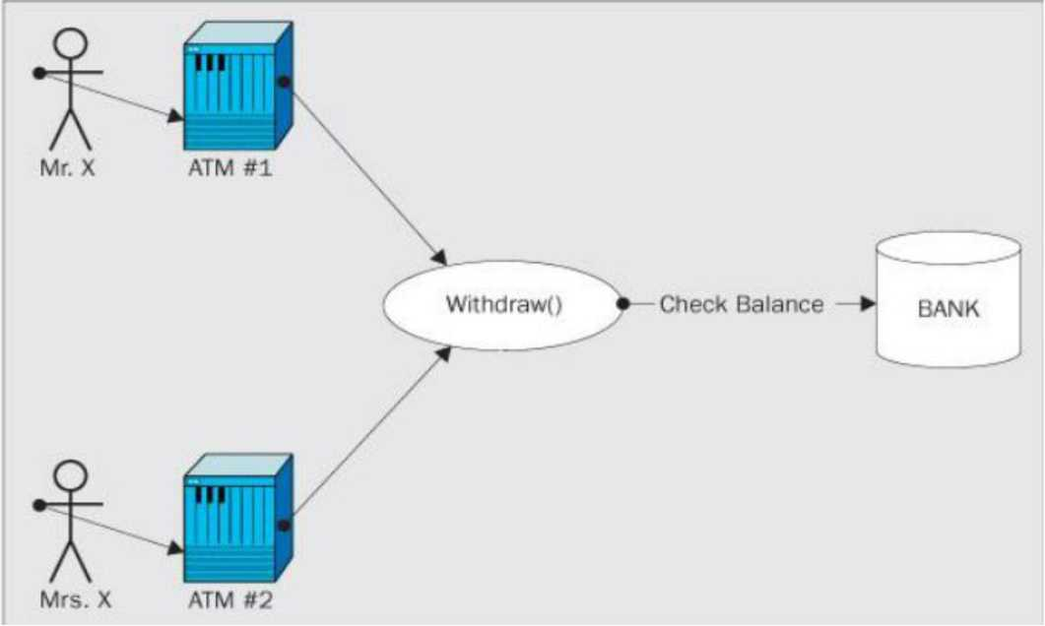
Thread Synchronization
•Synchronization is a technique that allows only one thread to access the resource for the particular time. No other thread can interrupt until the assigned thread finishes its task.
•Advantages:
• Consistency Maintain
• No Thread Interference
Money withdraw from the same bank account at the same time
By : Dr. Vikrant
15

Slide 277
Thread Synchronization
Synchronizing critical data using lock :
•lock keyword to execute program synchronously. It is used to get lock for the current thread, execute the task and then release the lock.
• It ensures that other thread does not interrupt the execution until the execution finish
By : Dr. Vikrant
16

Slide 278
Synchronizing critical data using lock
using System.Threading; namespace Sessionl2Demo {
2 references
public class Program
{
2 references
public void getThreadlnformationO
{
lockCthisD
{
for (int i = 1; i <=10; i++D
{
Thread.SleepClOOOD;
Console.WriteLineC"i=" +i + " " + " Thread Name: " + Thread.CurrentThread.Name}
}
}
}
static void MainCstring[] args)
{
Program obj=new ProgramO;
Thread tl = new Thread(new ThreadStartCobj.getThreadlnformationDD; Thread t2 = new ThreadCnew ThreadStartCobj.getThreadlnformationDD; tl.Name = "MyThreadl"; t2.Name = "MyThread2"; tl. Start O; t2. Start CD;
}
}
17
}

Slide 279
Monitor class
• Provides a mechanism that synchronizes access to objects.
• It can be done by acquiring a significant lock so that only one thread can enter in a given piece of code at one time.
• Monitor is not different from lock but the monitor class provides more control over the synchronization of various threads trying to access the same block of code.
• The Monitor class has the following methods for the synchronize access to a region of code by taking and releasing a lock:
• Monitor. Enter
• Monitor.TryEnter
• Monitor.Exit.
By : Dr. Vikrant
18

Slide 280
Monitor class
using System.Threading; namespace Sessionl2Demo {
0 references
public class Program
{
public static object locker = new objectO;
2 references
public static void PrintNumO
{ >
Monitor.Enter(locker);
3: try
{
for (int i = 1; i <= 10; i++)
{
Thread.Sleep(1000);
Console .WriteLineCi .ToStringO);
}
}
finally
{
Monitor.Exit(locker);
}
}

Slide 281
static void Main(string[] args)
{
Thread tl=new ThreadCnew ThreadStartCPrintNum)); Thread t2 = new ThreadCnew ThreadStartCPrintNum)); tl.StartO; t2.Start();
}
Vikrant
19

Slide 282
Working with Tasks
•the task is basically used to implement Asynchronous Programming i.e. executing operations asynchronously
•Task-related classes are in System.Threading.Tasks namespace.
• In a performance point of view, the Task.Run or Task.Factory.StartNew methods are preferable to create and schedule the computational tasks.
By : Dr. Vikrant
20

Slide 283
Working with Tasks
using System.Ihreading; namespace Sessionl2Demo {
0 references
public class Program
{
3 references
public static void PrintNumO
{
Console.WriteLineO'Child Thread + Thread.CurrentThread.ManagedThreadld + for (int i = 1; i <= 10; i++)
" started.
{
Console.WriteLine(i);
}
Console.WriteLineO'Child Thread + Thread.CurrentThread.ManagedThreadld +
" finished
}
0 references
static void Main(string[] args)
{
Console.WriteLineC'Main Threads Started");
// Create a Task Task tl = new Task(PrintNum); tl.StartO;
// Create a started task using Factory|
Task t2 = Task.Factory.StartNew(PrintNum);
// Creating a started task using Task.Run Task t3 = Task.RunCO => { PrintNumO; 30;
Console.WriteLineC'Main Threads Completed");
3 3
By : Dr. Vikrant
3

Slide 284
Task return type
Using async and await
• Async methods that don't contain a return statement or that contain a return statement that doesn't return an operand usually have a return type of Task.
• If you use a Task return type for an async method, a calling method can use an await operator to suspend the caller's completion until the called async method has finished.
By : Dr. Vikrant
22

Slide 285
Task return type
Using async and await
static void Main(string[] argsD
using System.Threading; {
namesoace Sessionl2Demo Task tl=Task.Run(() => {DisplavCurrentlnfoAsvncO;}
■ ■ III k. ak ^^k I ■ ^k III vVWVWVNAA/WWWWWVWWWN^WWW ■
< ,
0 references
public class Program '
{ „
public static async Task DisplayCurrentlnfoAsyncO
{
try
{
Console.WriteLineC'I am in display information.");
Console.WriteLineC'Sorry for the delay...");
}catch CException ex)
{
Console .WriteLineCex .ToStringO);
}
await Task.Delay(1000);
}
r\ ————
By : Dr. Vikrant
23

Slide 286
References
1. C# 8.0 and .NET Core 3.0 - Modern Cross-Platform Development Fourth Edition by MarkJ. Price
2. https://www.geeksforgeeks.org
By : Dr. Vikrant
24

Slide 287
Session-13
Introduction to ASP.NET

Slide 288
Contents
•What is ASP.NET?
•ASP.NET and earlier Web Development platforms
•Seven important facts about ASP.NET
•Web Architecture
•ASP.NET page life cycle
•Validation controls
By : Dr. Vikrant

Slide 289
What isASP.NET?
ASP.NET is a server-side technology for building powerful, dynamic Web applications and is part of the .NET Framework
By : Dr. Vikrant
3

Slide 290
ASP.NET and earlier web development platforms
✓ ASP.NET features a completely object-oriented programming model, which includes an event-driven, control-based architecture that encourages code encapsulation and code reuse.
✓ ASP.NET gives you the ability to code in any supported .NET language (including Visual Basic, C#, J#, and many other languages that have third-party compilers)
By : Dr. Vikrant
4

Slide 291
ASP.NET and earlier web development platforms
✓ ASP.NET is also a platform for building web services, which are reusable units of code that other applications can call across platform and computer boundaries.
✓ ASP.NET is dedicated to high performance. ASP.NET pages and components are compiled on demand instead of being interpreted every time they're used. ASP.NET also includes a finetuned data access model and flexible data caching to further boost performance.
By : Dr. Vikrant
5

Slide 292
Seven Important Facts About ASP.NE1
Fact 1: ASP.NET Is Integrated with the .NET Framework
Fact 2: ASP.NET Is Compiled, Not Interpreted
Fact 3: ASP.NET is Multilanguage
Fact 4: ASP.NET runs inside the CLR
Fact 5: ASP.NET is Object Oriented
Fact 6: ASP.NET is Multidevice and Multibrowser
Fact 7: ASP.NET is Easy to Deploy and configure
By : Dr. Vikrant

Slide 293

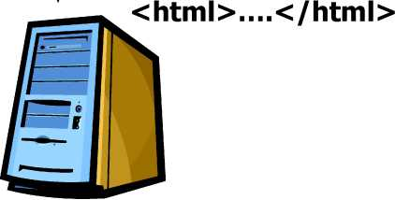
Web Architecture
Client
PC/Mac/Unix/... + Browser
Request:
http://www.digimon.com/default.aspx
Network
HTTP, TCP/IP
Response:
Server
Web Server
By : Dr. Vikrant
7

Slide 294
ASP.NET Page Life Cycle
Srno | Stages | Description
1. | Page request | When the page is requested by a user, ASP.NET determines whether the page needs to be parsed and compiled (therefore beginning the life of a page)
2. | Start | Page properties such as Request and Response are set. At this stage, the page also determines whether the request is a postback or a new request and sets the IsPostBack property
3. | Initialization | During page initialization, controls on the page are available and each control's UniquelD property is set. A master page and themes are also applied to the page if applicable.
4 | Load | During load, if the current request is a postback, control properties are loaded with information recovered from view state and control state.
By : Dr. Vikrant
8

Slide 295
ASP.NET Page Life Cycle
Srno | Stages | Description
5. | Postback event handling | If the request is a postback, control event handlers are called. After that, the Validate method of all validator controls is called, which sets the IsValid property of individual validator controls and of the page
6. | Rendering | Before rendering, view state is saved for the page and all controls. During the rendering stage, the page calls the Render method for each control, providing a text writer that writes its output to the OutputStream object of the page's Response property.
7. | Unload | The Unload event is raised after the page has been fully rendered, sent to the client, and is ready to be discarded. At this point, page properties such as Response and Request are unloaded and cleanup is performed.
By : Dr. Vikrant
9

Slide 296
Validation Controls
•A Validation server control is used to validate the data of an input control.
• If the data does not pass validation, it will display an error message to the user.
•Syntax:
<asp:control_name id="some_id" runat="server" />
By : Dr. Vikrant
10

Slide 297
Validation Controls
Validation Server Control | Description
ReauiredFieldValidator | Makes an input control a required field
RanaeValidator | Checks that the user enters a value that falls between two values
ComoareValidator | Compares the value of one input control to the value of another input control or to a fixed value
ReaularExoressionValidator | Ensures that the value of an input control matches a specified pattern
CustomValidator | Allows you to write a method to handle the validation of the value entered
ValidationSummarv | Displays a report of all validation errors occurred in a Web page
By : Dr. Vikrant
11

Slide 298
Validation Controls
RequiredFieldValidator: ensures that the required field is not empty. It is generally tied to a text box to force input into the text box.
Syntax:
<asp:Required Field Validator ID="rfvusername" runat="server"
ControlTo Validate ="txtUsername"
ErrorMessage="*" >
</asp:RequiredFieldValidator>
By : Dr. Vikrant
12

Slide 299
Validation Controls
•The RangeValidator control verifies that the input value falls within a
predetermined range.
• It has three specific properties:
<asp:RangeValidator ID="rvclass" runat-'server" ControlToValidate="txtclass" ErrorMessage-'Enter your class (6 -12)"
MaximumValue="12"
MinimumValue="6"
Type="lnteger">
</asp:RangeValidator>
Properties | Description
Type | it defines the type of the data; the available values are: Currency, Date, Double, Integer and String
MinimumV alue | it specifies the minimum value of the range
MaximumV alue | it specifies the maximum value of the range
By : Dr. Vikrant
13

Slide 300
Validation Controls
•The CompareValidator control compares a value in one control with a fixed value, or, a value in another control.
• It has specific properties:
Properties | Description
Type | it specifies the data type
ControlToCompare | it specifies the value of the input control to compare with
ValueToCompare | it specifies the constant value to compare with
Operator | it specifies the comparison operator, the available values are: Equal, NotEqual, GreaterThan, GreaterThanEqual, LessThan, LessThanEqual and DataTypeCheck
By : Dr. Vikrant
14

Slide 301
Validation Controls
CompareValidator control:
Syntax:
<asp:CompareValidator
ID="CompareValidatorl"
runat="server"
ErrorMessage="Password Must Be Same" ControlToValidate="txtConfirmPwd^{M} ControlToCompare="txtChoosePwd"> </asp:CompareValidator>
By : Dr. Vikrant
15

Slide 302
Validation Controls
•The RegularExpressionValidator allows validating the input text by matching against a pattern against a regular expression. The regular expression is set in the ValidationExpression property.
• Syntax:
<asp:RegularExpressionValidator
ID="RegularExpressionValidatorl"
runat-'server"
ErrorMessage-'Please Enter Valid Email"
ControlToValidate-'txtEmail"
ValidationExpression="\w+([-+.']\w+)*@\w+([- .]\w+)*\.\w+([-.]\w+)*"> </asp:RegularExpressionValidator>
By : Dr. Vikrant
16

Slide 303
Validation Controls
•The CustomValidator control allows writing application specific custom validation routines for both the client side and the server side validation.
•The client side validation is accomplished through the ClientValidotionFunction property. The client side validation routine should be written in a scripting language, like JavaScript or VBScript, which the browser can understand.
•The server side validation routine must be called from the controls ServerValidate event handler. The server side validation routine should be written in any .Net language, like C# or VB.Net.
By : Dr. Vikrant
17

Slide 304
Validation Controls
•Syntax:
<asp:CustomValidator
ID="CustomValidatorl"
runat="server"
ErrorMessage="Password Should not be less than 5 ControlToValidate="txtChoosePwd" ClientValidationFunction="validateText"> </asp:CustomValidator>
character
By : Dr. Vikrant

Slide 305
Validation Controls
•The ValidationSummary control does not perform any validation but shows a summary of all errors in the page.
•The summary displays the values of the ErrorMessage property of all validation controls that failed validation.
•Syntax:
<asp:ValidationSummary
ID="ValidationSummaryl"
runat="server"
DisplayMode = "BulletList" />
By : Dr. Vikrant
19

Slide 306
References
1. C .Net Web Developers Guide by Syngress
2. ASP.NET 4.5, Covers C# and VB Codes, Black Book, Kogent Learning Solutions Inc.
By : Dr. Vikrant
20

Slide 307
Session-14
Introduction to ASP.NET MVC

Slide 308
Contents
•ASP.NET MVC Architecture •ASP.NET MVC folder structure
• Creating controllers •Action Methods
• Different Types of Action Results
By : Dr. Vikrant
2

Slide 309
ASP.NET MVC Architecture
• MVC stands for Model, View, and Controller.
• MVC is a standard design pattern
•The ASP.NET MVC framework is a lightweight, highly testable presentation framework that (as with Web Forms-based applications) is integrated with existing ASP.NET features, such as master pages
•The MVC framework is defined in the System.Web.Mvc namespace and is a fundamental, supported part of the System.Web namespace.
By : Dr. Vikrant
3

Slide 310
ASP.NET MVC Architecture
Models.
•Model objects are the parts of the application that implement the logic for the applications data domain.
•Often, model objects retrieve and store model state in a database.
•For example, a Product object might retrieve information from a database, operate on it, and then write updated information back to a Products table in SQL Server.
By : Dr. Vikrant
4

Slide 311
ASP.NET MVC Architecture
View
•View in MVC is a user interface.
•View display model data to the user and also enables them to modify them.
•View in ASP.NET MVC is HTML, CSS, and some special syntax (Razor syntax) that makes it easy to communicate with the model and the controller.
By : Dr. Vikrant
5

Slide 312
ASP.NET MVC Architecture
Controller:
•The controller handles the user request.
•Typically, the user uses the view and raises an HTTP request, which will be handled by the controller.
•The controller processes the request and returns the appropriate view as a response.
• Controller is the request handler
By : Dr. Vikrant

Slide 313
Solution Explorer | ^{T}© - c o a o | ▼ -P X ^0
Search Solution Explorer (Ctrl+;) |  | p
Solution 'MyMVCApplication' (1 of 1 project)
^{A} MyMVCApplication
ASP.NET MVC folder structure
•App_Data folder can contain application data files like LocalDB, .mdf files, XML files, and other data related files.
• App_Start: folder can contain class files that will be executed when the application starts
• Content: folder contains static files like CSS files, images, and icons files. MVC application includes bootstrap.css, bootstrap.min.css, and Site.css by default.
> /> Properties
> References
EE App_Data
> EE App_Start EE Content
^ EE Controllers
> EE fonts
EE Models
t> EE Scripts
\> EE Views
favicon.ico ^ <jE) Global.asax
packages.config £] Web.config
By : Dr. Vikrant
7

Slide 314
Solution Explorer | ^{T}© - c o a o | ▼ -P X ^0
Search Solution Explorer (Ctrl+;) |  | p
Solution 'MyMVCApplication' (1 of 1 project)
^{A} MyMVCApplication
ASP.NET MVC folder structure
• Controllers: folder contains class files for the controllers. A controller handles users' request and returns a response. MVC requires the name of all controller files to end with "Controller". Eg. HomeController
• Fonts : folder contains custom font files for your application.
• Models : folder contains model class files. Typically model class includes public properties, which will be used by the application to hold and manipulate application data.
> /> Properties
> References
EE App_Data
> EE App_Start EE Content
^ EE Controllers
> EE fonts
EE Models
t> EE Scripts
\> EE Views
favicon.ico ^ <jE) Global.asax £] packages.config £) Web.config
By : Dr. Vikrant
8

Slide 315
Solution Explorer | ^{T}© - c o a o | ▼ -P X ^0
Search Solution Explorer (Ctrl+;) |  | p
Solution 'MyMVCApplication' (1 of 1 project)
^{A} MyMVCApplication
ASP.NET MVC folder structure
•Scripts folder contains JavaScript or VBScript files for the application.
• Views folder contains HTML files for the application. Typically view file is a .cshtml file where you write HTML and C# code.
The Views folder includes a separate folder for each controller.
• For example, all the .cshtml files, which will be rendered by HomeController will be in View -> Home folder. The Shared folder under the View folder contains all the views shared among different controllers e.g., layout files.
> /> Properties
> References
EE App_Data
> EE App_Start EE Content
^ EE Controllers
> EE fonts
EE Models
t> EE Scripts
\> EE Views
favicon.ico ^ <jE) Global.asax £] packages.config £) Web.config
By : Dr. Vikrant
9

Slide 316
Solution Explorer | ^{T}© - c o a o | ▼ -Ca X ^0
Search Solution Explorer (Ctrl+;) |  | P
Solution 'MyMVCApplication' (1 of 1 project)
^{A} §0 MyMVCApplication
ASP.NET MVC folder structure
Configuration files:
• Global.asax : file allows you to write code that runs in response to application-level events, such as Application_BeginRequest, application_start, application_error, session_start, session_end, etc.
• Packages.config : file is managed by NuGet to track what packages and versions you have installed in the application.
•Web.config : file contains
application-level configurations.
> /> Properties
> References
EE App_Data
> EE App_Start EE Content
^ EE Controllers
> EE fonts
EE Models
t> EE Scripts
\> EE Views
favicon.ico ^ <jE) Global.asax £] packages.config £] Web.config
By : Dr. Vikrant
10

Slide 317
Creating Controllers
•The Controller in MVC architecture handles any incoming URL request
•Controller is a class derived from the base class Sy ste m.Web.Mvc.Controller
•Controller class contains public methods called Action methods.
•Controller and its action method handles incoming browser requests, retrieves necessary model data and returns appropriate responses.
By : Dr. Vikrant
11

Slide 318
Creating the Controller
00 File | Edit View | Git Project | Build | Debug | Test Analyze | Tools Extensions Wi |
1 © * | ’i|5i - e5 | El 9 - |  | Debug * | Any CPU | ► IIS Express (Google C
Toolbox | ▼ | x
Si | Controller...
D | New Item... | Ctrl+Shift+A
n | Existing Item... | Shift+Alt+A
 | New Scaffolded Item...
tb | New Folder
 | Add ASP.NET Folder | ►
♦f | Application Insights Telemetry...
 | REST API Client...
 | Container Orchestrator Support...
Ear | Docker Support...
9 | Client-Side Library...
■& | Machine Learning Model...
 | New Azure WebJob Project Existing Project as Azure WebJob
 | Web API Controller Class (v2.1)
 | Web Form
 | Style Sheet
% | Class...
0 | New EditorConfig
MyMVCApplication
o
O
Live Share
X
R
lution Explorer | - X |  | “O o
J5 ^{T}© - 090 |  |  | fD 3- CD VI
prch Solution Explorer (Ctrl+;) | P | l
3 Solution 'MyMVCApplication' (1 of 1 project) |  | ▲
Search Toolbox
PH
> General
There are no usable controls in this group. Drag an item onto this text to add it to the toolbox.
§5 MyMVCApplication
Connected Services P P Properties > References CU App_Data
P P~) Ann Start_
View in Browser (Google Chrome) Browse With...
Ctrl+Shift+W
Add
 | Scope to This
 | Change View To | ►
s | New Solution Explorer View
 | Exclude From Project
x | Cut | Ctrl+X
& | Copy | Ctrl+C
 | Paste | Ctrl+V
X | Delete | Del
 | Rename | F2
[5 | Copy Full Path
c* | Open Folder in File Explorer
m | Open in Terminal
p | Properties | Alt+Enter
Server Explorer | E
Error List Output
l~l This item does not support previewing | f

Slide 319
Creating Controller
Add New Scaffolded Item
A Installed
A Common A MVC Area
Controller
View Web API
0
MVC 5 Controller - Empty
MVC 5 Controller - Empty
by Microsoft v5.0.0.0
MVC 5 Controller with read/write actions
MVC 5 Controller with views, using Entity Framework
An empty MVC controller.
Id: MvcControllerEmptyScaffolder
Add
Cancel
By : Dr. Vikrant
13

Slide 320
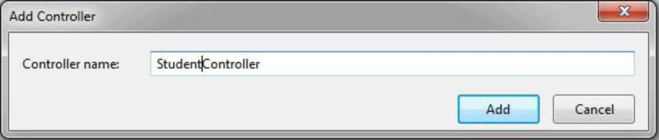
Creating Controller
By : Dr. Vikrant
14

Slide 321
Example : StudentController
oject Build Debug Test Analyze Tools Extensions Window Help Search (Ctrl+Q)
P | MyMVCApplication
Q
©
O
ir$ Live Share
Debug
Any CPU
” ► IIS Express (Google Chrome) " C> » O " & ,
StudentController.es -e X
Solution Explorer
f£f «P
- X
^0
§3 MyMVCApplication
" MyMVCApplication.Controllers.Stud "^{r} 0 IndexQ
^{T}0^O90
1
2
3
4
5
6
7
8
9
10
11
12
13
14
15
16 17
Busing System;
Search Solution Explorer (Ctrl+;)
PV
using System.Collections.Generic; using System.Linq; using System.Web; using System.Web.Mvc;
Solution 'MyMVCApplication' (1 of 1 project) ^{A} MyMVCApplication
C$3 Connected Services > P Properties l> S-B References CD App_Data P ED App_Start P ED Content ^{A} B Controllers
P C» HomeController.es
Bnamespace MyMVCApplication.Controllers
{
at
Ell
0 references
E
public class StudentController : Controller
{
// GET: Student
0 references
P C<* StudentController.es
E
public string IndexO
{
P ED fonts
□ Models
P ED Scripts
^{A} B Views
P ED Home
P ED Shared
ED Student
[@] ViewStart.cshtml
Web.config
IMl favicon.ico
P Global.asax
return "This is Student Controller";
}
}
}
100% -’!•© © No issues found
^ —¹ -_{T}
Git Changes
Ln: 17 Ch: 2 SPC CRLF
Solution Explorer

Slide 322
Example : StudentController
| https://localhost:44307/student X +
<- C A localhost:44307/student
::: Apps T> Mirror Shodhganga... Best way to learn k... NPTEL :: Computer... Big Data Career Gui...
This is Student Controller
■a ITIL Foundation Cer...
By : Dr. Vikrant
16

Slide 323
Action Methods
•All the public methods of the Controller class are called Action methods.
•They are like any other normal methods with the following restrictions:
Return type
• Action method must be public. It cannot be private or protected
• Action method cannot be overloaded
• Action method cannot be a static method.
By : Dr. Vikrant

Slide 324

Student Controller class
Base Controller class
\
public class StudentController ^ Controller
tudent /
public AcnonResult Indqx()
Action method
< i
return ViewQ;
'ievjQ defined in base
}
Controller class
17

Slide 325
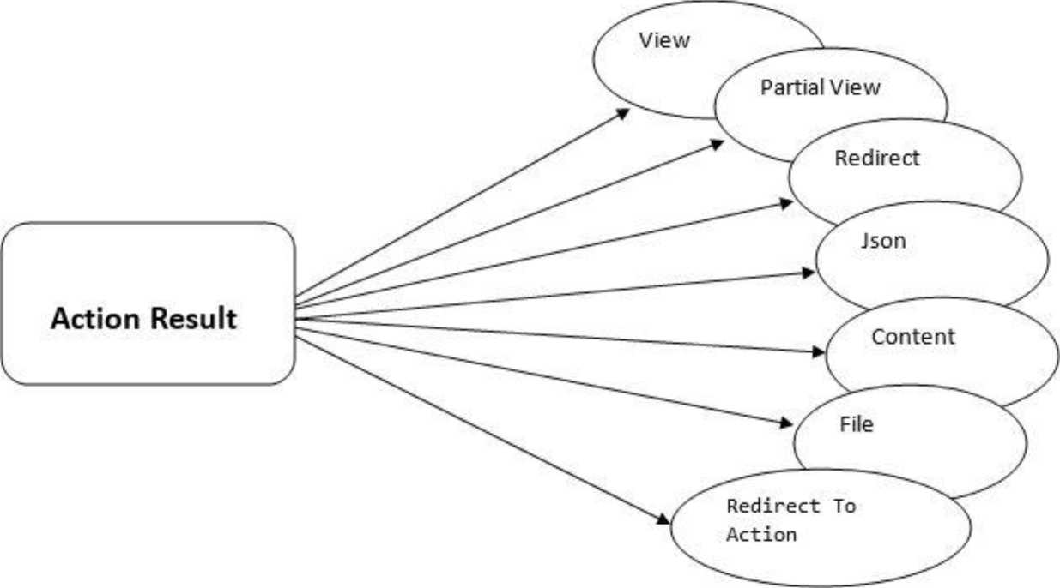
Different Types Of Action Results In ASP.NET MVC
By : Dr. Vikrant
18

Slide 326
View Result
View result is a basic view result. It returns basic results to view page. View result can return data to view page through which class is defined in the model. View page is a simple HTML page.
public ViewResult GallaryQ {
ViewBag.Message = "This is about gallary page"; return ViewQ;
}
By : Dr. Vikrant
19

Slide 327
PartialView Result
Partial View Result is returning the result to Partial view page. Partial view is one of the views that we can call inside Normal view page.
We should create a Partial view inside shared folder, otherwise we cannot access the Partial view.
public PartialViewResult lndex()
{
return PartialView("_PartialView");
}
By : Dr. Vikrant
20

Slide 328
Redirect Result
• Redirect result is returning the result to specific URL. It is rendered to the page by URL.
public RedirectResult lndex()
{
return RedirectfHome/Contact");
}
By : Dr. Vikrant
21

Slide 329
Redirect to Action Result
Redirect to Action result is returning the result to a specified controller and action method. Controller name is optional in Redirect to Action method. If not mentioned, Controller name redirects to a mentioned action method in current Controller
public ActionResult lndex()
{
return RedirectToActionfGetStudents", "Student");
}
By : Dr. Vikrant
22

Slide 330
Json Result
public JsonResult GetAIIStudents()
{
List<Student> students = new List<Student>()
{
new Student
{
Studentld = 1,
StudentName = "Alex"
}.
new Student
{
Studentld = 2,
StudentName = "Smith"
}
};
return Json(students, JsonRequestBehavior.AllowGet);
Json (JavaScript Object Notation) result is a significant Action Result in MVC. It will return simple text file format and key value pairs.
By : Dr. Vikrant
23

Slide 331
File Result
File Result returns different file format view page when we implement file download concept in MVC using file result.
public ActionResult lndex()
{
return File("Web.Config", "text");
}
By : Dr. Vikrant
24

Slide 332
Content Result
Content result returns different content's format to view. MVC returns different format using content return like HTML format, Java Script format and any other format.
public ActionResult lndex()
{
return Content("<script>alert('Welcome To All');</script>");
}
By : Dr. Vikrant
25

Slide 333
References
1. C .Net Web Developers Guide by Syngress
2. ASP.NET 4.5, Covers C# and VB Codes, Black Book, Kogent Learning Solutions Inc.
By : Dr. Vikrant
26

Slide 334
Session-15
Understanding Views and State
management

Slide 335
Contents
• Razor View Engine
•HTML Helpers
• Standard HTML Helper methods
• Strongly-Typed HTML Helper
•Validations using Data Annotation Attributes
•State Management
• Client side state management
• Server side State management
By : Dr. Vikrant

Slide 336
Razor View Engine
• Razor is one of the view engines supported in ASP.NET MVC. Razor allows you to write a mix of HTML and server-side code using C# or Visual Basic
•The razor view uses @ character to include the server-side code. You can use C# or Visual Basic syntax to write server-side code inside the razor view.
By : Dr. Vikrant

Slide 337
Razor View Engine
ASP.NET MVC supports the following types of razor view files:
File extension | Description
.cshtml | C# Razor view. Supports C# code with html tags.
.vbhtml | Visual Basic Razor view. Supports Visual Basic code with html tags.
.aspx | ASP.Net web form
.ascx | ASP.NET web control
By : Dr. Vikrant
4

Slide 338



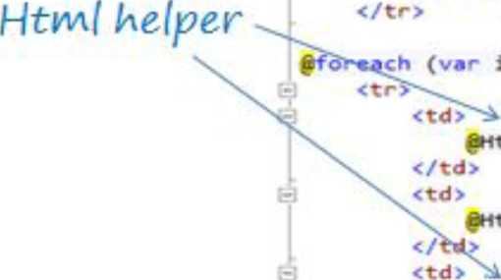
Razor View Engine
£model Iinuirersble<HVC_BasicTutorials.Models.Stjdent>
ViewBag.Title - “Index";
Layout - "~/Views/Shared/_Layout.csbtml";
Razor Syntax
<H2>Index</h2>
£Html.ActionLink("Create Mew", "Create")
</p>
Actable class-"table">
•1. DisplayMameFor (model -> model.StudentName)
Html
ml.DisplayMameFor(model -> model.Age)
h>
Item in Model) {
:ml.DisplayFor(modeIItern -> itcm.StudentName)
:ml.DisplayFor(model!tern •> item.Age)
$Html.ActionLink("Edit", "Edit", new ( id-item.Studentld }) |
By : Dr. Vikrant
5

Slide 339
HTML Helpers
• HtmIHelper class renders HTML controls in the razor view.
• It binds the model object to HTML controls to display the value of model properties into those controls and also assigns the value of the controls to the model properties while submitting a web form.
• So we can use the HtmIHelper class in razor view instead of writing HTML tags manually.
• @Html is an object of the HtmIHelper
class
HtmIHelper
By : Dr. Vikrant

Slide 340
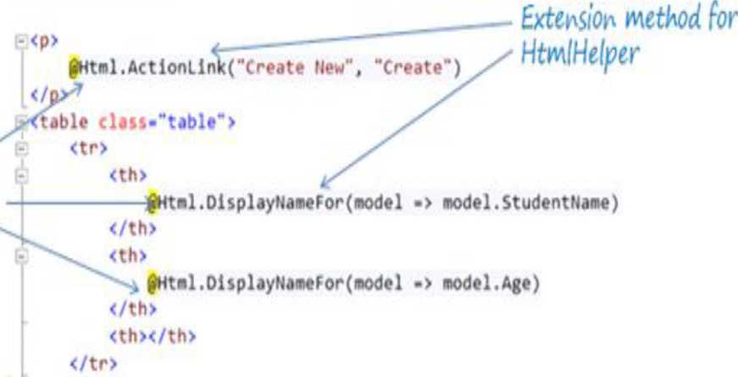
0mod*l II mi erdblf<HVC_BasicTutorials.Models.Student>
K
ViewBag.Title ■ “Index";
Layout • ^{H}«/Views/Shared/_Layout.csht*r;
)
<h2>Index</h2>
6

Slide 341
Form Design using HTML Helpers Methods
II Index.cshtml II StudentController
@model Sessionl5DemoMVC.Models.Student
public ActionResult Forml( Student obj)
{
ViewBag.ld = obj.Studentld; ViewBag.lMame = obj.StudentIMame; ViewBag.Age=obj.Age;
return View("Index");
}
@{
Layout = null;
}
dDOCTYPE html>
<html>
<head>
<meta name-'viewport" content="width=device-width" />
<title>lndex</title>
</head>
<body>
@using (Html.BeginForm(“Formr, “Student", FormMethod.Post))
{
@Html.LabelFor(m => m.Studentld); @Html.TextBoxFor(m => m.Studentld); @Html.LabelFor(m => m.StudentName); @Html.TextBoxFor(m => m.StudentName); @Html.LabelFor(m => m.Age); @Html.TextBoxFor(m => m.Age);
<input type="submit" value="Submit Form" />
}
</body>
<h4 style="color:purple">
<b>ID:</b> @ViewBag.ld <br />
<b>Name:</b> @ViewBag.Name <br/>
<b>Age:</b> @ViewBag.Age </h4>
</html>

Slide 342
Standard HTML Helper methods
• @Html.ActionLink() - Used to create link on html page
• @Html.TextBox() - Used to create text box
• @Html.CheckBox() - Used to create check box
• @Html.RadioButton() - Used to create Radio Button
• @Html.BeginForm() - Used to start a form
• @Html.EndForm() - Used to end a form
• @Html.DropDownList() - Used to create drop down list
• @Html.Hidden() - Used to create hidden fields
• @Html.label() - Used for creating HTML label is on the browser
• @ Ht ml.Text Area () - The TextArea Method renders textarea element on browser
• @Html.Password() - This method is responsible for creating password input field on browser
• @Html.ListBox() - The ListBox helper method creates html ListBox with scrollbar on browser
By : Dr. Vikrant
8

Slide 343
Strongly-Typed HTML Helper
• @Html.HiddenFor()
• @Html.LabelFor()
• @Html.TextBoxFor()
• @Html.RadioButtonFor()
• @Html.DropDownListFor()
• @Html.CheckBoxFor()
• @ Ht ml.Text Area For()
• @Html. Password For()
• @Html.ListBoxFor()
By : Dr. Vikrant

Slide 344
Validations using Data Annotation Attributes
Attribute | Usage
Required | Specifies that a property value is required.
StringLength | Specifies the minimum and maximum length of characters that are allowed in a string type property.
Range | Specifies the numeric range constraints for the value of a property.
RegularExpression | Specifies that a property value must match the specified regular expression.
CustomValidation | Specifies a custom validation method that is used to validate a property.
•ASP.NET MVC includes built-in attribute classes in the System.ComponentMo del.DataAnnotations namespace.
•You can apply these attributes to the properties of the model class to display appropriate validation messages to the users.
By : Dr. Vikrant
10

Slide 345
Validations using Data Annotation Attributes
Attribute | Usage
EmailAddress | Validates an email address.
FileExtension | Validates file name extensions.
MaxLength | Specifies the maximum length of array or string data allowed in a property.
MinLength | Specifies the minimum length of array or string data allowed in a property.
Phone | Specifies that a property value is a well-formed phone number.
By : Dr. Vikrant
11

Slide 346
Validations using Data Annotation Attributes
Student.es (inside model)
using System;
using System.Collections.Generic; using System.Linq; using System.Web;
using System. ComponentModel. DataAnnotations;
namespace Sessionl 5DemoMVC.Models
{
public class Student
{
[Required]
public int Studentld { get; set; }
[StringLength(IO)]
[Required]
public string StudentName { get; set; }
[Range (18,45)] public int Age { get; set; }
[EmailAddress]
[Required]
public string Email { get; set; }
}
By : Dr. Vikrant
12

Slide 347
Validations using Data Annotation Attributes
Index.cshtml
@model Sessionl5DemoMVC.Models.Student
ViewBag.Title = "Registration";
Layout = "~/Views/Shared/_Layout.cshtml";
@Html.LabelForCm => m.Age);
@Html.TextBoxFor(m => m.Age);
@Html.ValidationMessageFor(m => m.Age, new { @class = "text-danger" }) <br />
@Html.LabelForCm => m.Email);
@Html.TextBoxFor(m => m.Email);
@Html.ValidationHessageFor(m => m.Email, new { @class = "text-danger" }) <br />
<input type="submit" value="Submit Form" />
}
</body>
<h4 style="color:purple">
<b>ID:</b> @ViewBag.Id <br />
<b>Name:</b> @ViewBag.Name <br />
<b>Age:</b> @ViewBag.Age<br />
<b>Email:</b> @ViewBag.Email </h4>
</html>
<!DOCTYPE html>
- <html>|
-<head>
<meta name="viewport" content="width=device-width" />
<title>Index</title>
</head>
-<body>
fusing (Html.BeginForm("Forml", "Department", FormMethod.Post))
{
@Html.LabelForCm => m.Studentld);
@Html.TextBoxFor(m => m.Studentld);
@Html.ValidationMessageFor(m => m.Studentld, new { @class = "text-danger" }) <br />
@Html.LabelForCm => m.StudentName);
@Html.TextBoxFor(m => m.StudentName);
@Html.ValidationMessageForCm => m.StudentName, new { @class = "text-danger" }) <br />
i
AIM 1 ■ I 1 R f a >
By : Dr. Vikrant
13

Slide 348
State Management
•State Management is the process where developers can maintain status, user state and page information on multiple requests for the same or different pages within the web application.
•Two types :
• Client-side state management - The information is stored in the customer system while end-to-end interaction. Eg. ViewBag, TempData, Cookies, QueryStrings
• Server-side state management - Store all the information in the server's memory. Eg. Session and Application
By : Dr. Vikrant
14

Slide 349
Client-Side State Management
//EmployeeDetails.cshtml
_ . . r i i ViewBag.Title = "EmployeeDetails'
View bag : It is used to transfer the data >
from Controller to View
<h2>EmployeeDetails</h2>
<h3>@ViewBag.Message</h3>
<html>
<body>
var emp = ViewBag.Emp; <table>
<tr>
<td>ID :</td>
<td> @emp.Empid</td> </tr>
<tr>
<td>Name :</td>
<td> @emp.Ename</td> </tr>
</table>
}
</body>
By : Dr. Vikrant </html>
//HomeController
public ActionResult EmployeeDetails()
{
Employee employee = new Employee();
{
employee.Empid = 101; employee. Ename = "Alex";
}
ViewBag.Message = "Employee Details"; ViewBag. Emp= employee; return ViewQ;

Slide 350
Client-Side State Management
TempData: stores value in key/value pair. It is derived from TempDataDictionary. It is mainly used to transfer the data from one request to another request or we can say subsequent request. If the data for TempData has been read, then it will get cleaned. To persist the data, we use KeepQ
By : Dr. Vikrant
16

Slide 351
Client-Side State Management
//About.cshtml
@{
ViewBag.Title = "About";
}
<h2>@ViewBag.Title. </h2>
<P>
@{
var data = (StateManagementDemo.Models.Employee)TempData["Emp"]; TempData. Keep();
@data. Empid;
@data. Ename;
}
</p>
TempData:
public ActionResult TestTempData()
{
Employee employee = new Employee(); {
employee. Empid = 101; employee. Ename = "Alex";
}
//Setting the TempData TempData["emp"] = employee; return RedirectToAction("Contact");
}
public ActionResult Contact()
{
//Not reading TempData return ViewQ;
public ActionResult About()
{
//Data will available here because we have not read data yet var tempEmpData = TempData["Emp"];
return ViewQ;
}
By : Dr. Vikrant
17

Slide 352
Client-Side State Management
Cookies:
• A cookie is a plain-text file stored by the client (usually a browser), tied to a specific website.
• The client will then allow this specific website to read the information stored in this file on subsequent requests, basically allowing the server (or even the client itself) to store information for later use.
public ActionResult Cookietest()
{
HttpCookie cookie = new HttpCookie("TestCookie"); cookie.Value = "This is test cookie"; //Setting Cookie value this.ControllerContext.HttpContext. Response. Cookies. Add(cookie);
if (this.ControllerContext.HttpContext.Request.Cookies.AIIKeys.Contains("TestCookie"))
{
HttpCookie cookievar = this.ControllerContext.HttpContext.Request.Cookies["TestCookie"];
ViewBag.CookieMessage = cookievar. Value;
}
return ViewQ;
}
By : Dr. Vikrant
18

Slide 353
Client-Side State Management
Querystring
• A query string is a string variable that is inserted at the end of the page URL. It can be used for sending data over several pages
//HomeController
public ActionResult QueryStringTest()
{
//Send Model object in QueryString to another Controller.
return RedirectToAction("lndex", "Employee", new { Empid = 1, Ename = "Gary"});
}
//EmpoyeeController
public ActionResult lndex()
{
Employee obj = new Employee()
{
Empid = int.Parse(Request.QueryString["Empid"]),
Ename = Request.QueryString["Ename"]
};
return View(obj);
}
By : Dr. Vikrant 19

Slide 354
//QueryStringTest.cshtml of
HomeController
@{
Layout = null;
}
dDOCTYPE html>
<html>
<head>
<meta name="viewport" content="width=device-width" /> <title>QueryStringTest</title>
</head>
<body>
@using (Html.BeginForm("Formr, "Home", FormMethod.Post))
{
<input type="submit" value-'Send" />
}
</body>
</html>
By : D

Slide 355
//Index.cshtml of EmployeeController
@model StateManagementDemo.Models. Employee
@{
Layout = null;
}
dDOCTYPE html>
<html>
<head>
<meta name="viewport" content="width=device-width" />
<title>lndex</title>
</head>
<body>
<table cellpadding="0" cellspacing="0">
<tr>
<th colspan="2" align="center">Employee Details</th </tr>
<tr>
<td>Employee ID: </td>
<td>@Model.Empid</td>
</tr>
<tr>
<td>Name: </td>
<td>@Model.Ename</td>
</tr>
</table>
</body>
</html>

Slide 356
Server-Side State Management
Session : Session state enables you to store and retrieve values for a user when the user navigates to other view in an ASP.NET MVC application
//Index.cshtnnl
//EmployeeController
Session Name :
@if (Session["empid"] != null)
{
@Html.Label(Convert.ToString(Session["empid"]))
}
public ActionResult Forml (Employee obj)
{
Session["empid"] = Convert.ToString(obj.EmplD); return View("lndex");
}
By : Dr. Vikrant
21

Slide 357
Server-Side State Management
• Application State : is stored in the memory of the server and is faster than storing and retrieving information in a database.
• Session sate is specific for a single user session, but Application State is for all users and sessions.
•Technically the data is shared amongst users by a HTTPApplicationState class and the data can be stored here in a key/value pair.
• It can also be accessed using the application property of the HTTPContext class.
• Global.asax file is used for handling application events or methods. It always exists in the root level
By : Dr. Vikrant
22

Slide 358
Server-Side State Management
Event execution by the HTTPApplication class for any
specific requirement.
Application_BeginRequest
I
Application_AuthenticateRequest.
Application_Authorizerequest.
Application_ResolveRequestCache.
| • The request is handed off to the appropriate handler.
I...................................¹
Application_AcquireRequestCache.
1
»
§
8
Application_PreRequesthandlerExecute.
The appropriate handler executes the request. • Application_PostrequesthandlerExecute.
■ Application_ReleaseRequestState.
Application_UpdateRequestCache.
Application_EndRequest.
By : Dr. Vikrant
23

Slide 359
References
1. C .Net Web Developers Guide by Syngress
2. ASP.NET 4.5, Covers C# and VB Codes, Black Book, Kogent Learning Solutions Inc.
By : Dr. Vikrant
24

Slide 360
Session-16
Data Management With ADO.NET, Routing and Request
Life Cycle

Slide 361
Contents
•What is ADO.NET? •ADO.NET Architecture •ADO.NET Data Providers •ADO.NET Namespaces •ADO.NET objects
• Routing
•Configure Routes in MVC
• Multiple Routes
• Register Routes
• Request Life cycle

Slide 362
By : Dr. Vikrant
2

Slide 363
What is ADO.NET?
•The .NET Framework includes its own data access technology, ADO.NET.
•ADO. NET consists of managed classes that allow .NET applications to connect to data sources (usually relational data bases),execute commands, and manage disconnected data
By : Dr. Vikrant
3

Slide 364
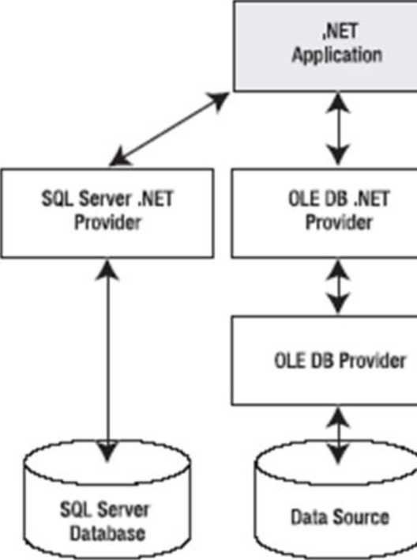
ADO.NET Architecture
By : Dr. Vikrant

Slide 365
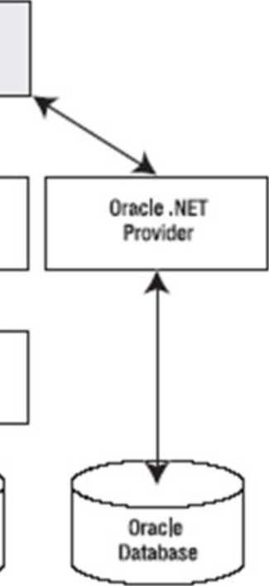
4

Slide 366
ADO.NET Data Providers
A data provider is a set of ADO.NET classes that allows you to :
• access a specific database
• execute SQL commands and retrieve data.
Essentially, a data provider is a bridge between vour application and a data source.
By : Dr. Vikrant
5

Slide 367
ADO.NET Namespaces
Namespace | Description
System. Data | Contains the key data container classes that model columns, relations, tables, datasets, rows, views, and constraints. In addition, contains the key Interfaces that are Implemented by the connection-based data objects.
System. Data. Common | Contains base, mostly abstract classes that Implement some of the Interfaces from System.Data and define the core ADO.NET functionality. Data providers Inherit from these classes to create their own specialized versions.
System. Data. OleDb | Contains the classes used to connect to an OLE DB provider, Including OleDbCommand, OleDbConnection, and OleDbDataAdapter. These classes support most OLE DB providers but not those that require OLE DB version 2.5 Interfaces.
System. Data.SqlCllent | Contains the classes you use to connect to a Microsoft SQL Server database, Including SqlDbCommand, SqlDbConnectlon, and SqlDBDataAdapter These classes are optimized to use the TDS Interface to SQL Server.
System. D ata.OracleClient | Contains the classes required to connect to an Oracle database (version 8.1.7 or later), Including OracleCommand, OracleConnectlon, and OracleDataAdapter. These classes are using the optimized Oracle Call Interface (OCI).
System. Data. Od be | Contains the classes required to connect to most ODBC drivers. These classes Include OdbcCommand, OdbcConnectlon, and OdbcDataAdapter. ODBC drivers are included for all kinds of data sources and are configured through the Data Sources Icon In the Control Panel.
System. Data.SqFiypes | Contains structures that match the native data types In SQL Server. These classes aren't required but provide an alternative to using standard .NET data types, which require automatic conversion.
By : Dr. Vikrant
6

Slide 368
ADO.NET Objects
■Connection: You use this object to establish a connection to a data source.
■Command: You use this object to execute SQL commands and stored procedures.
■DataReader: This object provides fast read-only, forward-only access to the data retrieved from a query.
■ DataAdapter: This object performs two tasks. First, you can use it to fill a DataSet (a disconnected collection of tables and relationships) with information extracted from a data source. Second, you can use it to apply changes to a data source, according to the modifications you've made in a DataSet.
By : Dr. Vikrant
7

Slide 369
Routing
• ASP.NET Routing module is responsible for mapping incoming browser requests to particular MVC controller actions
• When you create a new ASP.NET MVC application, the application is already configured to use ASP.NET Routing
• All the configured routes of an application stored in RouteTable and will be used by the Routing engine to determine appropriate handler class or file for an incoming request.

Slide 370
 | URL Request
 |  | A
RoutingEngine
RouteTable
Routel | URL Pattern | Handler
Route2 | URL Pattern | Handler
Route3 | URL Pattern | Handler
No
URL matches with configured Routes?
Yes
Execute Controller and Action method
8

Slide 371
Configure Routes in MVC
Every MVC application must configure (register) at least one route configured by the MVC framework by default
the route is configured using the MapRoute()
!Jj Sclutjco MVC&KTutorials'd pro i T MVC BaskTutori*
wblic class RouteCorfie
P A Properties P ••References I AppJJiU 4 App.Start P c* BundtoC0nfi9.cs P C* FiltofC0rft9.CS
public static void RegisterP.outes(
KOU
routes)
{ ^*0* Route to ignore
routes.IgnoreRoute("{resource}.axd/{*path!nfo}");
RouteCovifig.es
routes. MapRoute( name: "Default",
Route name
p 35 R0offc0ffl9.es
P C Content i Controllers P C* HcmeCcrtrder.cs P I ferts I Models P ■ Scopes P i Views
■URL Pattern
url: "{controller}/{action}/{id}", defaults: new { controller = "Howe", action = "Index", id = UrlPararaeter.Optional } ); \
Defaults for Route
RouteConfig.es under App_Start folder
By : Dr. Vikrant
9

Slide 372
URL Pattern
•The URL pattern is considered only after the domain name part in the URL
• For example, the URL pattern "{controwould look like : localhost:1234/{controller}/{action}/{id}.
Control l w^Action method
http://localhost:1234/home/index/100 parameter value
Controller .Action n\etWod m »
http://localhost:1234/home/index
By : Dr. Vikrant
10

Slide 373
Multiple Routes
the URL pattern for the Student route is students/{id}, which specifies that any URL that starts
with domainName/students, must be handled by the StudentController.
Notice that we haven't
specified {action} in the URL pattern
because we want every URL that starts
with students should always use
the indexQ action of
the StudentController class.
namespace MVCProject
{
public class RouteConfig
{
public static void RegisterRoutes(RouteCollection routes)
{
routes. lgnoreRoute("{resource}.axd/{*pathlnfo}");
routes.MapRoute( name: "Student", url: “students/{id}",
defaults: new { controller = "Student", action = "Index" }
);
routes.MapRoute( name: "Default", url: "{controller}/{action}/{id}",
defaults: new { controller = "Home", action = "Index", id = UrIParameter.Optional}
);
}
}
}
By : Dr. Vikrant
11

Slide 374
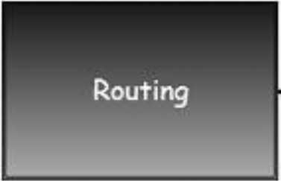
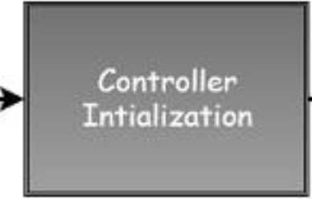

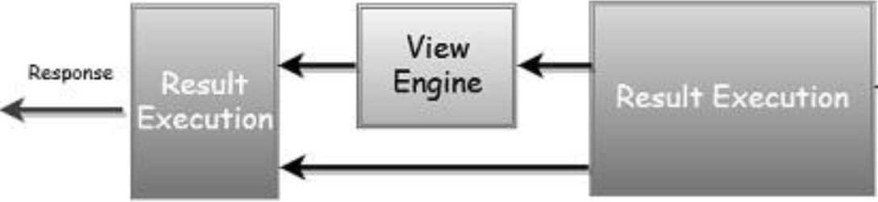
Request Life Cycle
Request
m
Action
Execution
By : Dr. Vikrant
12

Slide 375
Register Routes
All the routes are registered in Application_Start() in Global.asax.
namespace MVCProject
{
public class MvcApplication : System .Web. HttpApplication
{
protected void Application_Start()
{
AreaRegistration.RegisterAIIAreas(); FilterConfig.RegisterGlobalFilters(GlobalFilters. Filters); RouteConfig.RegisterRoutes(RouteTable.Routes); BundleConfig.RegisterBundles(BundleTable. Bundles);
>
}
}
By : Dr. Vikrant
13

Slide 376
References
1. C .Net Web Developers Guide by Syngress
2. ASP.NET 4.5, Covers C# and VB Codes, Black Book, Kogent Learning Solutions Inc.
By : Dr. Vikrant
14

Slide 377
Session-17
Layout, Bundle, Minification and
MVC Security

Slide 378
Contents
• Layout View
• Understanding Bundles and Bundle Types
• Minification
• Error handling in MVC with log entry
• MVC Security
•Cross Site Request Forgery Attacks •Anti-forgery token
• Introduction to OAuth
By : Dr. Vikrant

Slide 379
Layout View
•An application may contain a specific Ul portion that remains the same throughout the application, such as header, left navigation bar, right bar, or footer section.
•ASP.NET MVC introduced a Layout view which contains these common Ul portions so that we don't have to write the same code in every page
•The layout view eliminates duplicate coding and enhances development speed and easy maintenance
By : Dr. Vikrant
3

Slide 380
Layout View
•The layout view has the same extension as other views, .cshtml or .vbhtml.
• Layout views are shared with multiple views, so it must be stored in the Shared folder

Slide 381
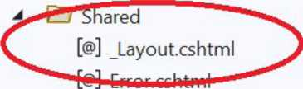
Solution Explorer | ▼ -p X 1
<stb’Sogo | Z' | »*
Search Solution Explorer (Ctrl+;) | p | ■w
Solution 'Session!7Project' (1 of 1 project)
* Session 17Project |  | —
C$> Connected Services
> Properties
> References EH App_Data
> EH App_Start t> EH Content
^ EH Controllers EH fonts EH Models
> EH Scripts & Views
l> EH Home
5
[@] _ViewStart.cshtml Web.config favicon.ico $E) Global.asax «£) packages.config <£] Web.config

Slide 382
Layout View
Method
RenderBodyQ
RenderSection(string name)
By:

Slide 383
Description
Renders the portion of the child view that is not within a named section. Layout view must include the RenderBody() method.
Renders a content of named section and specifies whether the section is required.
Dr. Vikrant

Slide 384
Start Bootstrap
Toggle Menu
Home Link Dropdown
Home
ASP.NET @RenderBody
ASRNET is a free web framework for building great Web sites and Web applications using HTML, CSS and JavaScript.
About
Contact
Learn more »
Getting started
ASP.NET MVC gives you a powerful, patterns-based way to build dynamic websites that enables a clean separation of concerns and gives you full control over markup for enjoyable, agile development.
Get more libraries
NuGet is a free Visual Studio extension that makes it easy to add, remove, and update libraries and tools in Visual Studio projects.
Learn more »
Web Hosting
You can easily find a web hosting company that offers the right mix of features and price for your applications.
Learn more »
Learn more »
@RenderSection
Footer Section
^ startbootstrap-sim....zip ^{A}
'Shew bH ¹ *

Slide 385
Layout View
@RenderSection :
•false parameter denotes that particular section is optional and It is your choice whether to use it or not.
• If you use true parameter then it is compulsory to use this section in child page otherwise you will get error.
@RenderSection("subheader", required:false)
By : Dr. Vikrant

Slide 386
Layout View
Layout View (jnyLayout.cshtml)
<div class="container-fluid">
<P>
@RenderBody()
</p>
<div class="border-end bg-primary" style="color: white"> @RenderSection("subh$ader", required:false)
</div>
</div>
Child View (About.cshtml)
ViewBag.Title = "About";
}
<h2>@ViewBag.Title. </h2> <h3>@ViewBag.Message</h3>
<p>Use this area to provide additional information.</p>
@section subheader {
About Us Footer
}
8

Slide 387
Bundling
• Bundling and minification techniques were introduced in MVC 4 to improve request load time.
• Bundling allows us to load the bunch of static files from the server in a single HTTP request.

Slide 388
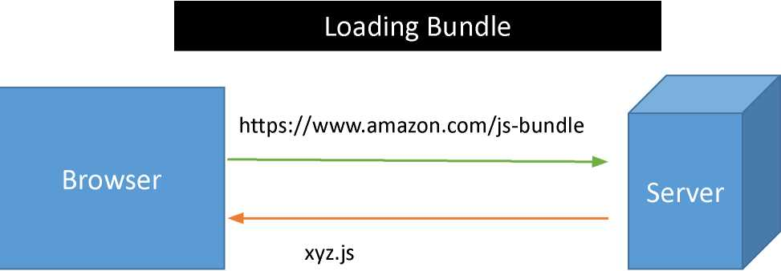
Loading Scripts in Separate Request
 | https://www.amazon.com/Scripts/abc.js | / A
 | -► abc.js
Browser | https://www.amazon.com/Scripts/xyz.js -► | Server _A
 | xyz.js
abc.js
»r. Vikrant 9

Slide 389
Bundle Types
"ScriptBundle: ScriptBundle is responsible for JavaScript minification of single or multiple script files.
bundles.Add(new ScriptBundle("~/bundles/myjsfiles").lnclude(
"-/Scripts/scripts.js")); //In BundleConfig.es
@Scripts.Render("~/bundles/myjsfiles") //In .cshtml file
•StyleBundle: StyleBundle is responsible for CSS minification of single or multiple style sheet files.
bundles.Add(new StyleBundle("~/Content/mycss").lnclude(
"-/Content/styles.css")); //In BundleConfig.es
@Styles.Render("~/Content/mycss") //In .cshtml file
By : Dr. Vikrant
10

Slide 390
Minification
Minification technique optimizes script or CSS file size by removing unnecessary white space and comments and shortening variable names to one character.
Example: JavaScript Minification
details = function(name)
_j- sayHello=function(n){var t="Hello,,+n;alert(t)}
//this is comment
var msg= "Hello"+ name; alert(msg);
>
By : Dr. Vikrant
11

Slide 391
Error handling in MVC with log entry
HandleError is the default bulit-in exception filter in ASP.NET MVC
HandleError Attribute filter works only when custom errors are
enabled in the Web.config file of your application.
Controller
<system.web>
<customErrors mode="On">
<error statusCode="404" redirect="~/Error/NotFound"/> </customErrors>
</system.web>
Action
By : Dr. Vikrant
12

Slide 392
MVC Security
• MVC Security implements security features in the application. It also supports new membership features included with ASP.NET and available for use from ASP.NET MVC.
•Also it has the new identity components that is a part ofASP.NET and see how to customize membership for our users and roles.
By : Dr. Vikrant
13

Slide 393
MVC Security
n x
Create a new ASP.NET Web Application
Authentication of user means verifying the identity of the user. This is really important.
You might need to present your application only to the
authenticated users for obvious reasons.
r^j Empty
An empty project template for creating ASP.NET applications. This template does not have any content in it.
Authentication
 | None | -
 | None
sites ;t | Individual Accounts Microsoft identity platform Windows
 | ~~| Web Forms
j Web Forms
A project template for creating ASP.NET Web Forms applications. ASP.NET Web Forms lets you build dynamic wel using a familiar drag-and-drop, event-driven model. A design surface and hundreds of controls and components you rapidly build sophisticated, powerful Ul-driven sites with data access.
>J
✓ MVC
□ Web API
MVC
A project template for creating ASP.NET MVC applications. ASP.NET MVC allows you to build applications using the Model-View-Controller architecture. ASP.NET MVC includes many features that enable fast, test-driven development for creating applications that use the latest standards.
d
Advanced
\V\ Configure for HTTPS
□ Docker support (Requires Docker Desktop)
Web API
A project template for creating RESTful HTTP services that can reach a broad range of clients including browsers and mobile devices.
Single Page Application
A project template for creating rich client side JavaScript driven HTML5 applications using ASP.NET Web API. Single Page Applications provide a rich user experience which includes client-side interactions using HTML5, CSSB, and JavaScript.
□ Also create a project for unit tests
MVCSecurityDemo.Tests
Back
Create
By : Dr. Vikrant
14

Slide 394
MVC Security
Authentication options
1. None : The first option is No Authentication/None and this option is used when you want to build a website that doesn't care who the visitors are.
2. Individual User Accounts : This is the traditional forms-based authentication where users can visit a website. They can register, create a login, and by default their username is stored in a SQL Server database using some new ASP.NET identity features
3. Microsoft Identity platform: It's an open-source libraries, and application management tools
4. Windows rwhich works well for intranet applications. A user logs into Windows desktop and can launch a browser to the application that sits inside the same firewall
By : Dr. Vikrant
15

Slide 395
Cross Site Request Forgery Attacks
• CSRF attacks are possible against web sites that use cookies for authentication, because browsers send all relevant cookies to the destination web site.
• Example of a CSRF attack:
1. A user logs into www.somewebsite.conn using form authentication
2. The server authenticates the user. The response from the server includes an authentication cookie.
Malicious websites HTML form
<h1>Congratulations!! </h1>
<form action="http://somewebsite.com/api/account" method="post">
<input type="hidden" name="Transaction" value-'withdraw" />
<input type="hidden" name-'Amount" value=“2000000" /> <input type="submit" value-'Click Me"/>
</form>
3. Without logging out, the user visits a malicious web site. This malicious site contains the given HTML form.
4. The user clicks the submit button. The browser includes the authentication cookie with the request.
5. The request runs on the server with the user's authentication context, and can do anything that an authenticated user is allowed to do.
Notice that the form action posts to the vulnerable site, not to the malicious site. This is the "cross-site" part of CSRF.
By : Dr. Vikrant
16

Slide 396
Cross Site Request Forgery Attacks
•As soon as user clicks the form button, the malicious page could just as easily run a script that submits the form automatically.
• Even SSL does not prevent a CSRF attack, because the malicious site can send an "https://" request.
By : Dr. Vikrant
17

Slide 397
Anti-forgery token
To help prevent CSRF attacks, ASP.NET MVC uses anti-forgery tokens, also
called request verification tokens.
1. The client requests an HTML page that contains a form.
2. The server includes two tokens in the response. One token is sent as a cookie. The other is placed in a hidden form field. The tokens are generated randomly so that an adversary cannot guess the values.
3. When the client submits the form, it must send both tokens back to the server. The client sends the cookie token as a cookie, and it sends the form token inside the form data.
4. If a request does not include both tokens, the server disallows the request.
By : Dr. Vikrant
18

Slide 398
Anti-forgery token
Example of an HTML form with hidden form token:
<form action="/Home/Test" method="post">
<input name-'_RequestVerificationToken"
type="hidden"
value="6fGBtLZmVBZ59oUad1 Fr33BuPxANKY9 q3Srr5y[...]" />
<input type=,,submit" value-'Submit" />
</form>
By : Dt

Slide 399
To add the anti-forgery tokens to a Razor page, use the HtmlHelper.AntiForgeryToken helper method:
@using (Html.BeginForm(“Form2", “Employee"))
{
@Html.AntiForgeryToken()
}
Vikrant
19

Slide 400
OAuth
•OAuth stands for Open Authorization
•OAuth is an open standard for authorization.
•OAuth provides client applications a "secure delegated access" to server resources on behalf of a resource owner.
• It specifies a process for resource owners to authorize third-party access to their server resources without sharing their credentials.
• It is an open standard for token-based authentication and authorization.
By : Dr. Vikrant
20

Slide 401
References
1. C .Net Web Developers Guide by Syngress
2. ASP.NET 4.5, Covers C# and VB Codes, Black Book, Kogent Learning Solutions Inc.
3. https://docs.microsoft.com/
By : Dr. Vikrant
21

Slide 402
Session-18
Entity Framework and ASP.NET
MVC Core

Slide 403
Contents
• Introduction to Entity Framework
• Different Approaches
• Code First
• Database First
• Model First
• Data Annotations Attributes in EF 6
• Introduction to ASP.NET Core
• Difference ASP.NET MVC and MVC Core
By : Dr. Vikrant

Slide 404
Introduction to Entity Framework
•Entity Framework is an Object Relational Mapper (ORM) which is a type of tool that simplifies mapping between objects in your software to the tables and columns of a relational database.
• It is an open source ORM framework for ADO.NET which is a part of .NET Framework.
•An ORM takes care of creating database connections and executing commands, as well as taking query results and automatically materializing those results as your application objects.
By : Dr. Vikrant
3

Slide 405
Different Approaches
The Entity Framework provides three approaches to create an entity model and each one has their own pros and cons.
•Code First
• Database First
• Model First
By : Dr. Vikrant
4

Slide 406
Different Approaches
Code First:
• Code First modeling workflow targets a database that doesn't exist and Code First will create it.
• It can also be used if you have an empty database and then Code First will add new tables to it.
• Code First allows you to define your model using C# or VB.Net classes.
By : Dr. Vikrant
5

Slide 407
Different Approaches
Code First:
•The domain classes have nothing to do with Entity Framework. They're just the items of your business domain.
• Entity Framework, then, has a context that manages the interaction between those classes and your database.
By : Dr. Vi

Slide 408
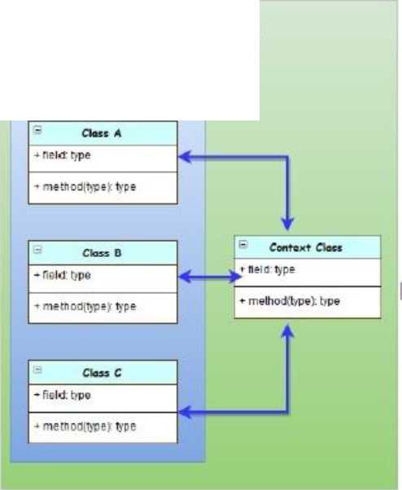
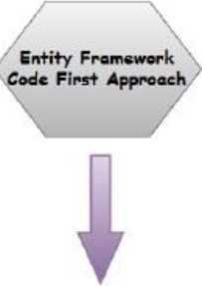
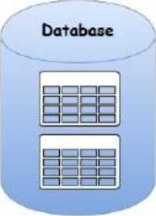
Application
Domain Classes
krant
6

Slide 409
Different Approaches
Database First:
• It creates model codes (classes, properties, DbContext etc.) from the database in the project and those classes become the link between the database and controller.
• creates the entity framework from an existing database.
By : Dr. Vikrant
7

Slide 410
Different Approaches
Model First:
• Model First is good when you are starting a new project where the database doesn't even exist yet.
•The model is stored in an EDMX file and can be viewed and edited in the Entity Framework Designer.
• In Model First, you define your model in an Entity Framework designer then generate SQL, which will create database schema to match your model and then you execute the SQL to create the schema in your database.
•The classes that you interact with in your application are automatically generated from the EDMX file.
By : Dr. Vikrant
8

Slide 411
Data Annotations Attributes in EF 6
Namespace to include : System.ComponentModel.DataAnnotations
Attribute | Description
Key | Can be applied to a property to specify a key property in an entity and make the corresponding column a PrimaryKey column in the database.
Reauired | Can be applied to a property to specify that the corresponding column is a NotNull column in the database.
MinLenath | Can be applied to a property to specify the minimum string length allowed in the corresponding column in the database.
MaxLenath | Can be applied to a property to specify the maximum string length allowed in the corresponding column in the database.
StrinaLenath | Can be applied to a property to specify the maximum string length allowed in the corresponding column in the database.
By : Dr. Vikrant
9

Slide 412
Data Annotations Attributes in EF 6
Namespace to include :
System.ComponentModel.DataAnnotations.Schema Attributes
Attribute | Description
Table | Can be applied to an entity class to configure the corresponding table name and schema in the database.
Column | Can be applied to a property to configure the corresponding column name, order and data type in the database.
Index | Can be applied to a property to configure that the corresponding column should have an Index in the database. (EF 6.1 onwards only)
ForeianKev | Can be applied to a property to mark it as a foreign key property.
NotMaDoed | Can be applied to a property or entity class which should be excluded from the model and should not generate a corresponding column or table in the database.
By : Dr. Vikrant
10

Slide 413
Some Examples of Data Annotations in EF
1. Table
using System.ComponentModel.DataAnnotations.Schema;
[Table("StudentMaster")] public class Student
{
public int StudentID { get; set; } public string StudentName { get; set; }
>
2. Key
using System.ComponentModel.DataAnnotations; public class Student {
[Key]
public int StudentKey { get; set; } public string StudentName { get; set; }
>

Slide 414
Introduction to ASP.NET Core
ASP.NET Core is a cross-platform,
high-performance, open-source framework for building modern, cloud-enabled, Internet-connected apps. With ASP.NET Core, you can:
• Build web apps and services, Internet of Things (loT) apps, and mobile backends.
• Use your favorite development tools on Windows, macOS, and Linux.
• Deploy to the cloud or on-premises.
• Run on .NET Core.
By : Dr. Vikrant
12

Slide 415
Difference ASP.NET MVC and MVC Core
Difference 1 - Single aligned web stack for ASP.NET Core MVC and Web APIs
Create a new ASP.NET Core web application | Create a new ASP.NET Web Application
MKan ASPMVCa* VO ♦ y ASP.MET Cor* Empty , Authentication | f—e Authentication ipfl ,™'^{ty} _________
|mj A5P.NET Con Web API | yi ^{w}'^{b,}°^’
* tavu. fa. nMn, « ASPAET Co. «***» m Ca*db. In. . AHIU HTIP -rm.
ASP NET Co«« App 1 3 tonA*™ MIW5 | ^{mvc}
u.+XA^TMT *"« | Vm t iWiu*w —h—itona AS**fit I W. ntje^t nw> Ualitm that mtA ImI »r«! dm— iWw^wtiiI ta
ASP NET Cara WM> App (MeM Vtow CmimMw) A pnQfart wmAO h» 41—til «n AV SI t (<— applra—» art* a—npfc AV SI t r<— MVC VM an* CoMhim IMi un 4m b*t—U to IKS1M HTTP — . | iflJI ^{w}*^{bA}*¹ Advanced A p»t*n1 OwfMiO So (Mini RtSIU M||f wan Itiat (*i >—if a bool *a*p ^ ibtti rekebny bu—n oil . . __
By : Dr. Vikrant
13

Slide 416
Difference ASP.NET MVC and MVC Core
Difference 2 - Project (Solution) Structure Changes : asp.netcore5 mvcsolution
explorer on the right-hand side, there is no Web.config, Global.asax
¹ J Solution 'DemoAspNetCore' (1 of 1 project) | ¹ J Solution 'AspNetMVC5Demo' (1 of 1 project)
^ <0>J DemoAspNetCore j | Ej] AspNetMVC5Demo
Cyi Connected Services | Connected Services
Dependencies | Properties
yS Properties | References
l> wwwroot | iB App Data
* Controllers | ^ Bl App_Start
I> ^{c}** HomeController.es | Content
Bi Models | Bl Controllers
Wl Views | I> Bri fonts
BB Home | Bl Models
^ m Shared | ^ ifl Scripts
E _Viewlmports.cshtml | Bl Views
E _ViewStart.cshtml | El favicon.ico
oT appsettings.json | Global.asax
> C* Program.es | O packages.config
^{c}** Startup.es | Web.config
A Q D Kl ^ 1 ti i ro | ASP.NET MVC 5 project structure
ASP.NET Core project structure
14

Slide 417
Difference ASP.NET MVC and MVC Core
Difference 3 - ASP.NET Core apps don't need IIS for hosting
The goal of ASP.NET Core is to be cross-platform using .NET Core (.NET 5). With this in mind, Microsoft decided to host ASP.NET Core applications on IIS and be self-hosted or use the Nginx web server on Linux.
Difference 4 - wwwroot folder for static files
J Solution DemoAspNetCore' {1 of 1 project) ^ %T. DemoAspNetCore
Connected Services *V Dependencies ytf Properties ^{A} @ wwwroot
fr css
t> M JS
t> M lib
By : Dr. Vikrant
15

Slide 418
Difference ASP.NET MVC and MVC Core
Solution 'DemoAspNetCore' (1 of 1 project) a !§n DemoAspNetCore
Connected Services a Dependencies
> jjr Analyzers
a -EE Frameworks
> Microsoft.AspNetCore.App
> •E|J Microsoft.NE7Core.App
> S8 Properties_
a @ wwwroot
> M css
> m js a iJ lib
> til bootstrap
> jquery
t> jquery-validation
> ■ jquery-validation-unobtrusive
__El favicon.ico_
Controllers
> C* HomeController.es
> il Models a 0 Views
Difference 5 - New approach to Server-side and client-side dependency management of
packages. Leverage the experience of working in Visual Studio IDE and deploy ASP.NET Core applications either on Windows, Linux, or Mac using .NET Core, its Server side management of dependencies. Client-side dependency management is more important because the client-side has more different packages from the server-side. Client-side will indeed have jQuery, Bootstrap, grunt, and any Javascript frameworks like AngularJS, Backbone, images, and style files.
Server Side (red) and Client-Side (green) Dependency Management
By : Dr. Vikrant
16

Slide 419
Difference ASP.NET MVC and MVC Core
Difference 6- Inbuilt Dependency Injection (Dl) supportforASP.NET Core 5
Dependency Injection (Dl) achieves loosely coupled, more testable code; it's vital because it helps write unit tests.
Note : The Dependency Injection Design Pattern in C# is a process in which we are injecting the object of a class into a class that depends on that object. Dependency Injection pattern involves 3 types of classes:
• Client Class: The Client class (dependent class) is a class that depends on the service class.
• Service Class: The Service class (dependency) is a class that provides service to the client class.
• Injector Class: The Injector class injects the service class object into the client class.
By : Dr. Vikrant
17

Slide 420
References
1. C .Net Web Developers Guide by Syngress
2. ASP.NET 4.5, Covers C# and VB Codes, Black Book, Kogent Learning Solutions Inc.
3. https://docs.microsoft.com/
By : Dr. Vikrant
18

Slide 421
Session-19
Localization in MVC
and
Deploying MVC Application

Slide 422
Contents
• Localization
• ISO Codes for Cultures •Culturelnfo class
•Server Side Culture Declaration
• Setting the culture to the client's cultu
• Deploying MVC Application on IIS
By : Dr. Vikrant

Slide 423
Localization
• Internationalization is the process of enabling your code to run correctly all over the world. It has two parts: globalization and localization.
•Globalization is about writing your code to accommodate multiple languages and region combinations. The combination of a language and a region is known as a culture.
•Localization the process of customization to make our application behave depending on the current culture and locale
•The namespace required : System.Globalization
By : Dr. Vikrant

Slide 424
ISO Codes for Culture Combinations
• There are International Organization for Standardization (ISO) codes for all culture combinations.
• For example,
1. in the code da-DK, da indicates the Danish language and DK indicates the Denmark region,
2. in the code fr-CA, fr indicates the French language and CA indicates the Canadian region.
By : Dr. Vikrant

Slide 425
Culturelnfo Class
• In the .NET Framework, the Culturelnfo class from System.Globalization namespace provides culture-specific information such as the associated language, country or region, calendar, and cultural conventions.
•The CurrentCulture property represents the culture that the current thread uses.
•The CurrentUICulture property represents the current culture that Resource Manager uses to look up culture-specific resources at run time.
By : Dr. Vikrant

Slide 426
Server Side Culture Declaration
•ASP.NET enables you to define the culture used by your entire ASP.NET application or by a specific page within your application. You can specify the culture for any of your ASP.NET applications by means of the appropriate configuration files.
• Defining the <globalization> section in the web.config file
<configuration>
<system.web>
<globalization culture="ru-RU" uiCulture="ru-RU" />
</system.web>
</configuration>
Note : Setting the culture at either the server-wide or the application-wide level
By : Dr. Vikrant
6

Slide 427
Server Side Culture Declaration
• Defining the culture at the page level using the @Page directive
<%@ Page Language="C#" UICulture="ru-RU" Culture="ru-RU" %>
This example determines that the Russian language and culture settings are used for everything on the page.
By : Dr. Vikrant

Slide 428
Setting the culture to the client's culture
When working with culture on the client side, the culture that is used is the culture that is defined on the server. Therefore, if you have the culture set to en-US on your server, this is the default that is utilized on the client-side operations as well.
int value=3000;
//Spanish(Mexico)
Thread.CurrentThread.CurrentCulture = new System.Globalization.Culturelnfo("es-MX"); Console.WriteLinefvalue.ToStringC'c"));
//English(UK)
Thread.CurrentThread.CurrentCulture = new System.Globalization.Culturelnfo("en-GB"); Console.WriteLinefvalue.ToStringC'c"));
By : Dr. Vikrant
8

Slide 429
Deploying MVC Application
If^; Windows Features — □ X
Turn Windows features on or off ©
Enabling IIS and required IIS components on Windows 10
1. Open Control Panel and click Programs and Features > Turn Windows features on or off.
2. Enable Internet Information Services.
3. Expand the Internet Information Services feature and verify that the web server components listed in the next section are enabled.
4. Click OK.
5. Check from start menu for " IIS Manager" in Windows
To turn a feature on, select its check box. To turn a feature off, clear its check box. A filled box means that only part of the feature is turned on.
0 Internet Explorer 11 a
B [■] Internet Information Services
III 0 FTP Server
S3 [■] Web Management Tools
B [■] World Wide Web Services
B 0 Application Development Features 0 .NET Extensibility 3.5
0 .NET Extensibility 4.8
0 Application Initialization 0 ASP
0 ASP.NET 3.5
0 ASP.NET 4.8
0 CGI
_i—i----------
OK
Cancel

Slide 430
Deploying MVC Application
6. Start IIS Manager with Administrator
Best match
Internet Information Services (IIS)
Manager App
Search the web |  | Internet Information Services (IIS) Manager
P MS - See web results | > |  | App
P iiser P iisc | > | IZj | Open
 | > | ^0 | Run as administrator
Folders |  | 53 | Open file location
IISExpress - in Documents | > | -ta | Pin to Start
IISExpress - in Documents | > | -Da | Pin to taskbar
Photos
By : Dr. Vikrant
10

Slide 431
Deploying MVC Application
Publish
Where are you publishing today?
Publish the MVC application
1. Open the Visual Studio with Administrator
2. In the Solution explorer, Right click the Project and Select "Publish"
3. Select Webserver (IIS) and Click next
4. Then Select "Web Deploy Package" and click Next
5. Then provide the location of your Project and Mention site name.
6. Then Publish
Target
A
Azure
Publish your application to the Microsoft cloud
Docker Container Registry
Publish your application to any supported Container Registry that works with Docker images
□
Folder
Publish your application to a local folder or file share FTP/FTPS Server
Publish your application to an FTP/FTPS server Web Server (IIS)
Publish your application to IIS using Web Deploy or Web Deploy Package
Publish your application to IIS usii
Import Profile
Import your publish settings to deploy your app
 | Next | Finish | Cancel
By : Dr. Vikrant
11

Slide 432
Deploying MVC Application
Creating Virtual Directory
1. Open the IIS Manager with Administrator
2. Right Click on the Default Web Site and Create Virtual Directory
3. Give the Alias and path of the Application folder
4. Click OK
5. Test the website execution by right click on virtual directory > Manage Application and Browse

Slide 433
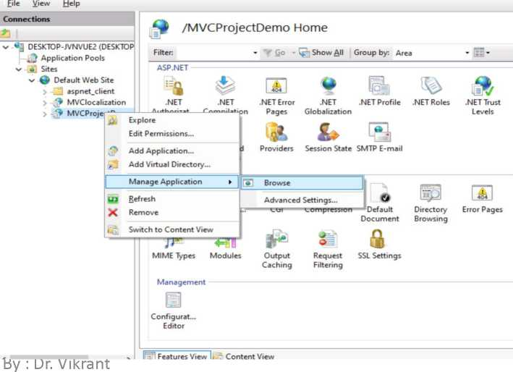
*3 Internet Information Services (IIS) Manager
X
 |  | 9 ► DESKTOP-JVNVUE2 ► Sites ► Default Web Site ► | va
File | View | Help
^) Default Web Site Home
Actions
 | Explore Edit Permissions... | A
H | Edit Site Bindings... Basic Settings...
 | View Applications View Virtual Directories
Manage Website ^ it Restart ► Start ■ Stop
 | Browse Website Browse *:80 (http)
 | Advanced Settings...
 | Configure | V
£
^ DESKTOP-JVNVUE2 (DESKTOP Application Pools -SI Sites
Filter
» Go - Show All Group by: Area
• 11’
ASP.NET
.NET
.NET
> Default Web Site
Authorttat... Compilation
.NET Error .NET Pages Globalization
.NET Profile .NET Roles
9
V—
& ft¹
.NET Trust Levels
.NET Users Application Connection Machine Key Pages and Settings Strings Controls
& £
Providers Session State SMTP E-mail
- Features View |. Content View
*eady
•3-3 Internet Information Services (IIS) Manager
«1:
► DESKTOP-JVNVUE2 . Sites ► Default Web Site . MVCProjectDemo .
12

Slide 434
References
1. C# 8.0 and .NET Core 3.0 - Modern Cross-Platform Development
2. https://vmsdurano.com/deploving-vour-asp-net-mvc-5-app-to-iis8/
By : Dr. Vikrant
13

Slide 435
Session-20
Windows Communication Foundation(WCF)

Slide 436
Contents
•Services
•SOA
• WCF overview
•Contracts
• Service Contracts
• Data Contracts
• Message Contracts
• Programming Model of WCF •Binding Types
•Adding WCF in VS2022 •WCF Service Creation

Slide 437
By : Dr. Vikrant
2

Slide 438
Services
•Services are the logical encapsulation of self-contained business functionalities
•Services are not classes or namespaces or objects. It's just self-contained business functionality.
Example : The petrol filling station is providing three services! fuel filling up, air pressure checking, checking puncture) that are logically encapsulated within one filling station and they are self contained
By : Dr. Vikrant
3

Slide 439
Service Oriented Architecture (SOA)
SOA is nothing but an architectural style where two non-compatible applications can communicate using a common language.
Eg. Windows Communication Foundation (WCF)
 | XML/JSON/CSV
 |  | Java class
C# class
 | Communication by Message
The message format can be XML, JSON or even a plain CSV file
By : Dr. Vikrant
4

Slide 440
WCF Overview
• WCF stands for Windows Communication Foundation.
•It is a framework for building, configuring, and deploying network-distributed services by which we can send asynchronous message/data from one service endpoint to another service endpoint.
•The basic feature of WCF is interoperability
•WCF is used to build service-oriented applications.
•A WCF application consists of three components -
• WCF service,
• WCF service host, and
• WCF service client.
By : Dr. Vikrant
5

Slide 441
Fundamental Concepts of WCF
• Message : Message instances are sent as well as received for all types of communication between the client and the service.
•Endpoint : It defines the address where a message is to be sent or received.
•Binding: It defines the way an endpoint communicates. It comprises of some binding elements that make the infrastructure for communication. For example, a binding states the protocols used for transport like TCP, HTTP, etc., the format of message encoding, and the protocols related to security as well as reliability.
•Contracts: It is a collection of operations that specifies what functionality the endpoint exposes to the client. It generally consists of an interface name.
By : Dr. Vikrant
6

Slide 442
Fundamental Concepts of WCF
• Hosting: refers to the WCF service hosting which can be done through many available options like self-hosting and IIS hosting
•WCF Client: A client application that gets created for exposing the service operations in the form of methods is known as a WCF client.
•Channel: Channel is a medium through which a client communicates with a service.
•SOAP: Although termed as 'Simple Object Access Protocor. It is an
XML document comprising of a header and body section.
By : Dr. Vikrant
7

Slide 443
Contracts
The contracts layer is just next to the application layer and contains information similar to that of a real-world contract that specifies the operation of a service and the kind of accessible information it will make. Types discussed below:
•Service contract - This contract provides information to the client as well as to the outer world about the offerings of the endpoint, and the protocols to be used in the communication process.
•Data contract - The data exchanged by a service is defined by a data contract. Both the client and the service has to be in agreement with the data contract.
• Message contract - A data contract is controlled by a message contract. It primarily does the customization of the type formatting of the SOAP message parameters. SOAP stands for Simple Object Access Protocol.
By : Dr. Vikrant
8

Slide 444
Programming Model of WCF
Client |  |  | Service
C | B A O O Message O O A | B | C
Address | Binding | Contract
(Where) | (How) | (What)
The ABCs of Endpoints

Slide 445
Programming Model of WCF
•Address: "A" stands for Address that specifies where the service is. Every service has a unique address whose format is as follows:
[Transport] ‘.//[Domain Name]:[PoName]
• Binding: "B" stands for Binding that specifies how to talk with the service. All built-in bindings are defined in the System.ServiceModel namespace.
•Contract: "C" stands for Contract that tells us about what can service do for me.
By : Dr. Vikrant
10

Slide 446
Types of Bindings
• BasicHttpBinding: This is the basic web service for the communicate with a web server or a client application. It is designed to expose a WCF service as an asmx web service. This binding uses the HTTP protocol for communication.
• NetMsmqBinding: It is used to implement message queuing in a WCF service. It enables a client application to send a message to a WCF service even if the service is unavailable.
• NetTcpBinding: It allows the communication between a WCF service and a .NET client application over a network. It uses the TCP protocol and is a much faster and more reliable binding compared to HTTP protocol binding.
By : Dr. Vikrant
11

Slide 447
Types of Bindings
• NetPeerTcpBinding: For peer-to-peer communication where messages are sent and received using the TCP protocol.
• WSHttpBinding: It is similar to BasicHttpBinding and uses the HTTP or HTTPS protocol. It also supports WS-Transactions and WS-Security that are not supported by the BasicHttpBinding.
• WSDualHttpBinding: It is similar to WSHttpBinding, except it supports bi-directional communication which means both clients and services can communicate with each other by sending and receiving messages.
• NetNamedPipeBinding: This binding uses named pipes for communication between two services on the same machine that is most secure and the fastest binding among all the bindings.
By : Dr. Vikrant
12

Slide 448
Adding WCF in Visual Studio
Modifying — Visual Studio Community 2022 — 17.0.5
Search 'WCF' in the individual components and add Windows communication foundation in Visual Studio just like we add previous components
Workloads Individual components Language packs Installation locations
X
Installation details
Individual components *
Development activities
□ : Windows Communication Foundation i
B .NET Framework 4.8 SDK b .NET Framework 4.7.2 targeting pack B TypeScript Server Q TypeScript 4.4 SDK
B JavaScript and TypeScript language support □ JavaScript diagnostics b C# and Visual Basic Roslyn compilers B MSBuild B C# and Visual Basic B Text Template Transformation B Razor Language Services B IIS Express B NuGet package manager Q SQL Server ODBC Driver D SQL Server Express 2019 LocalDB B Connectivity and publishing tools Q CLR data types for SQL Server B SQL Server Command Line Utilities B ClickOnce Publishing
Location
C:\Program Files\Microsoft Visual Studio\2022\Community
By continuing, you agree to the license for the Visual Studio edition you selected. We also offer the ability to download other software with Visual Studio. This software is licensed separately, as set out in the 3rd Party Notices or in its accompanying license. By continuing, you also agree to those licenses.
Total space required -3 MB
Install while downloading ^ Modify
By : Dr. Vikrant
13

Slide 449
WCF Service Creation
Create a new project
1. Once WCF installed
completely, Create the New Project and Select WCF Service Library.
2. Click Next.
3. Then, Give the name for your Project and Click Create
Recent project templates
Gfc WCF Service Library C#
_t- ASP.NET Web Application (.NET •^{J} Framework)
Bl Console App C#
ASP.NET Core Web App (Model-View-® Controller)
i!j ASP.NET Core Web App C#
r 1 Windows Forms App (.NET Framework) C# SjJfj Class Library (.NET Framework) C#
Class Library C#
By : Dr. Vikrant

Slide 450


□
X
WCF Serve
X *
Clear all
All languages All platforms
All project types
WCF Service
A Web site for creating WCF services. This template does not produce a project file and has limited MSBuild support.
C# Windows Web Service
<x
WCF Service Application ^^9
A project for creating WCF Service Application that is hosted in IIS/WAS
C# Windows Web Service
WCF Service Library
A project for creating a host-independent WCF service class library (.dll) C# Windows Library Web Service
WCF Service Application ^^9
A project for creating WCF Service Application that is hosted in IIS/WAS
Visual Basic Windows Web
WCF Service Library ^^9
A project for creating a host-independent WCF service class library (.dll)
Next
14

Slide 451
WCF Service Creation
4. One interface and one class gets added in the project.
5. Check if the bindings and contracts mentioned properly in App.Config file
6. Test and execute

Slide 452
00 File Edit View Git Project Build Debug Test Analyze Tools Extensions Window Help | Search (Ctrl+Q)
® - eS B I
Data Sources Server Explorer Toolbox
|DemoServiceLibrary DemoServiceLibrary.lService! »|(J
 | 1^ Busing System; 1
 | 2 | using System.Collections.Generic;
 | 3 | using System.Linq;
 | 4 | using System.Runtime.Serialization;
 | 5 | using System.ServiceModel;
 | 6 | using System.Text;
 | 8 | namespace DemoServiceLibrary
 | 9 | {
 | 10 | // NOTE: You can use the "Rename" command on the "Refactor" menu to change t
 | 11 | [ServiceContract]
 |  | 1 reference
111 | 12 | public interface IServicel
 | 13 | {
 | 14 | [OperationContract]
 |  | 1 reference
111 | 15 | string GetDataCint value);
 | 16
 | 17 | [OperationContract]
 |  | 1 reference
111 | 18 | CompositeType GetDataUsingDataContract(CompositeType composite);
 | 19
 | 20 | // TODO: Add your service operations here
 | 21 | >
 | 22
 | 23 E | // Use a data contract as illustrated in the sample below to add composite t
 | 24 | // You can add XSD files into the project. After building the project, you c<
 | 25 | [DataContract]
© -;
O00
Search Solution Explorer (Ctrl+;)
E&4 Solution 'DemoServiceLibrary' (1 of 1 project)
DemoServiceLibrary
Properties && References ■£| App.config C** IService1.cs C** Service!.cs
App.config
<?xml version="l. 0" encoding="utf-8" ?>
- <configuration>
<appSettings>
<add key="aspnet:UseTaskFriendlySynchronizationContext" value="true" />
</appSettings>
<system.web>
compilation debug="true" />
</system.web>
<!— When deploying the service library project, the content of the config file must be added to the host's app.config file. System.Configuration does not support config files for libraries. —>
<system.serviceModel>
<services>
<service name="DemoServiceLibrary.Servicel">
<host>
<baseAddresses>
<add baseAddress = "http://localhost:8733/Design Time Addresses/DemoServiceLibrary/Servicel/" /> </baseAddresses>
</host>
<!— Service Endpoints —>
<!— Unless fully qualified, address is relative to base address supplied above —> <endpoint address="" binding="basicHttpBinding" contract="DemoServiceLibrary.IServicel"> _*-L^=_
Upon deployment, the following identity element should be removed or replaced to reflect the identity under which the deployed service runs. If removed, WCF will infer an appropriate identity automatically.
<identity>

Slide 453
References
1. https://docs.microsoft.com
By : Dr. Vikrant
16

Slide 454
Session-21
Web APIs

Slide 455
Contents
•API
•Web API • Uses of API
•Creating WebAPI project

Slide 456
API
An API, or application programming interface, is a set of rules that define how applications or devices can connect to and communicate with each other.
By : Dr. Vikrant

Slide 457
Web API
• Web API is an application programming interface (API) that is used to enable communication or interaction with software components with each other.
•ASP.NET Web API is a framework that makes it easy to build HTTP Service that reaches a broad range of clients, including browsers and mobile devices.
• Using ASP.NET, web API can enable communicating by different devices from the same database.

Slide 458
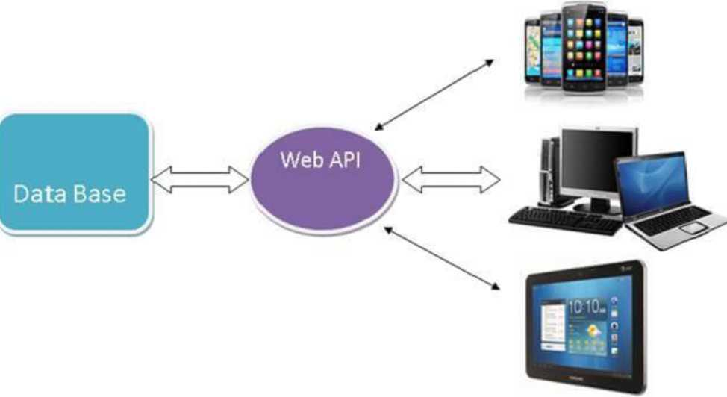
By : Dr. Vikrant
4

Slide 459
Uses of Web API
• It is used to access service data in web applications as well as many mobile apps and other external devices.
• It is used to create RESTful web services. REST stands for Representational State Transfer, which is an architectural style for networked hypermedia applications.
• It is primarily used to build Web Services that are lightweight, maintainable, and scalable, and support limited bandwidth.
• It is used to create a simple HTTP Web Service. It supports XML, JSON, and other data formats.
By : Dr. Vikrant
5

Slide 460
Creating Web API project
□ X
Create a new ASP.NET Web Application
S3 ^{Emp,y}
An empty project template for creating ASP.NET applications. This template does not have any content in it.
Authentication
None
Web Forms
A project template for creating ASP.NET Web Forms applications. ASP.NET Web Forms lets you build dynamic websites using a familiar drag-and-drop, event-driven model. A design surface and hundreds of controls and components let you rapidly build sophisticated, powerful Ul-driven sites with data access.
Add folders & core references
□ Web Forms
✓ MVC
✓ Web API
MVC
A project template for creating ASP.NET MVC applications. ASP.NET MVC allows you to build applications using the Model-View-Controller architecture. ASP.NET MVC includes many features that enable fast, test-driven development for creating applications that use the latest standards.
Web API
A project template for creating RESTful HTTP services that can reach a broad range of clients including browsers and mobile devices.
Advanced
0 Configure for HTTPS Docker support (Requires Docker Desktop)
lj Single Page Application
A project template for creating rich client side JavaScript driven HTML5 applications using ASP.NET Web API. Single Page Applications provide a rich user experience which includes client-side interactions using HTML5, CSS3, and JavaScript.
^ Also create a project for unit tests
WEBAPIDemo.Tests
Back
Create
By : Dr. Vikrant
6

Slide 461
Creating Web API project
WEBAPIDemo: Overview -u X
Overview
Connected Services Publish
Solution Explorer
^0
-t= X
'8-SOSU
ASRNET
Learn about the .NET platform, create your first application and extend it to the cloud.
Search Solution Explorer (Ctrl+;)
55 Solution 'WEBAPIDemo' (1 of 1 project)
■< §3 WEBAPIDemo
> ^ Properties
P References EH App_Data P EH App_Start P EH Areas P EH Content P EH Controllers P EH fonts EH Models P EH Scripts P EH Views m favicon.ico P tp Global.asax «£| packages.config P £] Web.config
{}
Build Your App
Get started with ASP.NET .NET application architecture
Connect To The Cloud
Publish your app to Azure
Get started with ASP.NET on Azure
By : Dr. Vikrant
7

Slide 462
Creating Web API project
WEBAPIDemo: Overview
Solution Explorer f£f
» -6 X
W- | WEBAPIDemo | "I^WEBAPIDemoWebApiConfig | •l!
 | 1® | using System;
 | 2 | using System.Collections.Generic;
 | 3 | using System.Linq;
 | 4 | using System.Web.Http;
 | 6 | namespace WEBAPIDemo
 | 7 | {
 | 8 | public static class WebApiConfig
 | 9 | {
 | 10 | public static void Register(HttpConfiguration con-fig)
 | 11 | {
 | 12 | // Web API configuration and services
 | 13
 | 14 | // Web API routes
 | 15 | con-fig. MapHttpAttributeRoutesO;
 | 16
 | 17 | con-fig. Routes. MapHttpRouteC
 | 18 | name: "DefaultApi",
 | 19 | routeTemplate: "api/{controller}/{id}^{M},
 | 20 | defaults: new { id = RouteParameter.Optional }
 | 21 | );
 | 22 | }
 | 23 | }
 | 24 | }
 | 25
^{T}0 • S O 0 0
^0
Search Solution Explorer (Ctrl+;)
E&4 Solution 'WEBAPIDemo' (1 of 1 project) ^{A} §3 WEBAPIDemo l> aP Properties > itS References EH App_Data ^{A} B App_Start
l> C« BundleConfig.es t> Co FilterConfig.es
H^'RouTeTonTigT^^^^^⁻
> c« WebApiConfig.es
P“^^7Trea^“
^ ED Content ^{A} B Controllers
t> Co ValuesController.es
CD Models ^ ED Scripts t> ED Views IHl favicon.ico ^ £) Global .asax
-v) packages.config l> Web.config
100%
■40
© No issues found
This project is same as default MVC project with two specific files for Web API, WebApiConfig.es (to configure routes and other things for Web API) in App_Start folder and ValuesController.es
in Controllers folder as shown below.
By : Dr. Vikrant
8

Slide 463
Creating Web API project
Web API has returned a result in XML or JSON format. Our output looks like below.
f- 0 fl localhost:44363/api/Values
::: Apps Mirror Shodhganga... •.,/ Best way to learn k... ⁽0 NPTEL :: Computer... Big Data Career Gui... ITIL Foundation Cer... ^ Paraphrasing Tool |... ^
This XML file does not appear to have any style information associated with it. The document tree is shown below.
▼<ArrayOfstring xmlns:i="http://www.w3.org/2001/XMLSchema-instance" xmlns="http://schemas.microsoft.com/2003/10/Serialization/Arrays"> <string>valuel</string>
<string>value2</string>
</ArrayOfstring>
<- -> O ft localhost:44363/api/Values/5
::: Apps T) Mirror Shodhganga... ■,/ Best way to learn k... 0 NPTEL :: Computer... I Big Data Career Gui... ITIL Founda
This XML file does not appear to have any style information associated with it. The document tree is shown below.
<string xmlns="http://schemas.microsoft.com/2003/10/Serialization/">value</string>

Slide 464
References
1. https://docs.microsoft.com
By : Dr. Vikrant
10

