Slide 1
Introduction to Models
Pravinkumar Dabade

Slide 2
Agenda –
Introduction to Model in ASP.NET MVC
Purpose of Model
Creating MVC Model using Classes
Model Binders in ASP.NET MVC
Data Annotation, Error Handling and Data Validation

Slide 3
Models in ASP.NET MVC
Set of classes also known as Business Entities/Domain Entities
These entities contains business logic of the application
These entities can also contains Validation logic of your domain
These entities are also used for handling Data Access Logic [DAL]
Models typically access the data from the persistent systems like SQL Server database, Oracle or File store and perform some business logic on the data
Models does not handle inputs from the Browsers directly
Models does not also generate any HTML for the browser
Model Classes are placed in Models folder in ASP.NET MVC application

Slide 4
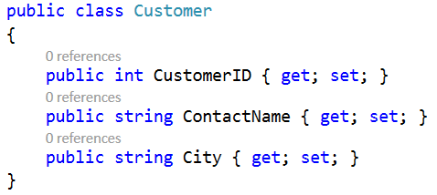
ASP.NET MVC – Example of Model

Slide 5
Model Binders
Provides a simple way to map posted form values to a .NET Framework type
The same type is passed to an action as a parameter
Model Binders are like type converters which converts HTTP Requests into Objects that are passed to an action method
Model Binders also contains the information about the current Controller context
ASP.NET MVC uses DefaultModelBinder class which works with most .NET Framework types like – Ilist, ICollection, and IDictionary objects
The ControllerActionInvoker invokes the DefaultModelBinder to transform the raw HTTP request into .NET Object.

Slide 6
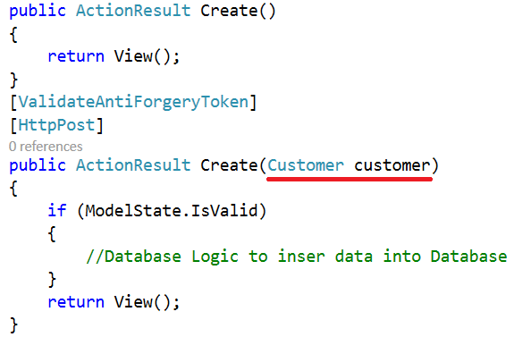
Model Binder – Example

Slide 7
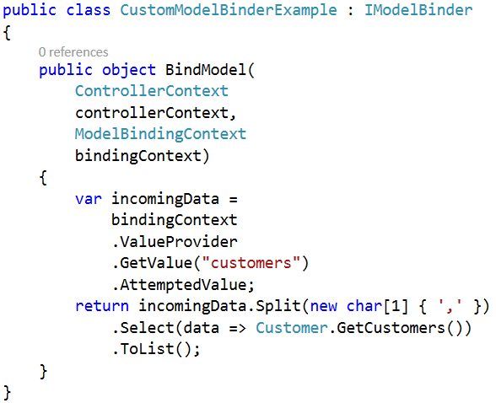
Writing Custom Model Binder

Slide 8
ASP.NET MVC Model and Validation
One of the best way to validate a model is to make use of Data Annotations.
You can make use of number of attributes to validate a model which you can find under System.ComponentModel.DataAnnotations.dll assembly.
There are number of attributes which you can apply to the properties of a model class

Slide 9
Data Annotation Classes
Required – Indicates that the property is a required field
DisplayName – Defines the text we want used on form fields and validation messages
StringLength – Defines a maximum length for a string field
Range – Gives a maximum and minimum value for a numeric field
Bind – Lists fields to exclude or include when binding parameter or form values to model properties
ScaffoldColumn – Allows hiding fields from editor forms
RegularExpression – Allows to validate the data using regular expressions

Slide 10
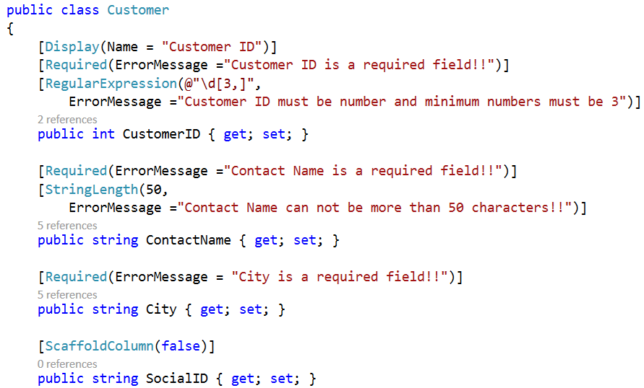
Validating Model using Data Annotations

Slide 11
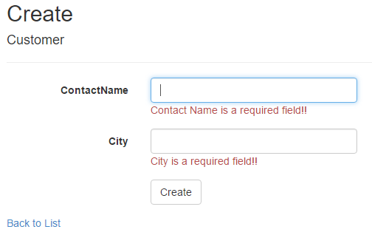
Validation Output – Data Annotations

Slide 12
Summary
Introduction to Model in ASP.NET MVC
Purpose of Model
Creating MVC Model using Classes
Model Binders in ASP.NET MVC
Data Annotation, Error Handling and Data Validation

