Slide 1
ASP.NET MVC Routing
Pravinkumar Dabade

Slide 2
Agenda –
Introduction to Route
URL Patterns
Adding Routes to MVC Application
Setting default values to route parameters
Adding constraints to route
How URLs are matched to Routes?
ASP.NET MVC 5 Attribute Routing

Slide 3
Introduction to Route
Route is a URL pattern mapped to a handler
A handler can be –
.ASPX page [Physical File]
Class which process a request [MVC Controller]
ASP.NET MVC application template comes by default with pre-configured route
Routes are defined in RouteConfig class available under App_Start folder

Slide 4
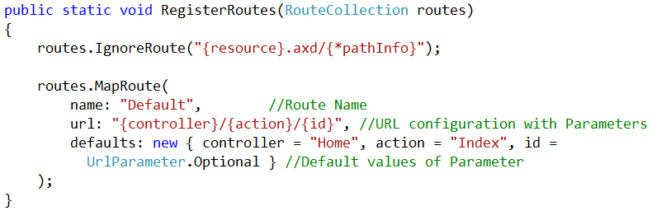
Introduction to Route

Slide 5
Routing URL Patterns
URL pattern contains –
Literal Values
Variable Placeholders [URL parameters]
Placeholders are defined in braces – {Placeholder}
The URL is parsed into –
Segments and placeholders
And variable values [Similar to Query Strings]
You can define more than one placeholder in a segment by separating them using literal values. For example –
{language}-{country}/action

Slide 6
Routing URL Patterns – Valid Route Patterns
Route Definition | Example of Matching URL
{controller}/{action}/{id} | Products/Discount/Electronics
topproduct/{action}/{id} | topproduct/show/5899
{reporttype}/{year}/{month}/{day} | /sales/2013/1/5
{language}-{country}/{action} | /en-US/show
{locale}/{action} | /UAE/show

Slide 7
URL Patterns – ASP.NET MVC Application
A Request to MVC application is routed to the UrlRoutingModule and the MvcHandler
The MvcHandler determines which controller to invoke by adding suffix controller. For example –
/Products – Products controller will be invoked
Then it calls action method based on the action parameter. For example –
/Products/Discount – calls the Discount action method of Products controller
routes.IgnoreRoute("{resource}.axd/{*pathInfo}");
The above method ignores the resources to be accessed using URL

Slide 8
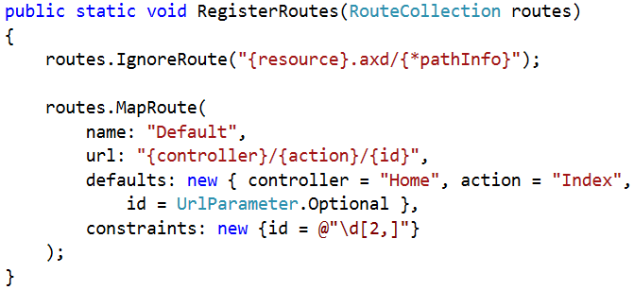
Route with Constraints

Slide 9
Adding Variable Number of Segments
query/{queryname}/{*queryvalues}
URL | Parameter Values
/query/select/bikes/onsale | queryname = "select" queryvalues = "bikes/onsale"
/query/select/bikes | queryname = "select" queryvalues = "bikes"
/query/select | queryname = "select" queryvalues = “” Empty String

Slide 10
How URLs are matched to Routes?
The route patterns that you have defined or the default route patterns.
The order in which you added them to the Routes collection.
Any default values that you have provided for a route.
Any constraints that you have provided for a route.

Slide 11
How URLs are matched to Routes?
Scenarios –
Route Declaration in Order | Result
{controller}/{action}/{id} customers/showprofile/{id} | The # 2 route will never be called
{report}/{year}/{month} with default values for Year and Month {report}/{year} with a default value for year | The # 2 route will never be called

Slide 12
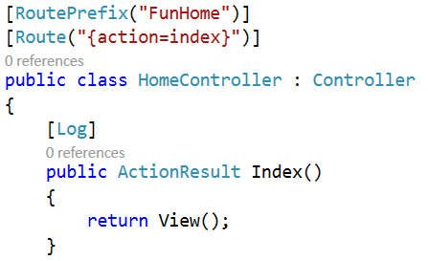
Attribute Routing in ASP.NET MVC 5

Slide 13
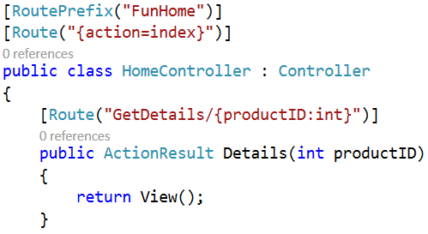
Attribute Routing and Constraints

Slide 14
Summary
Introduction to Route
URL Patterns
Adding Routes to MVC Application
Setting default values to route parameters
Adding constraints to route
How URLs are matched to Routes?
ASP.NET MVC 5 Attribute Routing

