Slide 1
ASP.NET MVC Unit Testing
Pravinkumar Dabade

Slide 2
Agenda –
What is Unit Testing?
Different Unit Testing frameworks
Introduction to Microsoft Unit Test framework
Testing Controller Action methods
Mock Testing Controller, Entity Framework and Action Method

Slide 3
Why Unit Testing?
if condition
switch case
for loop
foreach loop
while loop
do...while loop

Slide 4
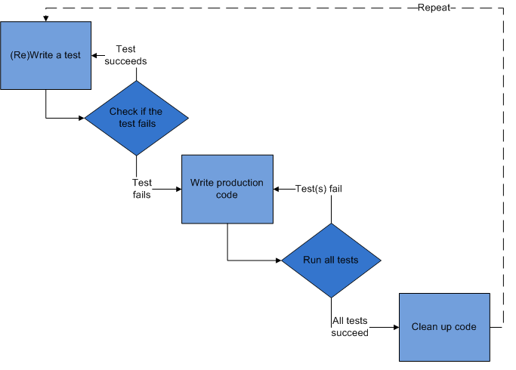
Test Driven Development in MVC

Slide 5
Test Driven Development in MVC
Add a Test –
  In TDD, each new feature starts with writing a test.
Run All Tests and the new ones fail
  The new test does not mistakenly pass without requiring any new code, and that the required feature does not already exist.
Write some code –
  The next step is to write some code that causes the test to pass. The new code written at this stage is not perfect and may. The code will be improved in step 5
Run Tests –
  If all test cases now pass, the programmer can be confident that the new code meets the test requirements, and does not break or degrade any existing features.

Slide 6
Test Driven Development in MVC
Refactor Code –
  New code can be moved from where it was convenient for passing a test to where it more logically belongs.
  Duplication must be removed.
  Objects, class, module, variable and method names should clearly represent their current purpose and use, as extra functionality is added.
  There are specific and general guidelines for refactoring and for creating clean code.
  By continually re-running the test cases throughout each refactoring phase, the developer can be confident that process is not altering any existing functionality.

Slide 7
Unit Testing Frameworks
MSTest
NUnit
xUnit
Others

Slide 8
Unit Test Runner
MSTest
NUnit
Resharper
NCrunch
Others

Slide 9
Microsoft Unit Test Framework
The Unit Testing Framework supports unit testing in Visual Studio.
Use the classes and members in the Microsoft.VisualStudio.TestTools.UnitTesting namespace when you are coding unit tests
The attributes to be used while writing the tests are –
  [TestClass()]
  [TestClassAttribute()]
Assert Class –
  Verifies conditions in unit tests using true/false propositions.

Slide 10
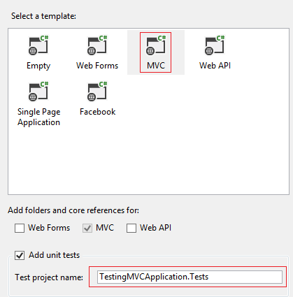
Testing ASP.NET MVC Controller Action Methods

Slide 11
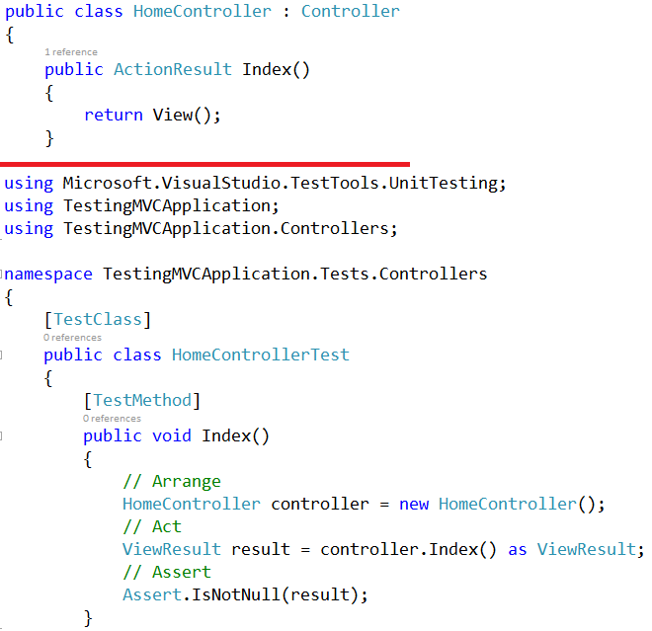
Index Action Method Test

Slide 12
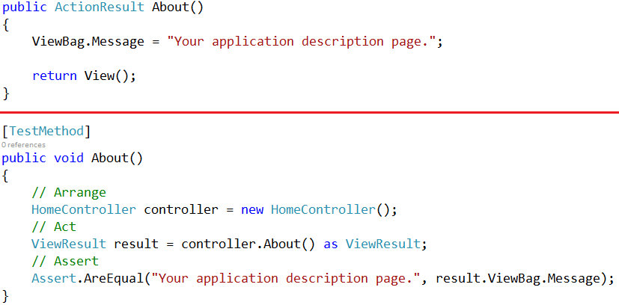
About Action Method Test

Slide 13
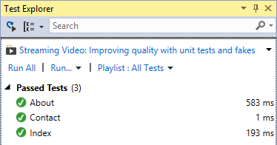
Test Explorer in Visual Studio

Slide 14
What is Mock Testing?
Isolating our code from external resources –
  Databases
  File systems
  Service calls
Avoid integration testing – Testing a method which does database connectivity or call other objects and their methods
Mocking allows us to decouple the dependencies
This decoupling can be done with the help of interfaces

Slide 15
Mocking Frameworks
FakeItEasy
JustMock
Moq
EasyMock.NET
NMock 3
TypeMock Isolator
Rhino Mocks
NSubstitue

Slide 16
Let’s See a Demo
Mock Testing Demo using Moq Testing
Framework and Ninject IoC container

Slide 17
Summary
What is Unit Testing?
Unit Testing frameworks
Introduction to Microsoft Unit Test framework
Testing Controller Action methods
Mock Testing Controller, Entity Framework and Action Method

