Slide 1
ASP.NET MVC Working with Data
Pravinkumar Dabade

Slide 2
Agenda –
Introduction to ORM
A closer look at NuGet Packages
Introduction to Entity Framework
Introduction to Database First/Model First/Code First Modelling
Writing LINQ queries
Implement CRUD operations
ASP.NET MVC Scaffolding
Introduction to Repository Pattern

Slide 3
What is ORM?
ORM – Object Relational Mapping
In ORM there are three main parts which we need to focus –
Domain Entities
Relational Database Objects [Tables, Views and Stored Procedures]
Mapping between Domain Entities and Relational Database objects
You can perform CRUD operations using ORM Frameworks.
.NET Framework provides LINQ-To-SQL and Entity Framework which are ORM frameworks

Slide 4
Entity Framework 6.1.3
Microsoft SQL Server
Database/Schema First
Entity Framework
SQL Compact
Model First
Oracle
Code First
Others

Slide 5
Entity Framework 6.1.3
Database/Schema First –
Use this approach for existing database.
ADO.NET Entity Framework will help convert Database objects [Tables, Views, Stores Procedures] into .NET object [Class]
Model First –
Use this approach to create a new model using the Entity Framework Designer
Then generate a database schema from the model
Code First –
Developer friendly
Use this approach to create a new database by using C#/VB.NET classes
Extremely flexible when you have schema changing environment in development

Slide 6
Entity Framework – Connection String
Database First / Model First Connection String –
CSDL – Conceptual Schema Definition Language
It is an XML-based language.
It describes the entities, relationships, and functions.
SSDL – Store Schema Definition Language
It is an XML-based language.
It describes the storage model of an Entity Framework application.
MSL – Mapping Specification Language
It is an XML-based language.
It describes the mapping between the conceptual model and storage model.

Slide 7
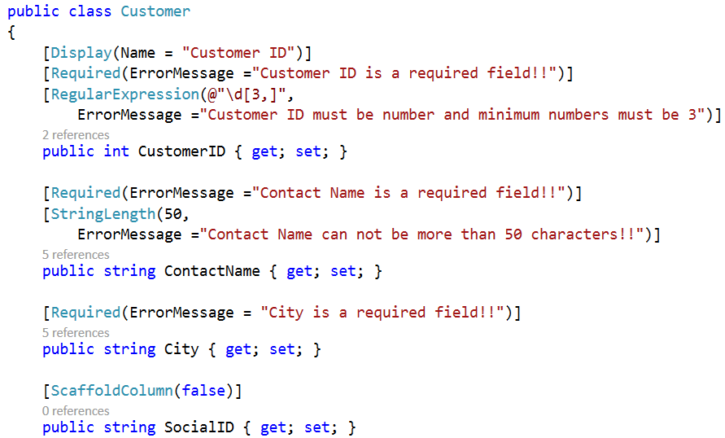
Entity Framework – Code First
Write POCO – Plain Old CLR Object

Slide 8
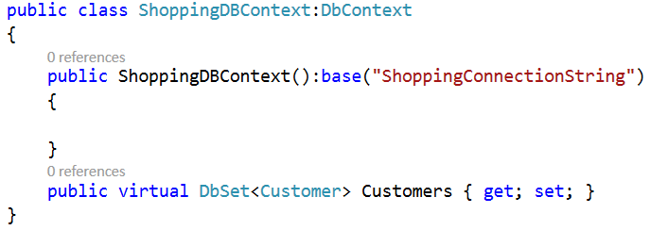
Entity Framework – Code First
Generate Database using EF Data Context

Slide 9
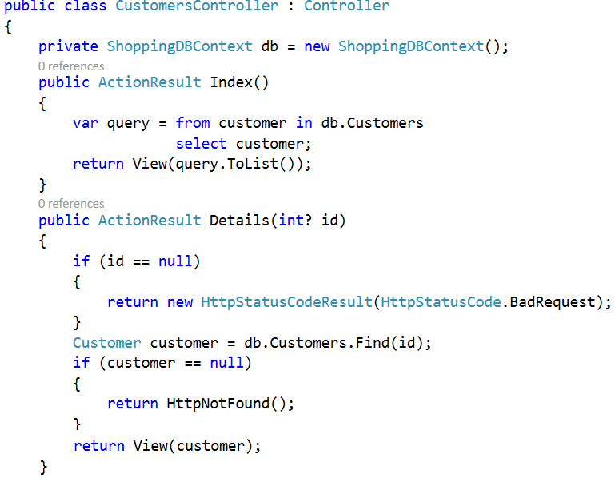
Writing LINQ – Accessing data in Controller

Slide 10
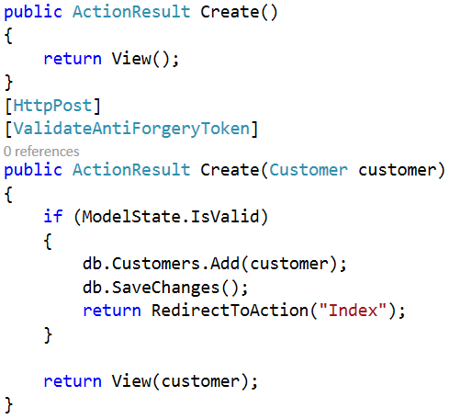
LINQ and CRUD – [Create/Read/Update/Delete]

Slide 11
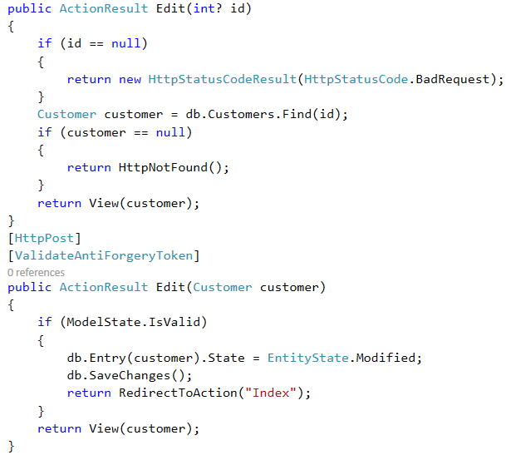
LINQ and CRUD – [Create/Read/Update/Delete]

Slide 12
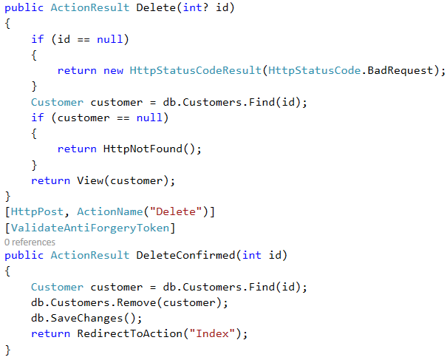
LINQ and CRUD – [Create/Read/Update/Delete]

Slide 13
Introduction to Repository Pattern
Use a repository to separate the logic that retrieves the data and maps it to the entity model
The repository mediates between the data source layer and the business layers of the application
Using repository pattern, you can make your code reusable which can act as a mediator between entity model and different data sources like SQL Server, Oracle, My SQL etc.
In simple words, Repository Pattern is a separation between Business Logic and Data Access Layer
Repository Pattern facilitate automated unit testing or test-driven development (TDD).

Slide 14
Architecture without Repository Pattern
Database
IIS
Controller
DbContext
Entity Framework

Slide 15
Architecture with Repository Pattern
Unit Of Work
Repository
Database
IIS
Controller
Entity Framework
DbContext
Repository

Slide 16
Architecture with Repository Pattern for Testing
Mock Unit Of Work
Mock Repository
Alternative Persistence Medium
IIS
Controller
DbContext
Mock Repository

Slide 17
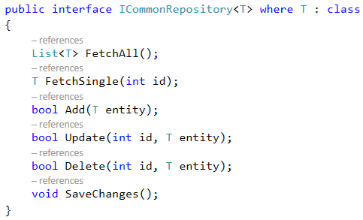
Writing Generic Repository Pattern

Slide 18
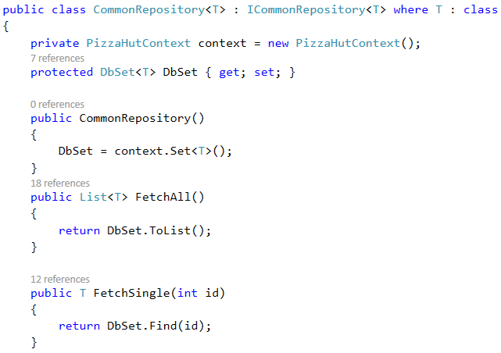
Writing Generic Repository Pattern

Slide 19
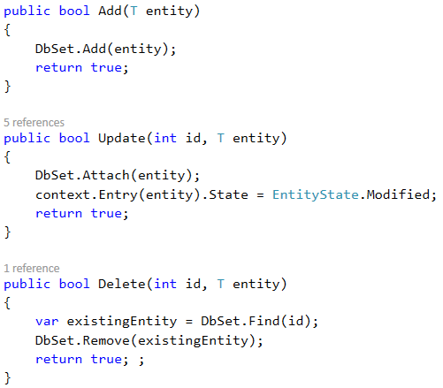
Writing Generic Repository Pattern

Slide 20
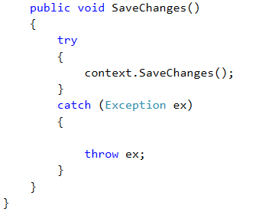
Writing Generic Repository Pattern

Slide 21
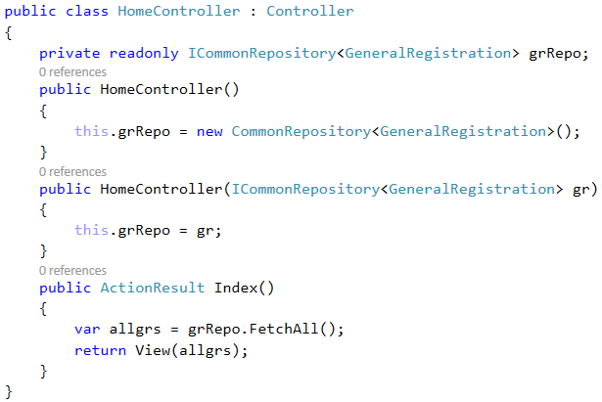
Consume Generic Repository in Controller

Slide 22
Summary
Introduction to ORM
A closer look at NuGet Packages
Introduction to Entity Framework
Introduction to Database First/Model First/Code First Modelling
Writing LINQ queries
Implement CRUD operations
ASP.NET MVC Scaffolding
Introduction to Repository Pattern

