Slide 1
ASP.NET Web API 2
Pravinkumar Dabade

Slide 2
Agenda –
Introduction to RESTful services
Introduction to Web API 2
Introduction to HTTP Actions
Creating your first ASP.NET Web API application
Implementing CRUD operations in ASP.NET Web API using Entity Framework
Testing Web API using different tools

Slide 3
What is REST?
REpresentational State Transfer
REST is Resource-Based
REST is –
Stateless
Client – Server Architecture
Cacheable
REST is an architectural style for designing networked applications.
REST is lightweight alternative to web service and RPC

Slide 4
REST is Resource Based
Resources are known as things/nouns. For example –
A Customer resource
An Address resource
In a SOAP, you will have a method like GetCustomerData() whereas in REST you will have URI as a resource which we ill call using HTTP verb like GET.
Resources are identified by URIs
Multiple URIs can access same resource to perform multiple actions

Slide 5
What is Representation?
How resources get manipulated
The state transferred between client-server –
JSON
XML
Example –
Resource – Customer [Maria Johns]
Service Name – Customer Service [GET]
Representations – Customer ID, Contact Name, City, Contact No, Email in JSON or XML format

Slide 6
REST Architecture
Defines the interface between client and server
RESTful design relies on –
HTTP Verbs [GET, POST, PUT, DELETE]
URIs [Resource Name]
HTTP Response –
Response Status
Response Body

Slide 7
REST is Stateless
Server contains no client state
RESTful request is self-descriptive
Each request contains resource name, verb and the data which is enough for the server to process the request

Slide 8
Why REST?
Less overhead – no SOAP envelop.
Less duplication – HTTP already represents DELETE, PUT, GET.
More Standardized.
More Human readable and testable.

Slide 9
HTTP Protocol Verbs
Verb | Action
POST | Create the resource.
GET | Retrieve a resource.
PUT | Update the resource.
DELETE | Delete the resource.
HEAD | Same as GET but header only

Slide 10
HTTP Headers
Name | Interpretation
Content-Type | What is the representation of the data?
Authorization | Credentials.
Location | URI of the resource in a response.
Last-Modified | Data representation last modified.
Cache-control | How long can local copy can be retained
If-Modified-Since | Get new representation only if it’s changed.

Slide 11
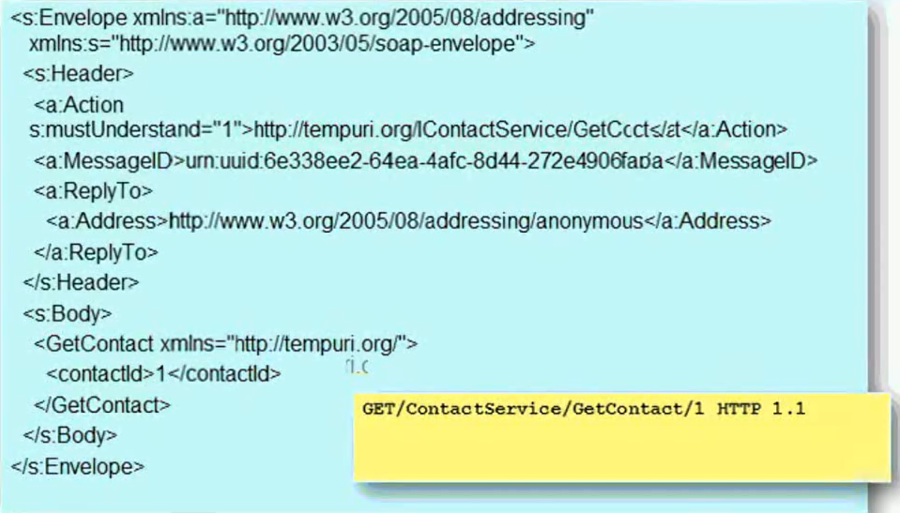
SOAP Vs REST

Slide 12
Introduction to ASP.NET Web API 2
This is the new framework for building HTTP services with easy and simple way.
Web API is open source an ideal platform for building RESTful services over the .NET Framework.
It use the full features of HTTP (like URIs, request/response headers, caching, versioning, various content formats)
It also supports the MVC features such as routing, controllers, action results, filter.
It can be hosted with in the application or on IIS.
It is light weight architecture and good for devices which have limited bandwidth like smart phones.

Slide 13
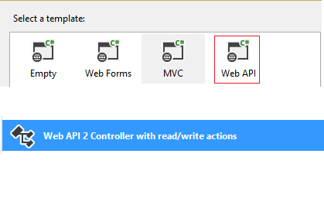
Create First Web API
You can use Web API template available under Microsoft Visual Studio 2012, 2013 or 2015 to create Web API application.

Slide 14
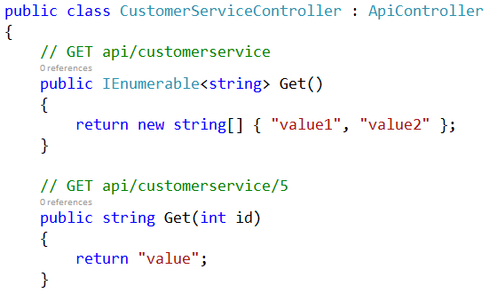
First Look at Web API

Slide 15
Web API and Routing
ASP.NET Web API supports many features of ASP.NET MVC –
Controller
Routing
Action Results
Filters
The routing configuration of ASP.NET Web API is available under App_Start folder in a class called – WebApiConfig
Web API configuration is done in Global.asax file

Slide 16
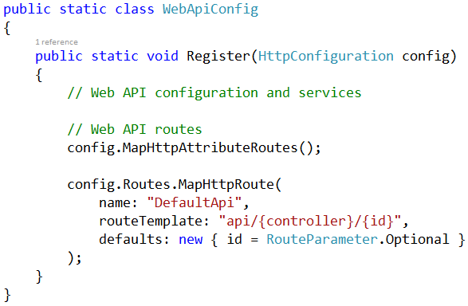
Web API Routing Configuration

Slide 17
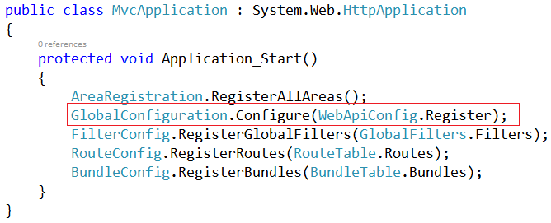
Web API Route Config Registration

Slide 18
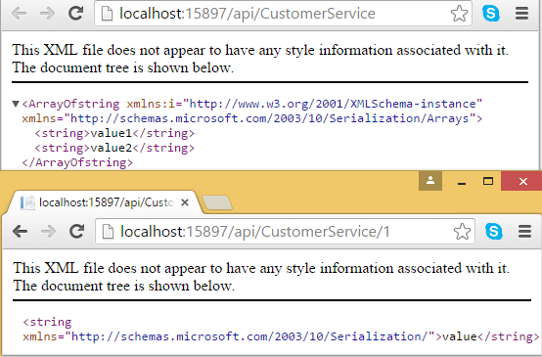
Output of First Web API

Slide 19
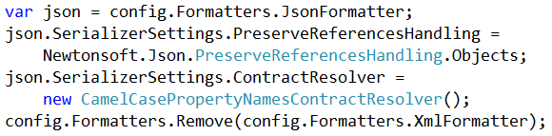
Configure Web API to Return JSON

Slide 20
Web API 2 – Return Values
ASP.NET Web API 2 can return –
Void – Returns empty [204 – No Content]
HttpResponseMessage - Convert directly to an HTTP response message.
IHttpActionResult – Call ExecuteAsync to create an HttpResponseMessage, then convert to an HTTP response message.
Some Other type - Write the serialized return value into the response body; return 200 (OK).

Slide 21
Web API 2 – Testing Tools
To test Web API 2, you can make use of different tools like –
Fiddler – Web debugging tool to test Web API by Telerik
Google chrome’s Postman plug-in
Browsers like – Google Chrome, Internet Explorer

Slide 22
Summary
Introduction to RESTful services
Introduction to Web API 2
Introduction to HTTP Actions
Creating your first ASP.NET Web API application
Implementing CRUD operations in ASP.NET Web API using Entity Framework
Testing Web API using different tools

