Slide 1
ASP.NET MVC Area
PRAVINKUMAR DABADE

Slide 2
Agenda –
Introduction to Area in ASP.NET MVC
How to add Area?
Registering Areas
Configuring Areas for routing

Slide 3
Introduction to Area
ASP.NET MVC main folders like Controllers, Models and Views
While working with large enterprise application, you need more manageable, neat and clean code separation
Adding hundreds of controllers under Controllers folder is a bad management
Instead, you can divide your application logically based on modules of the projects. For example – Administration, Employees, Customers Etc.
The division of these modules can be done with the help of Areas.

Slide 4
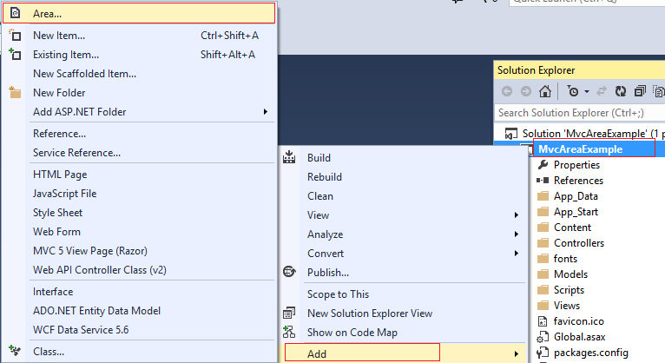
How to add Area?

Slide 5
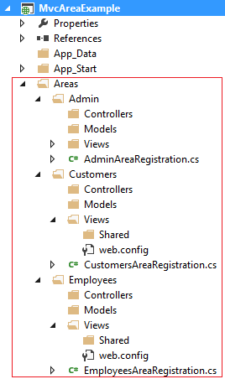
How to add Area?

Slide 6
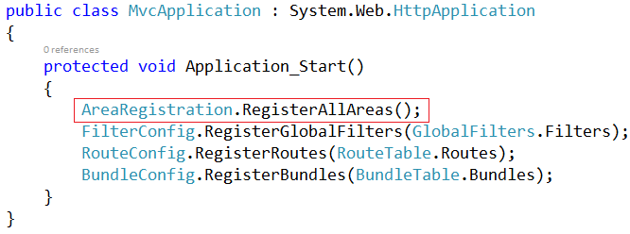
Registering Area

Slide 7
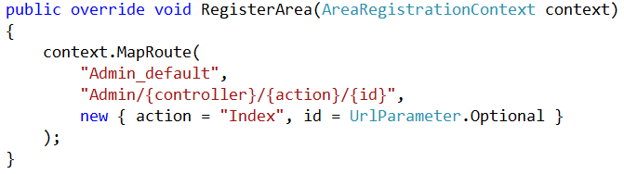
Configuring Areas for Routing

Slide 8
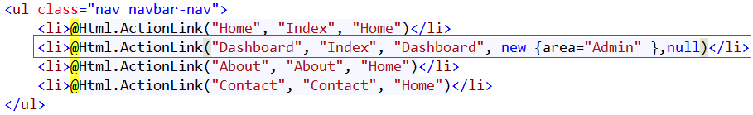
Configure Area in Layout

Slide 9
Summary
Introduction to Area in ASP.NET MVC
How to add Area?
Registering Areas
Configuring Areas for routing

