Slide 1
ASP.NET MVC – Bootstrap
Pravinkumar Dabade

Slide 2
Agenda –
Introduction to CSS Bootstrap
Bootstrap Features
Get Bootstrap
Bootstrap Themes
Responsive Layout
Grid System
Bootstrap – Components
Visual Studio Support for Bootstrap
Bootstrap and JavaScript

Slide 3
Introduction to Bootstrap
Bootstrap is a popular frontend toolkit for web application
Bootstrap helps building responsive web pages using HTML, CSS and JavaScript
It an open source toolkit for designer sand developers
Bootstrap provides number of features which you can include in your web sites/applications
ASP.NET MVC 5 is using bootstrap out-of-box for building responsive UI
Bootstrap provides small, meaningful CSS classes to build the UI
Bootstrap CSS follows SRP – For example – having and row strips are available in separate classes
Bootstrap designs are also Mobile First designs

Slide 4
Bootstrap Features
Glyphicons
Dropdowns
breadcrumbs
Buttons
Alerts
Pagination
Inputs
Jambotron
Progress bars
Labels
Badges
Page Header
List Groups
Navigations
Thumbnails
Panels

Slide 5
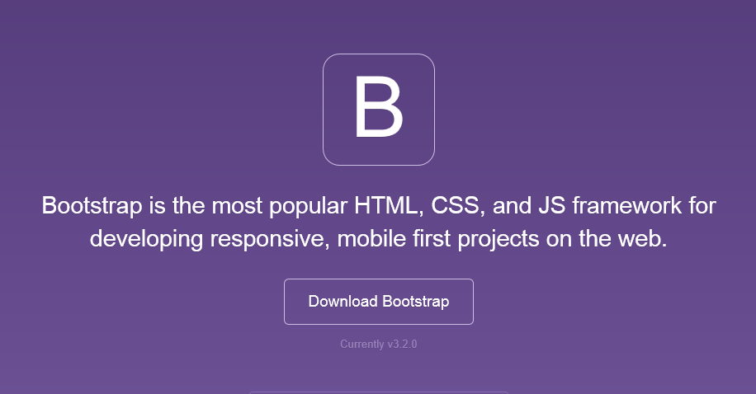
Get Bootstrap

Slide 6
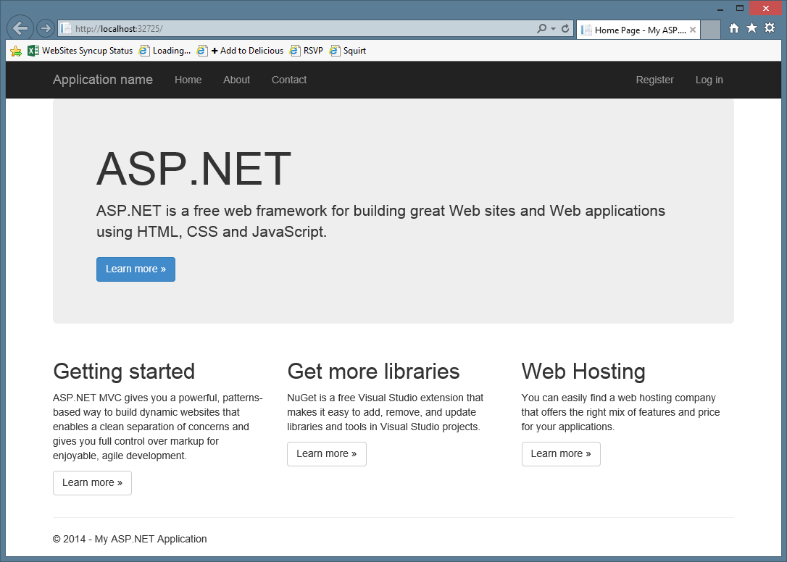
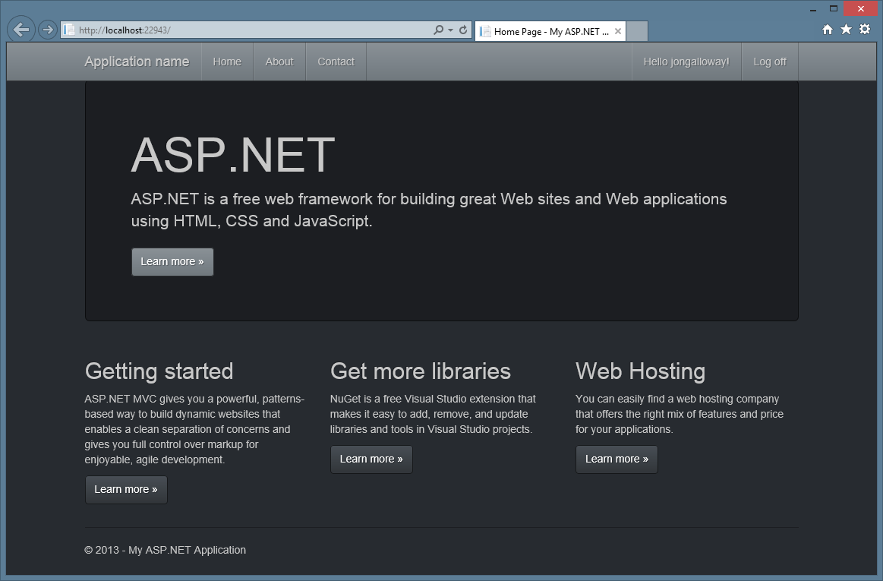
Bootstrap Theme Support

Slide 7
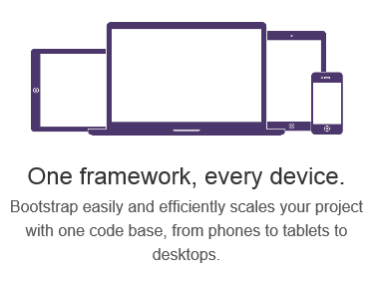
Responsive Layout

Slide 8
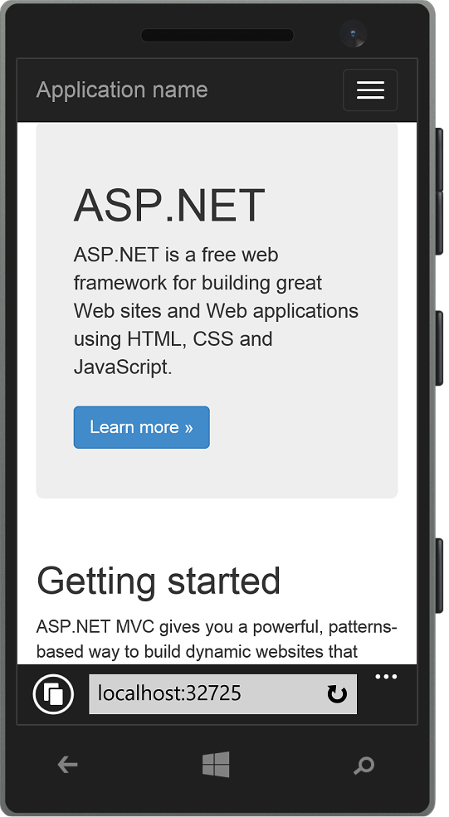
Responsive Layout

Slide 9
Grid System
 | Extra small devices Phones (<768px) | Small devices Tablets (≥768px) | Medium devices Desktops (≥992px) | Large devices Desktops (≥1200px)
Grid behavior | Horizontal at all times | Collapsed to start, horizontal above breakpoints
Container width | None (auto) | 750px | 970px | 1170px
Class prefix | .col-xs- | .col-sm- | .col-md- | .col-lg-
# of columns | 12
Column width | Auto | 60px | 78px | 95px
Gutter width | 30px (15px on each side of a column)

Slide 10
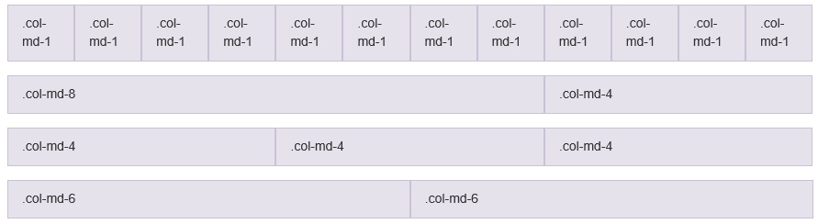
Grid System

Slide 11





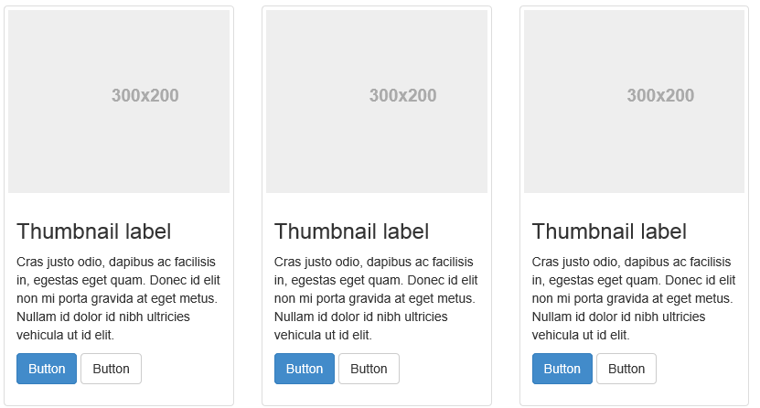
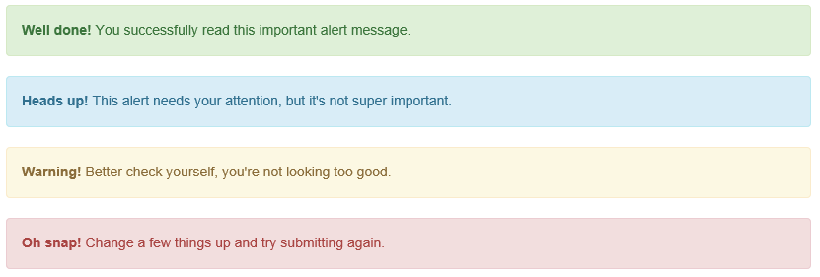
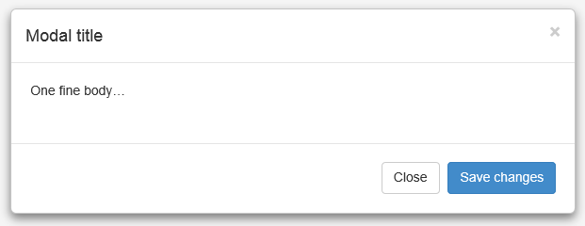
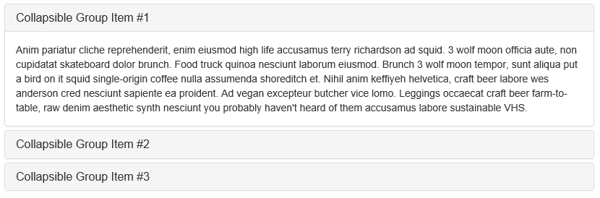
Bootstrap – Components

Slide 12
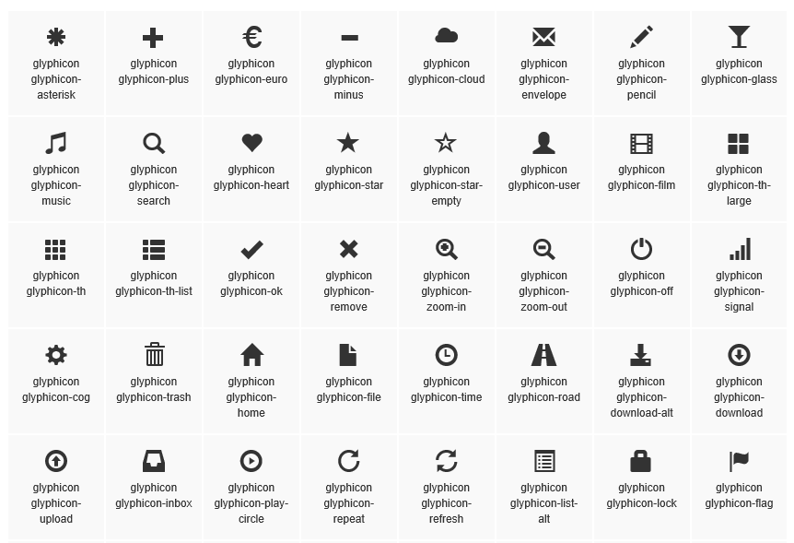
Bootstrap – Components

Slide 13
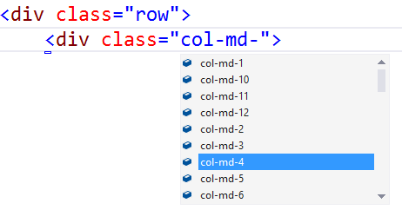
Visual Studio Support
Class IntelliSense

Slide 14
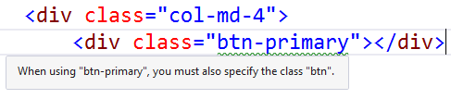
Visual Studio Support
Missing class detection

Slide 15
Bootstrap and JavaScript
All JavaScript functions
bootstrap.js
bootstrap.min.js
Individual files available
jQuery required
Most functionality are enabled by adding attributes and classes

Slide 16
Bootstrap and JavaScript – Model Dialogs
Configure dialog using classes
Container: modal
Configure dialog: modal-dialog
Content: modal-content
Header: modal-header
Content: modal-content
Footer: modal-footer
Configure launcher using classes
data-toggle="modal"
data-target="<id>"
Configure closer
data-dismiss="modal"

Slide 17
Bootstrap and JavaScript – Provide Help
Whenever possible, provide inline help
Bootstrap offers two main options
Tooltip for mouseover
Popover for a click

Slide 18
Summary
Introduction to CSS Bootstrap
Bootstrap Features
Get Bootstrap
Bootstrap Themes
Responsive Layout
Grid System
Bootstrap – Components
Visual Studio Support for Bootstrap
Bootstrap and JavaScript

