Slide 1
ASP.NET MVC 5 – Caching
Pravinkumar Dabade

Slide 2
Agenda –
Introduction to Caching
Introduction to [OutputCache]
Vary Caching techniques
Partial Page Caching and Donut Caching
Caching data
Configuring Cache into Web.Config file

Slide 3
Introduction to Caching
In ASP.NET MVC, you can use Caching to improve the performance of the application.
Caching avoid executing a database query every time any user invokes the same controller action.
Caching enables you to avoid performing redundant work on the server.
You can cache –
Entire Page
Part of the page
Vary page caching based on different parameters
To improve the performance, you can cache the data as well.

Slide 4
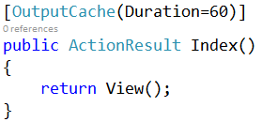
Using [OutputCache] attribute
Output cache enables you to cache the contents returned by a controller action.
You can enable output caching by adding an [OutputCache] attribute to –
Individual Controller Action
An entire controller class

Slide 5
[OutputCache] properties
Name | Description
CacheProfile | Gets or sets the cache profile name.
Duration | Gets or sets the cache duration, in seconds.
Location | Gets or sets the location.
VaryByContentEncoding | Gets or sets the vary-by-content encoding.
VaryByCustom | Gets or sets the vary-by-custom value.
VaryByHeader | Gets or sets the vary-by-header value.
VaryByParam | Gets or sets the vary-by-param value.
SqlDependency | Gets or sets the SQL dependency.

Slide 6
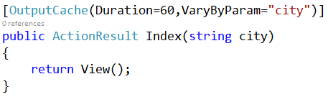
[OutputCache] and VaryByParam
The parameter value can come from URL, Query String or Form data. For Example –
http://localhost:15897/Home/Index/London
http://localhost:15897/Home/Index?city=London

Slide 7
[OutputCache] and Partial Page Caching
ASP.NET MVC, support partial page caching
In partial page caching, the part of the page is cached where as the other contents of page are dynamic
To implement partial page caching, you will have to use Partial Views with the [OutputCache] attribute
For Example –

Slide 8
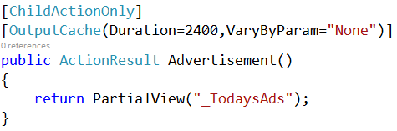
Partial Page Caching Example

Slide 9

ASP.NET MVC – Donut Caching
If we want the entire page to be cached but not a part of the page, we can make use of Donut Caching in ASP.NET
To use Donut Caching, install the NuGet package –

Slide 10
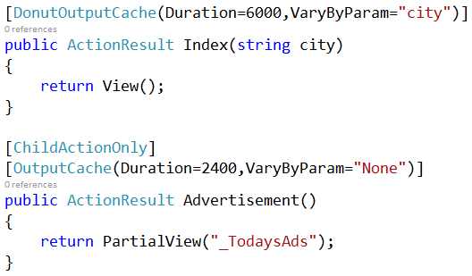
Donut Caching Example

Slide 11
ASP.NET MVC – Data Caching
To cache the data, we can make use of Cache object.
The data is cached using Key – Value pair. Each data cache can be identified using a Key.
The Cache object gives Insert method which has several overloads –
Key
Value
Dependency
Absolute Expiry time
Sliding Expiry time

Slide 12
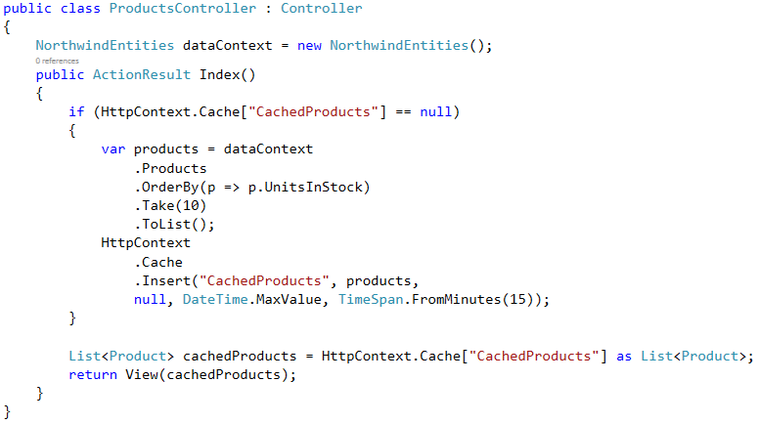
Data Caching Example

Slide 13
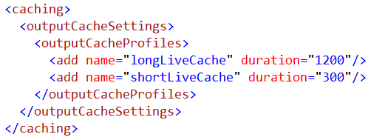
Cache Profiles

Slide 14
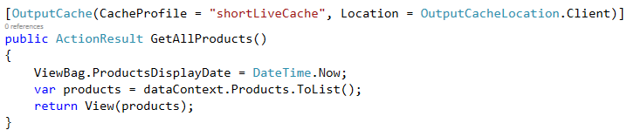
Using Cache Profiles

Slide 15
Summary
Introduction to Caching
Introduction to [OutputCache]
Vary Caching techniques
Partial Page Caching and Donut Caching
Caching data
Configuring Cache Profiles into Web.Config file

