Slide 1
Introduction to Controller
PRAVINKUMAR DABADE

Slide 2
Agenda –
Introduction to Controller
ASP.NET MVC Request Life Cycle
Controller Working – Synchronous and Asynchronous
Introduction to Routes in ASP.NET MVC
Writing Custom Routes
Introduction to Action Methods and Parameters
Introduction to ActionResult and Controller’s output
Introduction to Action Filters
Writing Custom Action Filters
Introduction to Asynchronous Controller

Slide 3
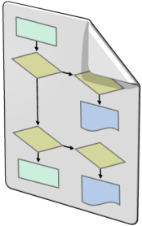

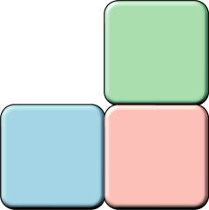
Introduction to Controller
Models
Model objects are the parts of the application that implement the logic for the application's data domain
Views
Views are the components that display the application's user interface (UI)
Controllers
Controllers are the components that handle user interaction, work with the model, and select a view to render the UI

Slide 4
Introduction to Controller
ASP.NET Controllers are the classes which are responsible for –
Handing the user/browser requests
Retrieve the model data
Make use of View templates to render the response to the browsers
Controller contains collection of methods which are known as Action Methods
Action methods are the ultimate request destination
These Action methods are non-static methods and there is no return value restrictions on these methods.

Slide 5
ASP.NET MVC Application Life Cycle
Http Request
URLRoutingModule
Route Table
[Collection of Routes]
ProcessRequest()
MvcHandler
MvcRouteHandler
Controller Factory
[Create controller]
Action Invoker
[Selects Action Method]
Action Method
[Returns ActionResult]
Http Response
ActionResult.ExecuteResult()
[Generates the Response]

Slide 6
ASP.NET MVC Application Life Cycle
UrlRoutingModule – knows about all the routes. It is registered under Application_Start method from Global.asax file.
MapRoute method tells UrlRoutingModule about the routes which is defined under App_Start folder and RouteConfig.cs file.
This method attach MvcRouteHandler with the route.
The UrlRoutingModule always select the first matching route from the route table.
MvcRouteHandler has GetHttpHandler() method which returns the reference of MvcHandler.
It is a normal HttpHanlder which has ProcessRequest() method
This method calls ProcessRequestInit() method which creates the controller Factory

Slide 7
ASP.NET MVC Application Life Cycle
The controller factory creates a controller.
A controller is a collection of Action Methods.
The controller calls ActionInvoker to call the action methods.
The controller factory gives a call to Execute() method and this method gives a call to ExecuteCore().
The ExecuteCore() method retrieves the action name from the route data
Then ExecuteCore() method gives a call to ActionInvoker’s InvokeAction method.
The ActionMethod is invoked and it always returns the ActionResult type.
The ActionResult generates the response by calling ExecuteResult method.

Slide 8
Synchronous Controller Architecture
ASP.NET Pipe-line
IIS Worker Process
CLR Thread-Pool
ASP.NET Application
Http Request
IIS Native Thread-Pool

Slide 9
Asynchronous Controller Architecture
IO Completion
Port
ASP.NET Pipe-line
IIS Worker Process
CLR Thread-Pool
ASP.NET Application
Http Request
IIS Native Thread-Pool

Slide 10
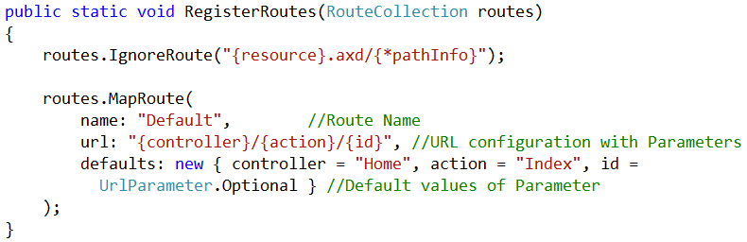
Routes and Controllers
HomeController
http:/localhost:9090/home/index

Slide 11
Action and Action Parameter
Action methods are the ultimate request destination
These Action methods are non-static methods and there is no return value restrictions on these methods
Any public method you write in side controller is an action which can be called using URL
Don’t write the methods in controller which you don’t want to call using URL
Action methods can accept parameters
Simple parameters
Complex parameters

Slide 12
Action Parameters
Action can take different types of parameters
Primitive parameters like – Integer, String, Boolean etc.
Complex Parameters
MVC framework/Model Binder looks for parameter values
In route data
In form data
In query string

Slide 13
List of ActionResult
Return Type | Description
ContentResult | Returns a string literal
EmptyResult | No response
FileContentResult | Return the contents of file
JavaScriptResult | Returns a script to execute
JsonResult | Returns data in JSON format
RedirectResult | Redirects the client to the new URL
RedirectToRouteResult | Redirects to another action or another controller’s action
ViewResult/PartialViewResult | Response is generated by a view engine

Slide 14
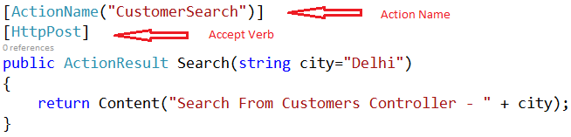
Action Selectors
Action Name
Accept Verbs
HttpGet, HttpPost, HttpPut, HttpDelete etc.

Slide 15
Action Filters
Return Type | Description
OutputCache | Cache the output of a controller
ValidateInput | Turn off request validation and allow dangerous input
Authorize | Restrict an action to authorized users or roles
ValidateAntiForgeryToken | Helps prevent cross site request forgeries
HandleError | Can specify a view to render in the event of an unhandled exception

Slide 16
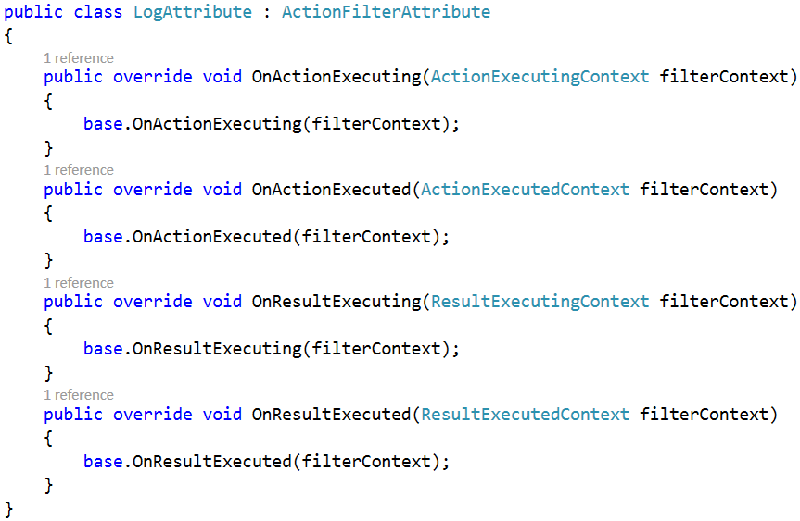
Writing Custom Action Filter

Slide 17
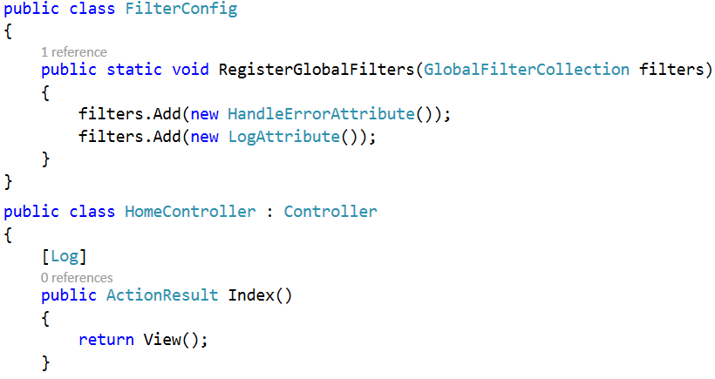
Using Custom Action Filter

Slide 18
Summary
Introduction to Controller
ASP.NET MVC Request Life Cycle
Controller Working – Synchronous and Asynchronous
Introduction to Routes in ASP.NET MVC
Writing Custom Routes
Introduction to Action Methods and Parameters
Introduction to ActionResult and Controller’s output
Introduction to Action Filters
Writing Custom Action Filters
Introduction to Asynchronous Controller

