Slide 1
ASP.NET MVC – Dependency Injection
Pravinkumar Dabade

Slide 2
Agenda –
Why should you think about Dependency Injection?
What is DI?
What is IoC container?
Introduction to different IoC containers
Implementing Dependency Injection into ASP.NET MVC Application

Slide 3
Why and What is Dependency Injection?
Dependency Injection is a design pattern
DI helps write maintainable and decoupled software code
One of the SOILD principle ‘D’
DI improves application testing
DI helps to create more readable code
DI follows the 4 rules –
the service object(s) to be used
the client object that is depending on the services it uses
the interfaces that define how the client may use the services
the injector, which is responsible for constructing the services and injecting them into the client

Slide 4
Why and What is Dependency Injection?
Tightly Coupled Architecture
Data Access Layer
Entity Framework
Data Access Layer
Entity Framework
Business Logic
Domain Layer
Business Logic
Domain Layer
View Layer
Views/Controller
View Layer
Views/Controller

Slide 5
Why and What is Dependency Injection?
Loosely Coupled Architecture
Data Access Layer
Entity Framework
IoC Container
Business Logic
Domain Layer
Dependency Resolver
View Layer
Views/Controller

Slide 6
How Dependency Injection works?
HD Television Rack
IHDTelevision
Implementation
Show me IHDTelevision
Samsung LED
Customer
Sony LED
Micromax LED
Sansui LED
Have Sony HD Television
Shopkeeper

Slide 7
What is IoC container?
IoC container is a Framework
It is also known as Dependency Injection Container
The framework creates dependencies and inject them automatically whenever required
IoC containers help manage dependencies in an easy way

Slide 8
Different IoC containers
Castle Windsor – based on the Castle MicroKernel.
Structure Map – Apache – 2
Spring.NET – Apache – 2
Autofact – MIT
Unity – Microsoft
Ninject – Apache – 2
LinFu – GPL

Slide 9
Microsoft Unit Container
Unity is a lightweight, extensible dependency injection container.
Unity supports constructor, property, and method call injection.
Unity offers simplified object creation, especially for hierarchical object structures and dependencies.
Dependencies can be configured using –
Code
Configuration file

Slide 10

ASP.NET MVC, DI and Unity Container
Install ASP.NET MVC5 Unit Package using NuGet package

Slide 11
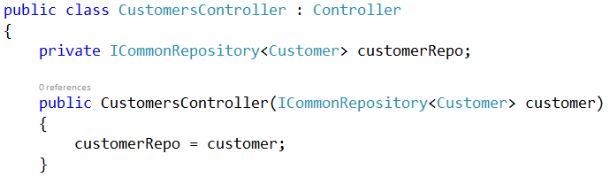
ASP.NET MVC, DI and Unity Container
ASP.NET MVC Controller with Constructor Injection
Constructor Injection

Slide 12
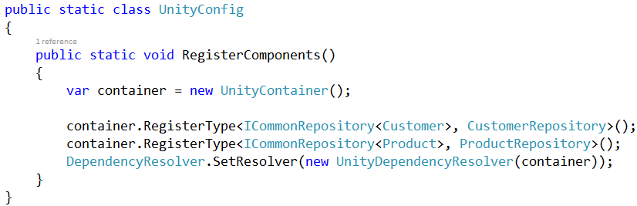
ASP.NET MVC, DI and Unity Container
Configure dependency object

Slide 13
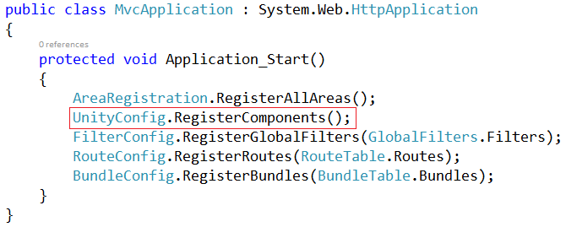
ASP.NET MVC, DI and Unity Container
Call RegisterComponents method of UnitConfig in Global.asax

Slide 14
Summary
Why should you think about Dependency Injection?
What is DI?
What is IoC container?
Different IoC containers
Implementing Dependency Injection into ASP.NET MVC Application

