Slide 1
ASP.NET MVC – Identity Authentication & Authorization
Pravinkumar Dabade

Slide 2
Agenda –
What is Identity?
How it started?
Architecture of ASP.NET Identity
Internet Authentication and Authorization
Creating and customizing SQL Server Database
Setting authentication and authorization in ASP.NET MVC Application
Introduction to OAuth
How Identity use OAuth?
Integrating with Social Authentication provider - Facebook

Slide 3
What is Identity?
Identity is Users, Authentication, Authorization
*Everyone has a different definition
Identity works with OWIN middleware and Identity system.
It is a claims based system
Stores login, claims, roles

Slide 4
ASP.NET Identity Supports
oAuth / OpenId
Organizational – AD, Azure AD, Office 365
Allows SSO
Individual database backed auth
Custom data stores (extendable)
Roles
Claims

Slide 5
Introduction to SSO
Single Sign On
User provides same credentials to access multiple services
User provides credentials once to access multiple services

Slide 6
What are claims?
Identity makes extensive use of Claims
User delivers claims to your app
Where do they come from?
Serialized in secured token
Can contain much information about user
Roles are single valued
Ex “Admins”
Claims are key/value per user
Ex “Facebook Access Token”, “CAAVl6UvghVkBAIGZB…”

Slide 7
How it started?
Nov 2005 ASP.NET 2.0 – Introducing Membership!
SQL Server, SQL Express
May 2012 Universal Providers (First NuGet)
SQL CE, Azure, one provider to access all SQL
Aug 2012 Simple Membership
Sourced in Web Pages, came to MVC / Web Forms
Oct 2013 ASP.NET Identity v1
Completely new model
Mar 2014 ASP.NET Identity v2
Two factor, account lockout, confirmation, reset, etc

Slide 8
Katana and Owin
Identity uses security middleware
Microsoft’s OWIN Implementation is Project Katana for v1, v2
Katana now fully integrated into ASP.NET 5
No longer called Katana in Identity v3
OWIN defines easy interface for items to communicate
Middleware gets IDictionary<string, object>
ASP.NET Identity can be hosted in any OWIN hosted app

Slide 9
Managers and Stores
ASP.NET Applications
Managers
High-level classes
Operations such as create user
Talks to stores via Interface (pluggable)
Stores
Talks to data access layer
Store users, roles, claims
Managers
User Manager, Role Manager
Stores
User Store, Role Store
Data Access Layer
Entity Framework
Data Store
SQL Server, MySQL, Windows
Azure Table Storage

Slide 10
Identity Key Components
Security Middleware
Microsoft.AspNet.Security.Facebook
Microsoft.AspNet.Security.Google
Microsoft.AspNet.Security.MicrosoftAccount
Microsoft.AspNet.Security.Oauth
Microsoft.AspNet.Security.Twitter
Microsoft.AspNet.Security
Identity
Microsoft.AspNet.Identity
Microsoft.AspNet.Identity.EntityFramework

Slide 11
Important Types to look at !!
IdentityUser – That’s you with your properties.
UserName, Email, Email Verified
EmailService, SmsService – Notified during 2-factor authentication
ApplicationUserManager – You call this to manage users. Talks to UserStore
SigninManager – You call this to sign-in a user

Slide 12
Internet Authentication – Local
Users not authenticated with a third party
Typically information stored in SQL databases
Authentication code exists on same server

Slide 13
Creating and customizing SQL Server Database
IdentityUser is typically for an EF implementation
Easily changeable via inheritance
UserStore is an EF implementation
So far so good
Default user fields are based on ApplicationUser : IdentityUser
Add to this class or create you own new one
All other Identity tables have a backing class EF is initialized with
Change context’s OnModelCreating to look at custom classes

Slide 14
What is OAuth?
oAuth is a protocol
The protocol allows for third party applications to access resources without users giving credentials to third party
Supports desktop, web, mobile, etc

Slide 15
Why use OAuth?
Allows your app to easily accept user registration
Very low friction to use existing accounts
Ensures user isn’t sharing credentials with your app = more trust
Allows your app to request resources on behalf of user with controlled access
Give this app my facebook profile YES
Give this app access to all my friends NO

Slide 16
How it works?
Client Application
Service
User
Can I have permission to send the user to you on behalf of my app?
Sure, here’s request token
User logs in directly w/provider
Access token granted
Resource request w/access token
Protected resource

Slide 17
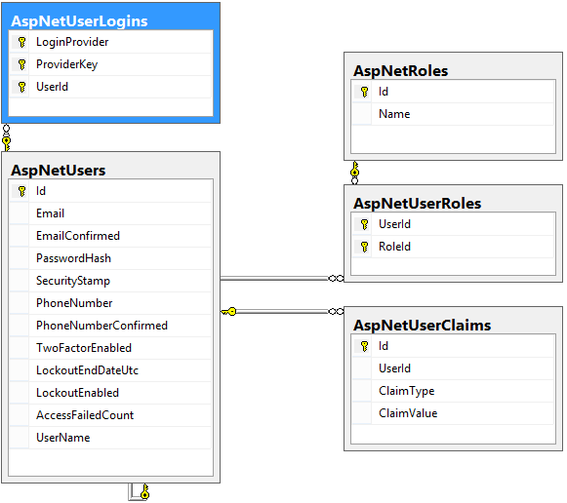
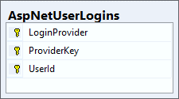
ASP.NET Store
AspNetUserLogin table
Tracks provider name
Tokens are not stored

Slide 18
Summary
What is Identity?
How it started?
Architecture of ASP.NET Identity
Internet Authentication and Authorization – Local
Creating and customizing SQL Server Database
Setting authentication and authorization in ASP.NET MVC Application
Introduction to OAuth
How Identity use OAuth?
Integrating with Social Authentication provider - Facebook

