Slide 1
Introduction to ASP.NET MVC
PRAVINKUMAR DABADE

Slide 2
Agenda –
Why MVC? Comparison between Web Forms and MVC
Introduction of Model – View – Controller
Architecture of ASP.NET MVC
Introduction to Visual Studio and ASP.NET MVC templates
Creating and Analysing the first ASP.NET MVC project
Discussion about assignments for this course

Slide 3
Why MVC?
It is a software architectural pattern for implementing User Interfaces
MVC is an implementation of Separation of Concerns
Ability to automatically test your applications without extra infrastructure or supporting framework
Greater control over mark-up
It is lightweight, highly testable presentation framework
It is an Extensible and Pluggable framework
Better support for Test-Driven-Development [TDD]
Other reasons over ASP.NET Web Forms

Slide 4
ASP.NET Web Forms Vs ASP.NET MVC
ASP.NET Web Form follows traditional event-driven development whereas ASP.NET MVC follows a architectural pattern for implementing UI
ASP.NET Web Form makes uses of Server controls whereas ASP.NET MVC makes uses of HTML helper methods
While using Web Server controls in ASP.NET Web form, we have very less control over the HTML generated by the framework. In MVC we can have a precise control over HTML
ASP.NET Web form has support for ViewState which may degrade the performance of web page rendering. In ASP.NET MVC we don’t‘ have ViewState

Slide 5
ASP.NET Web Forms Vs ASP.NET MVC
ASP.NET web form URL includes the name of the file which must be present physically in your application. In ASP.NET MVC, the URL target Controller and its action and it is based on Controller
ASP.NET Web form follows web form syntax. ASP.NET MVC follows RAZOR syntax
ASP.NET Web form are having design and the logic tightly coupled with each other. In ASP.NET MVC, the View and Logic are separated from each other.
ASP.NET web forms make use of Master Page and ASP.NET MVC makes use of Layout Page for common look and feel

Slide 6
ASP.NET Web Forms Vs ASP.NET MVC
ASP.NET web form makes uses of User Controls [.ascx] and ASP.NET MVC makes use of partial views
ASP.NET Web forms makes uses of built-in server controls which abstracts the generation of HTML and hence we don’t have a better control over the same. In ASP.NET MVC, we have a full control over HTML and follows all the web standards as required

Slide 7
When to Use Web Form Vs MVC
Priority | Web-Forms | MVC
Control over Markup |  | X
RAD | X
Unit Testing |  | X
Familiarity with patterns |  | X

Slide 8
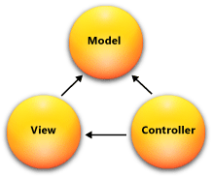
Introduction to Model-View-Controller

Slide 9
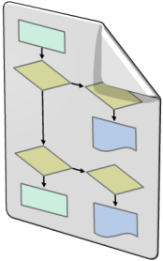

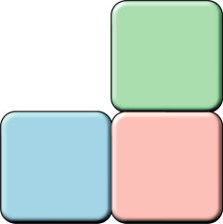
Introduction to Model-View-Controller
The ASP.NET MVC framework is a lightweight, highly testable presentation framework that is integrated with the existing ASP.NET features
The MVC framework includes the following components:
Models
Model objects are the parts of the application that implement the logic for the application's data domain
Views
Views are the components that display the application's user interface (UI)
Controllers
Controllers are the components that handle user interaction, work with the model, and select a view to render the UI

Slide 10
Architecture – ASP.NET MVC
1
2
Routing Engine
Search Controller
Found
HTTP Request
Not Found
3
4
Controllers
Models
Http Response
View (HTML, JSON, etc)
Search View
Found
Views
5

Slide 11
Architecture Explained
Step 1: The request goes through the ASP.NET stack and is handed over to the routing engine the first thing
Step 2: Based on the route configuration, the routing engine looks for the appropriate controller. If the controller is found, it is invoked. If not found, a Controller not found is returned by the Routing engine
Step 3: The Controller interacts with the Model as required. If there is incoming data, Model binding is done by ASP.NET MVC to make the incoming data into a strongly type Model if required
Step 4: The model if invoked, retrieves or save appropriate data and returns to the controller

Slide 12
Architecture Explained
Step 5: The controller then requests for a View with (or without) the data from Model. There may be one or more View engines registered so MVC Cycles through all the View engine until it finds one and renders the view. Then hands over the request to the View Engine which returns the Result to the Controller. The Controller send back the Result as a part of the HTTP response

Slide 13
Visual Studio and ASP.NET MVC
Let’s see an Example

Slide 14
Analysing ASP.NET MVC Application
ASP.NET MVC
Application
Structure

