Slide 1
ASP.NET MVC – jQuery
Pravinkumar Dabade

Slide 2
Agenda –
Introduction to jQuery
Including jQuery into ASP.NET MVC application
Using jQuery AJAX functionalities in ASP.NET MVC application
AJAX and Partial Page updates
Implementing Paging in ASP.NET MVC application
Introduction to jQuery UI

Slide 3
What is jQuery?
It is a single file.
Work cross-browser.
You can use different selectors.
Supports event handling.
Supports AJAX functionalities.
You can create your own plug-ins or use thousands of plug-ins available.
Supported by modern browsers as well as old browsers.

Slide 4

Why use jQuery?
How do you locate elements
with a specific class?
How do you apply styles to
multiple elements?
How do you handle events in a
cross-browser manner?
How many hours have you spent
dealing with cross-browser issues?

Slide 5
Getting Started –
To use jQuery in your Web Apps –
You can download jQuery script from http://jquery.com
Take a decision –
Need support for old browsers – use jQuery 1.x.
Need support only for modern browsers – use jQuery 2.x.
Reference jQuery as shown below –
<script type=“text/javascript” src=“jquery.js”> </script>

Slide 6
Content Delivery Networks
CDN is an alternative to download the jQuery into your application.
For example – you can make use Microsoft or Google CDN.
<script type=“text/javascript” src=“http://ajax.microsoft.com/ajax/jquery/jquery-[version].js”> </script>
<script type=“text/javascript” src=“http://ajax.googleapis.com/ajax/lib/jquery/[version]/jquery.min.js”> </script>

Slide 7
jQuery DOM ready() Function
Use $(document).ready() to detect when a page has loaded and is ready to use.
Call once DOM hierarchy is loaded.
<script type=“text/javascript”>
$(document).ready(function(){
//add code here.
});
<script>

Slide 8
jQuery DOM ready() Function
<script type=“text/javascript”>
$ (function(){
//add code here.
});
<script>

Slide 9
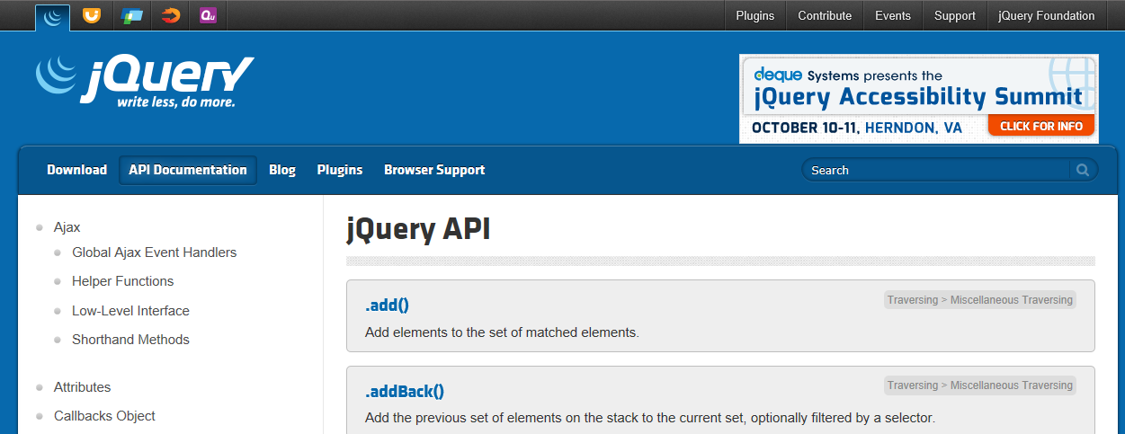
jQuery Documentation

Slide 10
jQuery AJAX Functions
jQuery allows Ajax requests to be made from a page –
Allows parts of a page to be updated.
Cross-Browser support.
Simple API.
GET and POST support.
Load JSON, XML, HTML or even scripts.

Slide 11
Introduction to AJAX Function
The ajax() function provides extra control over making Ajax calls to a server.
Configure using JSON properties –
contentType – JSON/XML
data – the data which you are passing.
dataType – what is the type of data you are getting back.
error – call back hook-up to error if there is any.
done -
type (GET/POST)

Slide 12
Using ajax() function
The ajax() function is configured by assigning values to JSON properties –
$.ajax({
url: ‘../EmployeeService.svc/InsertEmployees’,
data: customer,
dataType: ‘json’,
done: function (data, status, xhr) {
alert(‘Insert Status - ’ + data.d.Status + ‘\n’ + data.d.Message);
},
fail: function (xhr, status, error) {
alert(‘Error - ’ + status);
}
});

Slide 13
What is AJAX?
AJAX - Asynchronous JavaScript and XML
Using AJAX, you can –
Load data from server asynchronously
Update part of the page without full post back – also known as Partial Page Updates
AJAX offers several advantages like –
Non-blocking calls to server
Responsive UI
Reduced network traffic with performance
Non-flickering screens

Slide 14
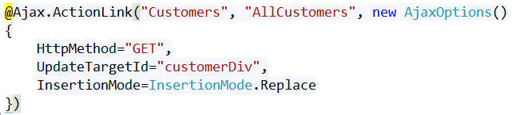
ASP.NET MVC and AJAX
ASP.NET MVC offers number of AJAX functionalities by providing AJAX helper methods –
AJAX enabled links which works with action and controller. For example –

Slide 15
Disadvantages of AJAX
Search engine like Google, Bing can not index Ajax pages
You can not Bookmark AJAX pages
AJAX relies on JavaScript. If JavaScript is disabled, AJAX functionality will not work
AJAX code is hard to debug

Slide 16
AJAX Options
Property | Description
Url | A request for a resource using URL
Confirm | Displays confirmation dialog box. On click of OK, the AJAX call execute
OnBegin | A user defined JavaScript function is called at the beginning of AJAX request
OnComplete | A user defined JavaScript function is called at the end of AJAX request
OnSuccess | A user defined JavaScript function is called when AJAX request is successful
OnFailure | A user defined JavaScript function is called when AJAX request is failed
LoadingElementID | Specifies an ID of the control which displays progress
LoadingElementDuration | Time in milliseconds which controls the progress of animation
UpdateTargetID | A control ID to be updated with HTML returned by an Action Method
InsertionMode | InsertAfter, InsertBefore, Replace [Default]

Slide 17
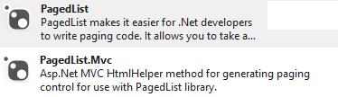
Paging using AJAX
To implement paging in ASP.NET MVC, install the NuGet packages –

Slide 18
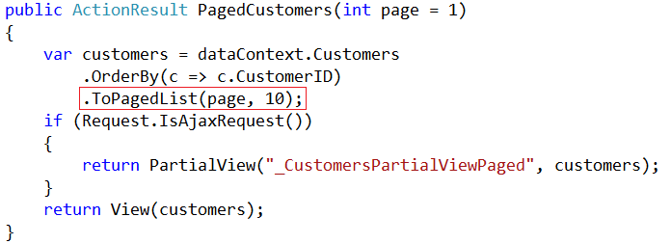
Paging using AJAX – Model Query

Slide 19
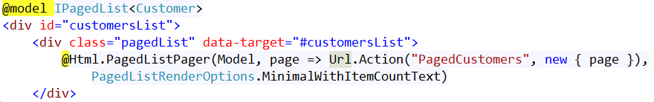
Add Pager into Partial View

Slide 20
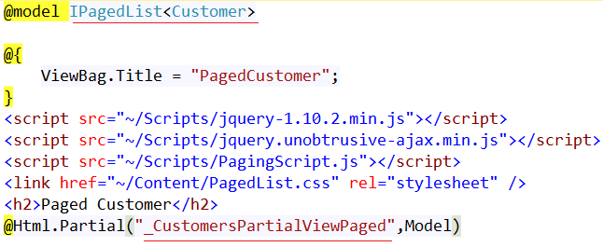
Invoke Partial View

Slide 21
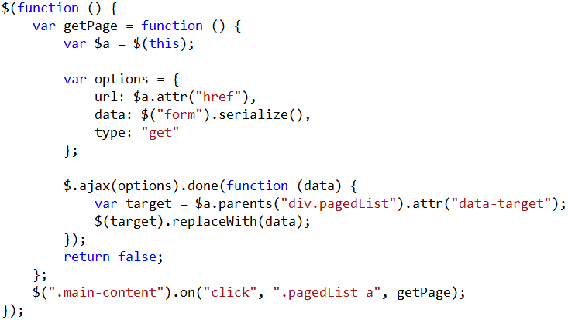
Write JavaScript Function for Paging

Slide 22
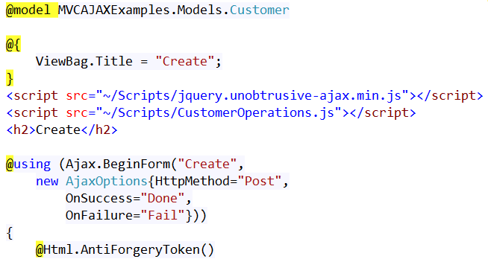
AJAX Helper – Ajax.BeginForm() Method

Slide 23
Introduction to jQuery UI
Download jQuery UI from jqueryui.com
Pick a theme
Use the options, events and methods

Slide 24
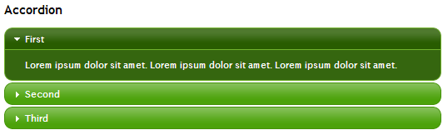

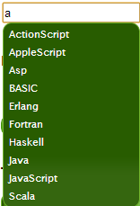
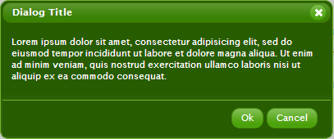
jQuery UI Widgets

Slide 25
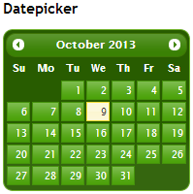
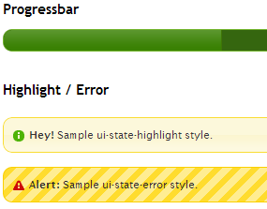
jQuery UI Widgets

Slide 26
Summary
Introduction to jQuery
Including jQuery into ASP.NET MVC application
Using jQuery AJAX functionalities in ASP.NET MVC application
AJAX and Partial Page updates
Implementing Paging in ASP.NET MVC application
Introduction to jQuery UI

